Slide 1

La Liga Data Scrapping
Teams and players
Season : 2022-2023

Slide 2

Summary
La Liga is one of the most important and famous league in Europe and always has 4 teams representing them in the UEFA Champions League.
The site used for scrapping : https://www.transfermarkt.us/
First the Teams data was scrapped and using the links of teams, players data was scrapped.
Final Query was written, analyzed and visualized.

Slide 3
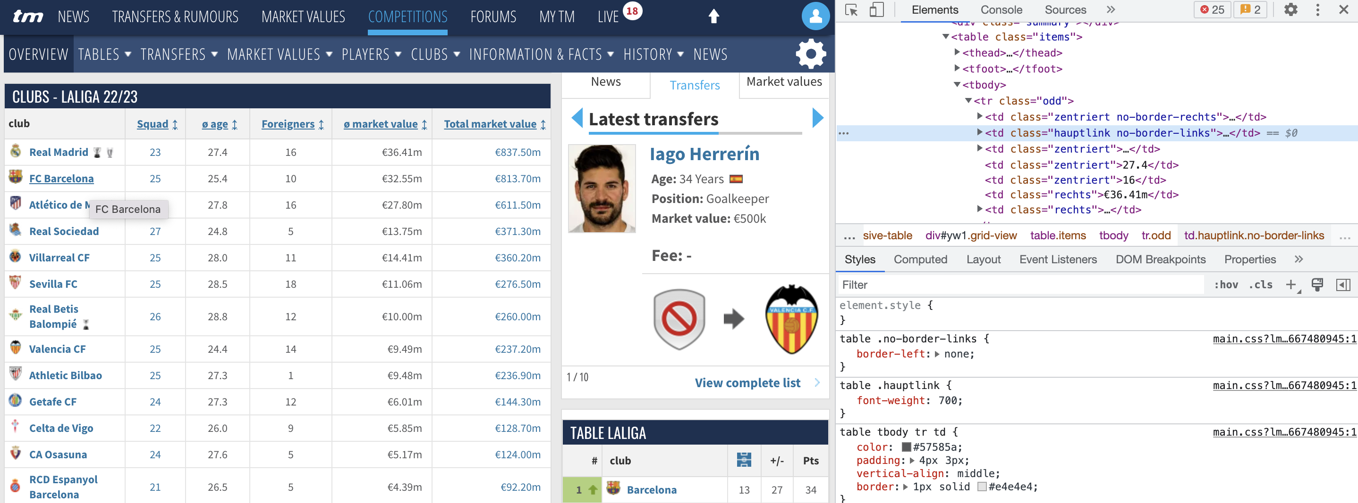
Team’s Data
Python library BeautifulSoup was used to scrape data from the transfermarkt website.
Elements on the original website were analyzed (as seen in the image below) and “class” and ”tag” of the required html objects was identified and fed into the code (team_scrapping.py)
Code was written using OOPS concepts for reusability and scalability.
Player’s data on website
HTML tags analysis

Slide 4
Player’s Data
TeamScrapper (first code) was first used to find the URLs of every team. This was possible because of the reusability element of our code.
A for loop was used to go over every URL one by one and required HTML “elements” were found to make this into a data frame. This was made possible because of the similar nature of design of every team’s URL.
Code was written using OOPS concepts for reusability and scalability and thus making our entire process into a pipeline
Lists of URLs
URL i
Set URL
Get player data
Append to DF
Next iteration

Slide 5
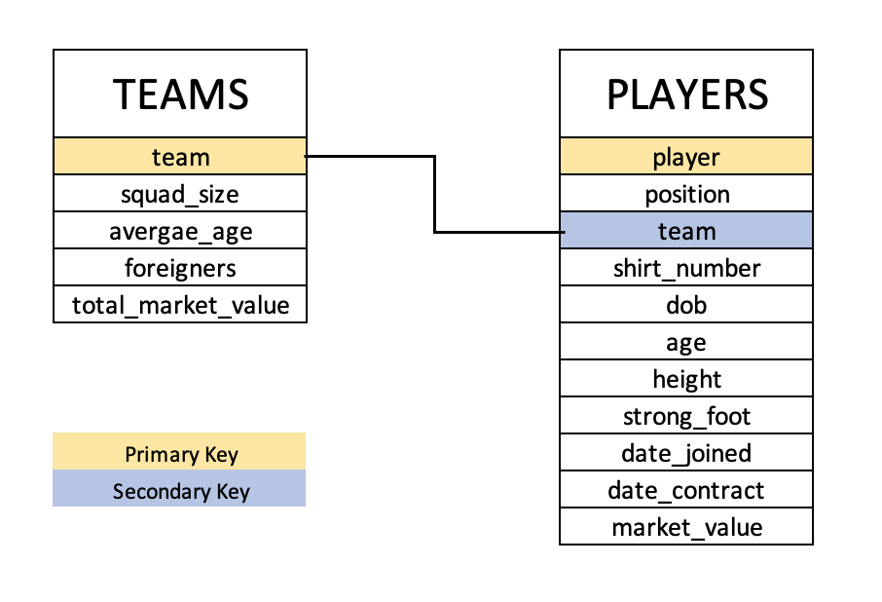
Table Schemas

Slide 6
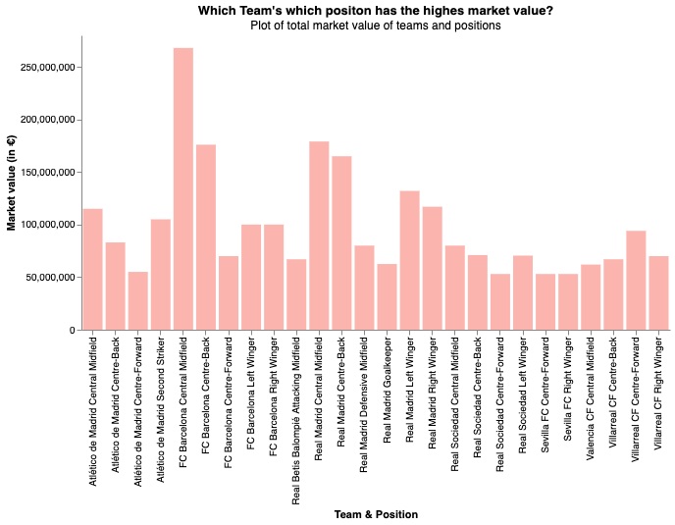
Final Query
The final objective of the project was to write a query that gets the total market value of each team in each position.
For the sake of this project, python has been chosen to execute this query with the sole reason being to be able to visualize our results later.
We can see in the visual that the highest market value is of Barcelona in the Centre Midfield position, followed by the same team in Centre Back position. This is a testimony of the lavish spending by the La Liga giants in the past few years. The nest best is Real Madrid in several positions which is no brainer.

Slide 7
Thank you

