Slide 1
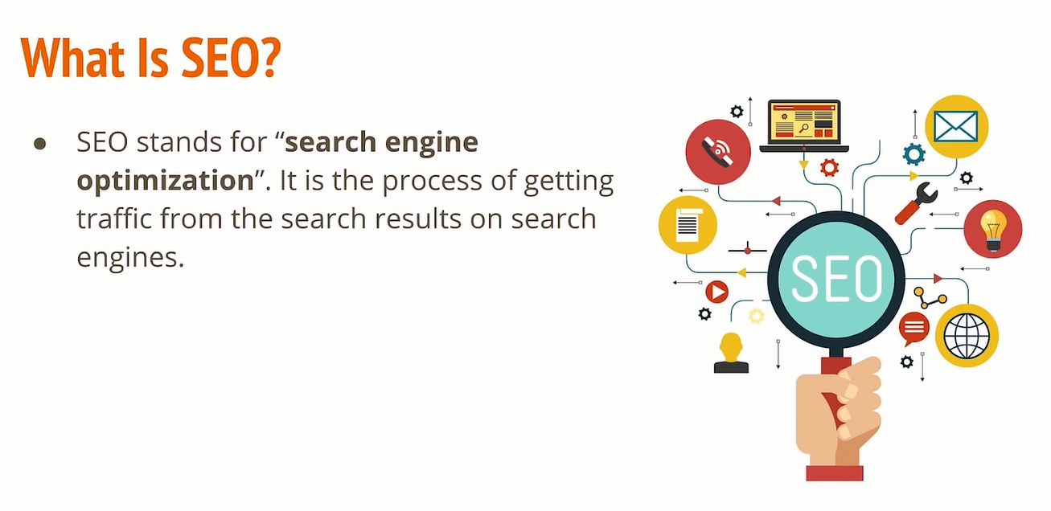

Slide 2
How Does Search Engine Works?
Crawling - Process of fetching all the web pages linked to a website. This task is performed by a software, called a crawler/ spider (or Googlebot, in case of Google).
Indexing - Process of creating index for all the fetched web pages and keeping them into a giant database from where it can later be retrieved
Processing - When a search request comes, the search engine processes it, i.e. it compares the search string in the search request with the indexed pages in the database.
Calculating Relevancy - It is likely that more than one page contains the search string, so the search engine starts calculating the relevancy of each of the pages in its index to the search string.
Retrieving Results - The last step in search engine activities is retrieving the best matched results. Basically, it is nothing more than simply displaying them in the browser.

Slide 3
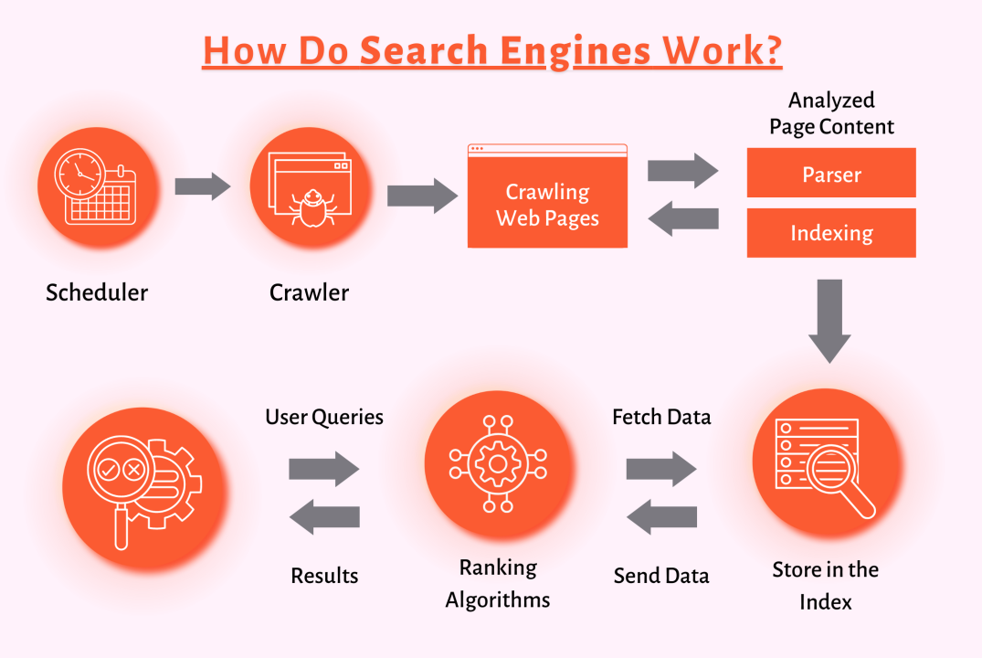

Slide 4
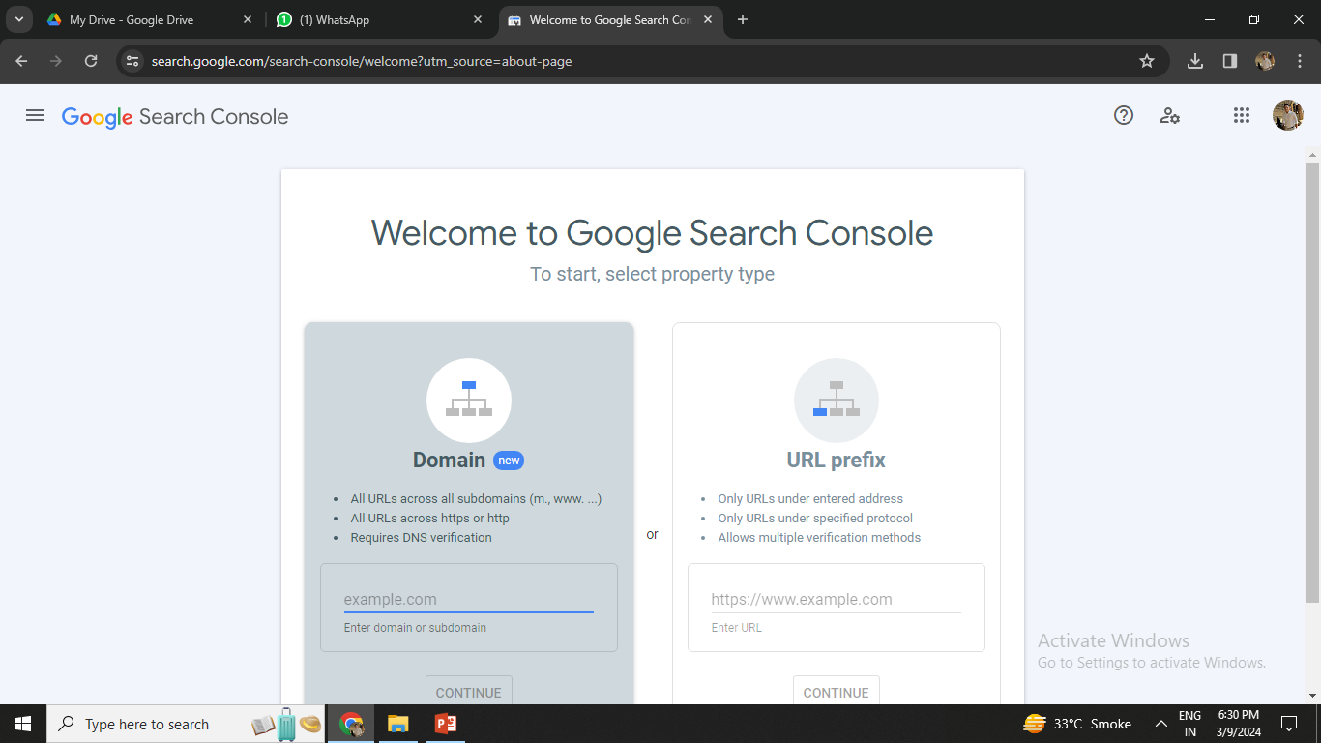
How to add website in gsc?

Slide 5
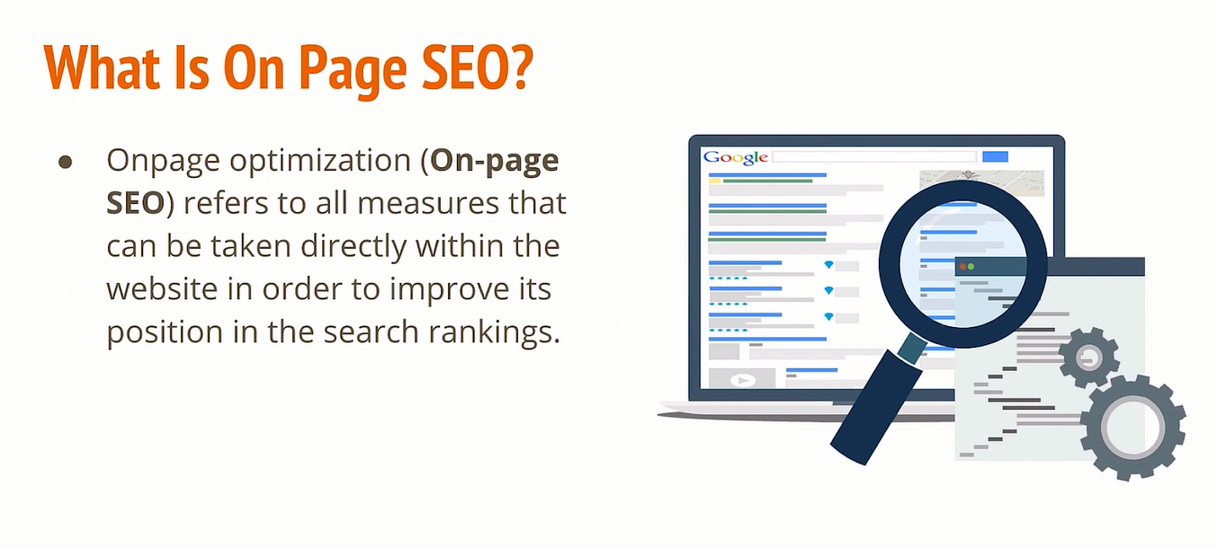

Slide 6
On Page SEO
It is consists of all the elements of SEO you can control
best(99% Control).
On-page SEO should be done even if you rank #1 in the search results because SEO is an ongoing process.
Ex: one time setup(https:, etc.)
Ex: once in a while(title, description, etc.)
When to do?
One time Setup
Once in a while

Slide 7
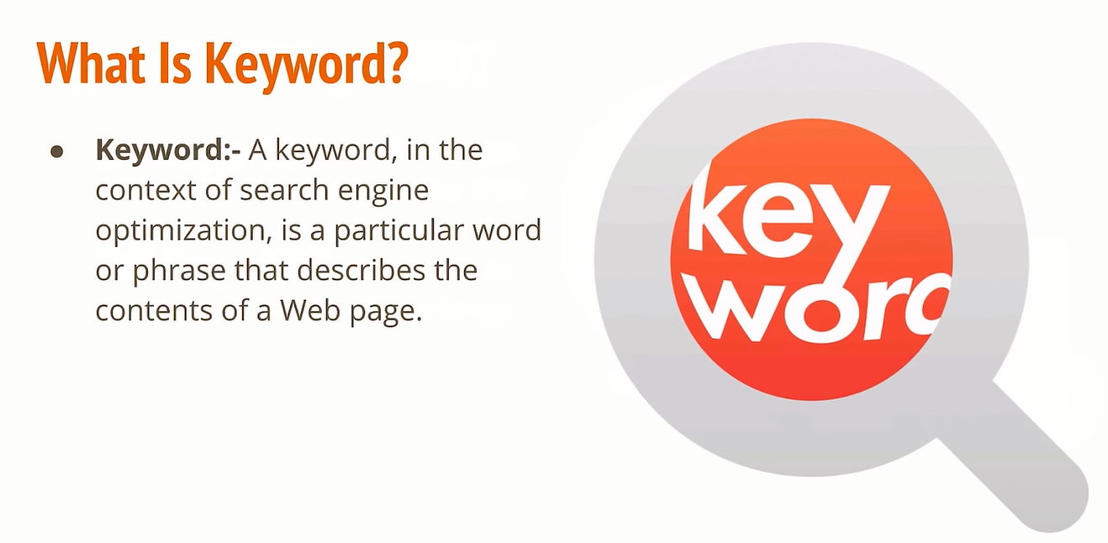

Slide 8
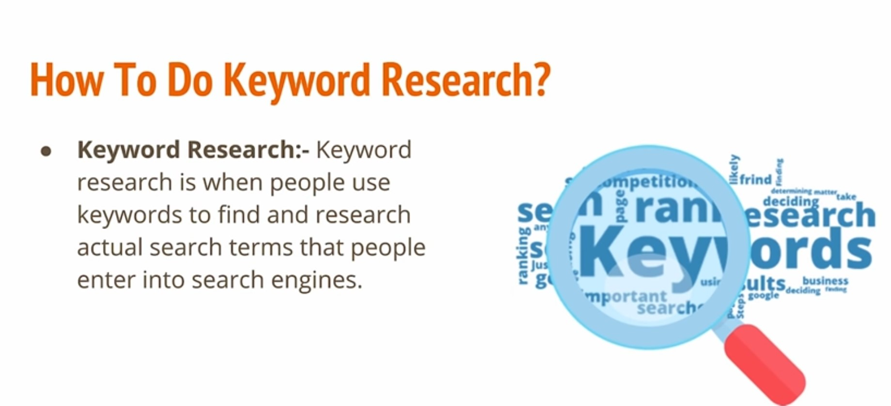
https://ahrefs.com/
https://www.semrush.com/
https://moz.com/
Google Keyword Planner

Slide 9
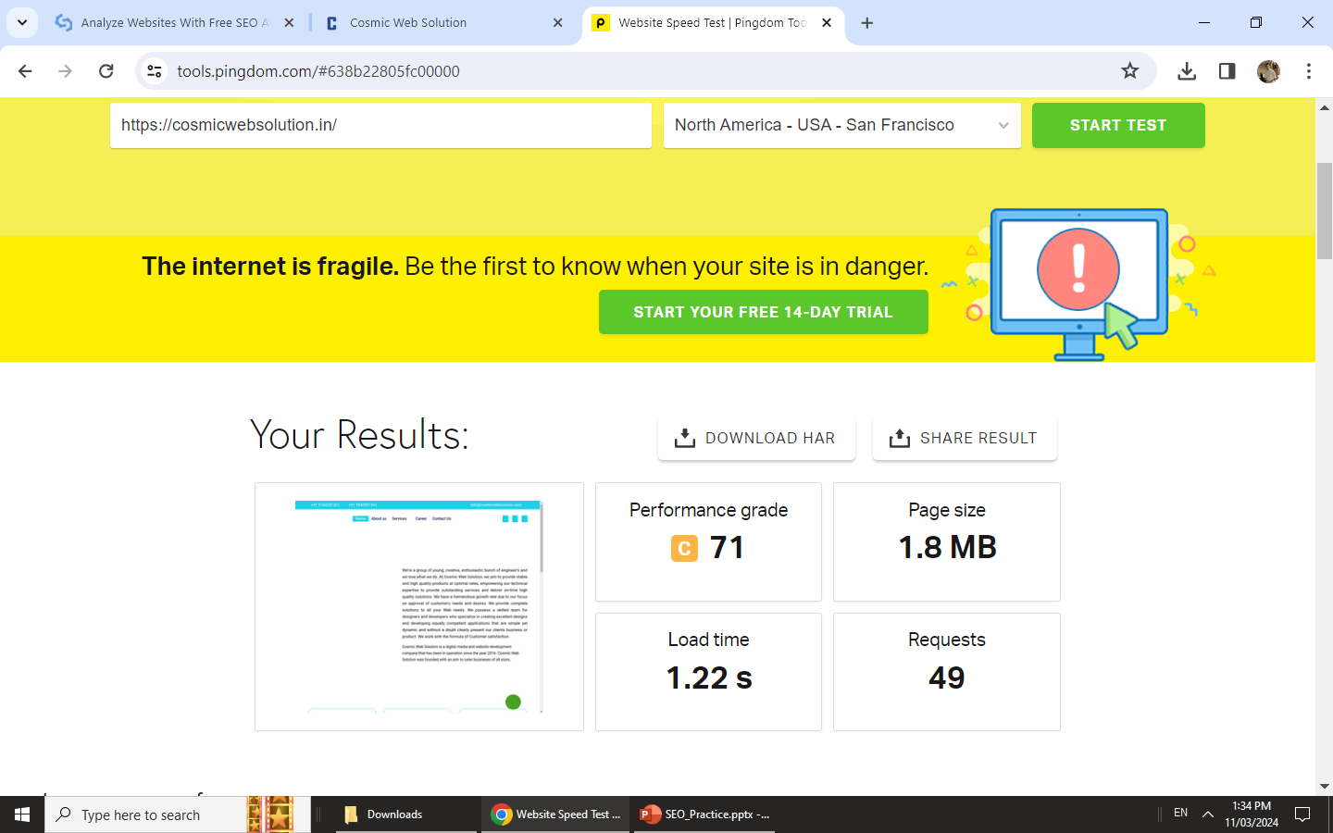
Website audit

Slide 10
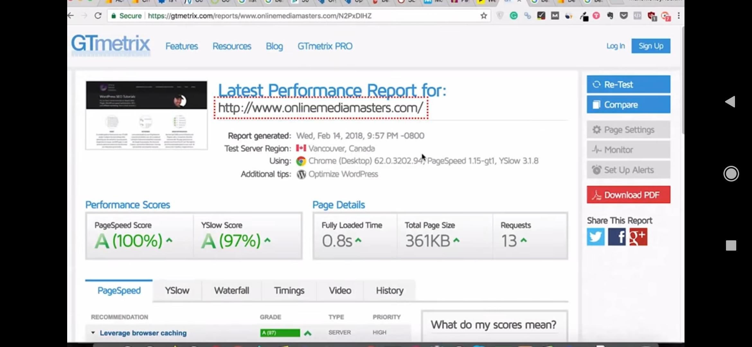
Website audit

Slide 11
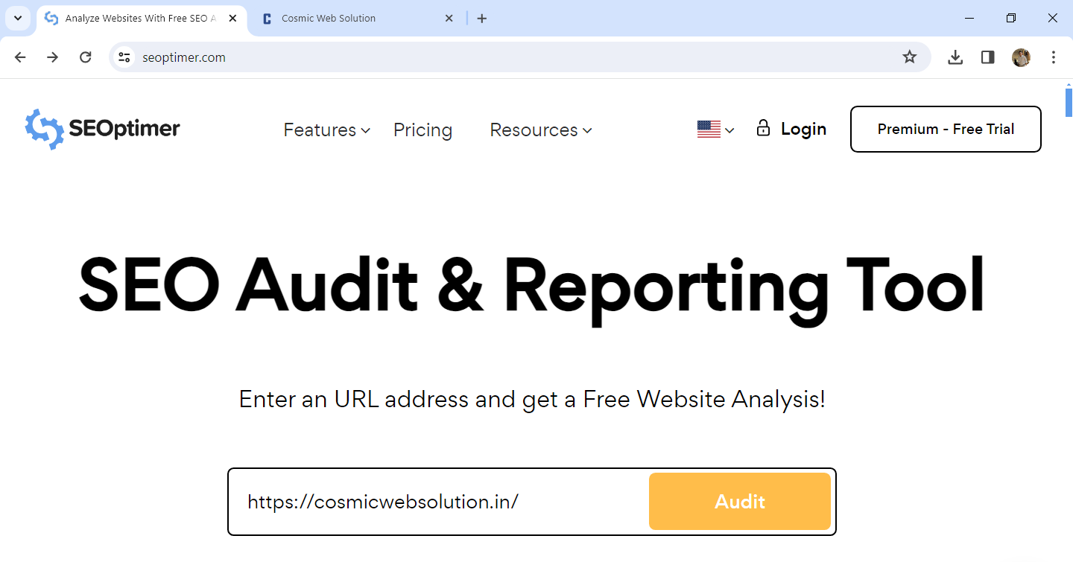
Website audit

Slide 12
On-Page SEO Factors
Some of the On Page SEO factors, which do have direct or indirect ranking effects.
Website should be Crawlable
Image Optimization
User Friendly URL’s
CTR
Well Targeted Content
Mobile Responsive
Keyword Optimization
Readability & UX
HTTPs
Website Structure

Slide 13
Some On-Page SEO Factors
Meta Title
Direct Ranking
Meta Description
Indirect Ranking
H1 Tag
Alt Tag

Slide 14
Meta Title & Description
Title tag: It is the title text which appears in search engine listings on the title bar of the browser window.
Meta description tag: It is the brief summary of the content of your page. It appears below the URL of your page in search engine listings.
Ex:
<head>
<title>Learn Online Digital Marketing | 25+ Modules | Raj</title>
<meta name=“description” content=“Want to Learn Online Digital Marketing? Raj is Online Digital Marketing Training platform. Become Master in SEO, SMM & SEM Today.”>
</head>

Slide 15
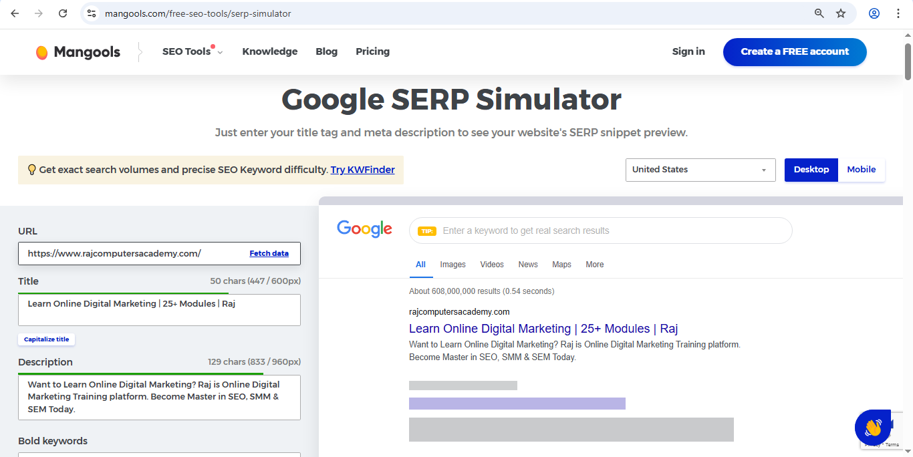
Meta Title & Description
https://mangools.com/free-seo-tools/serp-simulator

Slide 16
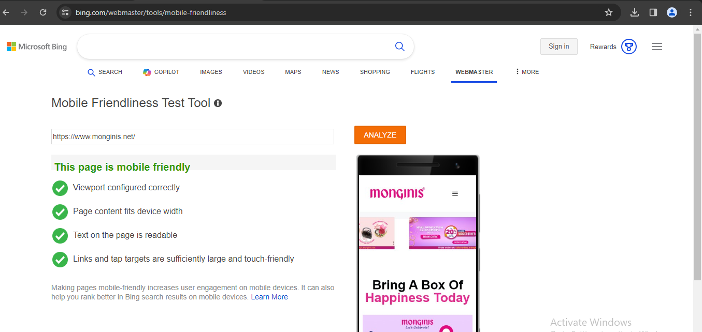
Mobile Friendly Website
https://www.bing.com/webmaster/tools/mobile-friendliness

Slide 17
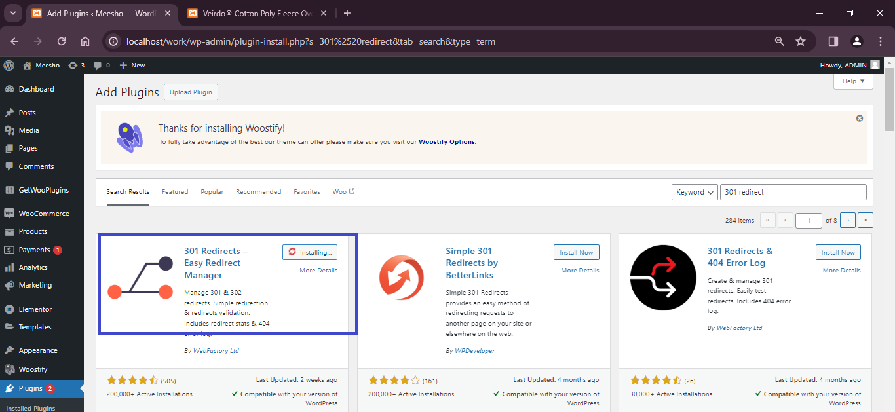
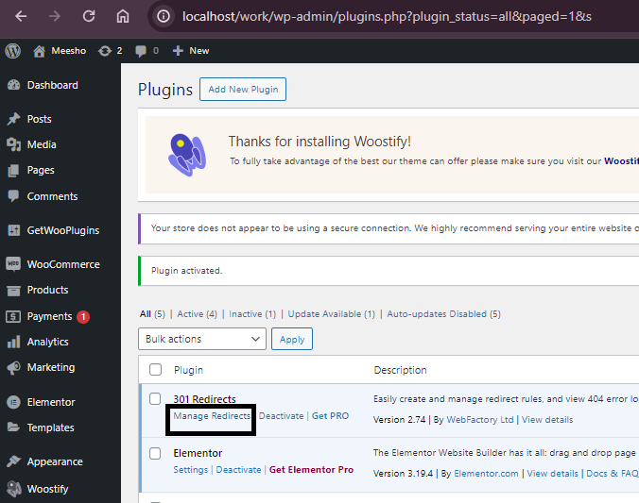
301 & 302 Redirection
A 301 redirect indicates that a page has permanently moved to a new location.
a 302 redirect says that the page has moved to a new location, but that it is only temporary.

Slide 18
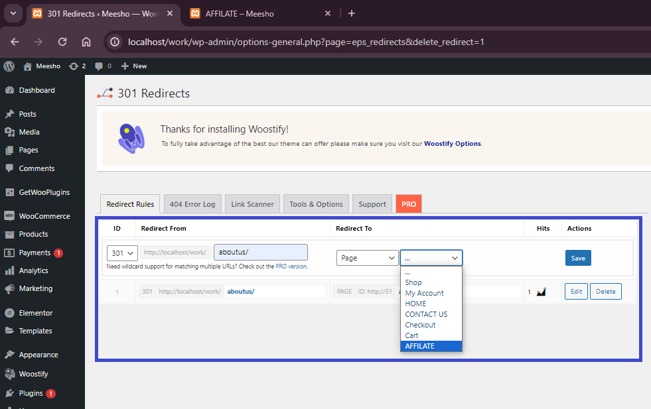
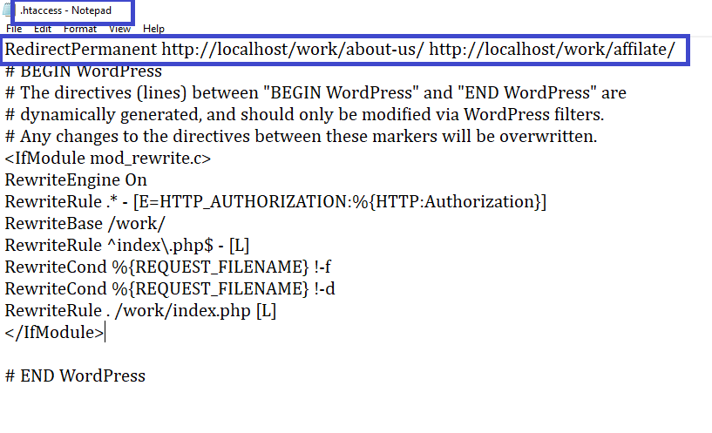
301 & 302 Redirection

Slide 19

404 error Optimization
The 404 error message is an HTTP standard response code which indicates that client is able to contact the server but the server is not able to find the page requested by the client.
Thus, it simply means that the webpage you are trying to reach cannot be found on the server. Errors 404 usually arise due to a wrong link on your site or if you have removed the requested page.
If you don't create 404 Error Page, it can affect your SEO. It is required to have 404 error page because it is a common problem.
To create a 404 page, you need to redirect all irrelevant requests to a single 404 error page.

Slide 20
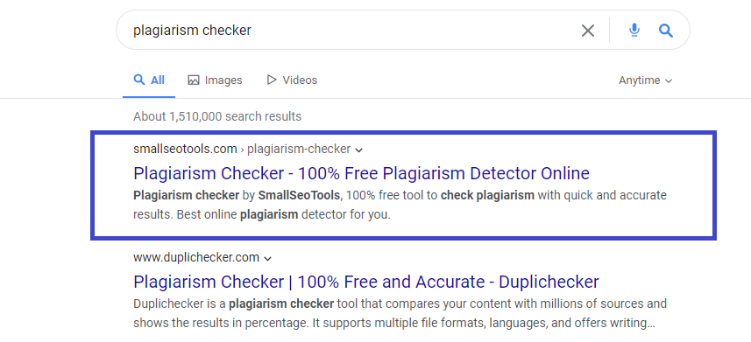
plagiarism

Slide 21
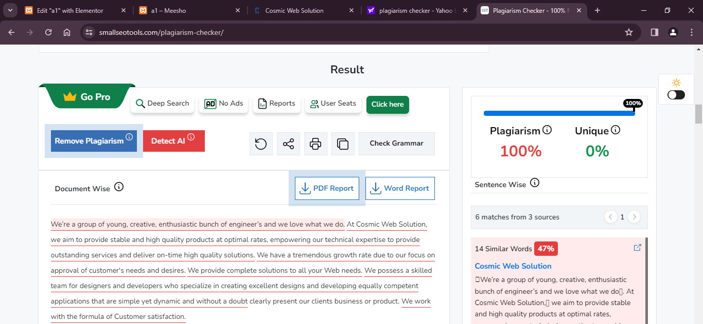
plagiarism

Slide 22
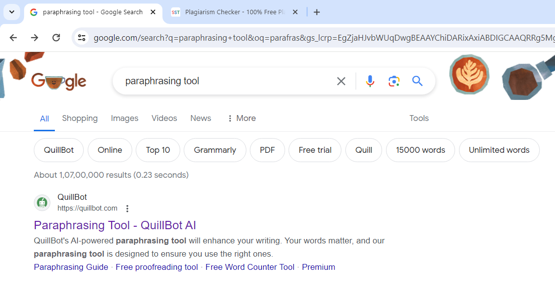
Paraphrasing Tool

Slide 23
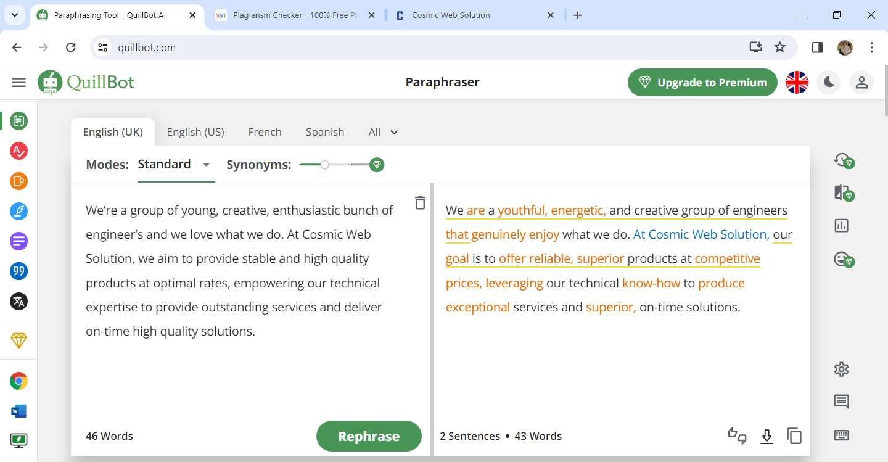
Paraphrasing Tool

Slide 24
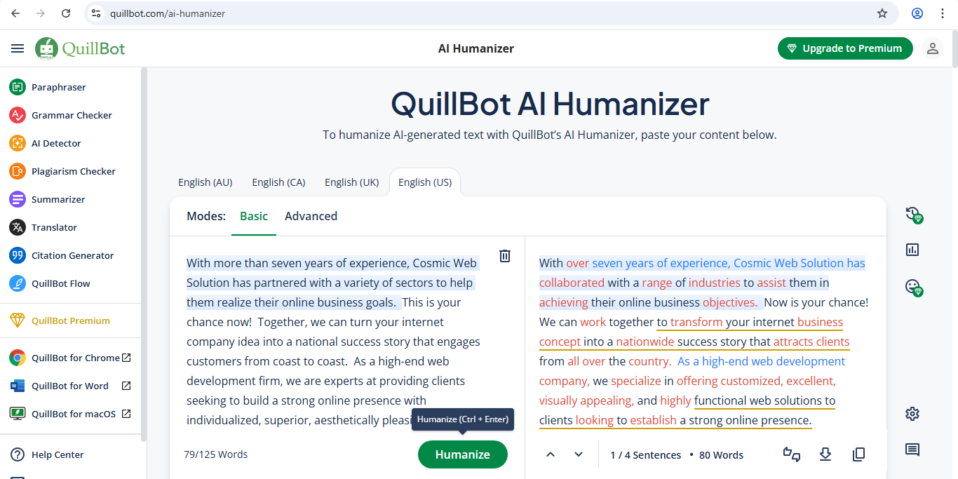
AI Humanizer
https://quillbot.com/ai-humanizer

Slide 25
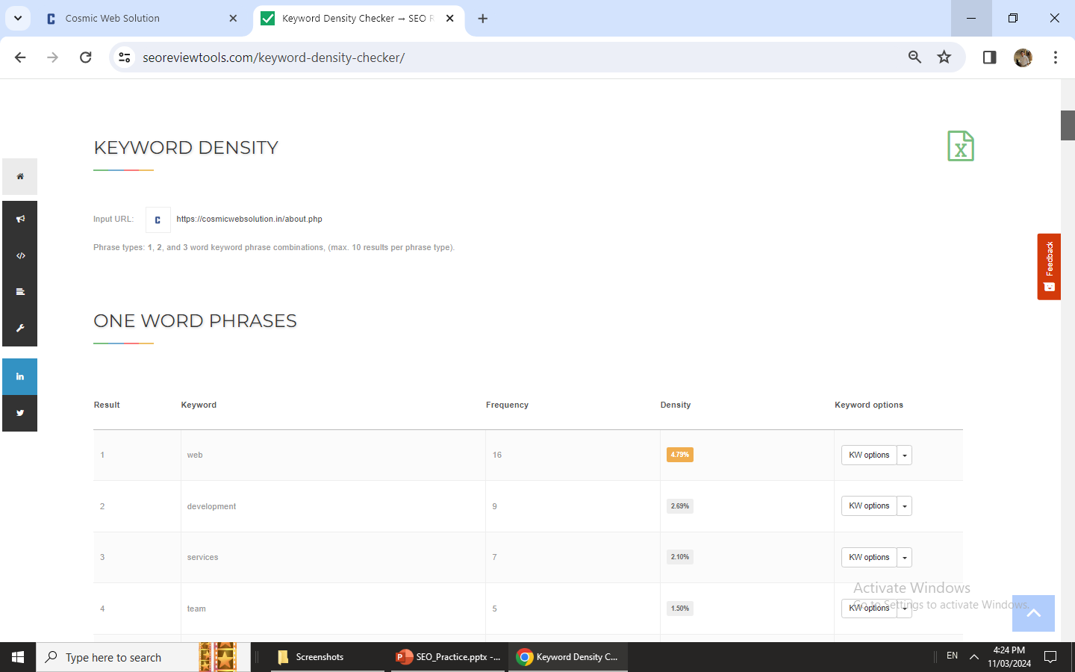
keyword Density<=2
https://www.seoreviewtools.com/keyword-density-checker/

Slide 26
Importance of H1 Tag in SEO
H1 are usually the most visually notable content on the page
Use Only one H1
The H1 should be from 20-70 Characters.
Answer user intent with your H1.

Slide 27
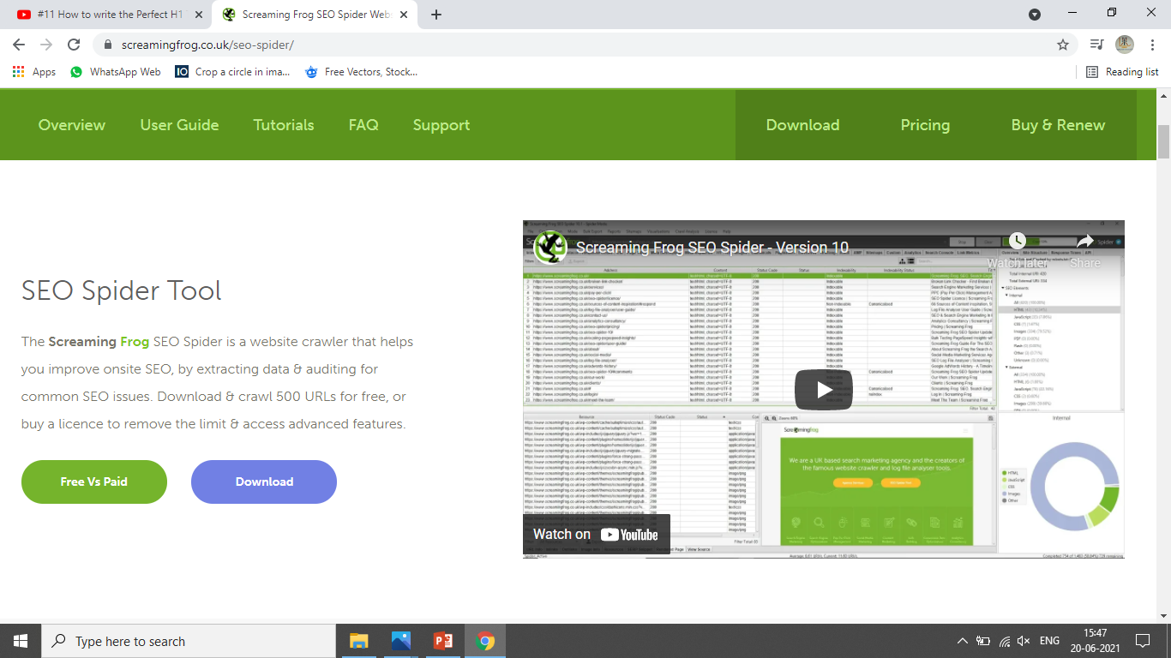
Importance of H1 Tag in SEO

Slide 28
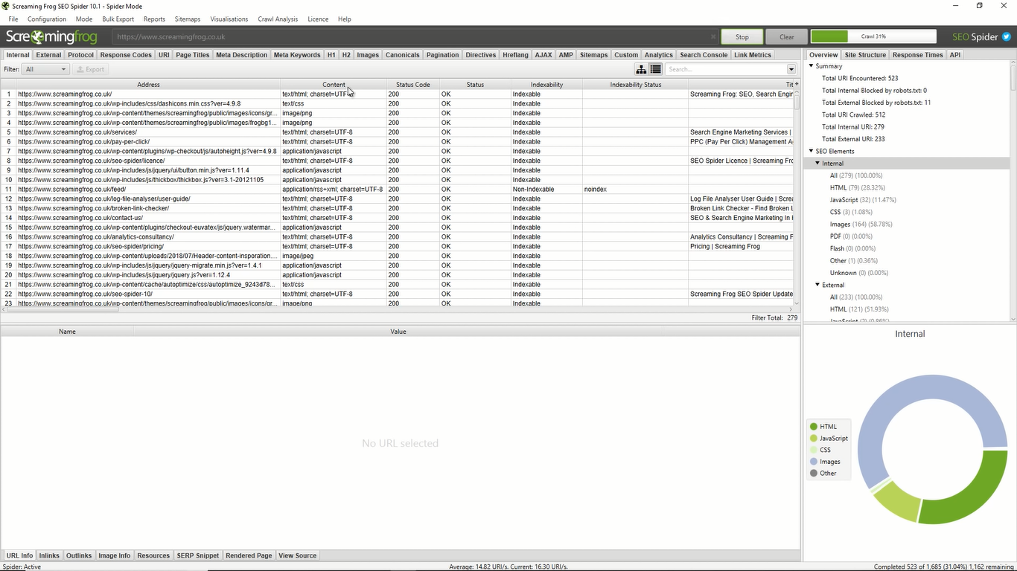
Importance of H1 Tag in SEO

Slide 29
Canonicalization Issue(Canonical Tag Optimization)
Canonical Tag is an HTML element that is used to prevent duplicate content issues.
Canonical Tag is a page level meta Tag that is placed in the HTML header of a website.
Use one Canonical tag per page.
How to apply a canonical tag?
You can apply this tag by adding a link tag to the head of the HTML code of the page that you want to be recognized as canonical by the search engine, e.g. to designate www.xyz.com with the canonical tag, the code will look like as shown below;
<link rel="canonical" href=" http://www.example.com/toys/cars/yellow" />

Slide 30
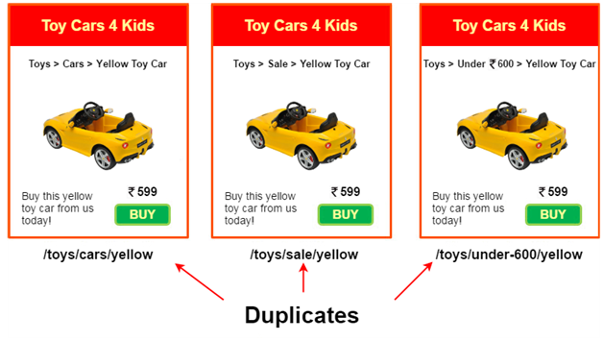
Canonicalization Issue(Canonical Tag Optimization)

Slide 31
Robots.txt
A robots.txt file tells search engines where they can and can’t go on your website.
Search spider arrives at a website with a pre-determined “allowance” for how
many pages it will crawl (or how much resource/time it will spend, based on a
sites' authority/ size/ reputation).(EX : Crawl Budget)
2. Sometimes you don’t want certain pages to be crawled & indexed due to certain reasons.(EX : xyz.com/wp-admin)
Why?

Slide 32
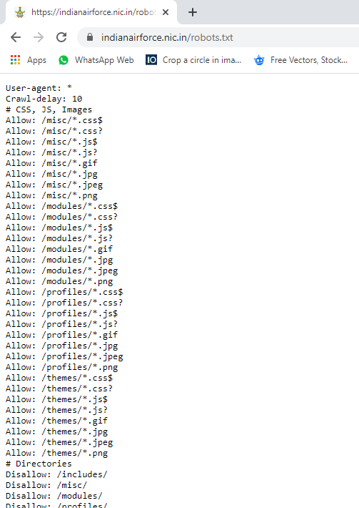
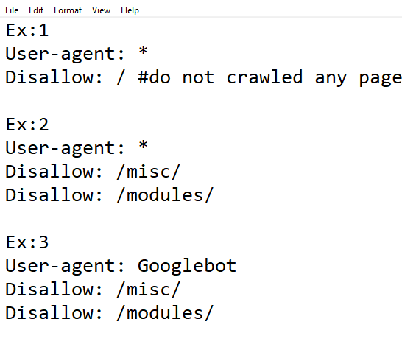
Robots.txt Examples

Slide 33
What is Sitemap? Its Types
Sitemap refers to the map of your site which shows the detailed structure of your site like its different sections and the links which connect them. The role of site map is to help users and search engines find information on your site.
A site map can be a static HTML file or an XML file.
An HTML sitemap enables lost human users to find a page on your site that they are looking for.
An XML sitemap is specially written for search engine spiders. A search engine spider can quickly and easily extract all the important pieces of information about your site by looking at the XML file.

Slide 34
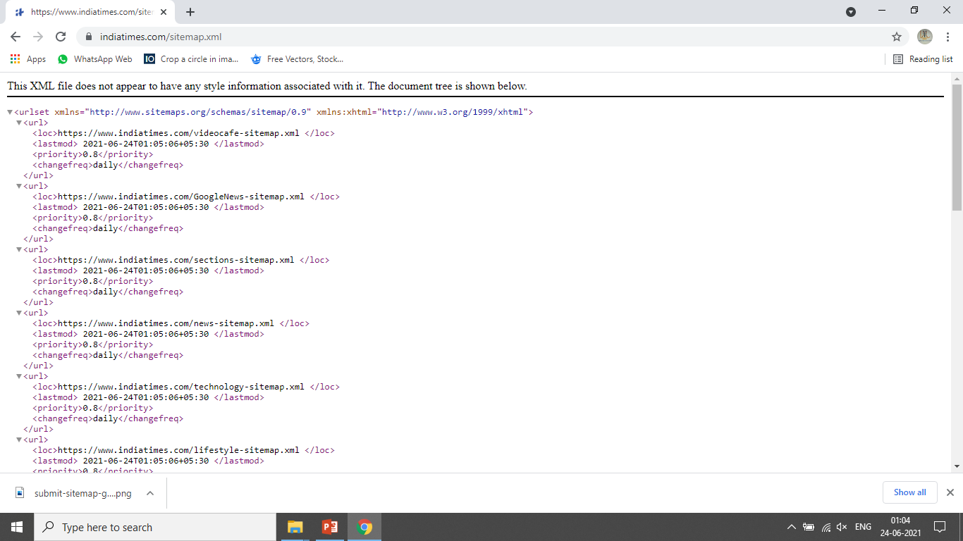
XML Sitemap

Slide 35
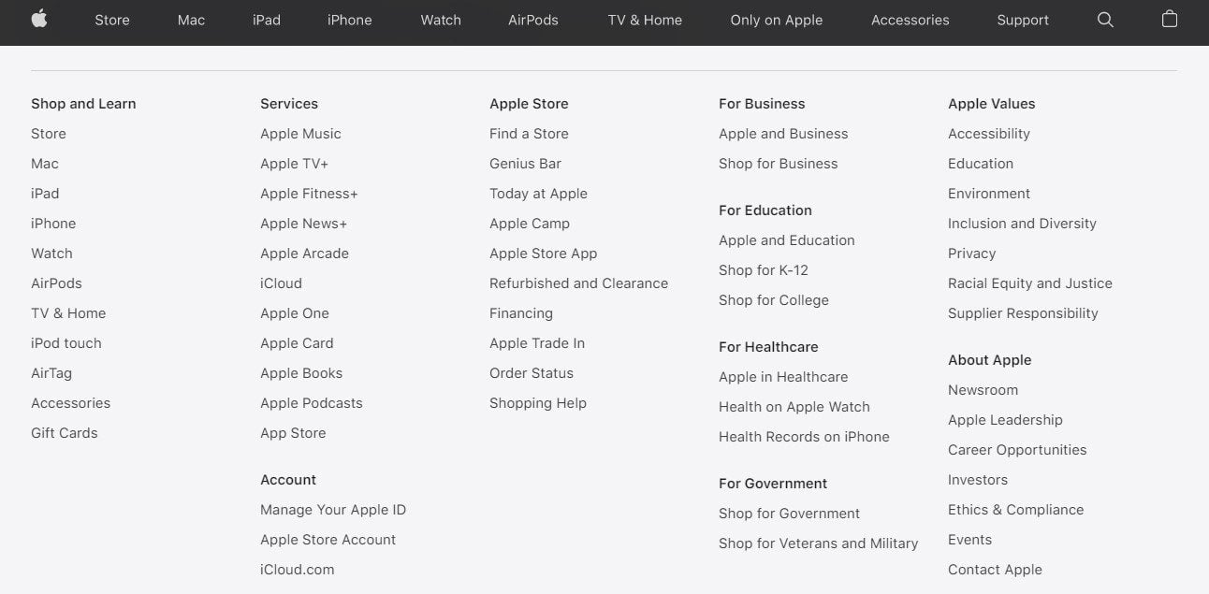
HTML Sitemap

Slide 36
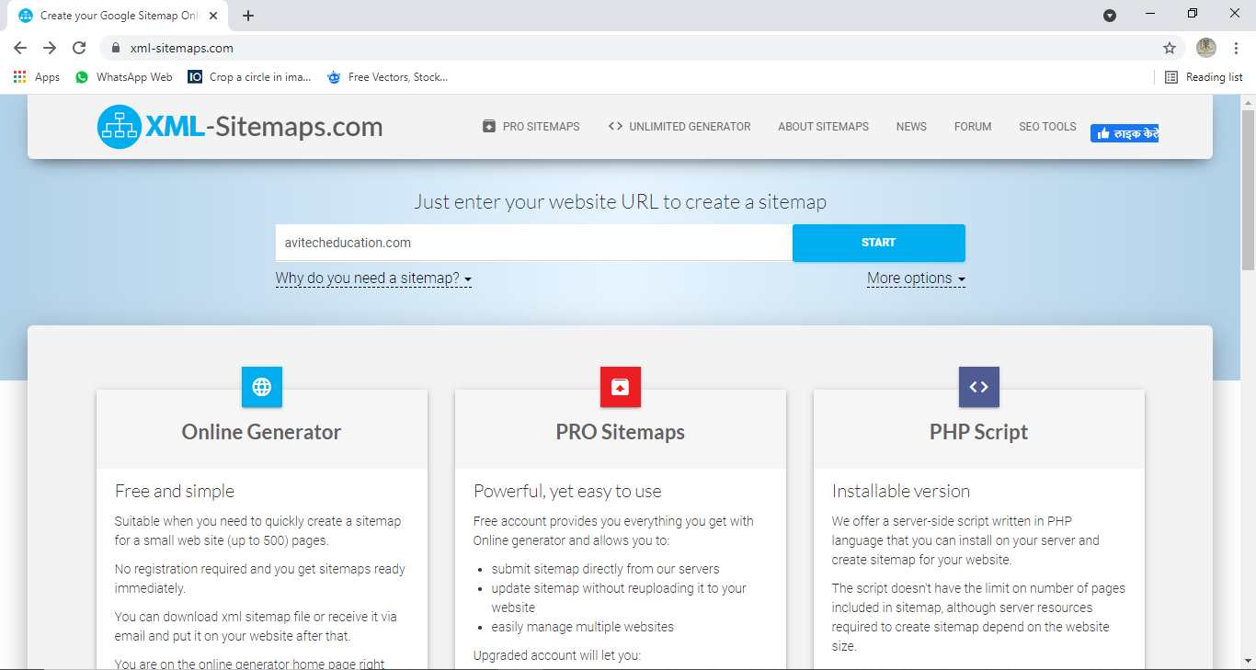
Sitemap Practically Step 1

Slide 37
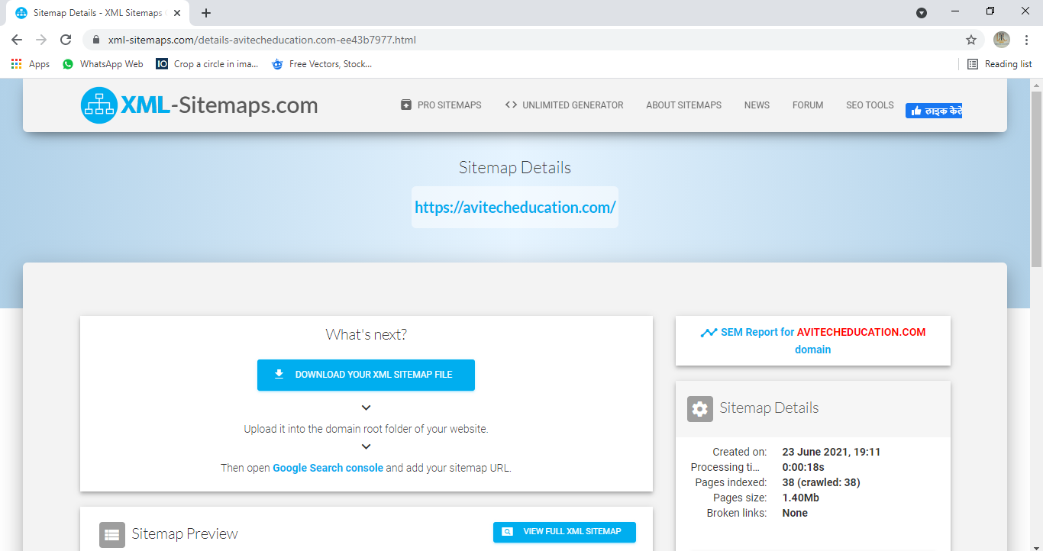
Sitemap Practically Step 2

Slide 38
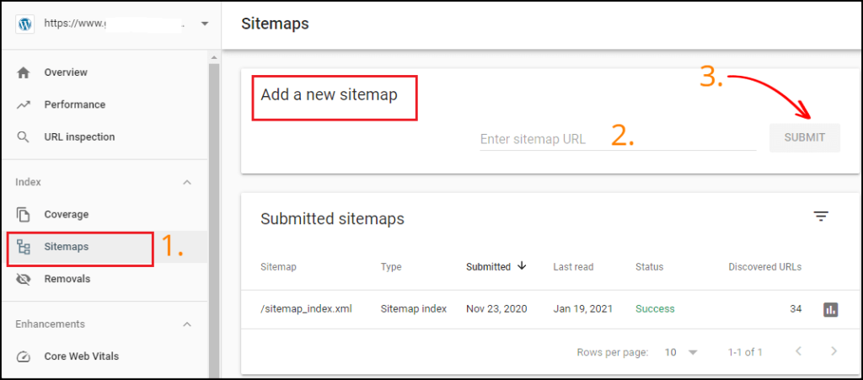
Sitemap Practically Step 3

Slide 39
SEO Friendly URLs
Use the Keyword in the URL.
Never include Special Characters.
Connect URL to the Page Title.(Not matching exactly but there should be some connection)
Avoid Automated Numeric Labels.
Characters in a URL should be lowercase.(Most CMS will allow you to have uppercase letters in a URL i.e. www.example.com/My-URL but have in mind that this is different from www.example.my-url)
Indirectly URLs can help in Backlinking.

Slide 40
SEO Friendly URLs
https://blog.alexa.com/create-complete-seo-audit-report-clients/
Fewer Folder :
www.example.com/categories/subcategories/producttype/product/product1/
www.example.com/categories/subcategories/product1/
Use only level 1, or level 2 if necessary then only level 3
Level 1
Level 2
Level 3
www.example.com/categories/subcategories/product1/

Slide 41
Alt Text Optimization
Alternate text or Alt text is a feature added to an image tag in HTML.
It appears in a blank image box when the image cannot be displayed for some reason like slow connection, broken URL or user is using a screen reader.
Alt text is designed to optimize images for speed and SEO. It helps search engines know what an image is about as they cannot see or interpret images.
EX: <img src=“example.jpg” alt=“about alt text”>
Keep it optimum in the length.
Use only primary keywords.
Avoid Keyword Stuffing.
Don’t use “Image of ” “photo of”(Ex. “this is image of digital marketing”)

Slide 42
Alt Text Optimization
Desired Format
Eg :<img src=“example.jpg” alt=“”>(Not Recommended)
Eg :<img src=“example.jpg” alt=“digital marketing”>OK
Eg :<img src=“example.jpg” alt=“Digital Marketing Course in Hindi”>Excellent
Eg :<img src=“example.jpg” alt=“the only digital marketing course in Hindi Digital marketing learn complete digital marketing here”>(Keyword Stuffing)

Slide 43
Internal Links
Internal Links occurs when you link one of your page to another page of yours.
Note: Internal Linking shall not be overdone(best kept 3-4).Link only when it is necessary.
EX:
www.example.com/page-1
www.example .com/page-2
Internal linking should always be done under strategy
The Relevance of pages
The relationship between pages
Value of pages

Slide 44
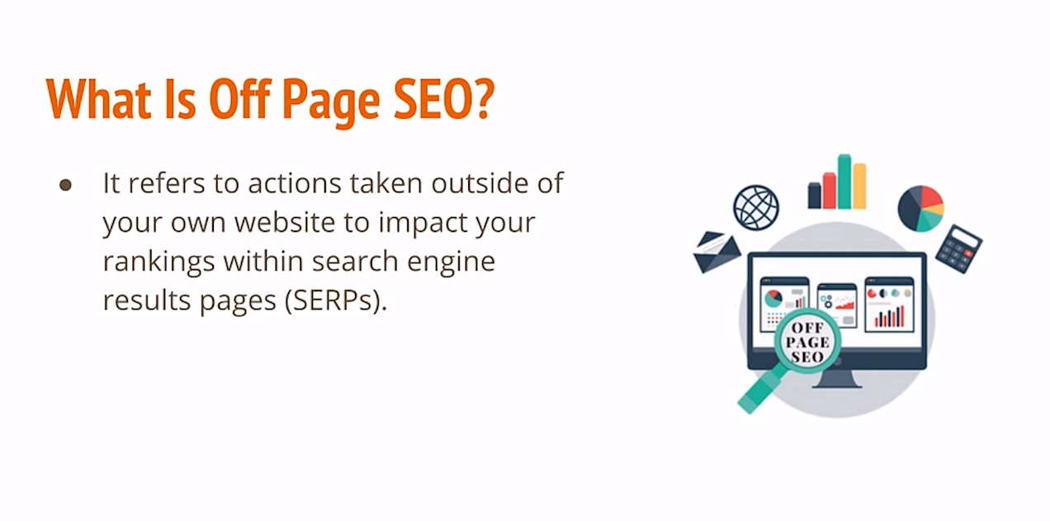

Slide 45
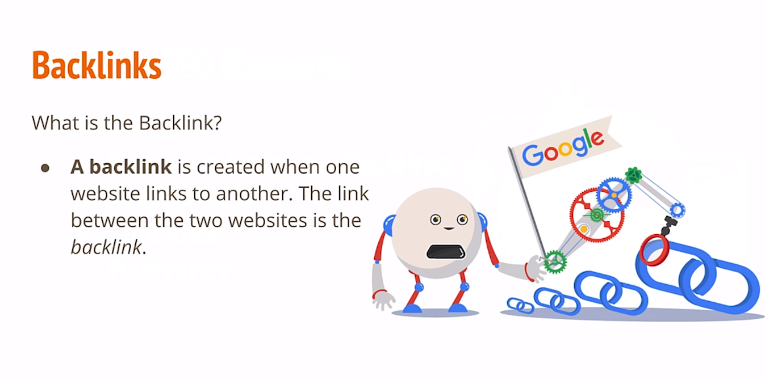

Slide 46
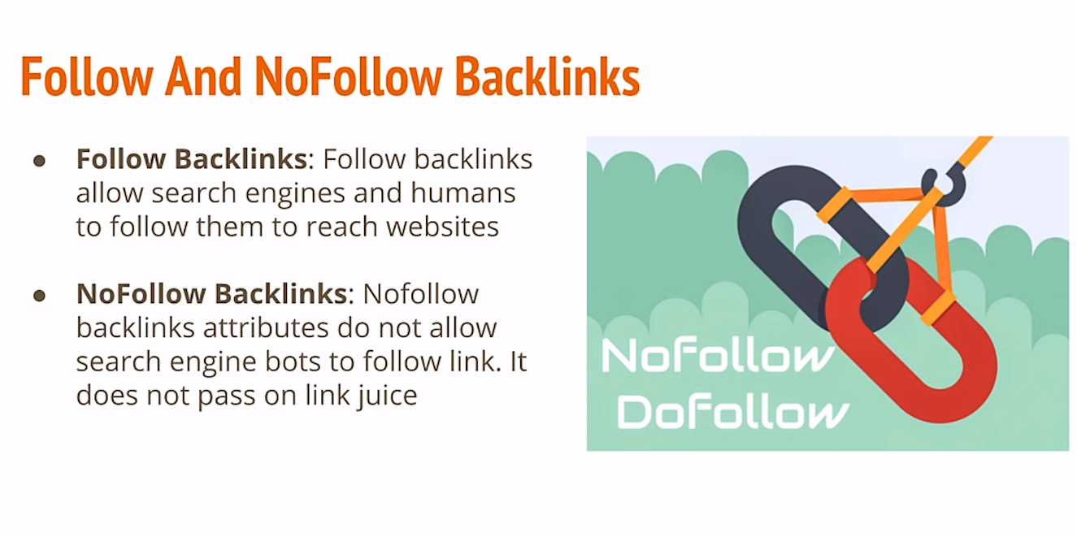

Slide 47
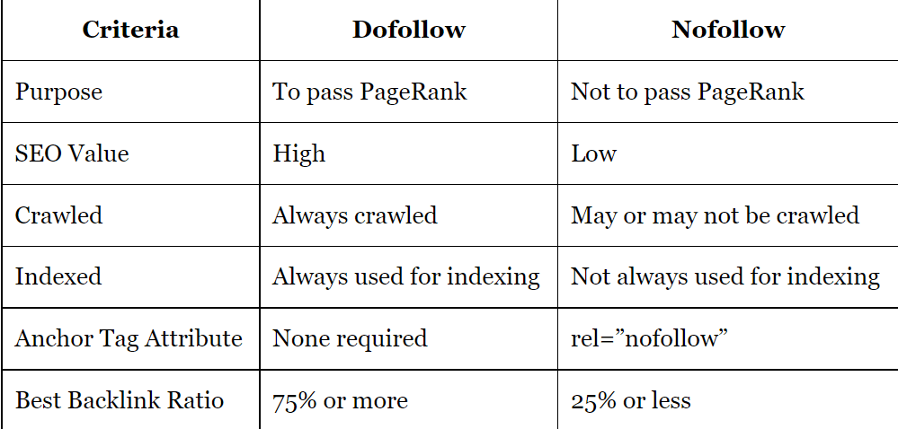
dofollow and nofollow Links

Slide 48

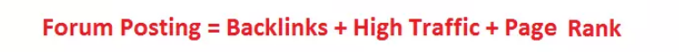
FORUM POSTING
A Forum posting site is an online discussion board that allows users to have meaningful conversations in the form of a posted message,
When carries out correctly.
Forum posting can bring multiple befits for your business.
Exposure to new customers.
Better understand of your customers.
Opportunities to answer any questions customer or potential customers must have.
Tools:
Quora.com
Stackoverflow.com, etc.

Slide 49
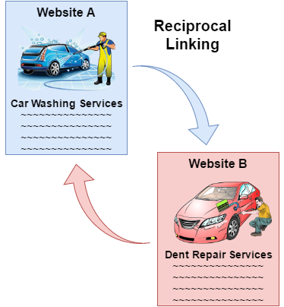
Reciprocal Linking
Reciprocal Linking refers to creating reciprocal link between two websites, i.e. it is created when a website 'A' links to website 'B' which in turn links to website 'A’.
It is an agreement between two websites where each website is hyperlinked to another website.
The purpose of reciprocal liking is to provide readers a quick access to the related sites and to boost search engine rankings of the sites.
The reciprocal links should be built between related websites otherwise it will irritate your users that will harm SEO of your site, e.g. A car wash and dent repair company in the same city may link each other sites to attract more customers.

Slide 50
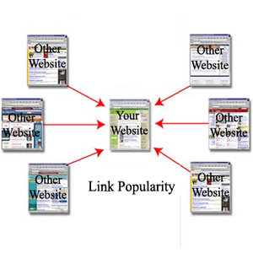
Link Popularity
Link Popularity refers to the total number of links that point to a website.
These links are of two types; internal and external. Internal links are the links from your own webpages and external links are from other webpages or websites.
The high link popularity shows that more people are connected to your site and it contains useful content and information. So, it is one of the important factors for the search engines to rank websites in search engine result pages, i.e. if there are two websites with same level of search engine optimization, the site with higher link popularity will be ranked higher than the other by the search engine.

Slide 51
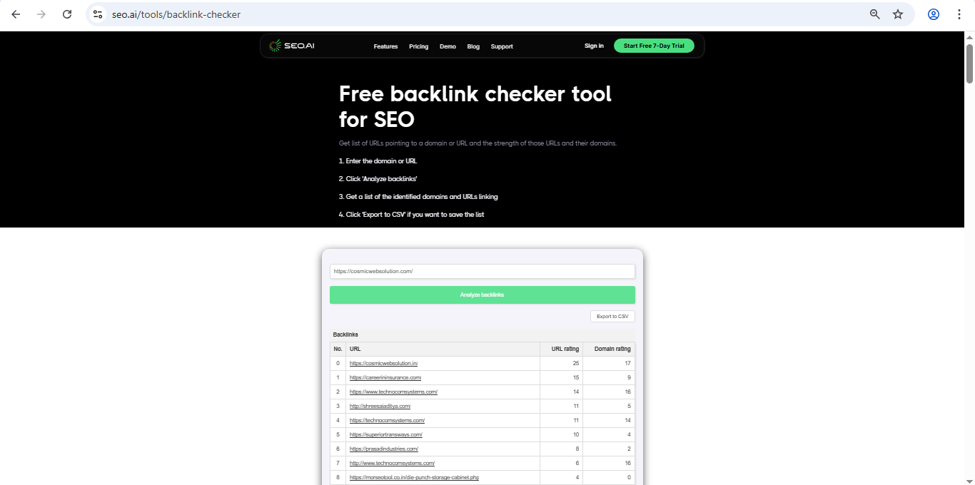
Link Popularity
https://seo.ai/tools/backlink-checker

