Slide 1


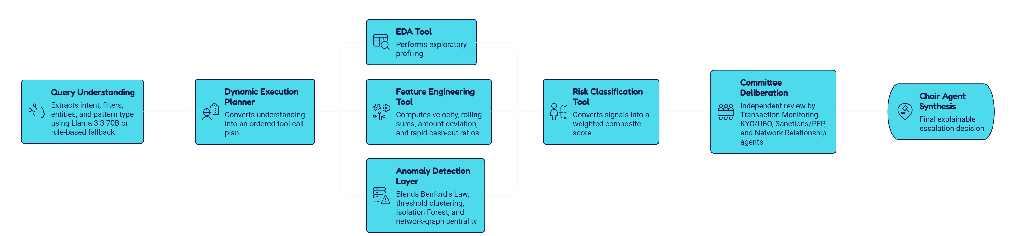
AI-POWERED SUSPICIOUS ACTIVITY DETECTION
Financial Crime Committee
An autonomous, multi-agent AML investigation agent
PROPOSED SOLUTION
Traditional rule-based AML systems generate excessive false positives and are blind to sophisticated laundering techniques such as structuring, smurfing, and layering. The Financial Crime Committee is an autonomous, query-driven agent that treats every compliance question as its own investigation rather than running one fixed pipeline against every request. It parses each natural-language query to extract intent, filters such as date range or country, target entities, and the specific AML pattern being asked about, then constructs a dynamic execution plan on the spot. That plan decides exactly which analytical tools to invoke, in what order, and on which subset of the data, so a simple counting question runs in seconds while a full suspicious-activity investigation runs the complete forensic and machine-learning suite only when it is actually needed.
ARCHITECTURE

Slide 2
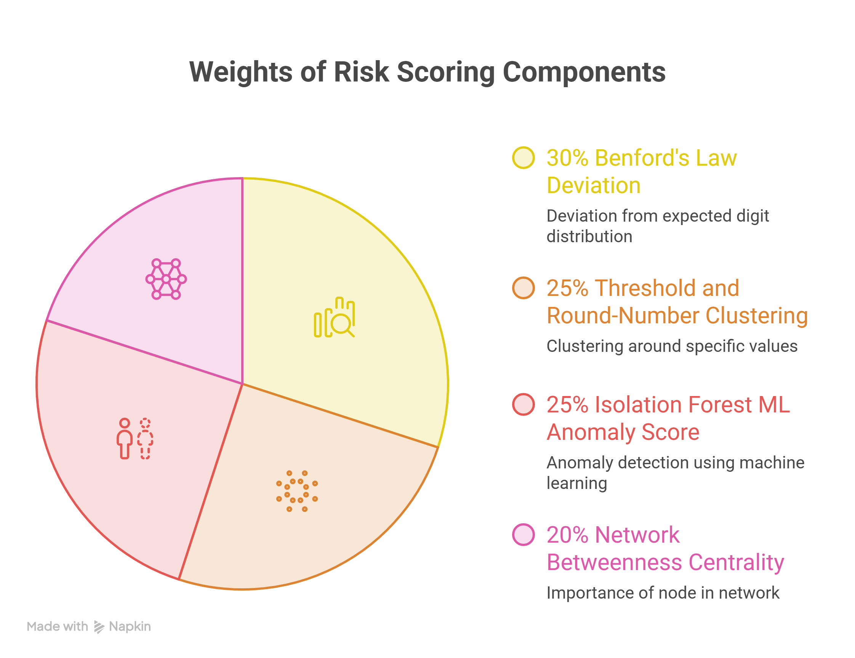


Technical Details & What Makes It Stand Out
KEY TECHNICAL DETAILS
Risk scoring is a transparent weighted composite: Benford's Law deviation contributes 30%, threshold and round-number clustering 25%, the Isolation Forest ML anomaly score 25%, and network betweenness centrality 20%, and these weights rebalance automatically when a signal genuinely cannot be computed, such as when an account has too few transactions for Benford's Law to be statistically meaningful. Feature engineering computes transaction velocity, 30-day rolling sums, amount-deviation z-scores, sub-threshold counts, structuring-regularity scores, and rapid cash-out ratios, all vectorized with pandas so the pipeline stays responsive across the full dataset rather than looping per customer. Network analysis builds a directed transaction graph, computes betweenness centrality and Louvain community detection, and only flags an account when a real absolute signal, meaningful centrality or an actual connected flagged account, backs the designation rather than a relative statistical ranking alone. Explanations and committee reasoning come from the same Llama 3.3 70B model, with every numeric claim cross-checked against the real computed signals before it is trusted, and a deterministic template fallback whenever the API is unavailable.
WHAT MAKES IT STAND OUT
Unlike most hackathon submissions, this system runs against the real, full-scale Kaggle SAML-D dataset, 9.5 million transactions across 855,000 accounts, not a small synthetic sample, and every tool was engineered to stay responsive at that scale. The agent's adaptiveness is not just claimed but provable: a Preview Plan endpoint shows exactly which tools a specific query will invoke before it runs, so a judge can verify the dynamic planning directly. Where most anomaly-detection demos rely purely on a black-box ML score, this one adds real forensic-accounting rigor with statistical safeguards against small-sample false positives. The four-specialist Committee produces genuine deliberation rather than a single opaque number, and when the quantitative risk score and the committee's qualitative decision disagree, the Chair explicitly states why instead of leaving the contradiction unexplained. Judges can also upload their own CSV to replace the live dataset, and every output panel, the banner, the Risk Memo, and the Committee Minutes, is guaranteed to cite the same case ID and the same underlying signals.
Meets all 6 of the hackathon's recommended outputs: execution summary, ranked suspicious accounts, risk tier, explanation tied to intent, escalation action, and supporting charts.

