Slide 1

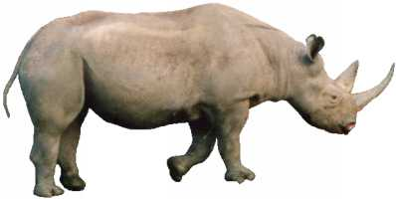
Rhino
Erez Avital
Eli Zaslavchik
Alex Okunev

Slide 2
Rhino - History
One of the oldest non-Java language runtime on the JVM
Originally part of Mozila’s all-java browser project from 1997.
Has it own bytecode generator from day One

Slide 3
Rhino – What Is It ?
It’s just JavaScript
You can run JavaScript Program on top of it.
Can Use Java Objects and libraries.
Can Use JavaScript Objects and libraries.

Slide 4
Rhino – Compatibility
Most of ECMAScript 5
Everything except strict mode
Full JS 1.7 and earlier support
Partial JS 1.8 support
Expression closures, destructuring assignment
No generator expressions
ECMAScript for xml (E4X)
JSON parser/stringifier

Slide 5
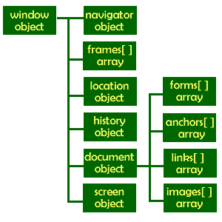
Rhino – Compatibility
It isn’t browser JavaScript runtime:
Doesn’t come with HTML DOM object.
Doesn’t come with Browser object.
HtmlUnit project can be used if that’s needed.

Slide 6
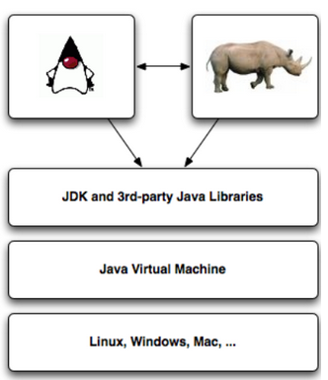
Rhino and Java - High-level Overview

Slide 7
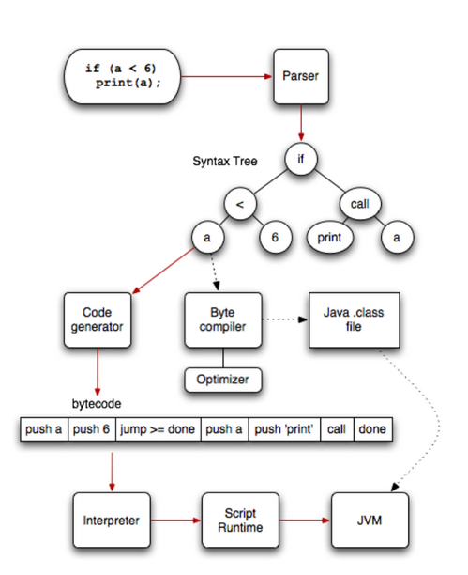
Rhino - Under the Hood

Slide 8
Rhino – Optimization Setting
Three optimization levels:
-1: pure interpreter
0: bytecode compiler; no optimizations
9:bytecode compiler with optiizations

Slide 9
Rhino – Optimization Setting
Let’s compare them using fib(30)
function time(f){ t1 = java.lang.System.currentTimeMillis()
f()
t2 = java.lang.System.currentTimeMillis()
print(t2-t1)
}
Function fib(n){
return n<2 ? n : fib(n-1) + fib(n-2)
}
time (function() {fib(30)})

Slide 10
Rhino – Optimization Setting
Let’s compare them using fib(30)
Interpreted took 14 second
Opt 0 took 0.9 seconds
Opt 9 took 0.3 seconds

Slide 11
Rhino – when to use which ?
Opt 9 in most cases
Opt 0 – don’t really have modern use case for it
Opt 1 – Constrained devices, environments that don’t allow you to load generated bytecode at runtime, or whan you need continuations.

Slide 12
Rhino – CommonJS
Since Rhino 1.7R3, we have CommonJS Modules support.
Code loading mechanism, originally for non-browser JS engines.

Slide 13
Rhino – Integration with Java
Packages “com”, “org”, “net”, “java”, “javax” exposed as top-level objects.
Just do “new javax.swing.Jframe”or such.
Other packages available as “Packages.*”

Slide 14
Rhino – Bundled Rhino
Rhino is also shipping as standard part of the JRE since Java 6.
In Java 8 is replaced by Nashorn scripting engine.

Slide 15
JavaScript Map-Reduce Job in Hadoop

