Slide 2
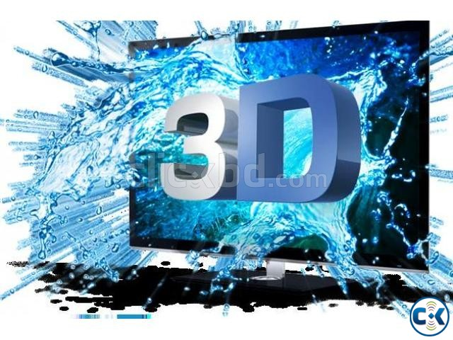
3D INTERNET

Slide 3
ABSTRACT
Internet today has become an integral part of our lives.Wide Web which started A small dull data repository has now become massive and irreplaceable. Present activities being partially or completely linked with the virtual world can be optimized to a higher level. Every activity associated with our daily life is mapped and related to some entity in the digital world.The world has seen vast advancements in Internet and in 3D stereoscopic displays. Time has come merge the two to deliver a new level of experience to the users. 3D Internet is an idea which is yet to be implemented and requires browsers having the property of depth perception and artificial intelligence. If this property is incorporated then the idea of Internet of things can become a reality which is also discussed in this paper. In this paper we have discussed the features, possible setup methods,applications, and advantages and obstacles faced in the implementation of 3D Internet. Through this paper we intend to provide a clear idea about 3D Internet and the possible benefits associated which clearly are worth the amount of financial investment required for it’ s implementation.

Slide 4
INTRODUCTION
3D Internet, also known as virtual worlds, is a powerful new way for you to reach consumers, business customers, co-workers, partners, and students.
People who take part in virtual worlds stay online longer with a heightened level of interest. To take advantage of that interest, diverse businesses and organizations have claimed an early stake in this fast-growing market.
They include technology leaders such as IBM, Microsoft, and Cisco, companies such as BMW, Toyota, Circuit City and Coca Cola.
3D worlds also hold benefits beyond simple social interactions. Companies that specialize in interior design or furniture showrooms, where users want to view entire rooms from a variety of angles and perspectives, will be able to offer customized models through users' homePCs. Google representatives report that the company Google is preparing a new revolutionary product called Google Goggles, an interactive visor that will present Internet content in three dimensions. Apparently the recent rumors of a Google phone refers to a product that is much more innovative than the recent Apple iPhone.

Slide 5
The success of 3D communities and mapping applications, combined with the falling costs of producing 3D environments, are leading some analysts to predict that a dramatic shift is taking place in the way people see and navigate the Internet.The appeal of 3D worlds to consumers and vendors lies in the level of immersion that the programs offer. The experience of interacting with another character in a 3D environment, as opposed to a screen name or a flat image, adds new appeal to the act of socializing on the Internet.Advertisements in Microsoft's Virtual Earth 3D mapping application are placed as billboards and signs on top of buildings, blendingin with the application's urbanlandscapes.

Slide 6
WHAT IS 3D INTERNET?
3D Internet is the next generation after the current 2d web.
3D Internet consists of interconnected services, presented as virtual worlds.
3D Internet is incredibly social. If you're reading a document, you can see other people reading the same document. You connect organically with other people that share your interests and consume the same services that you do.

Slide 7
3D Internet is the combination of two powerful technologies, Internet and 3D graphics. The aim of 3D Internet is to deliver interactive real-time 3D graphics over the web. It is also a simulation of a 2D webpage in real life graphics.
3D Internet is the next generation after the current 2d web.
3D Internet consists of interconnected services, presented as virtual worlds.
3D Internet is incredibly social. If you're reading a document, you can see other people reading the same document. You connect organically with other people that share your interests and consume the same services that you do.

Slide 8
3D Internet: Why?
Why do we need it? For most of its users the Internet is a familiar, comfortable medium where we communicate with each other, get our news, shop, pay our bills, and more.
From this perspective what we have, i.e. the 2D version, seems “sufficient” and the 3D Internet is yet another fad.
However, if we stop and think about the nature of the Internet for a moment we realize that it is nothing but a virtual envirThere is actually a much better alternative way of organizing data which everybody knows and uses. We spend all our lives in a 3D world navigating between places and organizing objects spatially. We rarely need search engines to find what we are looking for and our brains are naturally adept at remembering spatial relationships. Let us consider the following fictitious scenario on the 3D Internet. Instead of a flat 2D desktop I can put my documents on my desk at home, where documents, desk, and home are ?virtual? entities that are 3D representations of real-world counterparts with spatial relationships. Later, when the need of finding these documents arises, there is a high probability that I can easily remember their location without resorting to additional processes such as search engines or a ?recent documents? folder.

Slide 9
Obviously, it is very difficult -if not impossible- to realize this scenario on the current Internet. We are there like 2D creatures living on flat documents not knowing where we are or what is next to us. We teleport constantly from one flat surface to another, each time getting lost, each time asking for directions or help. In contrast, the ease of use and intuitiveness of 3D GUIs are an immediate consequence of the way our brains work, a result of a long evolutionary process ensuring adaptation to our world. Although the 3D Internet is not a solution to all problems, it provides an HCI framework that can decrease mental load and open doors to rich, innovative interface designs through spatial relationships. Another important point is the Webplace metaphore of the 3D Internet which enables interaction between people in a natural way. In this sense, the 3D Internet can be seen as a natural successor of Web 2.0.

Slide 10
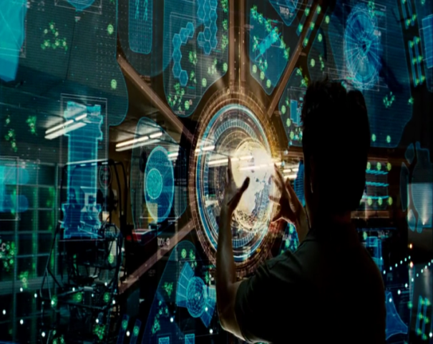
HOW 3D INTERNET WORKS?
The 3D internet is based on the following features or parameters:
Networking or distributed computing
Intelligent environment
Networking or distributed computing: A point of fact is that avatars have more data or information about the user who visits a 3D world than cookies do about a 2D website visitor. For example, avatars contain information about the appearance of visitor or behavior of a visitor.
Latency minimization: Latency which is observed by the clients when they are involving in communication with the servers is minimized. It proposed a hybrid peer-to-peer communication and server independent peer-to-peer communication.
Security and trust: There is a group of alternatives for transporting authentication of users and avatars. Systems like ‘Microsoft Passport’ and many other are developed based on this.
Intelligent Environment: They give the extra stress on user-friendly and efficient service support. The intelligent
environment also consists of intelligent services, intelligent agents, and rendering.
Sing available virtual platforms i.e. Second Life.
By using artificial intelligence.
Using 3d eyewear like Google Glass.
Using sensors and holographic image projections.

Slide 11
Along with this, we can avail the 3D internet:
With the use of artificial intelligence
By availing a 3d eyewear like the Google glass
By the implementation of sixth sense applied science.
Technology, Components, and Implementations of the 3D internet:
3D internet multi-users can read the same document and connect with the people who share the same interest.
It also provides other facilities like virtual meetings, training charts, and shopping etc.
Speed and hardware are the two technical implementations of it.

