Slide 1
Code-Switching as a Controlled Variable
Hebrew–English mixing degrades sentiment classification
and displaces representations
Aviv Barel · Reichman University · NLP Final Project

Slide 2
THE PROBLEM
Israeli tech Slack is not Hebrew. It is Hebrew ⇄ English.
• ״הdeployment קרס באמצע הלילה״ — Hebrew syntax, English noun
• Models are validated on clean Hebrew or clean English
• Real workplace text is neither — so reported accuracy may be optimistic
• Open question: how MUCH mixing breaks a model, and is it gradual or a cliff?

Slide 3
GAP IN PRIOR WORK
Prior work treats code-mixing as binary. We make it a dial.
• SemEval-2020 Task 9 (SentiMix): Hinglish/Spanglish sentiment — mixed or not mixed
• GLUECoS / LinCE: standard benchmarks — no Hebrew–English
• Our framing: hold meaning FIXED, vary mixing 0 → 30 → 60 → 100%
• Turns “harder” into a dose–response curve that localises the failure

Slide 4
DATASET
105 seeds × 4 mixing levels = 420 items, meaning held constant
• Israeli tech registers: deploys, standups, code review, incidents, hiring
• 0% pure Hebrew · 30% English nouns · 60% frequent alternation · 100% English
• Mixing level is a manipulated variable, not a corpus property
• Sentences: LLM-generated from hand-written seeds, not scraped Slack
• Labels: human reviewer + LLM reviewer (Claude), with the human adjudicating disagreements

Slide 5
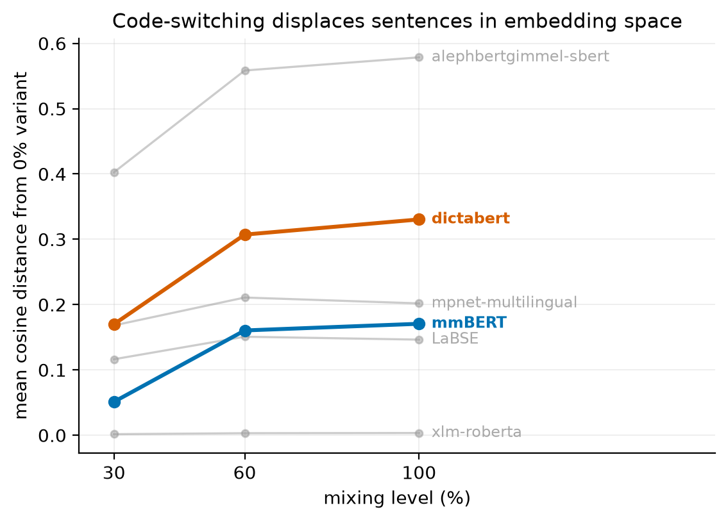
RESULT 1 — GEOMETRY
Mixing displaces sentences in embedding space
DictaBERT (Hebrew-specific) drifts ~2× further than multilingual mmBERT.

Slide 6
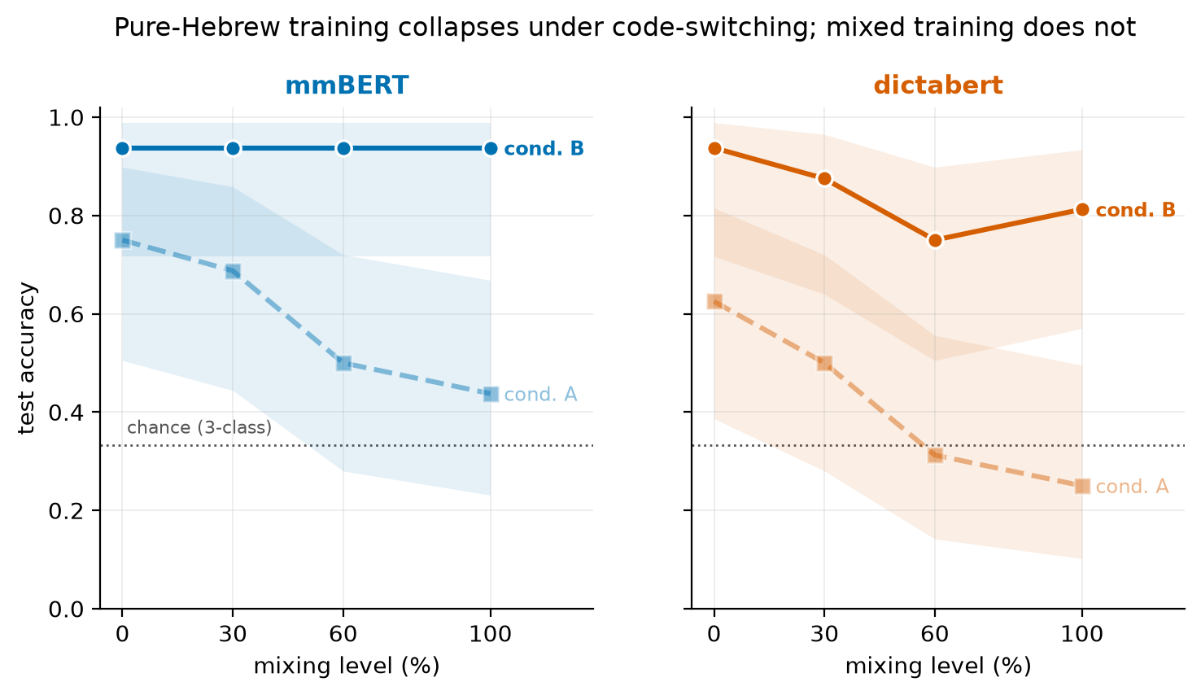
RESULT 2 — ACCURACY
Pure-Hebrew training collapses; mixed training does not
Cond. A degrades significantly (p=.042 / p=.019). Cond. B: trend gone.

Slide 7
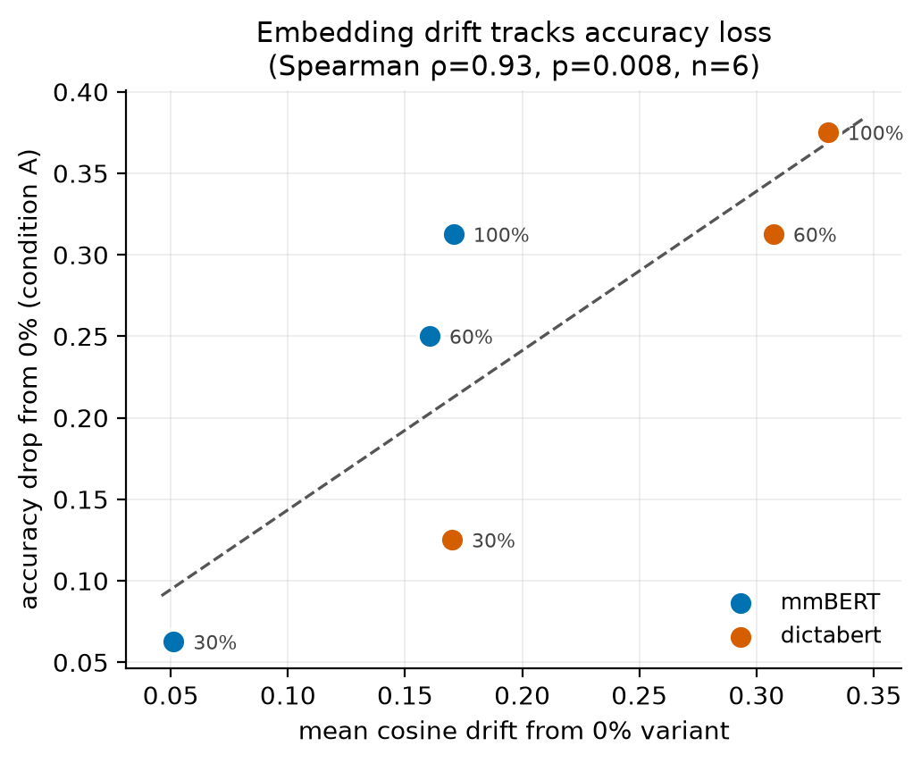
RESULT 3 — REPRESENTATION
Drift predicts accuracy loss
ρ=0.93 (n=6, descriptive) — and the model that drifts more degrades more.

Slide 8
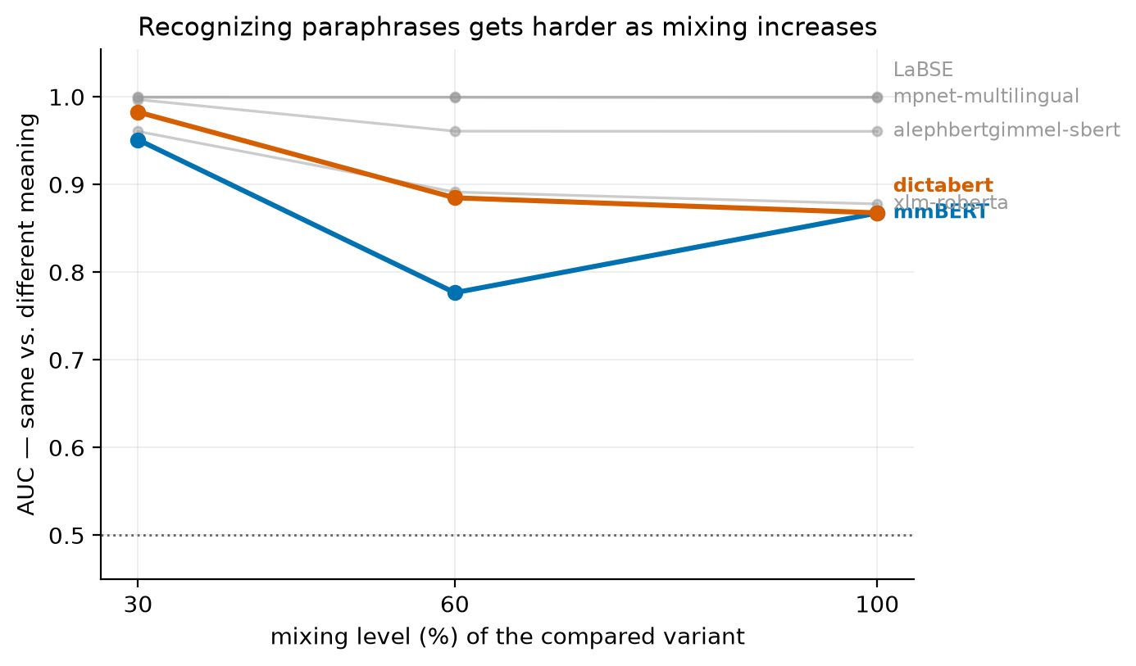
IS IT JUST SENTIMENT?
Recognizing paraphrases gets harder too
No new training needed. Same 30–60% break point shows up again.

Slide 9
WHAT WE FOUND
Five findings
• The break is between 30% and 60% mixing — lexical borrowing is fine, structural alternation is harder
• Hebrew-SPECIFIC is WORSE than multilingual here: specialisation appears to be a liability under code-switching
• Mixed-data fine-tuning recovers it: 0.59→0.94 (mmBERT), 0.42→0.84 (DictaBERT), p<1e-5
• Embedding drift is consistent with a contributing mechanism behind the accuracy loss
• The same break shows up in a complementary, label-free test (same-meaning check) — not a fluke of one task

Slide 10
Takeaway
A Hebrew-tuned model validated on clean Hebrew
will overstate its performance on real Israeli workplace text.
A simple and effective fix in our setting is to put mixed-language data in the training set.
Code, data, and analysis notebook: see repository

