Slide 1
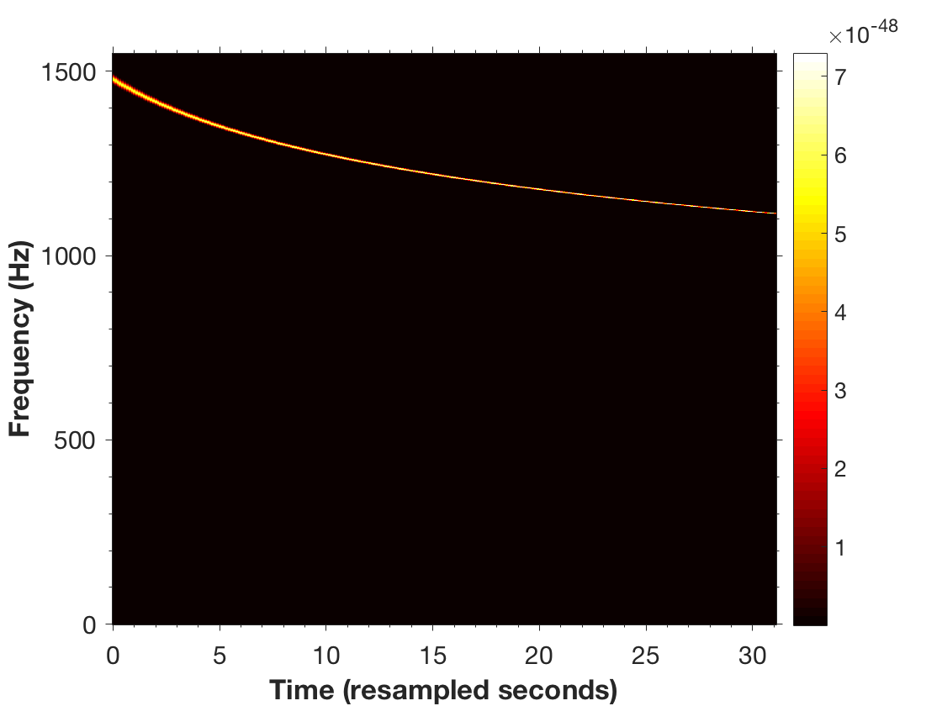
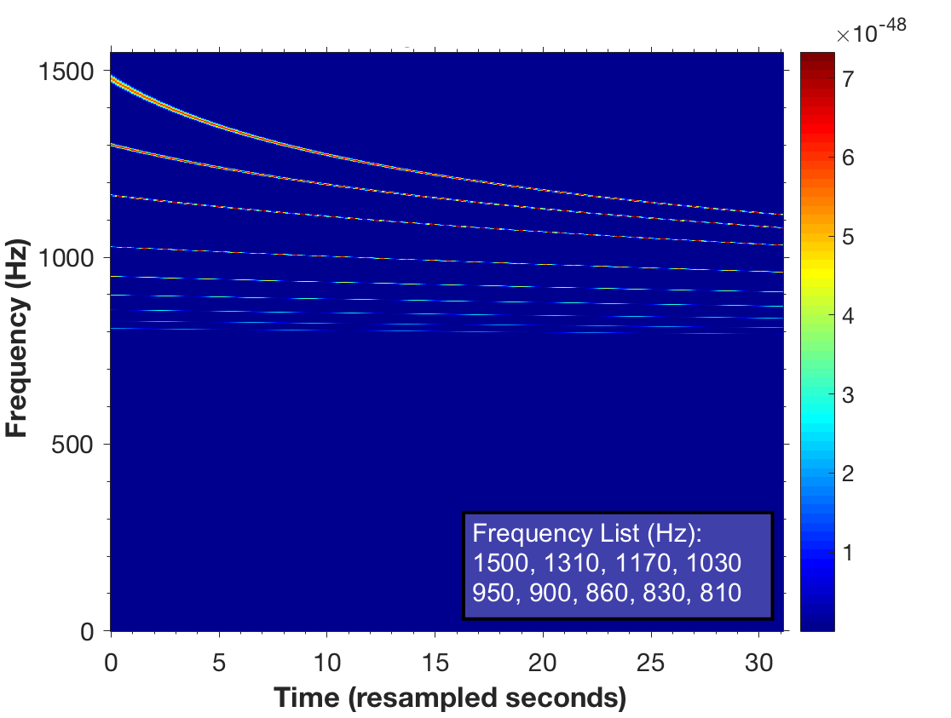
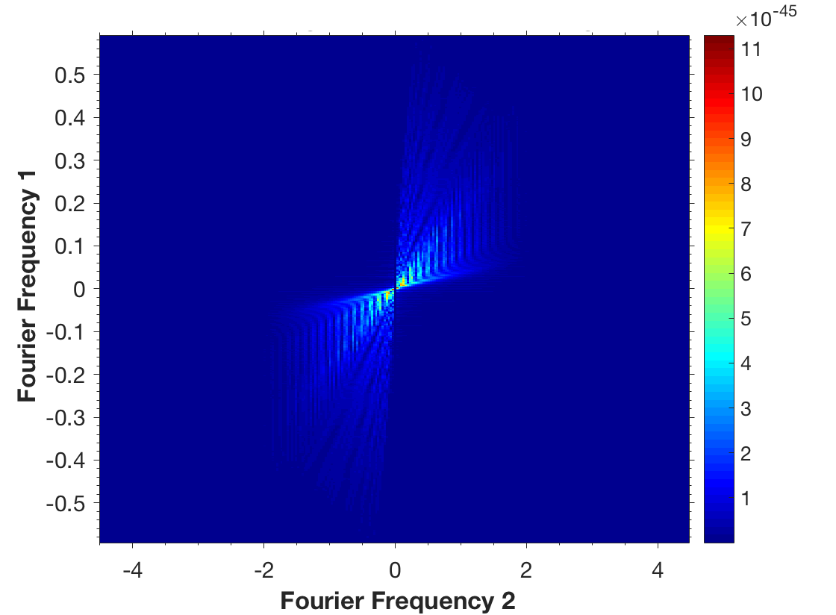
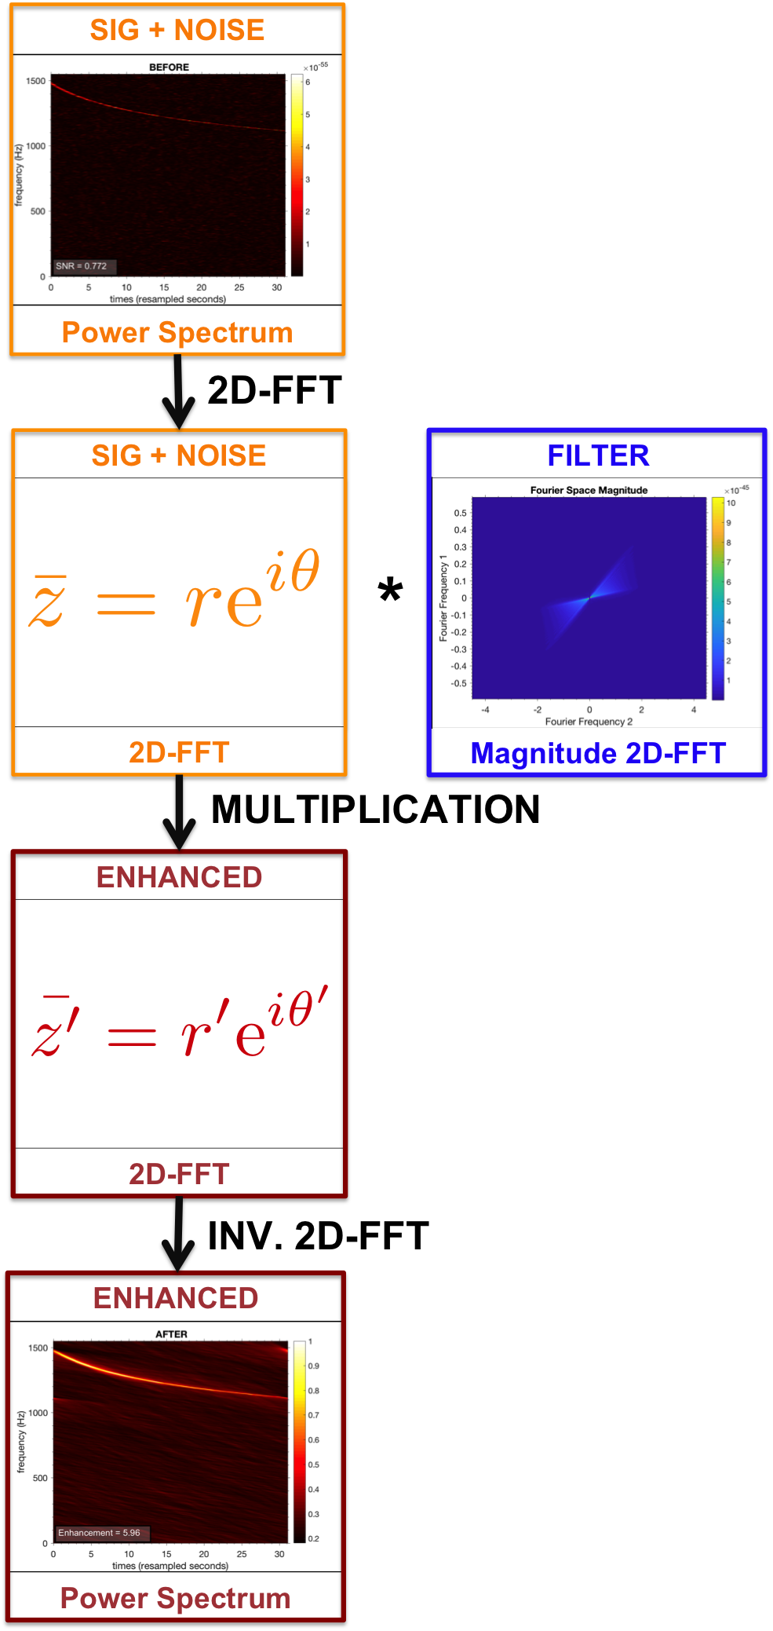
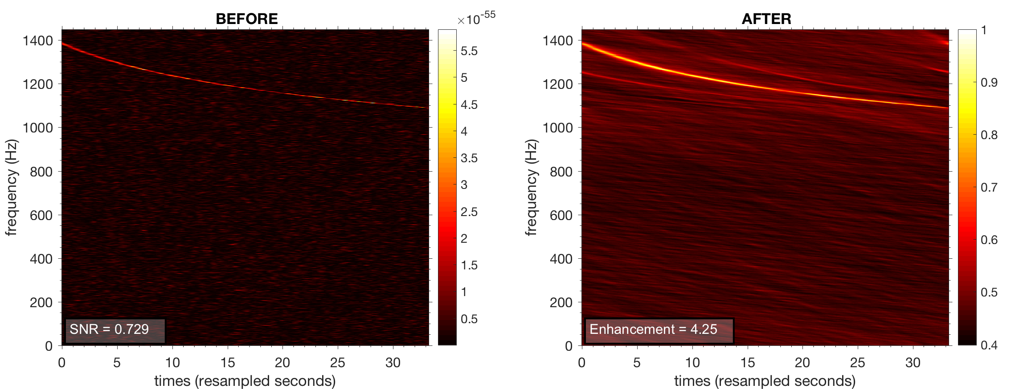
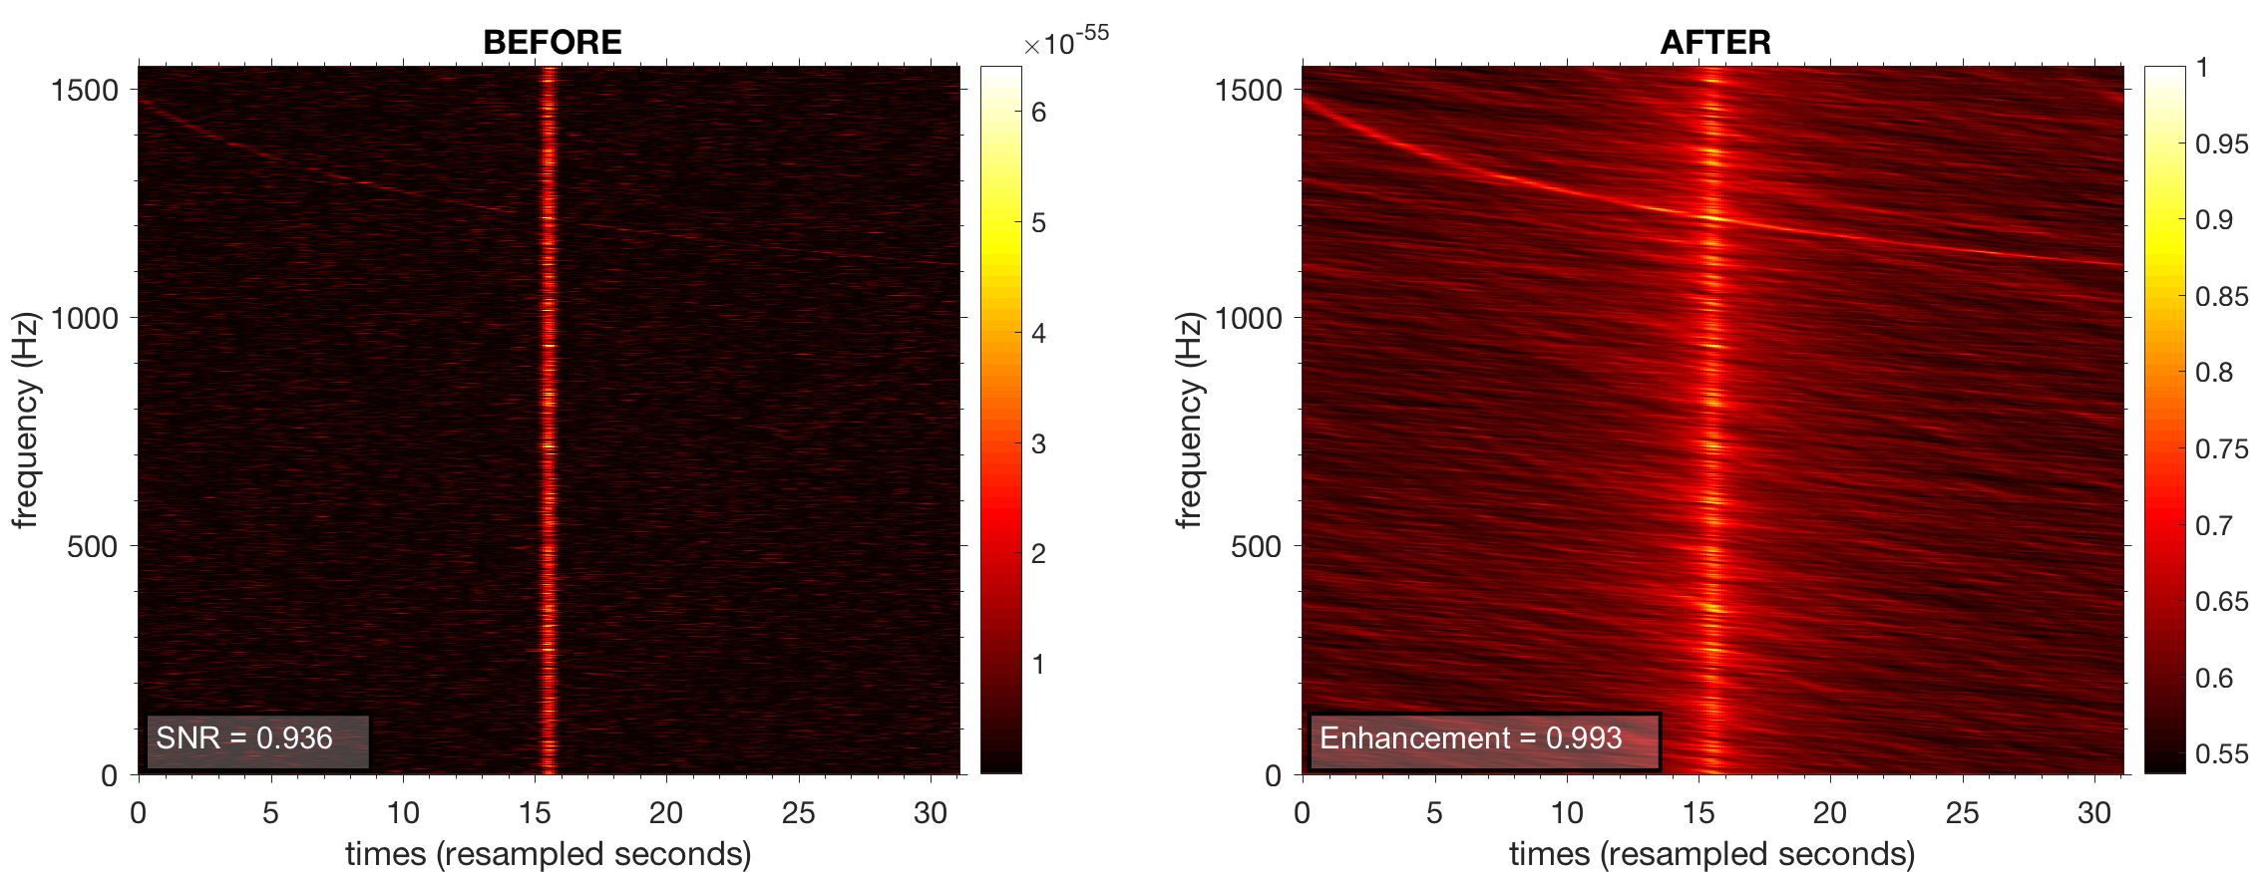
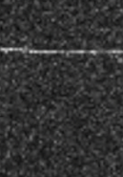
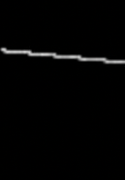
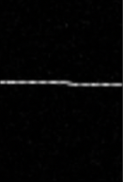
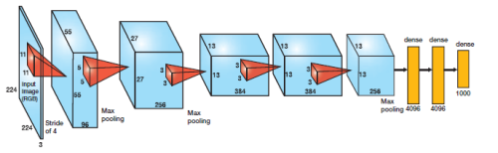
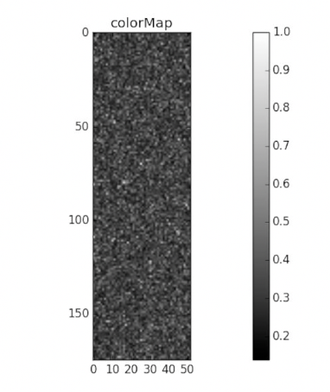
Simulating r-mode data
Filter generation
VIRGO LOGO?
LIGO LOGO?
UF/SAPEINZA
LOGO?
Frequency and amplitude evolution
Signal Power Spectra
Summed Signal Power Spectra
FILTER = |2D-FFT(power spectra )|
Nine different source frequencies
Study of a method to detect r-mode signals in white noise
Filtering Process
Filtering Results
Filtering data = signal + white noise
Filtering data = signal + white noise
Filtering data = signal + white noise + glitch
Avi Vajpeyi¹, Andrew Miller^{2,3,4},
Pia Astone³, Sergio Fresca^{3,4}
¹The College of Wooster, Ohio, USA
²The University of Florida, Florida, USA
³National Institute for Nuclear Physics, Italy
⁴Sapienza University, Rome, Italy
The data that is filtered contains a signal with source frequency of 1400 Hz, a source frequency that is not used to generate the filter. This demonstrates that the 2D FFT filter does not need to exactly match the parameters of a signal in data to enhance the signal.
The data that is filtered contains a glitch in amplitude – a phenomenon that can occur while recording gravitational wave data. We see that applying the 2D FFT filter on the data can help enhance the presence of the signal in comparison to the glitch.
Abstract
We present an investigation of r-mode gravitational waves which could be important to detect isolated neutron stars. We use 2D-FFT filters and convolutional neural networks. We show that we can achieve an enhancement in the quality of an r-mode signal using filters that do not match the exact parameters of the signal present in white noise, contrary to what is required with typical matched filtering methods.
CNN to detect signals
Future work
SIGNAL + NOISE
Investigate a method to parameter estimate with 2D FFT filters
Determine use of the phase of the 2D FFT for filtering
Improve calculation for enhancement
Create a CNN that can be used for parameter estimation
Study the improvement of signal detection by the CNN if filtered images are used..
NOISE
5 Convolutional
3 Fully Connected
On training with 1000 simulated datasets and testing with 230 unseen simulated datasets we obtained an accuracy of 99.57%. The architecture for the CNN used is AlexNet. The loss function is a categorical cross entropy function.
Parameter estimation with the same network architecture but a mean-square loss function has not yet provided accurate results.
Acknowledgements
We would like to thank the University of Florida and the National Science Foundation for helping fund this work.

Slide 2
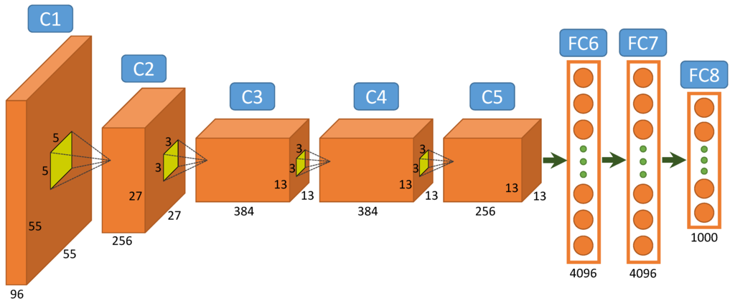

Slide 3
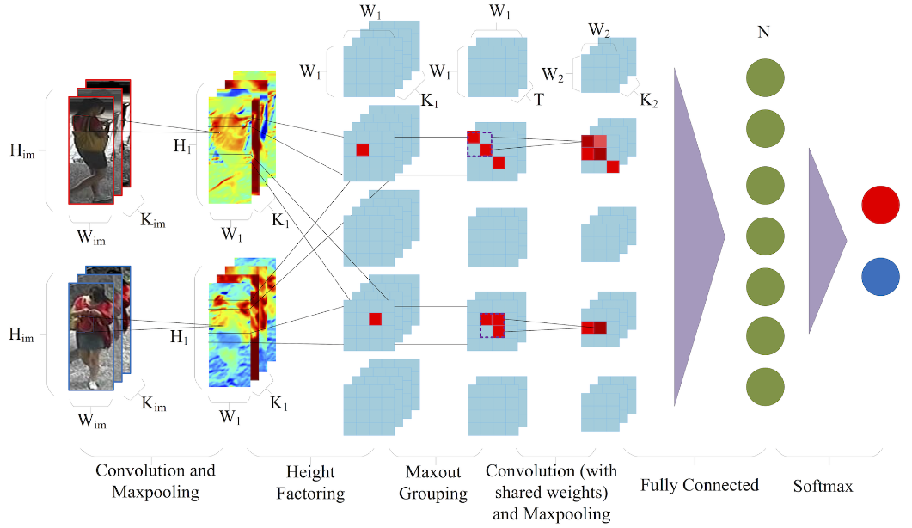

Slide 4
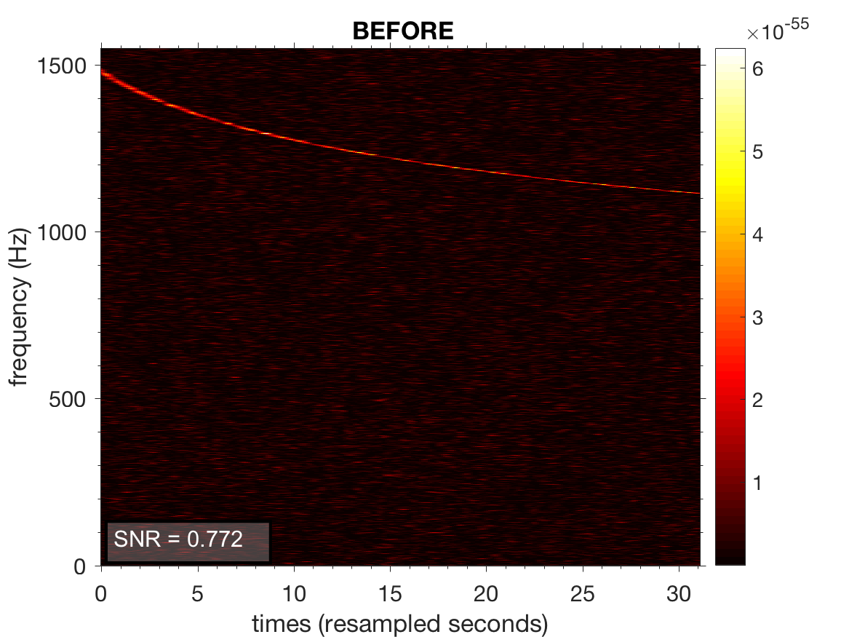
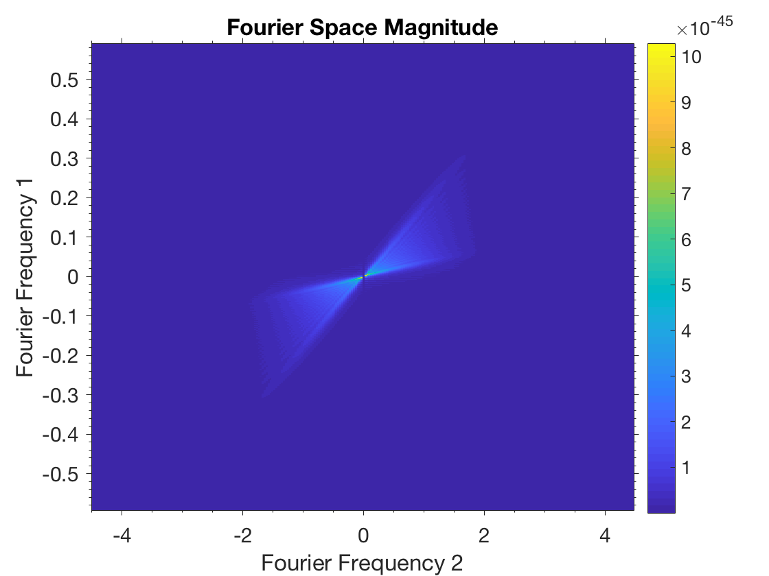
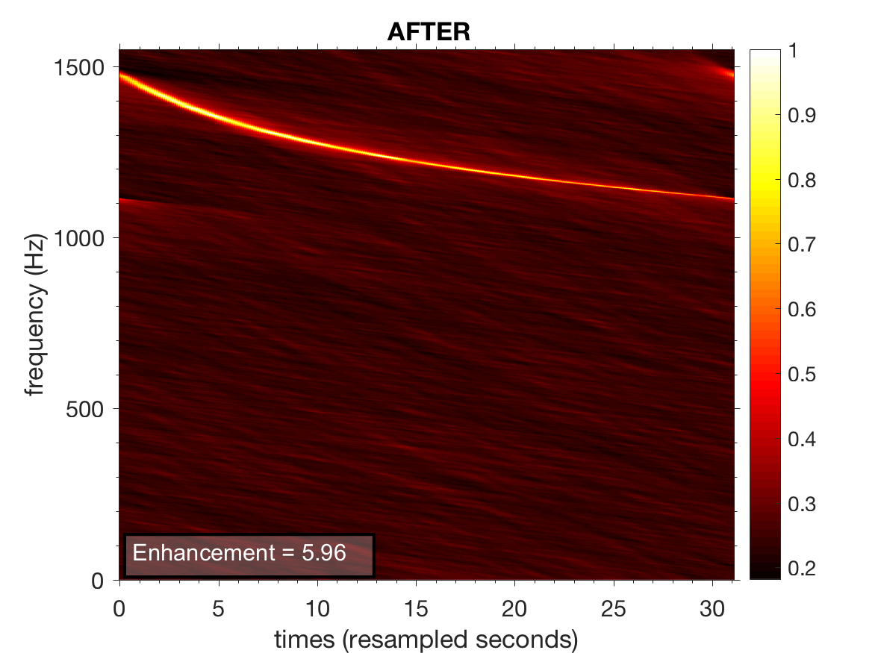
SIG + NOISE
Power Spectrum
2D-FFT
SIG + NOISE
FILTER
*
2D-FFT
MULTIPLICATION
Magnitude 2D-FFT
ENHANCED
2D-FFT
INV. 2D-FFT
ENHANCED
Power Spectrum

