Slide 1
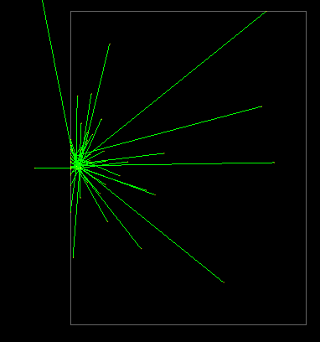
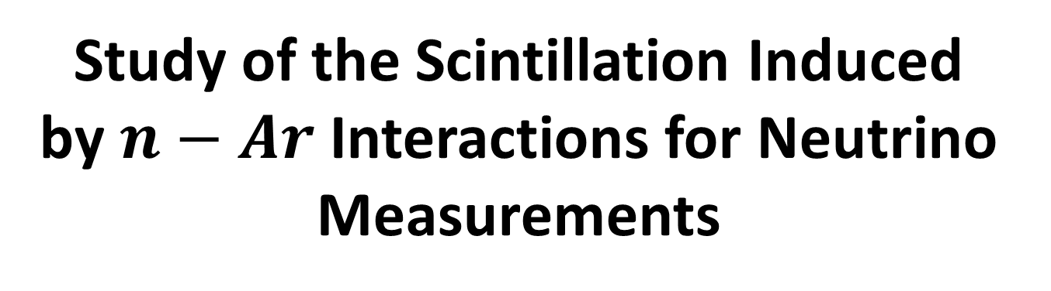
Study of the Scintillation Induced by $n−Ar$ Interactions for Neutrino Measurements
1
A. Ben Porat
Tel Aviv University – Student Seminar July 2025
avivbenporat@mail.tau.ac.il

Slide 2
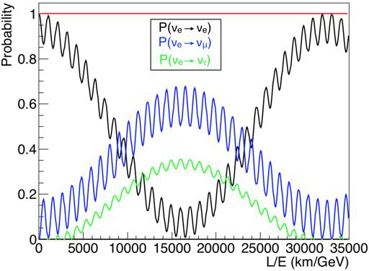
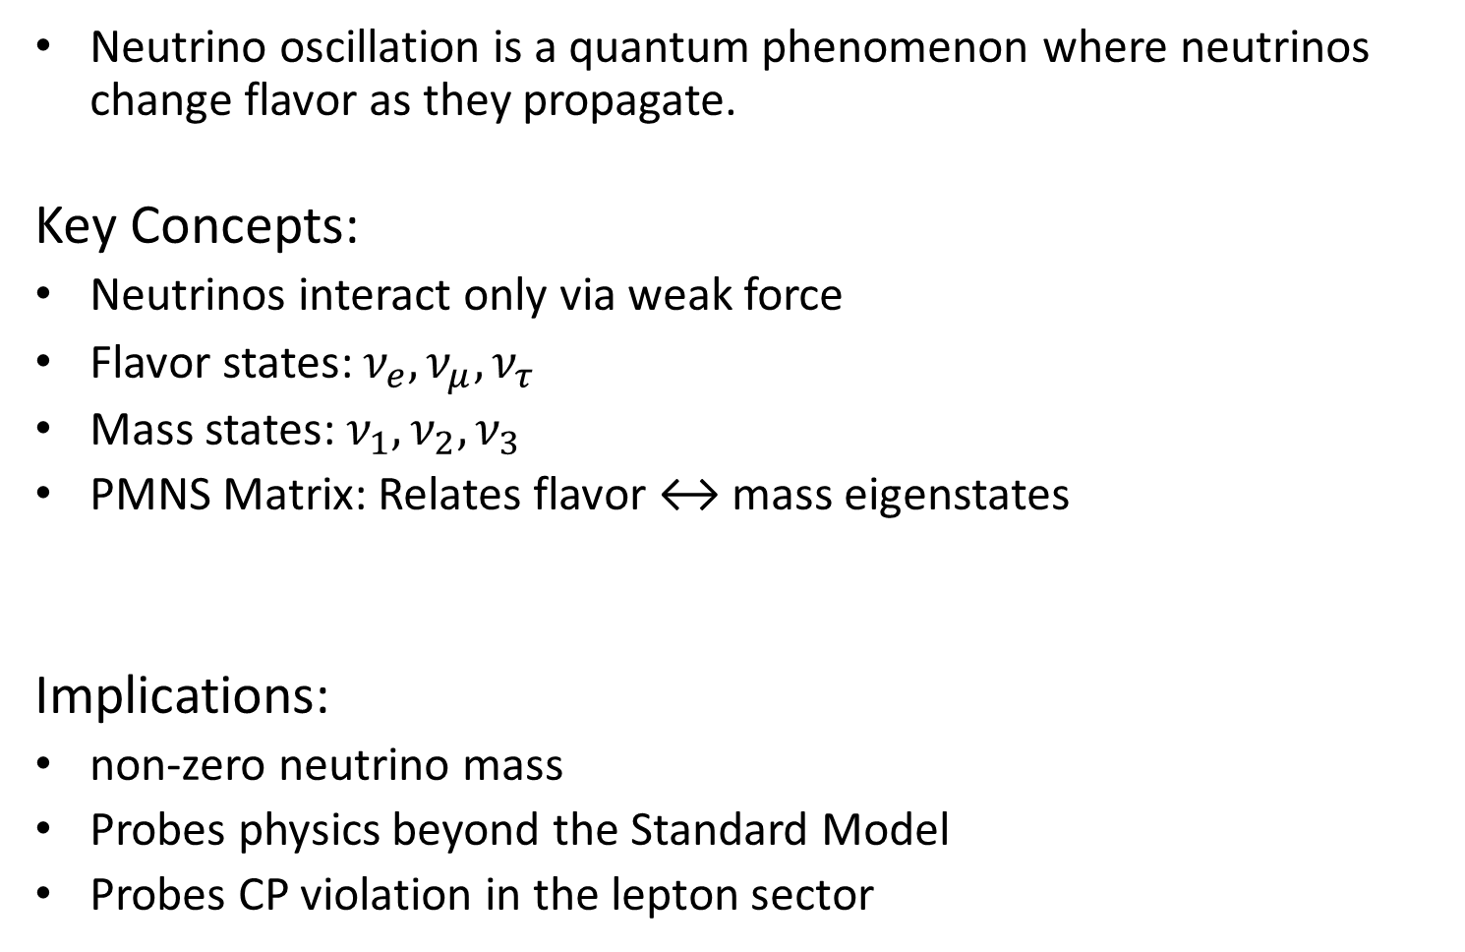
Background Neutrino Oscillation
Neutrino oscillation is a quantum phenomenon where neutrinos change flavor as they propagate.
Key Concepts:
Neutrinos interact only via weak force
Flavor states: $ν_{e}, ν_{μ}, ν_{τ}$
Mass states: $ν_{1},ν_{2},ν_{3}$
PMNS Matrix: Relates flavor ↔ mass eigenstates
Implications:
non-zero neutrino mass
Probes physics beyond the Standard Model
Probes CP violation in the lepton sector
P. Fernandez PhD Thesis

Slide 3
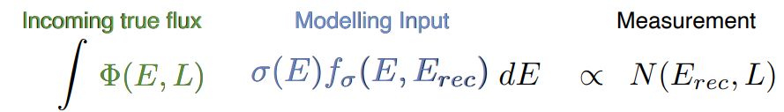
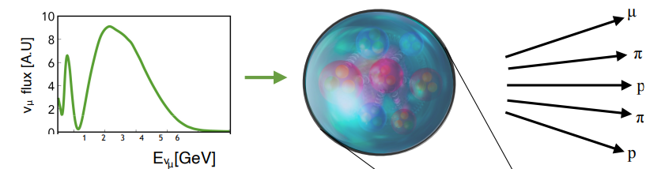








Neutrino detection challenge
Neutrinos have a very low cross section for interaction since they only interact weakly
They are neutral and thus invisible in our detectors
Need to study them via their interaction products

Slide 4
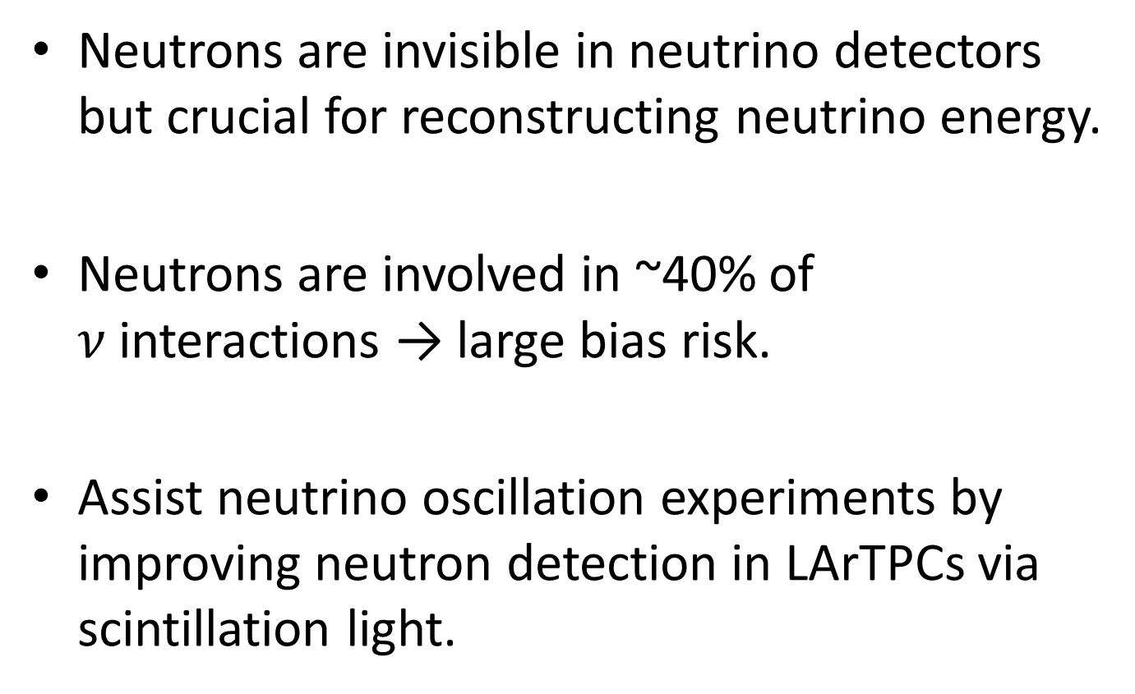
Motivation
Neutrons are invisible in neutrino detectors but crucial for reconstructing neutrino energy.
Neutrons are involved in ~40% of $ν$interactions → large bias risk.
Assist neutrino oscillation experiments by improving neutron detection in LArTPCs via scintillation light.

Slide 5
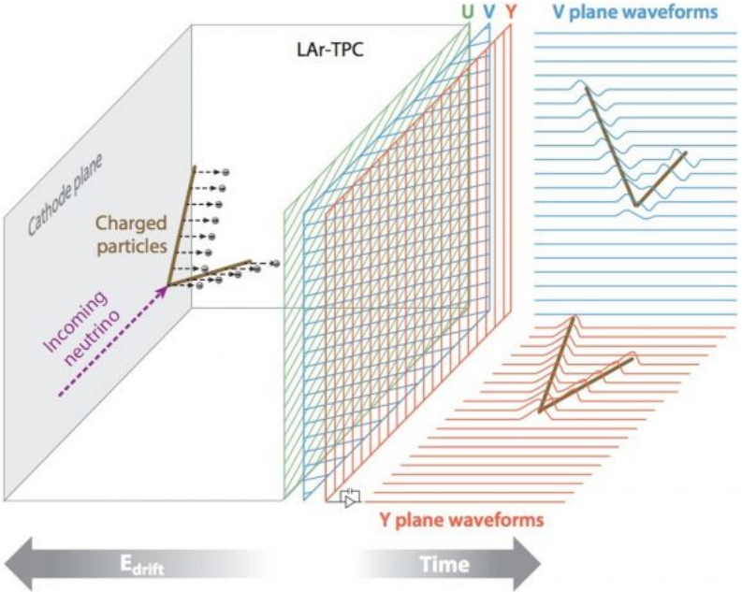
Background Liquid Argon Time Projection Chambers (LArTPCs)
Scintillation Light
PMT
Working mechanism:
• Incoming charged particle ionizes the LAr
• Ionization electrons drift to collection wires which readout the charge, providing x,y coordinates of the ionization electrons
• Scintillation light provides t₀ of the interaction, which enables to determine the drift distance and the z (drift direction) coordinates
Notes:
LArTPCs are high-resolution detectors used to map 3D tracks of particles

Slide 6
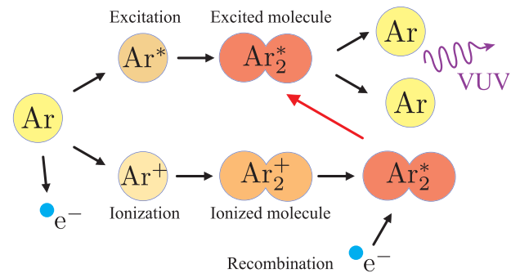
Background Scintillation in Liquid Argon
2009 J. Phys.: Conf. Ser. 160 012032
Notes:
The passage of ionizing particles in LAr can produce excited$Ar_{2}^{∗}$, or ionized, $Ar_{2}^{+}$ , argon dimers.
$Ar_{2}^{+}$ can recombine with a thermalized electron to form $Ar_{2}^{∗}$, which in turn decay non-radiatively to either a singlet or triplet state.
The de-excitation of these states leads to the emission of scintillation light of approximately the same wavelength – 128nm, while their lifetimes are very different: ~ 7ns for the singlet and ~1.5$μs$ for the triplet state
The presence of an electric field can drift thermalized electrons, preventing them from recombining and reducing the scintillation yield

Slide 7
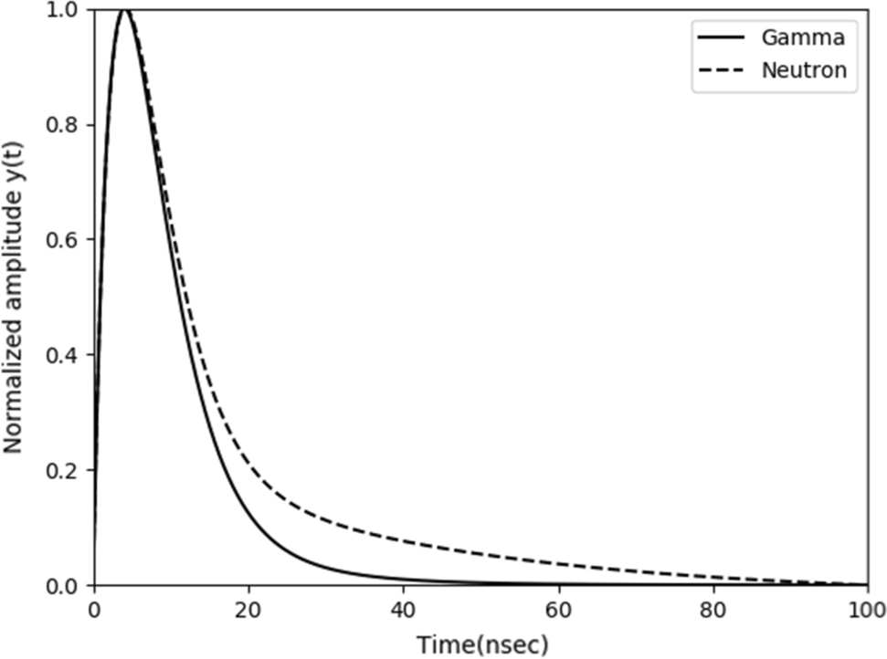
Particle Identification by Scintillation pulse shape
Analog Integr Circ Sig Process 111, 387–402 (2022)

Slide 8
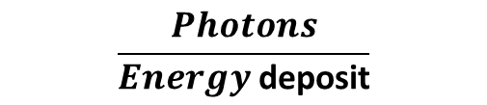
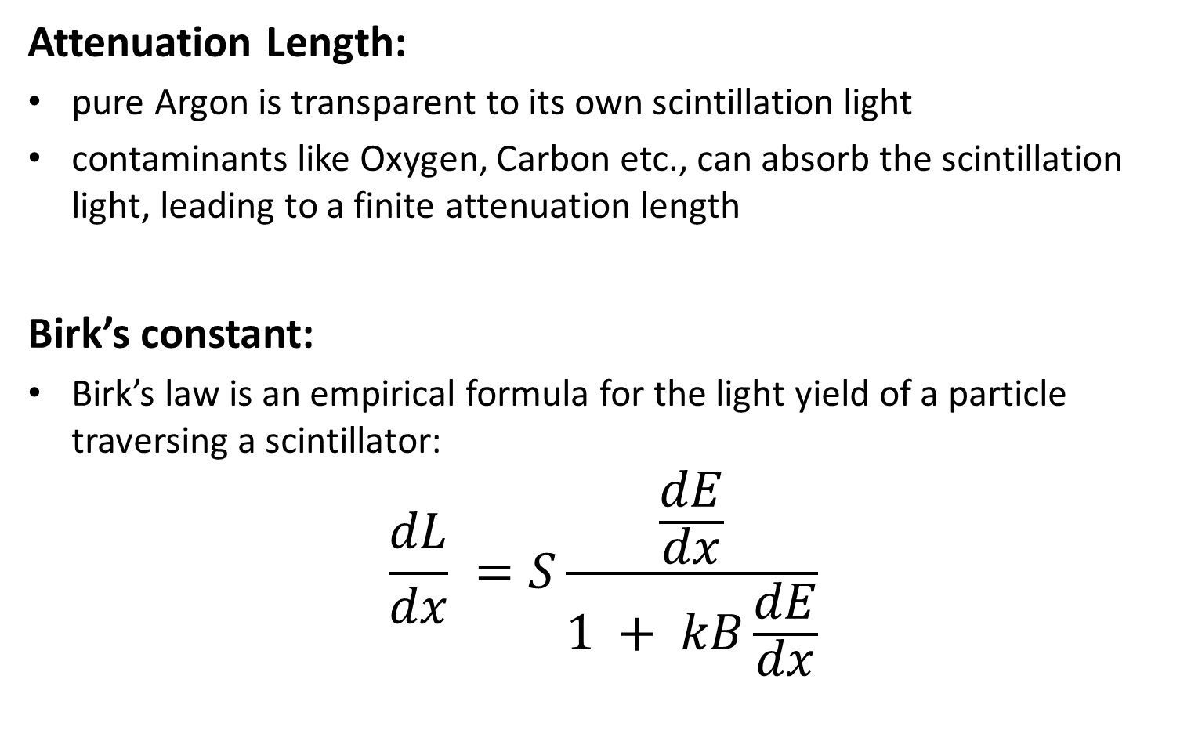
Background Optical properties of LAr detectors
Attenuation Length:
pure Argon is transparent to its own scintillation light
contaminants like Oxygen, Carbon etc., can absorb the scintillation light, leading to a finite attenuation length
Birk’s constant:
Birk’s law is an empirical formula for the light yield of a particle traversing a scintillator:
$$\frac{dL}{dx} =S\frac{\frac{dE}{dx}}{1 + kB\frac{dE}{dx}}$$
Birk’s coefficient
$$\frac{Photons}{Energy \text{deposit}}$$

Slide 9
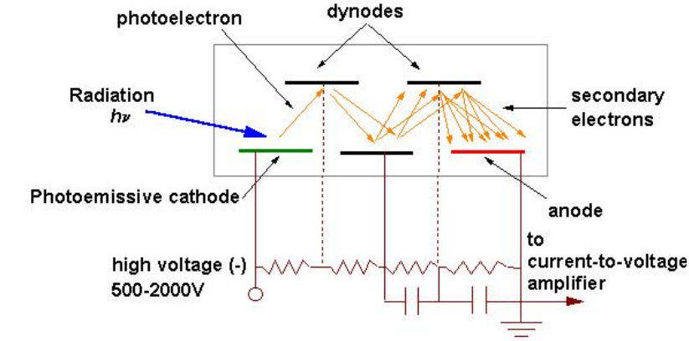
Background Optical properties of LAr detectors
Photomultiplier Tubes (PMTs)
Source
Working mechanism:
An incident photon hits the cathode and emits an electron via Photoelectric effect
A series of dynodes at increasing voltages cause cascade of secondary electrons
A voltage signal is measured in the anode
Photoelectron = signal measured from one photon absorbed by the PMT
In LAr experiments a Wavelength Shifter(WLS) is used to shift scintillation to visible spectrum
Notes:
Explain how PMTs work, and about photoelectrons. Also mention typical PMTs not sensitive to Ar scintillation wavelength so need TPB wavelength shifter

Slide 10
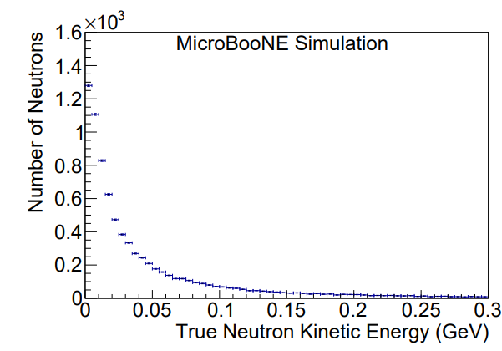
Background Neutron-Ar Interactions
Eur. Phys. J. C 84, 1052 (2024)
In the relevant energy regime, there are 2 types of interactions:
Elastic: causing a recoil Ar nucleus
Inelastic: neutron interaction with nucleons

Slide 11
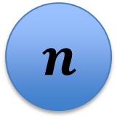

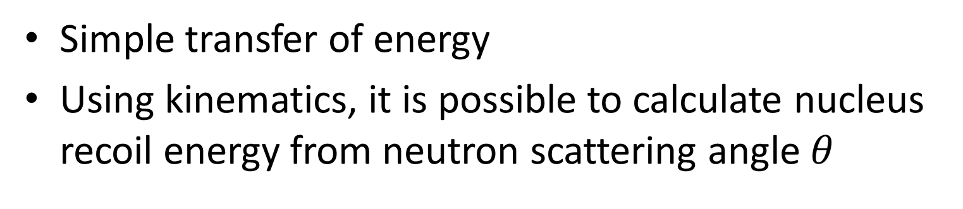
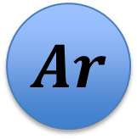
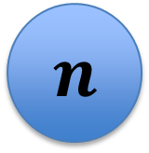

Background Elastic Scattering in LAr
Simple transfer of energy
Using kinematics, it is possible to calculate nucleus recoil energy from neutron scattering angle $θ$
$$n$$
$$n$$
$$Ar$$
$$θ$$
$$Ar$$

Slide 12
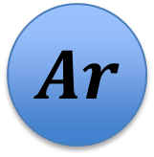
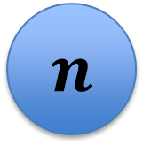

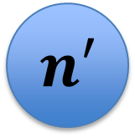
Background Inelastic Scattering in LAr
(n,n′): neutron creates Ar-41 excited state
De-excites via γ-ray emission and neutron isotropic scattering
$$n′$$
$$n$$
$$Ar$$
$$γ$$

Slide 13
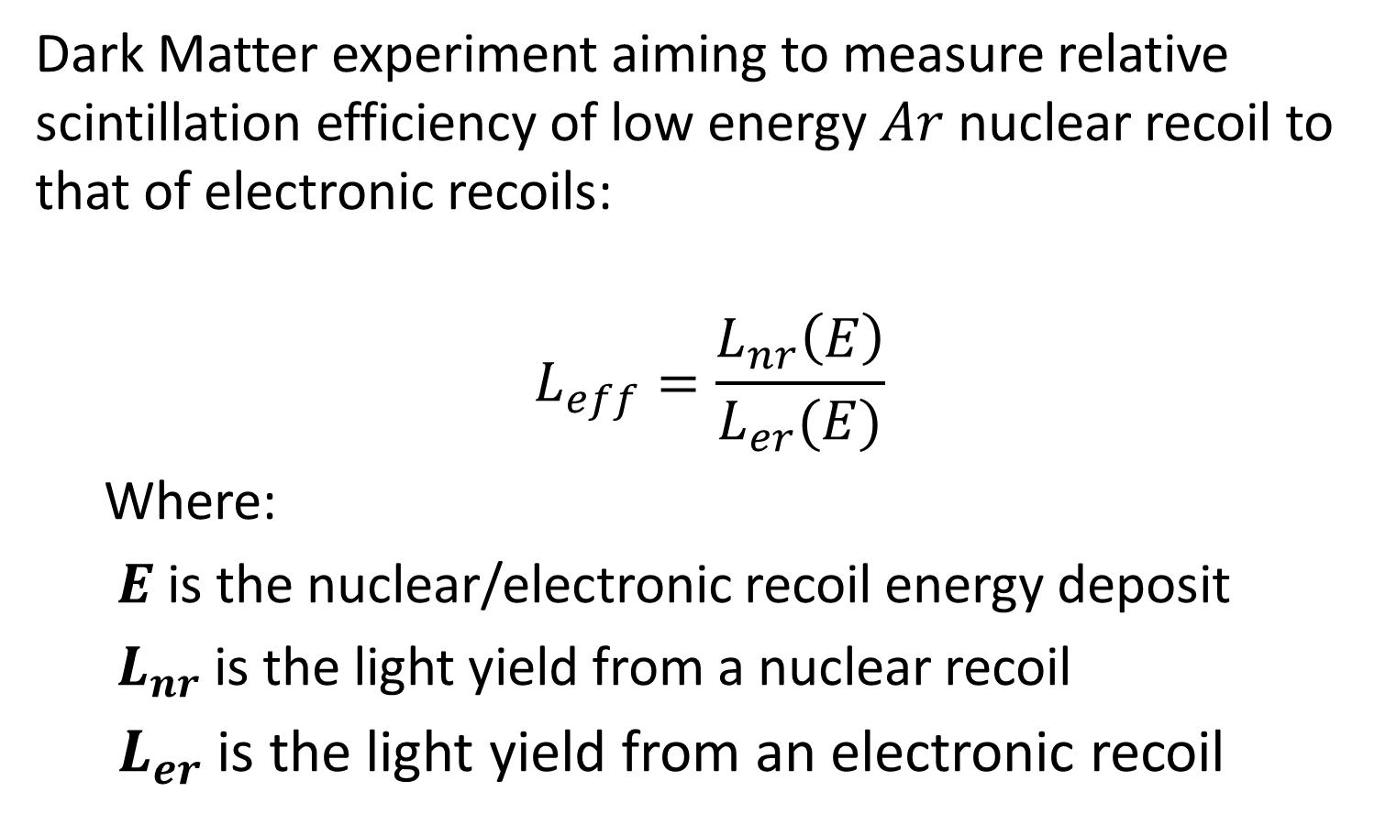
Geant4 Simulation Validation Energy deposit calibration
Creus experiment overview
Dark Matter experiment aiming to measure relative scintillation efficiency of low energy $Ar$ nuclear recoil to that of electronic recoils:
$$L_{eff}=\frac{L_{nr}\left(E\right)}{L_{er}(E)}$$
Where:
$E$is the nuclear/electronic recoil energy deposit
$L_{nr}$ is the light yield from a nuclear recoil
$L_{er}$ is the light yield from an electronic recoil

Slide 14
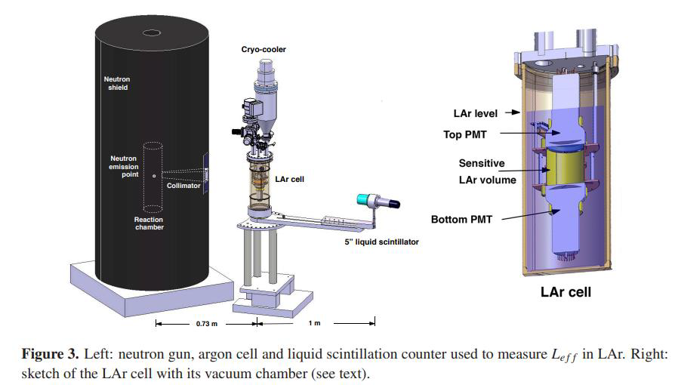
Geant4 Simulation Validation Energy deposit calibration
Creus Experiment Setup
W. Creus et al 2015 JINST 10 P08002
LAr cell with 2 PMTs and a wavelength shifter.
Neutron source: 2.45 MeV dd-fusion, collimated beam.
Liquid scintillator used to tag scattered neutron.

Slide 15
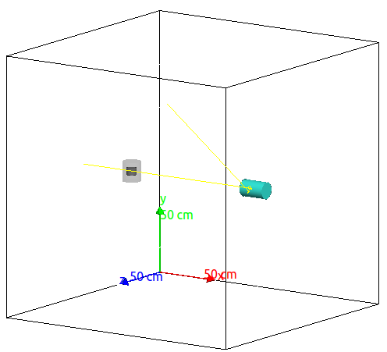
Geant4 Simulation Validation Energy deposit calibration
Geant4 setup
Neutron Beam
Liquid Scintillator - Neutron detector
LAr Cells
Notes:
Only the main components simulated

Slide 16
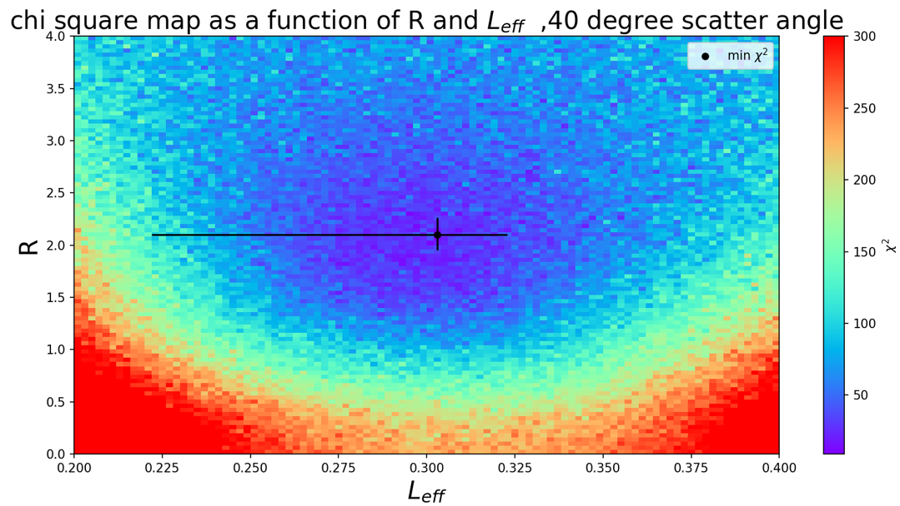
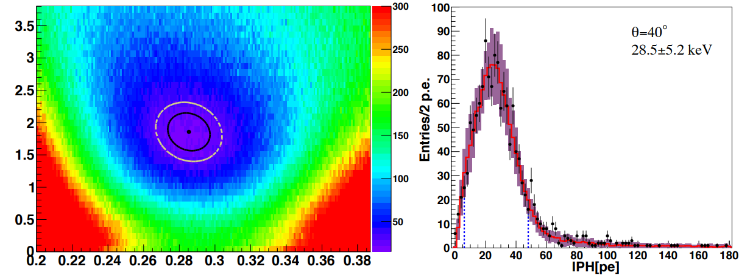


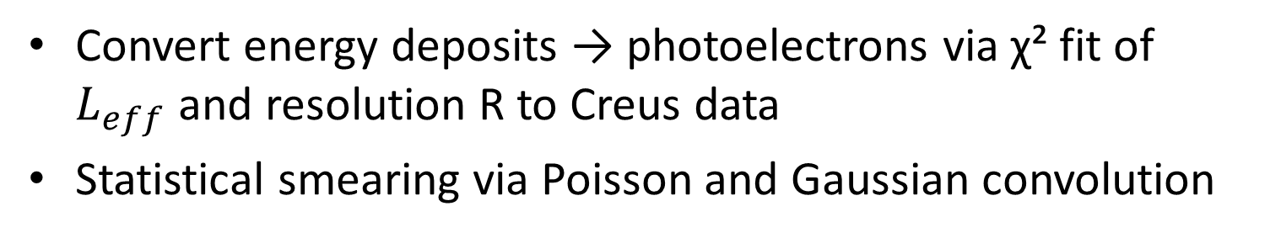
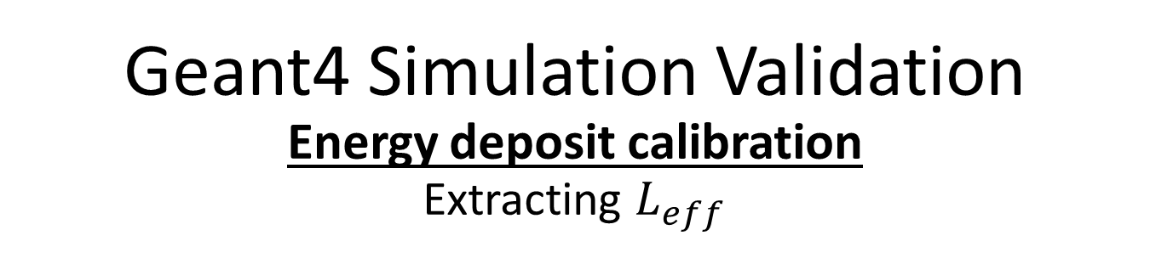
Geant4 Simulation Validation Energy deposit calibration
Extracting $L_{eff}$
Convert energy deposits → photoelectrons via χ² fit of $L_{eff}$and resolution R to Creus data
Statistical smearing via Poisson and Gaussian convolution
Geant4 simulation – A.B.P
W. Creus et al 2015 JINST 10 P08002

Slide 17
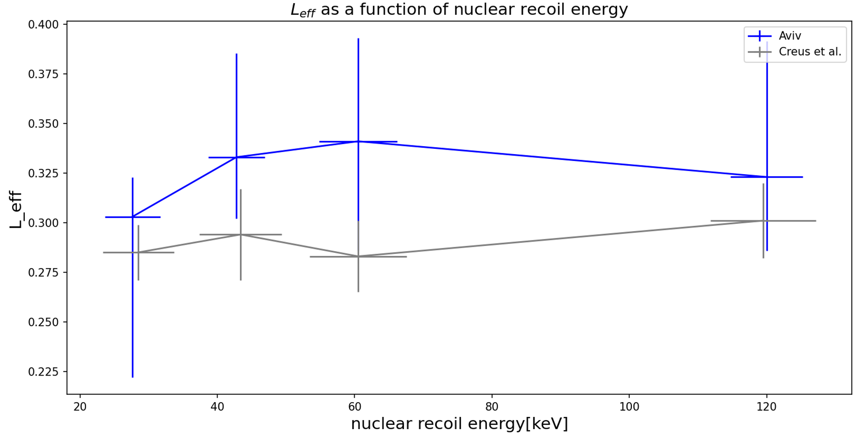
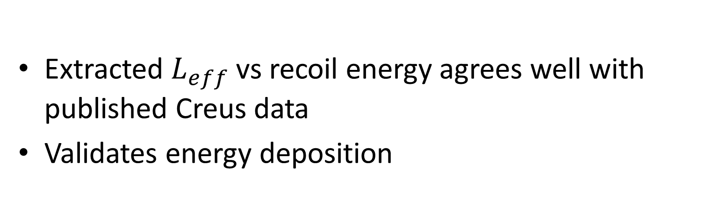
Geant4 Simulation Validation Energy deposit calibration
Simulation comparison with data
Extracted $L_{eff}$vs recoil energy agrees well with published Creus data
Validates energy deposition

Slide 18
Geant4 Simulation Validation Optical Photon Calibration
After validating our simulation in terms of energy deposit, we need to validate it in terms of optical photons produced
We use DarkSide and ARIS γ-ray scintillation data to tune optical parameters

Slide 19
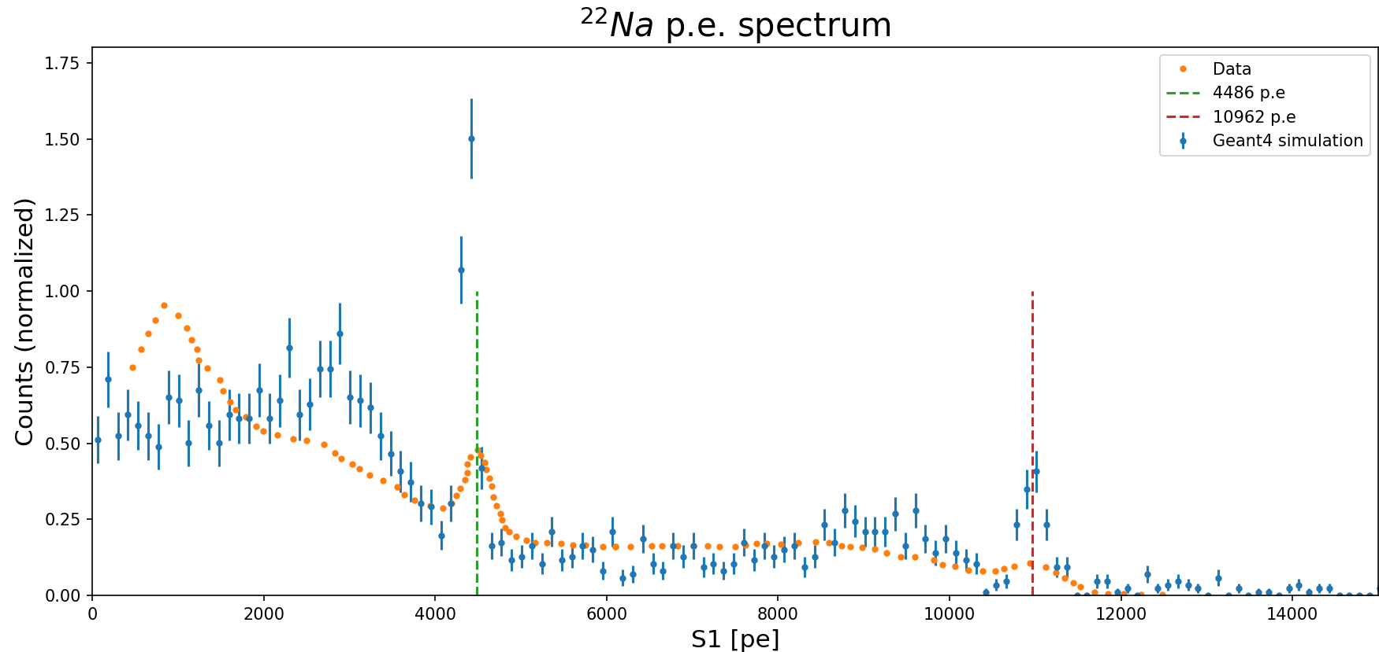
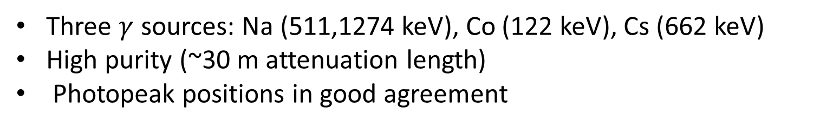
Geant4 Simulation Validation Optical Photon Calibration
DarkSide Comparison
Three $γ$ sources: Na (511,1274 keV), Co (122 keV), Cs (662 keV)
High purity (~30 m attenuation length)
Photopeak positions in good agreement

Slide 20
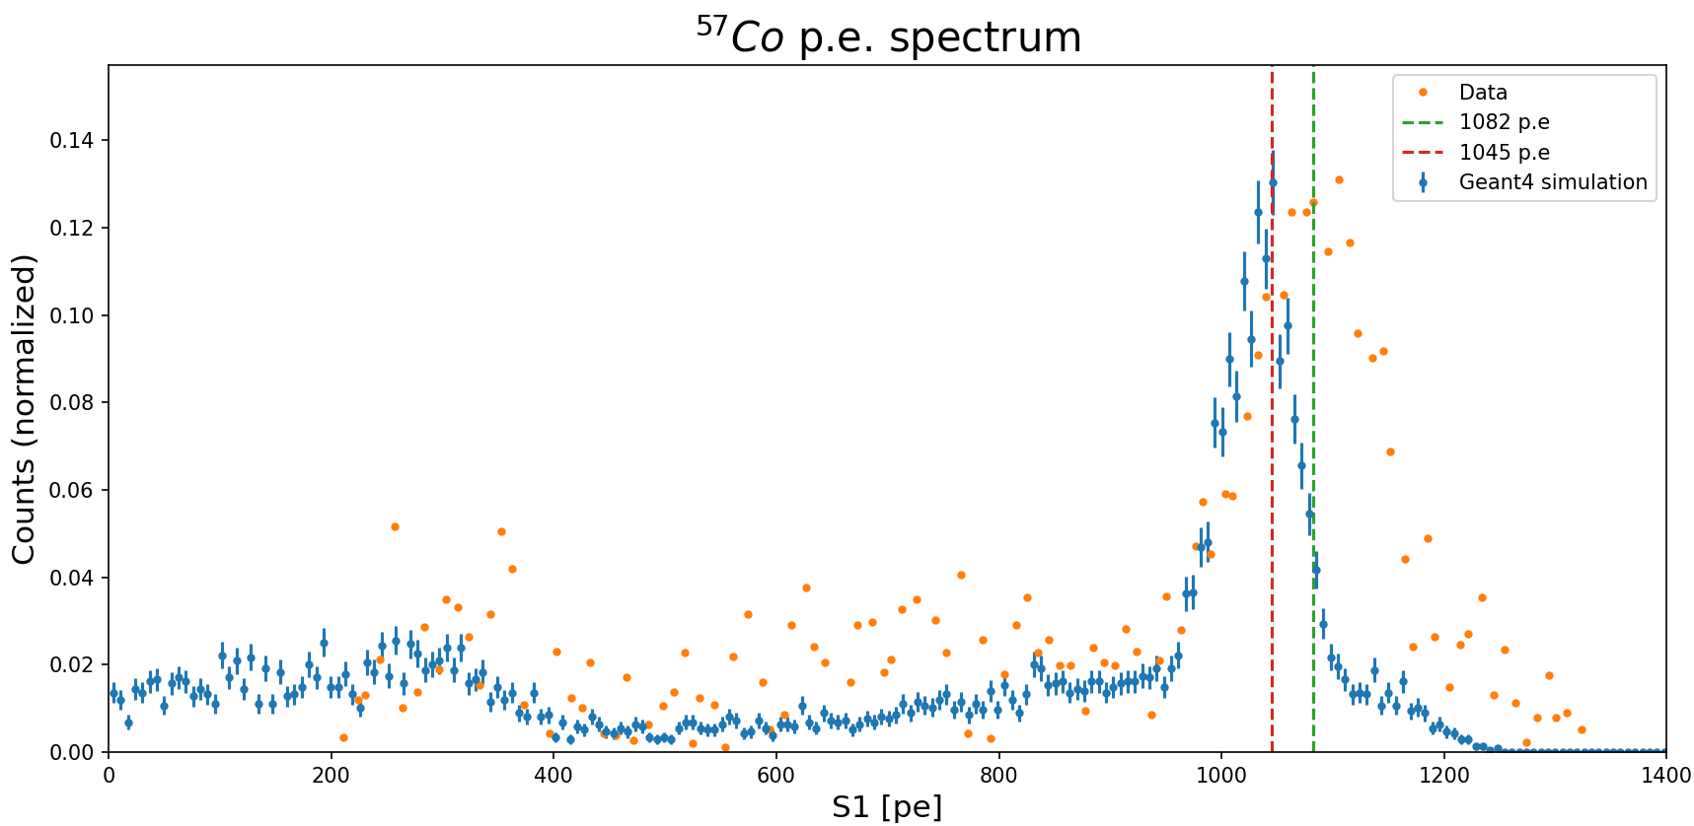
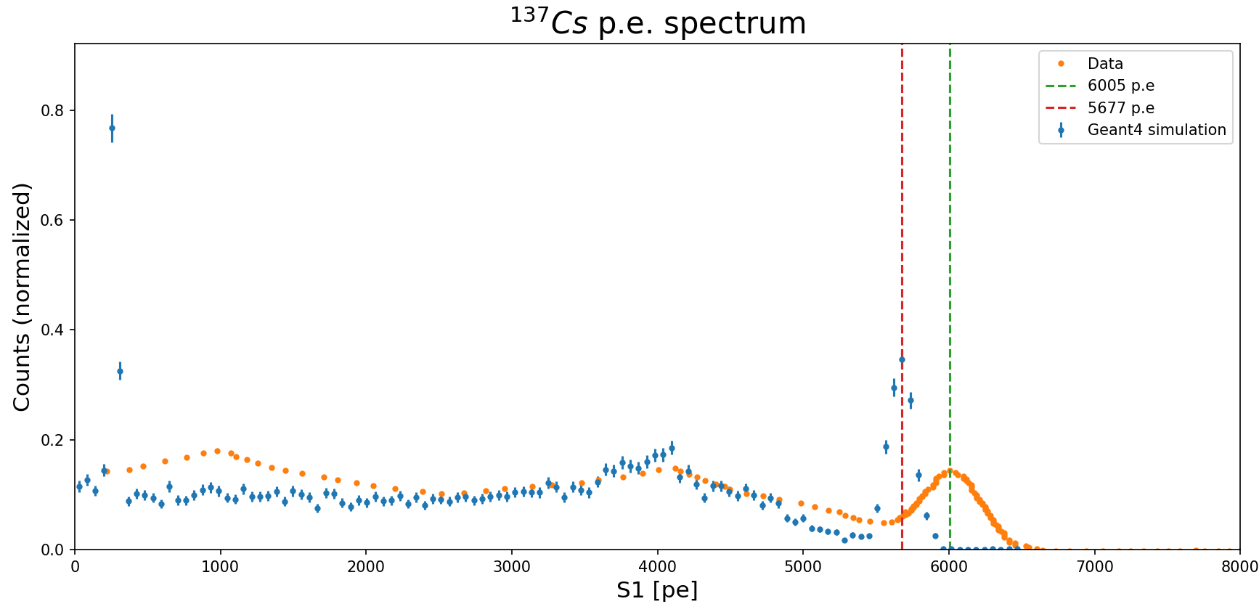
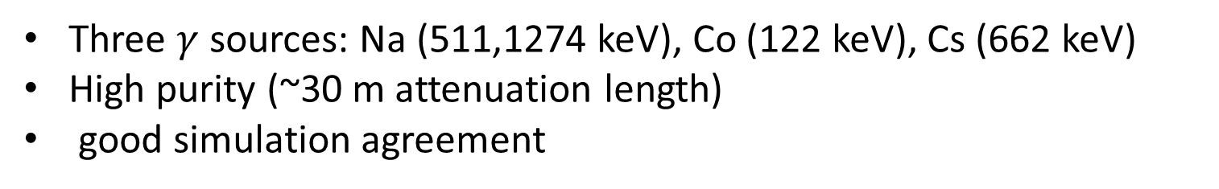
Geant4 Simulation Validation Optical Photon Calibration
DarkSide Comparison
Three $γ$ sources: Na (511,1274 keV), Co (122 keV), Cs (662 keV)
High purity (~30 m attenuation length)
good simulation agreement

Slide 21
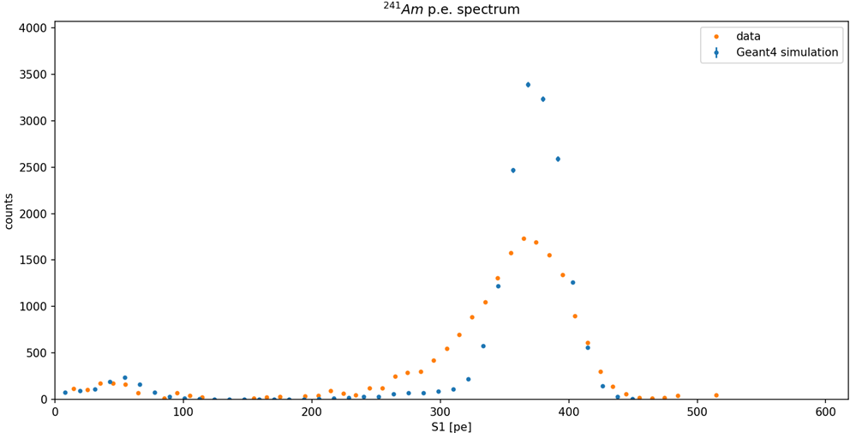
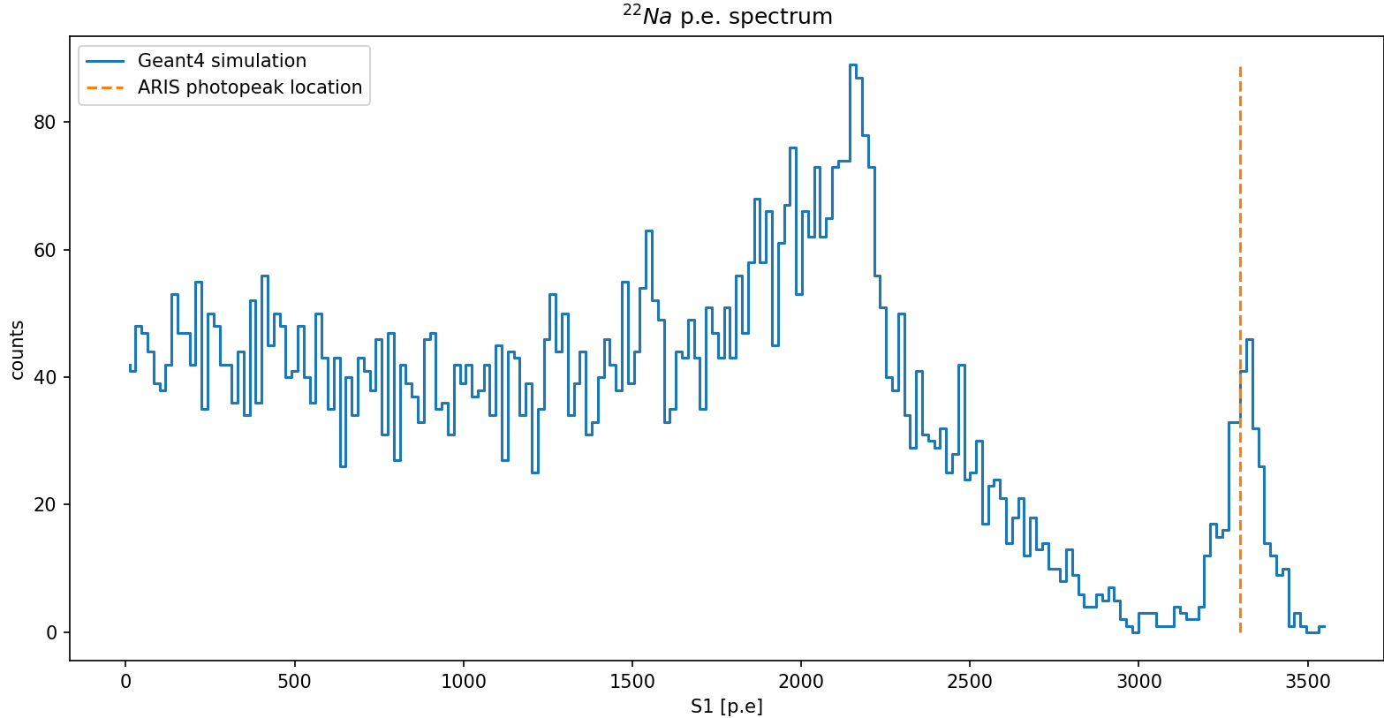
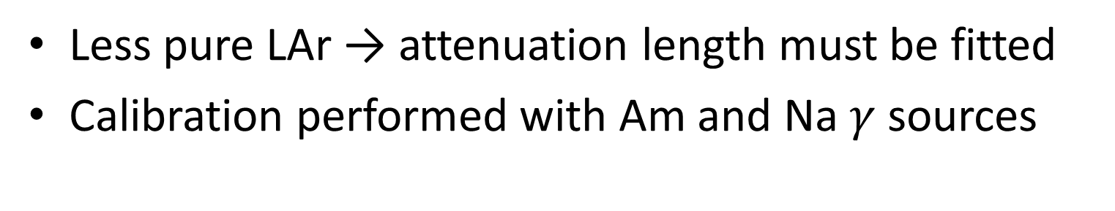
Geant4 Simulation Validation Optical Photon Calibration
ARIS Comparison
Less pure LAr → attenuation length must be fitted
Calibration performed with Am and Na $γ$ sources

Slide 22
Challenges Of Simulating Neutron-Induced Scintillation A model problem
Birk’s model too limited:
Same parameters for all particles
Can’t accurately describe different particles’ scintillation at the same time
A more realistic model: Hong model
Separates electronic & nuclear de-excitation behaviour
Data on LAr is lacking for full parameterization

Slide 23
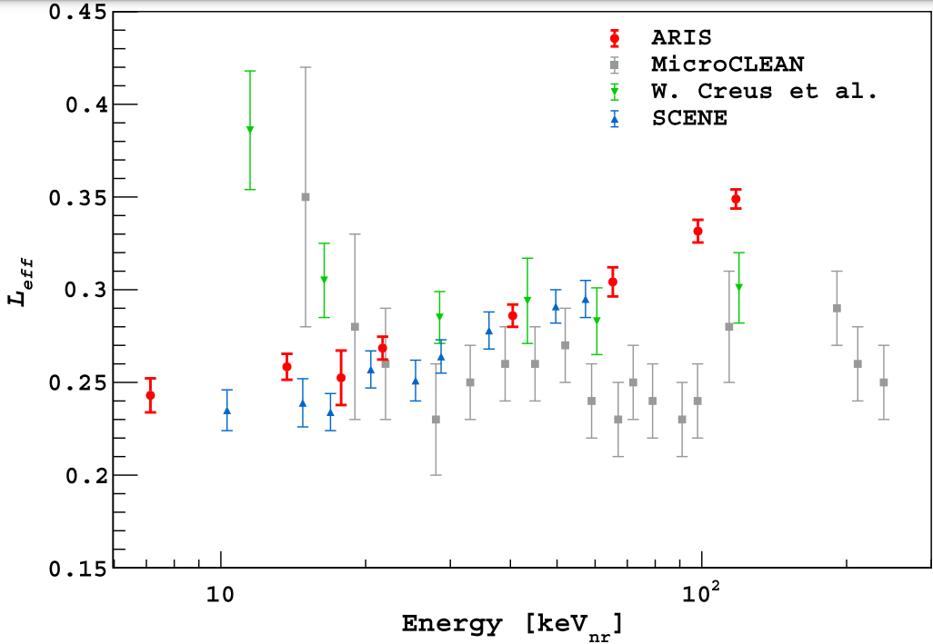
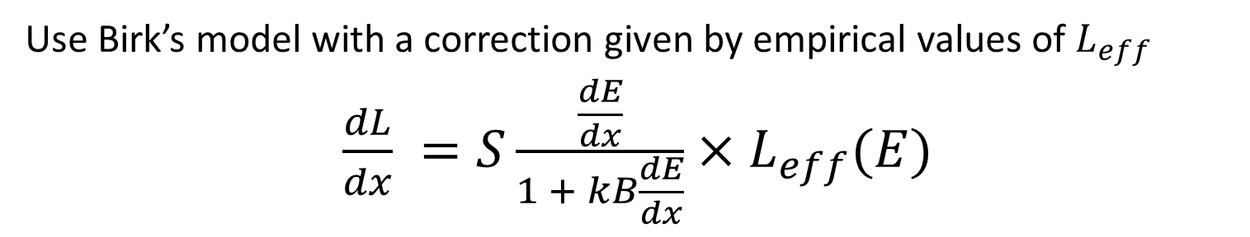
Correction Strategy
Use Birk’s model with a correction given by empirical values of $L_{eff}$
$\frac{dL}{dx} =S\frac{\frac{dE}{dx}}{1 + kB\frac{dE}{dx}}×L_{eff}(E)$
PHYS REV D 97, 112005 (2018)

Slide 24
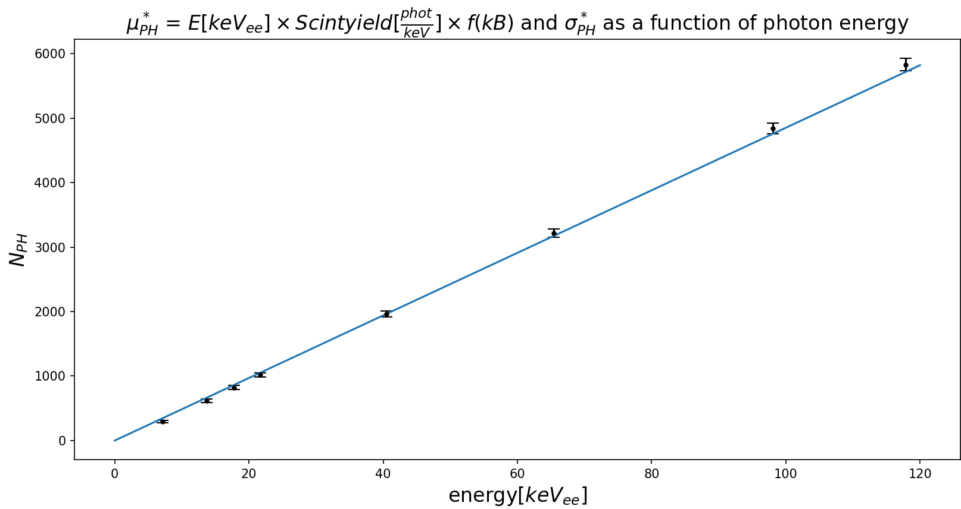

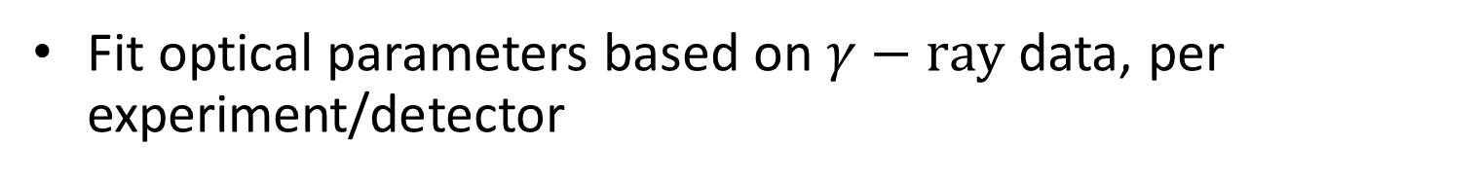
Correction Strategy The correction $N_{pe} →N_{pe}^{∗}$
Fit optical parameters based on $γ−ray$ data, per experiment/detector
Notes:
In each event i, we use GEANT4 to simulate a neutron impinged on LAr with energy $E_{n}$, depositing $ΔE_{i}$ in the desired reaction, and producing $N_{ph}$ scintillation photons. These scintillation photons propagate to the optical sensors and produce $N_{pe}$ photoelectrons.
• Since we do not trust $N_{ph}$, we make the correction $N_{pe}→N_{pe}^{∗}=N_{pe}×\frac{N_{ph}^{∗}}{N_{ph}}$ , where $N_{ph}^{∗}$is the number of scintillation photons that should have been produced at event i based on ΔEᵢ — based on empirical data.

Slide 25

Correction Strategy The correction $N_{pe} →N_{pe}^{∗}$
On event-by-event basis, make the correction:
$N_{pe}→N_{pe}^{∗}=N_{pe}×\frac{N_{ph}^{∗}}{N_{ph}}$
$N_{ph}^{∗}=(a×E_{dep}+b)×L_{eff}(E_{dep})$
Number of photons which should have been produced
Number of photoelectron measured
Number of photons produced
Fit parameters
Notes:
In each event i, we use GEANT4 to simulate a neutron impinged on LAr with energy $E_{n}$, depositing $ΔE_{i}$ in the desired reaction, and producing $N_{ph}$ scintillation photons. These scintillation photons propagate to the optical sensors and produce $N_{pe}$ photoelectrons.
• Since we do not trust $N_{ph}$, we make the correction $N_{pe}→N_{pe}^{∗}=N_{pe}×\frac{N_{ph}^{∗}}{N_{ph}}$ , where $N_{ph}^{∗}$is the number of scintillation photons that should have been produced at event i based on ΔEᵢ — based on empirical data.

Slide 26
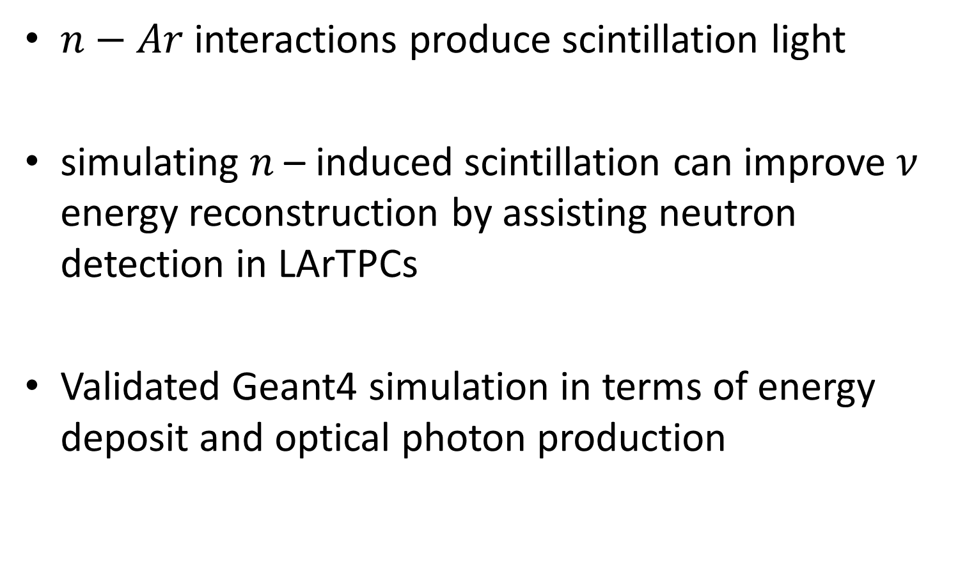
Summary
$n−Ar$ interactions produce scintillation light
simulating $n$ – induced scintillation can improve $ν$ energy reconstruction by assisting neutron detection in LArTPCs
Validated Geant4 simulation in terms of energy deposit and optical photon production

Slide 27
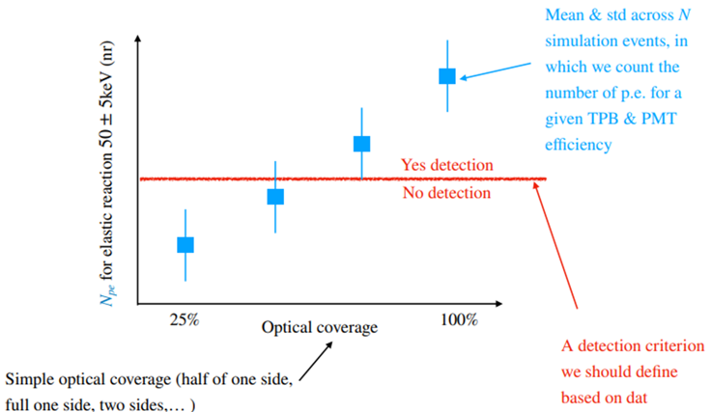
Future goals

Slide 28
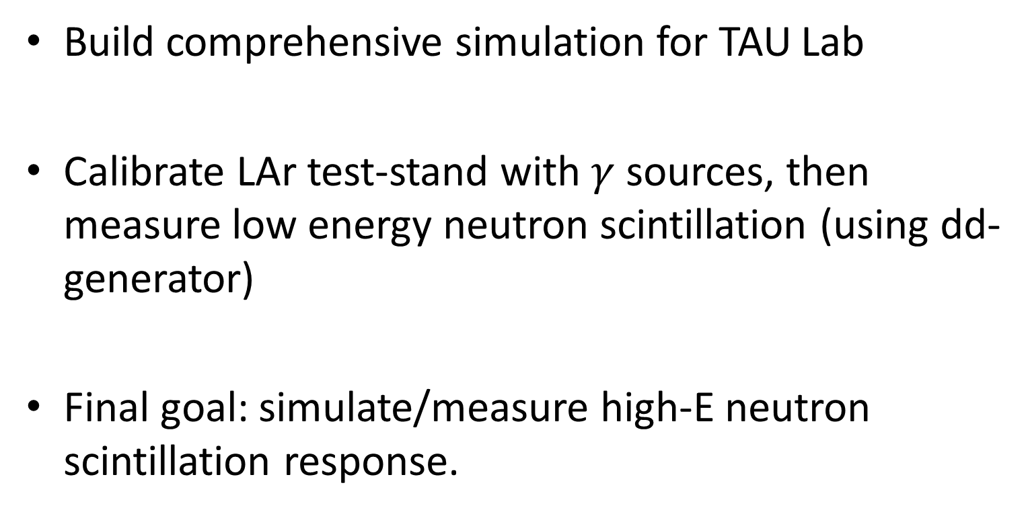
Future goals
Build comprehensive simulation for TAU Lab
Calibrate LAr test-stand with $γ$ sources, then measure low energy neutron scintillation (using dd-generator)
Final goal: simulate/measure high-E neutron scintillation response.

Slide 29
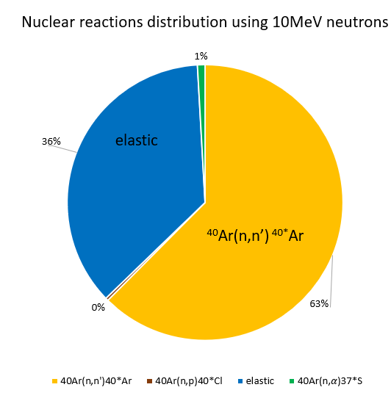
Background Interaction type breakdown
Distribution of interaction types at 10 MeV shows dominance of elastic + (n,n').
Important for modeling expected light yields and neutron ID.

Slide 30
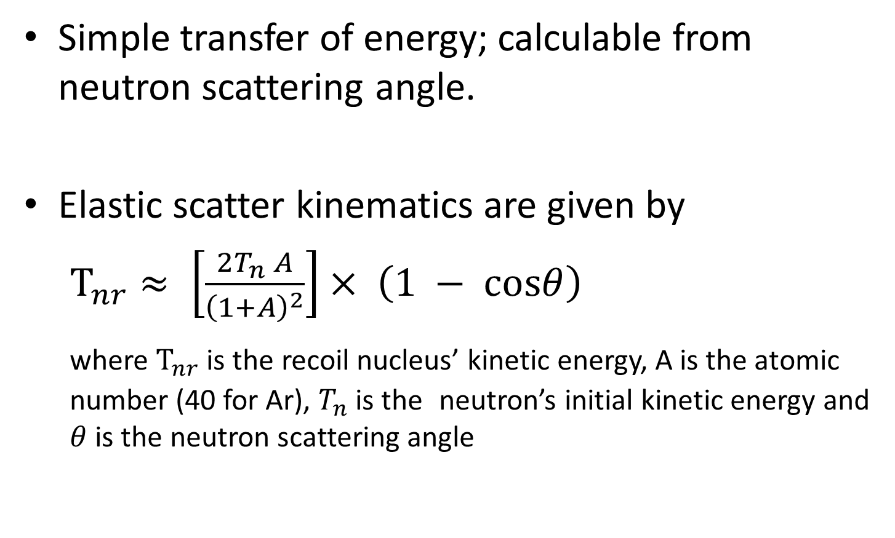
Background Elastic Scattering in LAr
Simple transfer of energy; calculable from neutron scattering angle.
Elastic scatter kinematics are given by
$T_{nr}≈ \left[\frac{2T_{n} A}{{\left(1+A\right)}^{2}}\right]× \left(1 − cosθ\right)$
where $T_{nr}$ is the recoil nucleus’ kinetic energy, A is the atomic number (40 for Ar), $T_{n}$is the neutron’s initial kinetic energy and $θ$ is the neutron scattering angle
Make sure to understand how to derive this

Slide 31
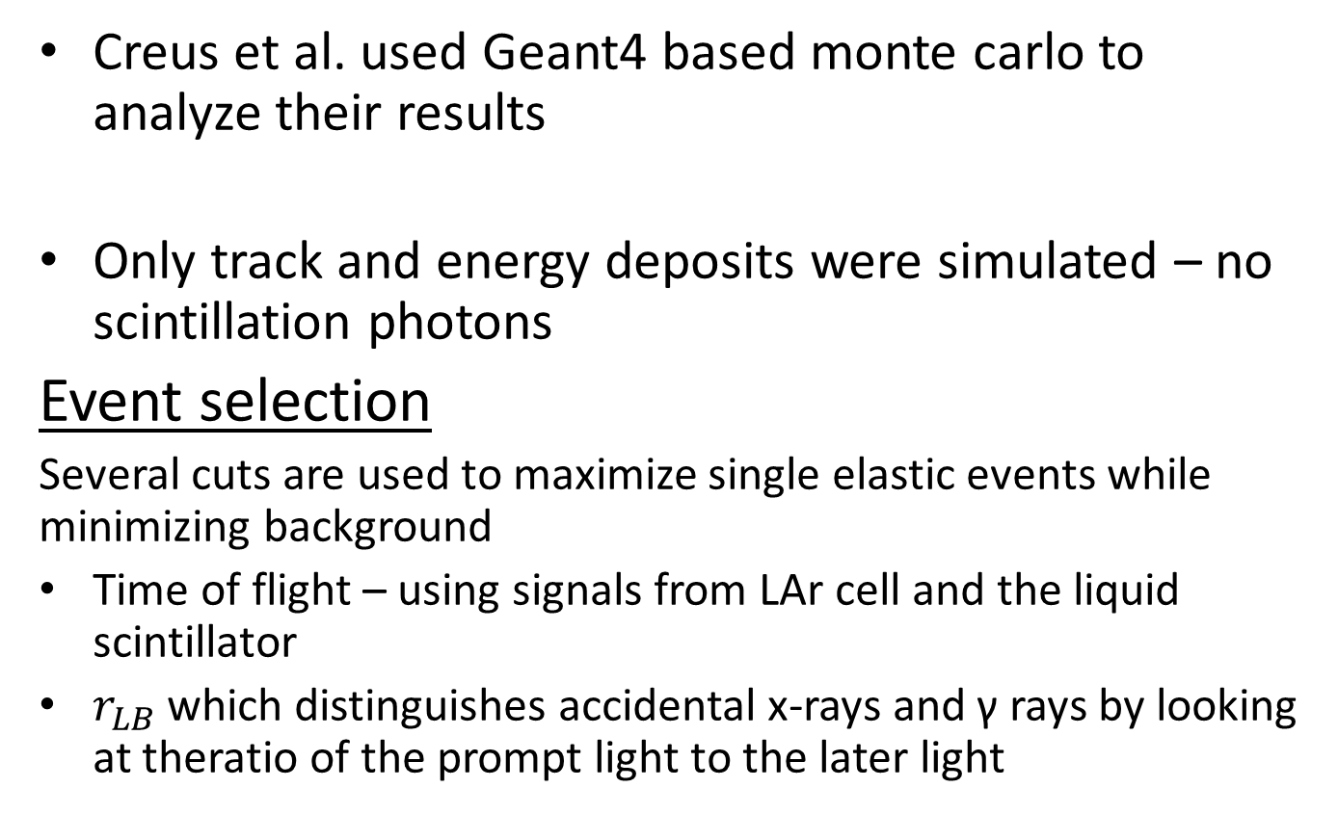
Geant4 Simulation Validation Energy deposit calibration
Creus Experiment Setup
Creus et al. used Geant4 based monte carlo to analyze their results
Only track and energy deposits were simulated – no scintillation photons
Event selection
Several cuts are used to maximize single elastic events while minimizing background
Time of flight – using signals from LAr cell and the liquid scintillator
$r_{LB}$which distinguishes accidental x-rays and γ rays by looking at theratio of the prompt light to the later light

Slide 32


Geant4 Simulation Validation Energy deposit calibration
Extracting $L_{eff}$
From energy deposit to photoelectrons
Since they did not simulate scintillation, a response function is needed to obtain number of photoelectrons (p.e.) from energy deposit:
$$N_{p.e}\left(ΔE\right)= Gauss\left(\begin{aligned}μ=L_{y}∙L_{eff}∙ΔE, \\ σ=\sqrt{R^{2}+R_{p.e}^{2}}∙\sqrt{L_{y}∙L_{eff}∙ΔE}\end{aligned}\right)$$
Measured Light Yield
Energy deposit
Resolution smearing
Resolution of 1pe PMT signal

Slide 33


Geant4 Simulation Validation Energy deposit calibration
Extracting $L_{eff}$
The best fit parameters R, $L_{eff}$ are determined via a $χ^{2}$ fit by comparing the calculated spectrum of p.e. in simulation to the data:

Slide 34
Geant4 Simulation Validation Optical Photon Calibration
DarkSide Comparison

Slide 35
Geant4 Simulation Validation Optical Photon Calibration
DarkSide Comparison

Slide 36
Geant4 Simulation Validation Optical Photon Calibration
ARIS Comparison

