Slide 1
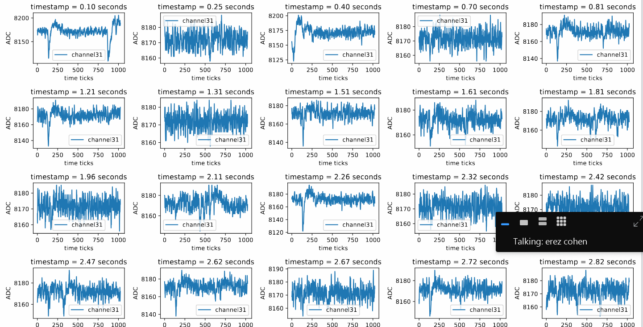
Mean and std of two sample waveforms which only include noise
mean = 8171.7880859375 std noise= 5.01024484108459
mean = 8171.9833984375 std noise= 4.289421691862734
Example of filtering for specific channel and plotting waveforms along a run

Slide 2
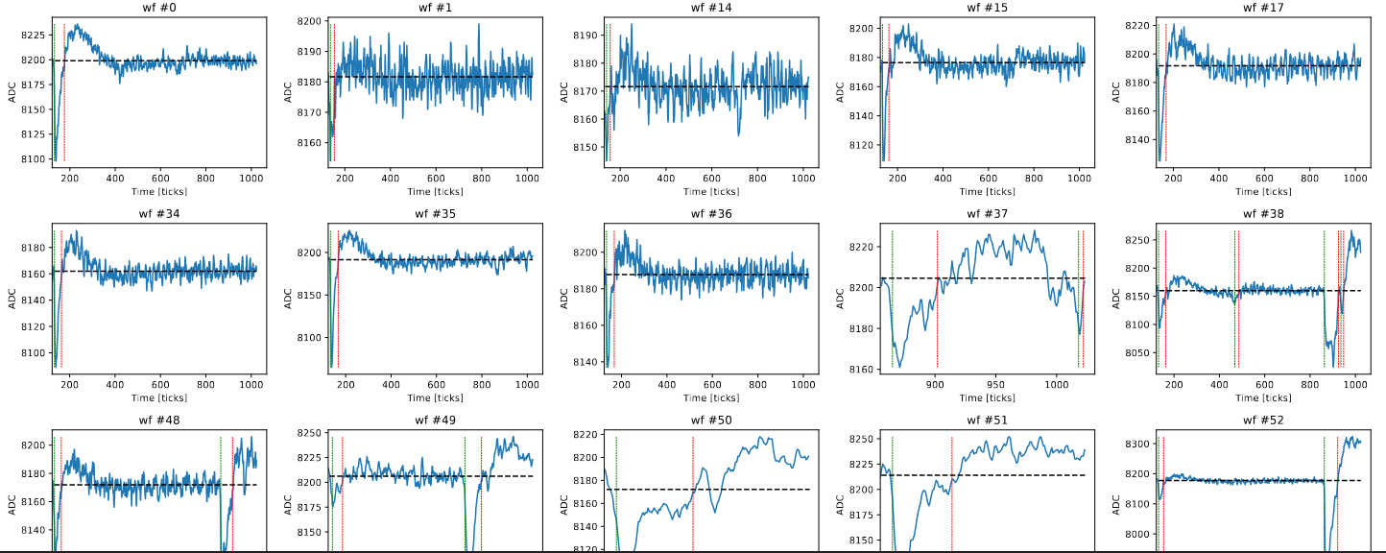
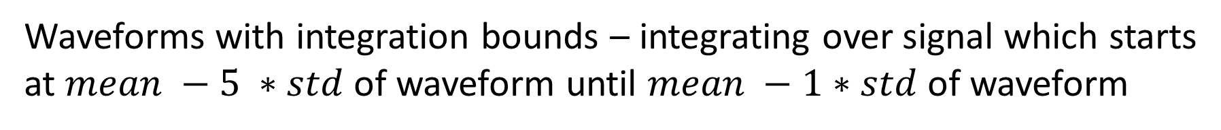
Waveforms with integration bounds – integrating over signal which starts at $mean −5 ∗std$ of waveform until $mean −1∗std$ of waveform

Slide 3
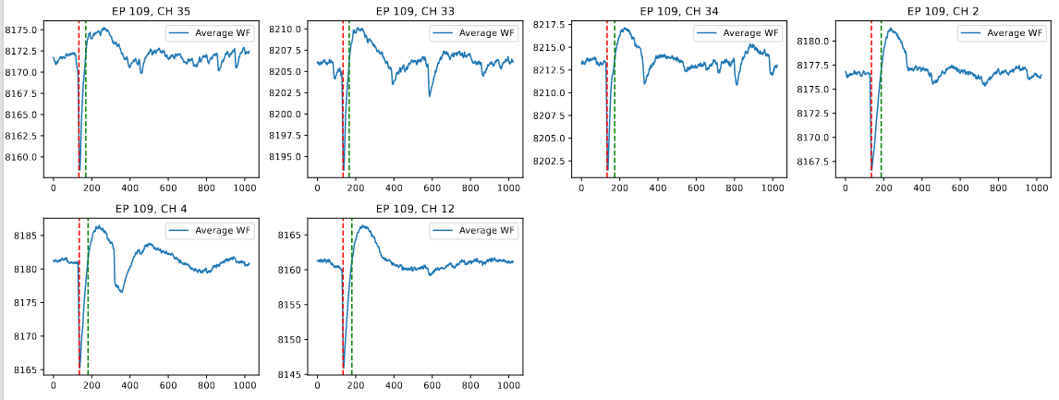
For LED calibration runs, we first average all waveforms coming from a specific endpoint,channel to find the integration windows for the charge ( ~ns coincidence because of the external trigger on LED)

Slide 4
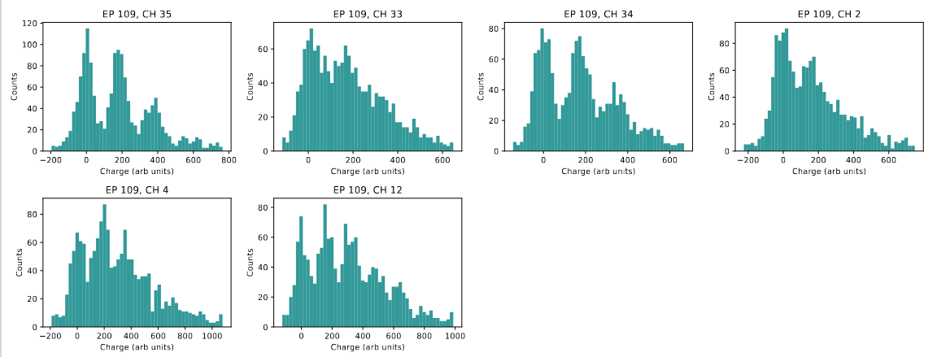
After that we can plot the charge histograms for each endpoint,channel

Slide 5
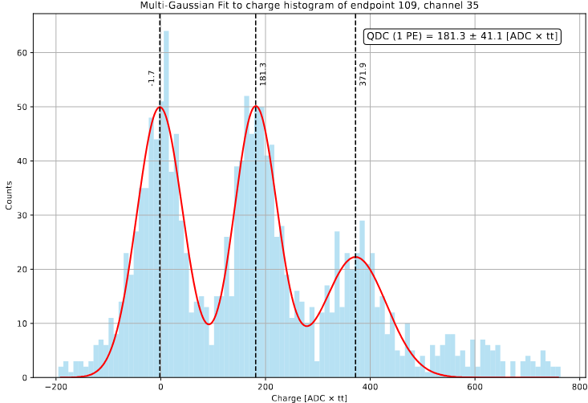

Slide 6
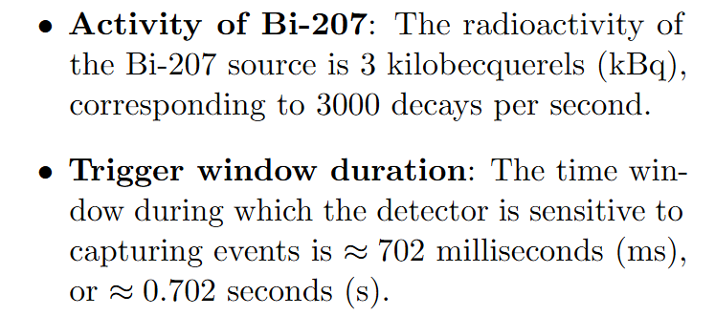
https://repository.cern/records/c1n0b-3j065

