Slide 1

Android App Remote Control Joystick Ori Abramovitch & Aviv Dimri
Advanced Programming 2 Bar-Ilan University -2021

Slide 2

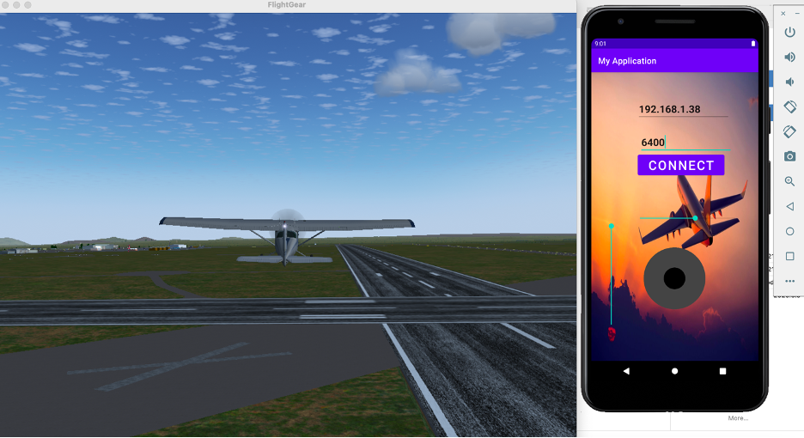
App & Flight Simulator

Slide 3
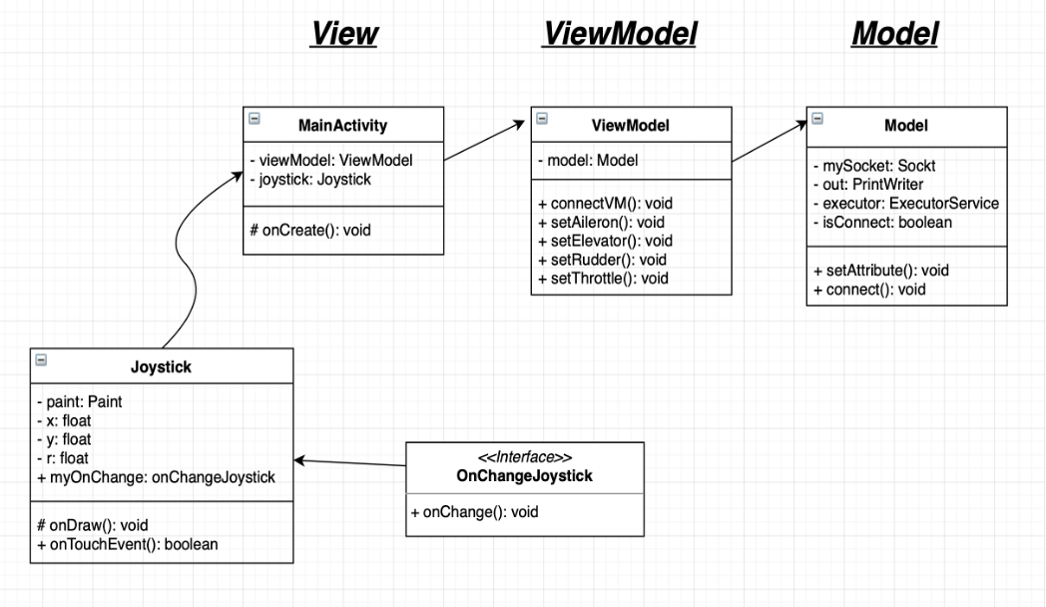
UML

