Slide 1
DoDiDo
Manage and work on todo list with group
Project Definition
Team Members:
Gal Rondel, Yuval Ben-Shaul, Aviv Nakar

Slide 2
Highlights
Product Name: DoDiDo
Product Short Description:
Make a board with cards lists that you can control and share with friends or work.
Users:
Guests, Board Creator, users
Key features:
Browse/select board, Manage board,Lock list by creator, change order of todo in list, make comments on lists, get exp and levels by completing Todos (API habitica)
Guest mode:
Guest Showcase base board without sharing it.

Slide 3
Main Pages
Home page
Welcome message and tutorial.
Board list
See all Boards, filter, search by name / status etc
Board
See cards list, manage the lists and todos within, add todos, move lists and todos and cards between,
Change backgournd color of cards, add cards, share, invite users to work as a group, etc
Board creator view
Login/Signup
Header
Welcome
Start Your Board Now!
Filter and search
board
board
Personal Boards:
board
Header
Secondary navbar

Slide 4
Main Pages UX

Slide 5
Home page – Top Fold, Below Fold
WELCOME
LOGO
Login
Top fold
Top fold
Create Board Now!
Top Progress

Slide 6
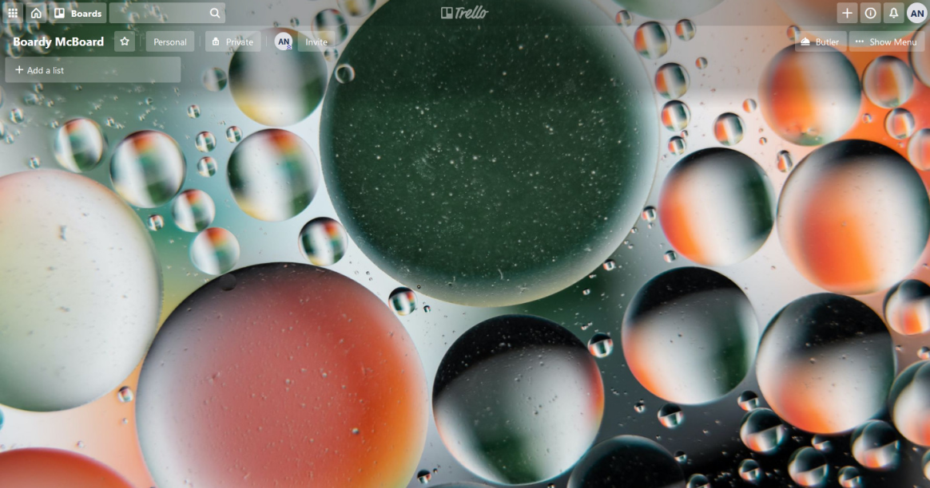
Main component – Board Preview
List of users in group
Loged user
Open menu of board
Invite to group
Board Name
stats
Board Body – here lists will be shown
Add a list with title

Slide 7
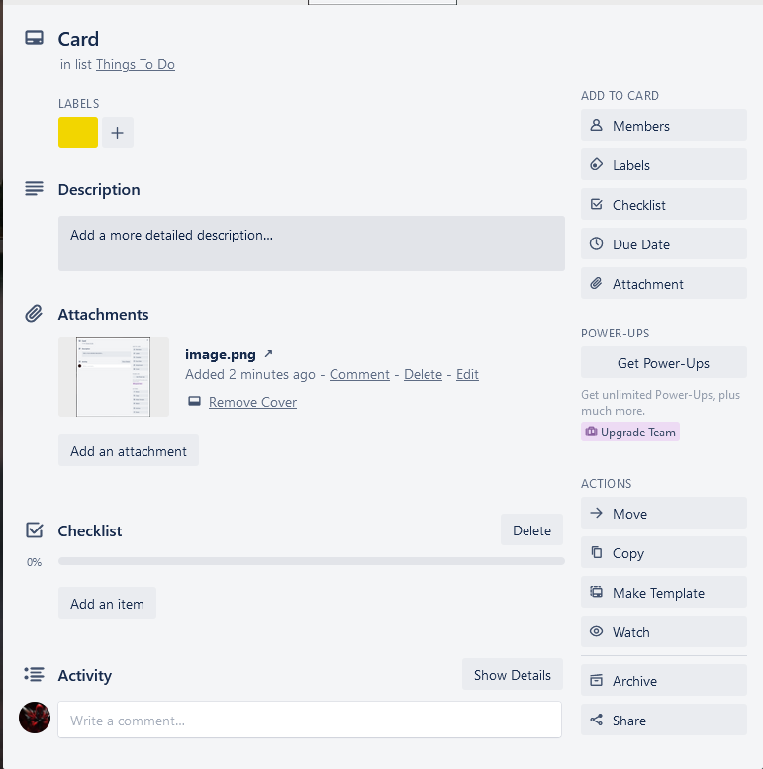
Card Details Page
Who is workin on this card
Card title
comments

Slide 8

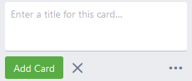
Board > Add List
List > Add card

Slide 9
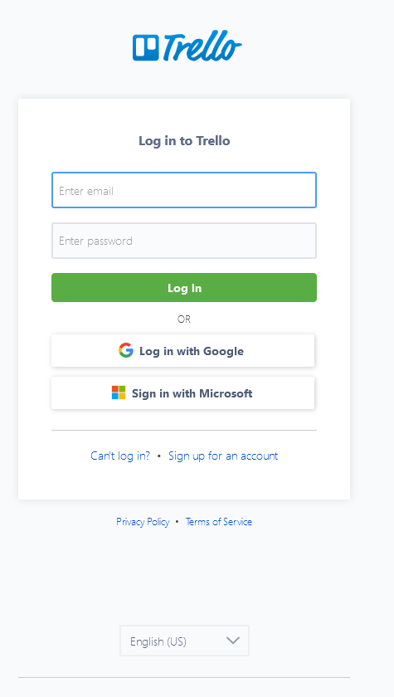
Login Page
LOGO

Slide 10
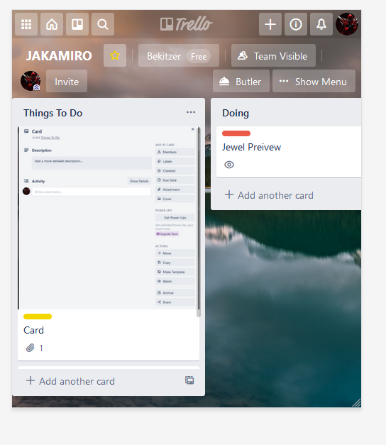
Main pages - mobile view

Slide 11
GUEST Mode
User is asked to login when: doing something else than private board
How Guests appear:
"Guest"

Slide 12
Special Functionality for Demo
Tutorial Mode in new board

Slide 13

Technical Design

Slide 14
Data Model

Slide 15
User
{
"_id": "u101",
"fullName": "Gal Rondel",
"userName": "gal@Todoiahu.com",
"password": "WhyImHere123",
"lastLoginAt": 4213425,
"phone": "972544436302",
// "starBoards": [{Board}, {Board}],
"imgUrl": "http://some-img/troll.jpg"
}

Slide 16
Board
{
"_id": "5c09",
"name": "BoardMcBoardy",
“desc": “this board is board",
"background": "/fdsfsdfds.jpg",
"createdBy": {mini-user}
"members": [{mini-user},{mini-user}],
Activities:[]
“cardLists": [
{
"title": “Grabage bin",
“id": “recycleBin_5c09",
"cards": [{card},{card}]
}
{
"title": "The End Sprint",
“_id": "s1001",
"isLock": false,
"cards": [card.id , card.id]
"createdBy": user.id
}
]
}

Slide 17
Card
{
"id": "5c09",
“title": "Do It",
"labels": [{"title": "IT", "color": "red"},{"title": "", "color": "orange"}],
"createdBy": {mini-},
“cardMembers": [{mini}],
“desc": "lorem blabla bla bla bla",
"dueDate": 541323455,
"
"cheklists": [
{
"id": "145fs3",
“title": “checklist22",
“todos”: [{
"id": "14sf3",
"text": "lorem blabla bla bla bla",
"doneAt": 14325434545,
"doneBy": {mini-user}
}]
},
],
"attachments": [{
"_id": "23s43",
"name": "lorem",
"url": "/img/ape.jpg"
"addedBy": user.id,
}],
}
}

Slide 18
Activity
{
"_id": "5c09",
“by” : {mini-user},
“card” : {mini-card},
“txt” : “Chaged Color”
“at” : 54523423,
}
Aviv changed color of task: Fix the Bug
{
"_id": "5c09",
“by” : {mini-user},
“txt” : “Change description”
“at” : 54523423,
}
Aviv changed description of the board

Slide 19
Activity
{
"_id": "5c09",
“by” : {mini-user},
“card” : {mini-card},
“txt” : “Moved Card”
“at” : 54523423,
“targetLIst: {mini-list}
}
Aviv moved Card Fix the Bug to list Testing

Slide 20
Store
Reducer
user
board
card
Actions
login
logout

Slide 21
Board Reducer
State
board
boards
currCard
Actions
addList
addCard
removeList
removeCard
moveList
moveCard
starBoard
loadBoard
inviteUser
archiveCard

Slide 22
User Reducer
State
user
Actions
logIn
logout
updateUser
signUp

Slide 23
Card Reducer
State
card
Actions
updateCard

Slide 24
Socket
Per Station Socket
Socket is connected when entering a specific station and closed when leaving a station

Slide 25
Socket Protocol
on
boardUpdated(boardId)
stationLeft(user)
playlistUpdated (playlist – an array of songs)
activeSongChanged (songId, time)
newChatMsg (msg)
emit
updateBoard(boardId)
joinStation (stationId)
leaveStation (stationId)
updatePlaylist(playlist)
changeActiveSong (songId, time)
sendMsg (msg)

Slide 26
Pages and Components

Slide 27
Pages
Page | Description | Routing
Homepage | Easy to read welcome page with a intro | /
Boards | Page that can show all boards of users | /:username/boards
BoardDetails | Show the lists | /b/:boardid/:boardname
CardDetails | Expand full details of card | /c/:cardid/:cardtitle
Statics | Stats about this board | /b/:boardid/:boardname/statics
Profile |  | /:username
loginSignupPage | Login / Signup | /signup

Slide 28
Components
Component | Props | State | Description
BoardPreview | board |  | Preview the background of board + title
BoardList | boards |  | List of boards
songSearch |  |  | Allow the user to find a song and emit to parent
CardPreview | cards |  | Preview the card title + icons of what inside
CardList | cards |  | List of boards

Slide 29
Used Techs and APIs
Ajax and REST API
CRUDL for stations with axios and Node.js
Authentication
User/password and server session
Storage
Cloudinary to store users profile and station images
Database
Mongodb on Atlas cloud databases
Web Sockets
Multi room with a Socket per station
Youtube API
Add and play songs from Youtube based on user search
Share
Share to Facebook (if time permits)

Slide 30
Thanks

