Slide 1
01
METACARDIS · MILESTONE 1
MULTI-OMICS · MISSING-MODALITY DISTANCES
Estimating sample distances
across multi-omics,
under missing modalities
Group ____________ · MetaCardis cohort

Slide 2
METACARDIS · MILESTONE 1
THE PROBLEM
WHAT WE ARE ACTUALLY ASKED TO BUILD
A sample×sample distance matrix from two omics — that holds up when an entire modality is missing.
02
Graded by Mantel test vs. ground truth: standardise all features → PCA → Euclidean in the first 2 PCs. The target geometry is linear.
With both modalities present that target is trivially recomputable — so the whole problem lives in the missing-modality regime.
COMPUTATIONAL MICROBIOME WORKSHOP
02 / 16

Slide 3
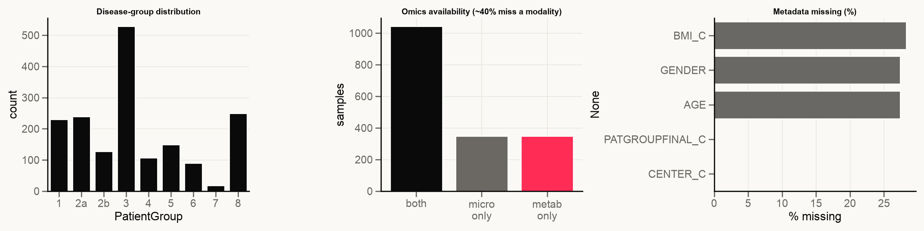
METACARDIS · MILESTONE 1
EXPLORATION / DATA
THE DATA ALREADY CONTAINS THE CHALLENGE
~40% of subjects are missing a whole modality
1042
348
348
528 → 18
BOTH OMICS
MICROBIOME ONLY
METABOLOME ONLY
T2D → CHF (IMBALANCE)
COMPUTATIONAL MICROBIOME WORKSHOP
03 / 16

Slide 4
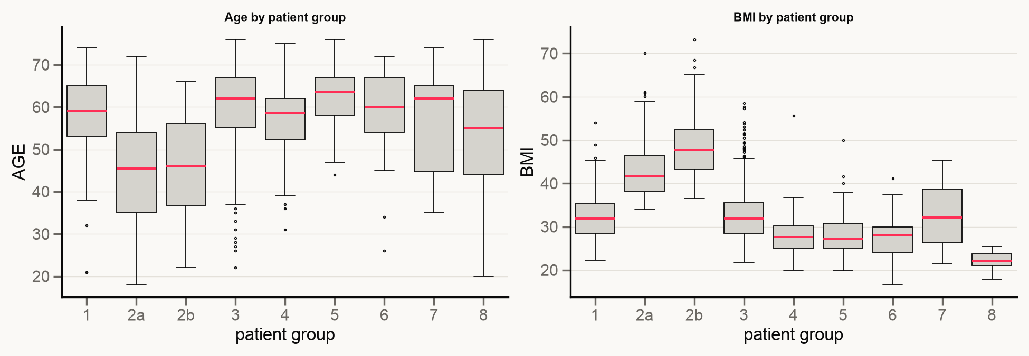
METACARDIS · MILESTONE 1
EXPLORATION / CONFOUNDERS
DEMOGRAPHICS DIFFER SHARPLY BETWEEN DISEASE GROUPS
OBESITY 2A/2B — YOUNGEST, BMI > 40 · DIABETES/CVD 3–6 — OLDER (~60) · AGE & BMI ARE PRIME CONFOUNDERS
COMPUTATIONAL MICROBIOME WORKSHOP
04 / 16

Slide 5
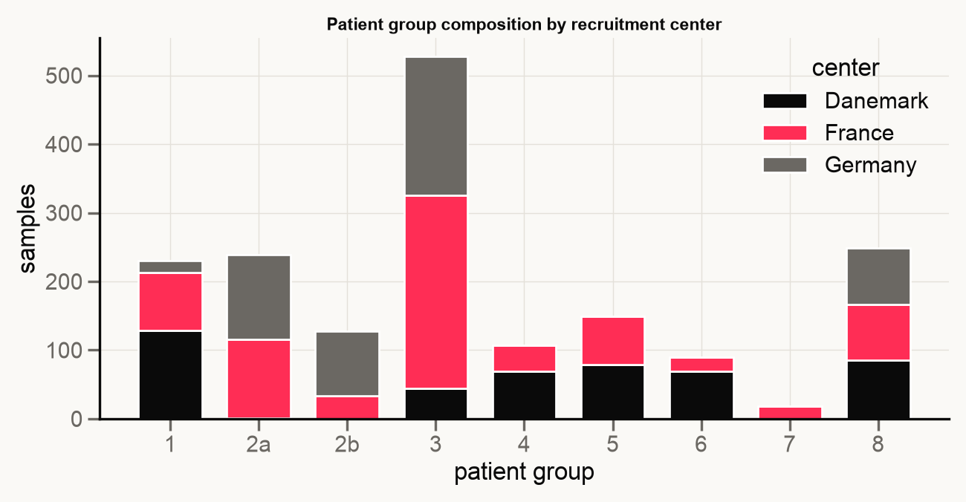
METACARDIS · MILESTONE 1
EXPLORATION / BATCH
RECRUITMENT CENTER IS A CONFOUNDER, NOT NOISE
8.84
PERMANOVA F · CENTER
3.72
05
PERMANOVA F · DISEASE GROUP
Groups are country-skewed (2b≈German, 7≈French, 4 no-Germany) and CENTER structures the microbiome more than disease. Denmark is 100% missing demographics (MNAR).
COMPUTATIONAL MICROBIOME WORKSHOP
05 / 16

Slide 6
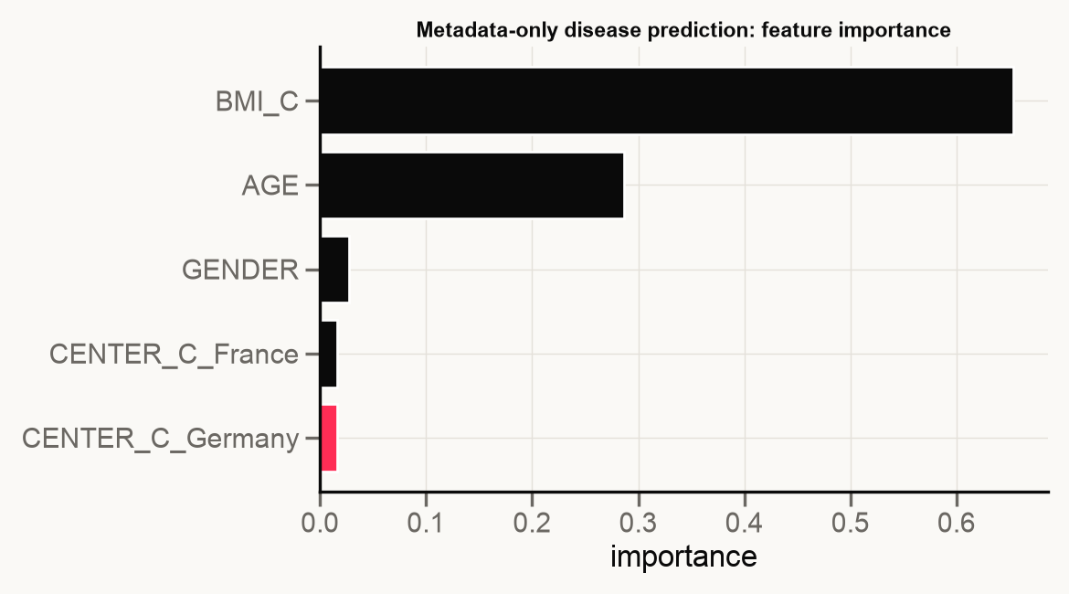
METACARDIS · MILESTONE 1
EXPLORATION / WHAT PREDICTS DISEASE
BASIC DEMOGRAPHICS PREDICT THE DISEASE BETTER THAN THE OMICS
0.34
METADATA-ONLY RF · 5-FOLD CV · BAL-ACC
Random Forest, 5-fold cross-validation, guessing the disease group (1 of 9). Same model, three inputs: metadata-only 0.34 · both-omics 0.26 · microbiome-only 0.191 (chance≈0.11).
BMI (0.653) and age (0.287) dominate — the disease signal in the omics is weak and distributed, so distances (not labels) are the right target.
Spec check — does imputing a missing omics help prediction? No: microbiome alone 0.191, + an imputed metabolome 0.183, + the real metabolome 0.26.
06
COMPUTATIONAL MICROBIOME WORKSHOP
06 / 16

Slide 7
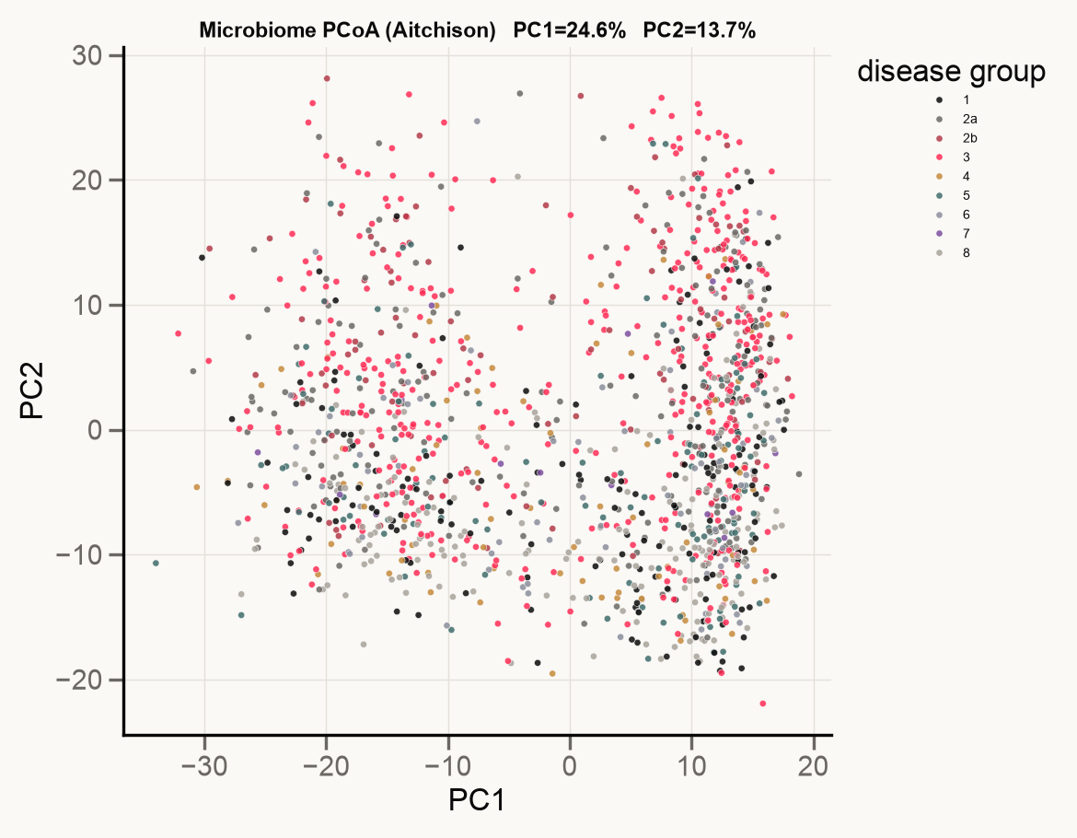
METACARDIS · MILESTONE 1
EXPLORATION / MICROBIOME MAP
DISEASE GROUPS DON'T FORM CLEAN CLUSTERS ON THE MICROBIOME MAP
38%
OF PATIENT DIFFERENCES VISIBLE IN THIS FLAT MAP · REST HIDDEN
PCOA (AITCHISON) · PC1 25% · PC2 14%
Disease colours are mixed everywhere — no clean clusters, so we place patients by distance, not predict a label. The 2 axes capture only 25%/14%; structure is high-dimensional.
Country also shapes this map; we judge that with the df-adjusted PERMANOVA on slide 05, not by eye.
07
COMPUTATIONAL MICROBIOME WORKSHOP
07 / 16

Slide 8
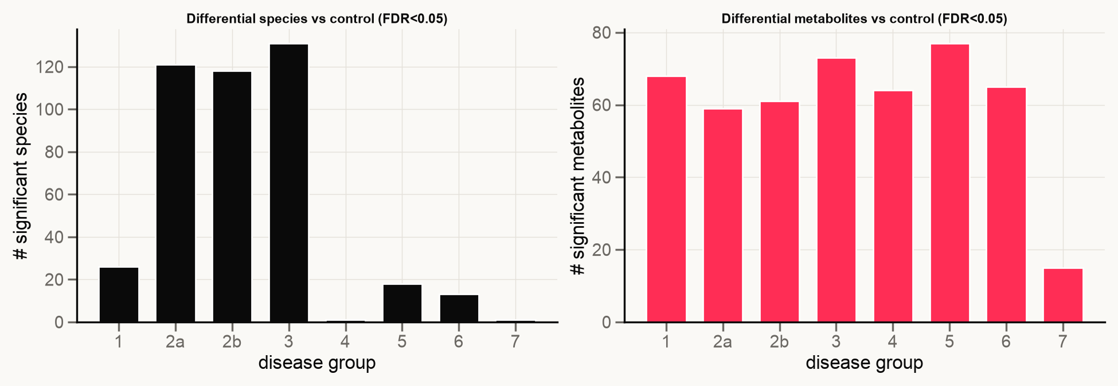
METACARDIS · MILESTONE 1
EXPLORATION / DIFFERENTIAL
BOTH OMICS CARRY DISEASE SIGNAL — AT DIFFERENT SCALES
VS. CONTROL, FDR<0.05 · UP TO 131 SPECIES AND 77 METABOLITES DIFFER · METABOLOME SHIFTS ARE BROAD
COMPUTATIONAL MICROBIOME WORKSHOP
08 / 16

Slide 9
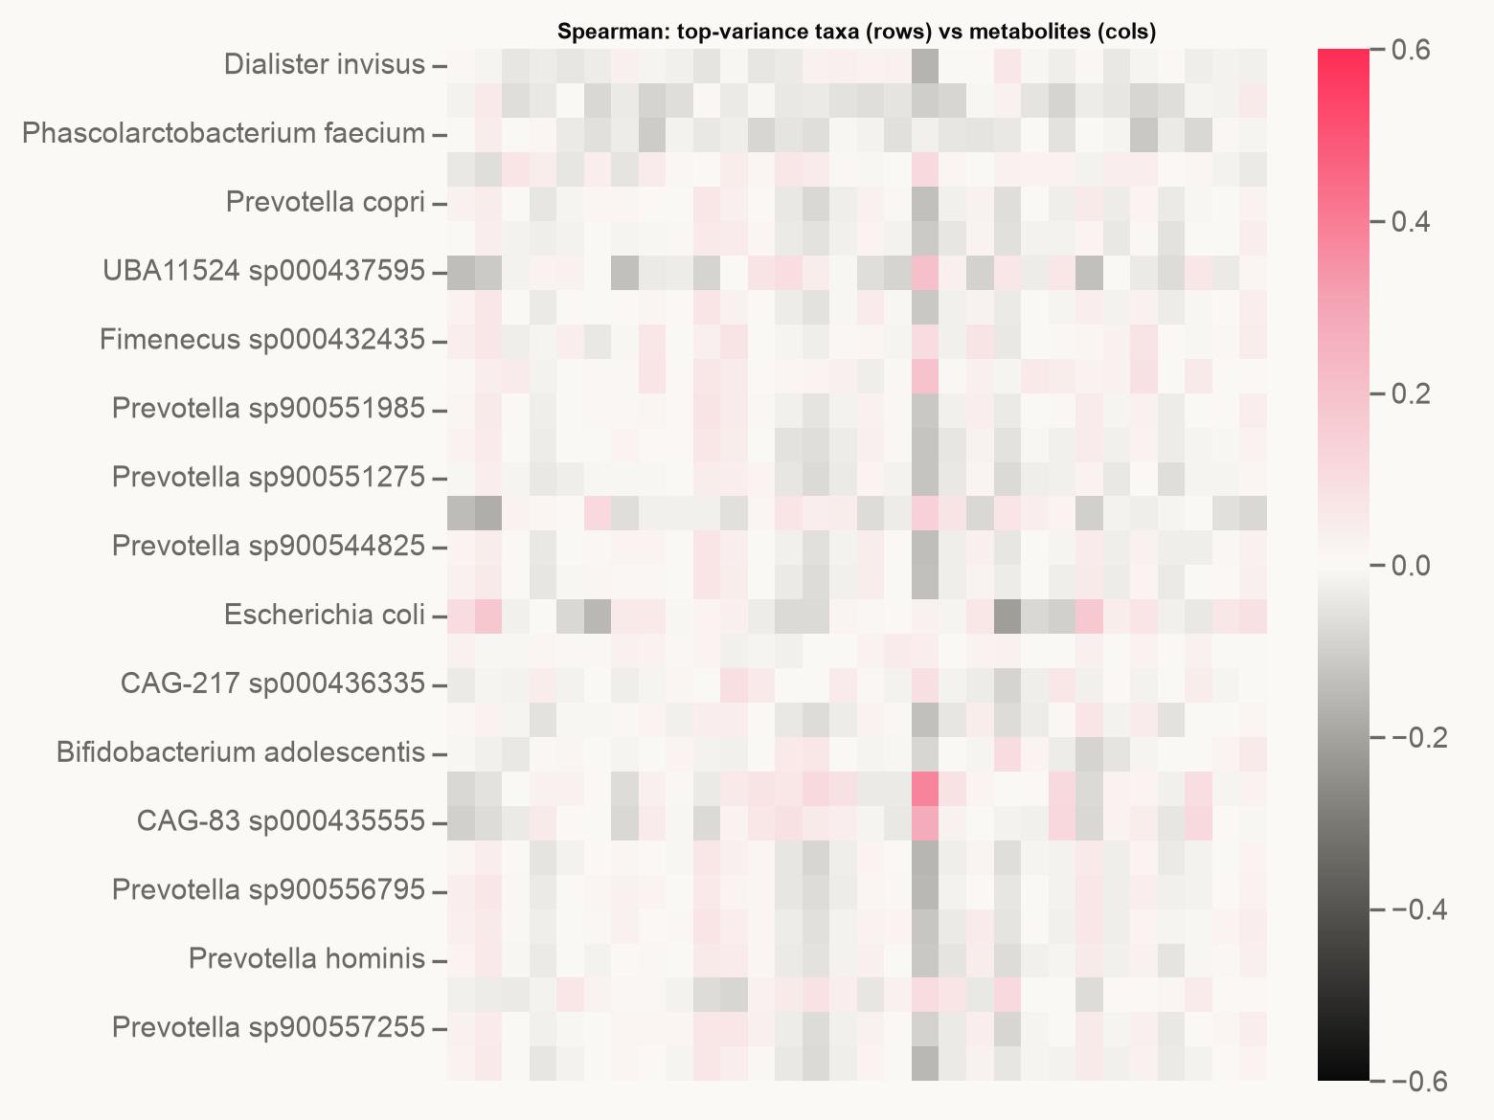
METACARDIS · MILESTONE 1
EXPLORATION / COUPLING
CROSS-OMICS COUPLING IS WEAK — THIS CAPS IMPUTATION
0.382
MAX |SPEARMAN| TAXA ↔ METABOLITE
Both partners find it independently (ρ < 0.25 in the top pairs). Only a metabolite-specific subset is predictable from microbiome → cross-modal recovery has a low ceiling.
09
COMPUTATIONAL MICROBIOME WORKSHOP
09 / 16

Slide 10
METACARDIS · MILESTONE 1
NAÏVE BASELINE
MANDATORY BASELINE — DROP A WHOLE MODALITY, RECOVER, THEN MEASURE DISTANCES
DROP WHOLE METABOLOME · RECOVER · MANTEL
All four tie — once a whole metabolome is gone, the only way to rebuild it is from the microbiome, and the two are weakly linked (slide 09). So the clever fills add almost nothing over a plain mean; even mean clears ~0.77 at 50% missing.
The high score is misleading: at low missing-% most patients keep both omics, so most distances are still exact and dominate it (slide 09). It is not the discriminating number.
DROPPED
MEAN
MED
KNN
RF
10%
0.957
0.957
0.956
0.955
30%
0.848
0.848
0.851
0.852
50%
0.78
0.779
0.75
0.771
10
Row = share whose whole metabolome we hid; column = how we rebuilt it; number = Mantel score (1 = identical to the true distances).
How the distances are made: each matrix is n×n (one row/column per patient), built the grader's way (standardize both omics, PCA, Euclidean distance in the first 2 PCs). The Mantel test scores the rank correlation between our matrix and the true one, over every patient pair.
ONE CONCLUSION: NAÏVE IMPUTATION CAN'T BEAT A TRIVIAL MEAN — THE CROSS-MODAL CEILING IS THE WALL THE PIPELINE MUST BREAK.
COMPUTATIONAL MICROBIOME WORKSHOP
10 / 16

Slide 11
METACARDIS · MILESTONE 1
METHOD SELECTION
HOW WE PICKED THE TWO METHODS ON THE NEXT SLIDES
We scanned many fields, then tried hard to break what we found.
— Test 1 — does it respect how we are scored? Mantel ranks distances against a PCA map, so the danger is not nonlinearity but methods like UMAP/t-SNE that distort the global geometry. We kept global-preserving methods.
— Test 2 — can it place a patient missing a whole omics? We kept methods that build each omics' own similarity and combine them, so a patient is placeable from the omics they have.
11
Then we tried to break our own picks and feature the hardened version that fixes each weakness. Every method must beat the naive baseline in the missing-omics case, or we report it as a negative result.
COMPUTATIONAL MICROBIOME WORKSHOP
11 / 16

Slide 12
METACARDIS · MILESTONE 1
INSPIRING METHOD ①
OPTIMAL TRANSPORT · MATH & VISION ORIGIN · SCOT+ 2025
① Augmented / Fused Gromov–Wasserstein
— GW compares samples in incomparable spaces using only within-modality geometry — no shared features needed.
— Adaptation: couple a missing-modality sample to the complete samples' geometry, then barycentric-project onto the joint-PCA anchor → distances.
— Honest fix (red-team): use Augmented GW — the feature term breaks GW's rotation/reflection ambiguity.
— Gate: must beat mean/PLS in the missing regime, else reported as a negative result.
12
COMPUTATIONAL MICROBIOME WORKSHOP
12 / 16

Slide 13
METACARDIS · MILESTONE 1
INSPIRING METHOD ②
WAYFINDING · GPS-STYLE TRIANGULATION · OUR SYNTHESIS
② CM-Harmonic-Aniso: triangulate, don't impute
— Pin the 1042 complete patients at their true first-two-PC coordinates (the exact thing we are graded on) as fixed landmarks. The only method anchored on the grader's own target.
— Place each of the 696 single-omics patients by triangulating off those landmarks: one harmonic solve on a fused graph where a missing omics is no edge, never an invented value.
— Honest per-axis split: the part carried by the omics you have beats every imputation baseline; the part needing the missing omics falls back to the average, provably never worse than mean-impute.
— Gate: must beat mean/PLS per-axis on held-out patients, with a fail-closed fallback to PLS on boundary-poor cohorts, else a negative result.
13
COMPUTATIONAL MICROBIOME WORKSHOP
13 / 16

Slide 14
METACARDIS · MILESTONE 1
PIPELINE & EVALUATION
THE PLAN
PIPELINE
EVALUATION
— CLR(microbiome), log1p+standardise(metabolome); scaler & PCA fit on train only.
— Core: AGW-OT and CM-Harmonic-Aniso vs. the baseline ladder.
— Ablations: ProMA (info-geometry floor) and DLB (diffusion-kernel check) to test what anchoring buys.
— Baseline ladder: mean / KNN / RF / PLS→frozen-PCA.
— Mantel r vs. PCA-2PC ground truth (reproduce the grader exactly).
— Sweep missing-% = 10/30/50, both directions.
— Subject-grouped CV — distance pairs are non-iid; no leakage.
— Report performance and runtime vs. the baseline.
14
COMPUTATIONAL MICROBIOME WORKSHOP
14 / 16

Slide 15
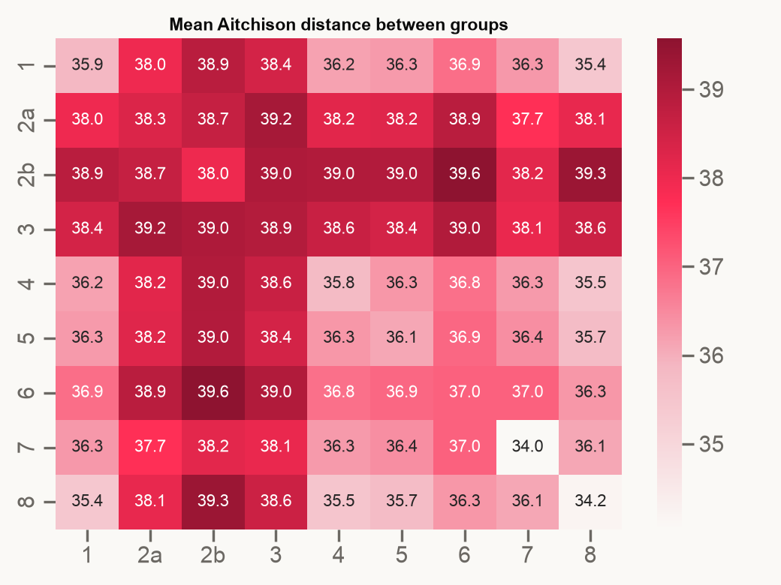
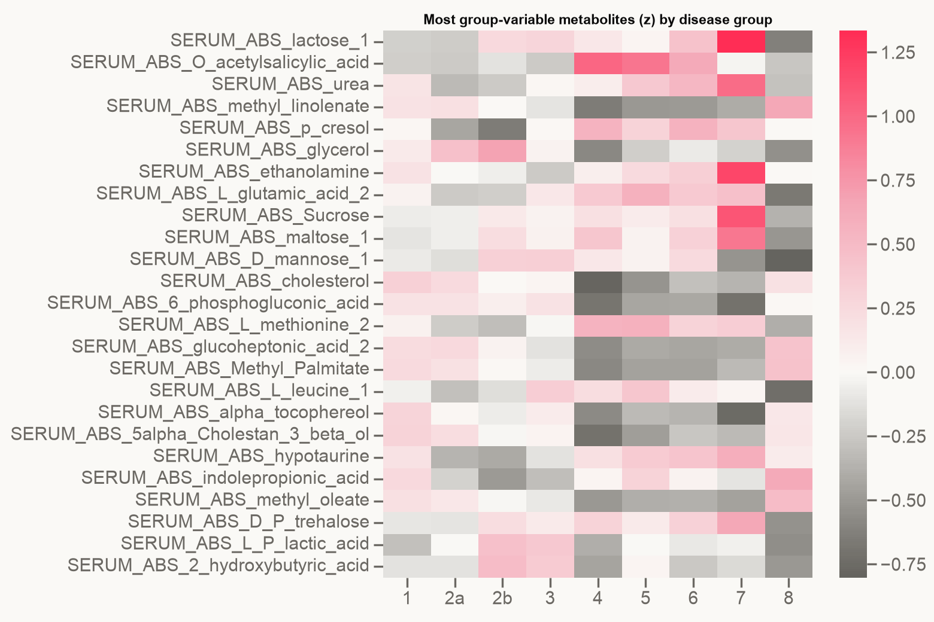
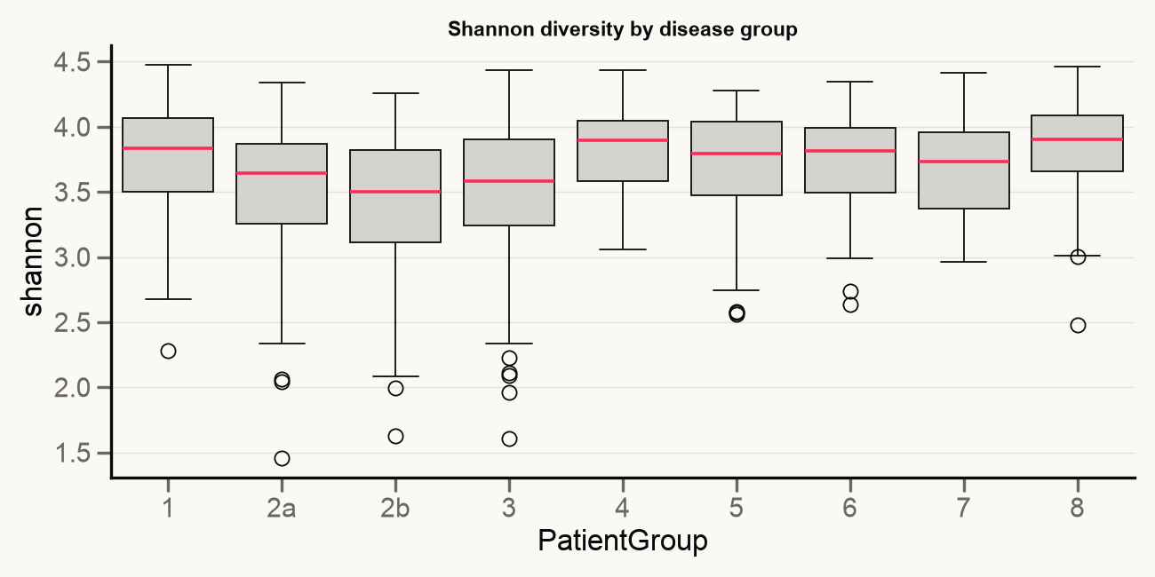
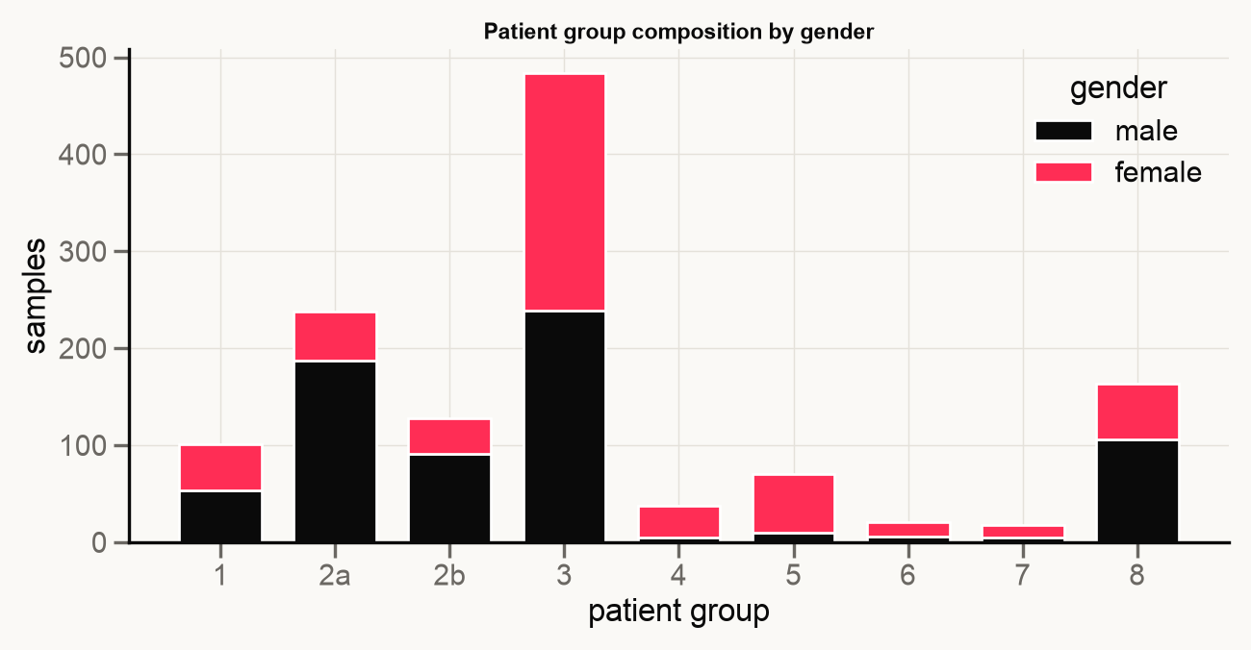
METACARDIS · MILESTONE 1
APPENDIX
APPENDIX · SUPPORTING EXPLORATION
AVG MICROBIOME DISTANCE BETWEEN GROUPS
METABOLITES ELEVATED / REDUCED BY GROUP
SHANNON DIVERSITY BY GROUP
GENDER COMPOSITION BY GROUP
COMPUTATIONAL MICROBIOME WORKSHOP
15 / 16

Slide 16
16
METACARDIS · MILESTONE 1
KEY CHALLENGES → NEXT STEPS
Beat mean imputation by exploiting the predictable cross-modal subset + the metabolome-only direction.
Next: implement AGW-OT + CM-Harmonic-Aniso · per-axis Mantel-vs-missing% sweep vs. the baseline ladder.

