Slide 1
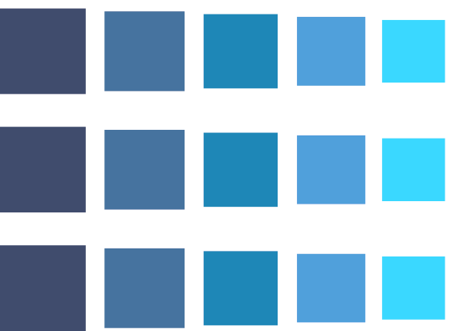

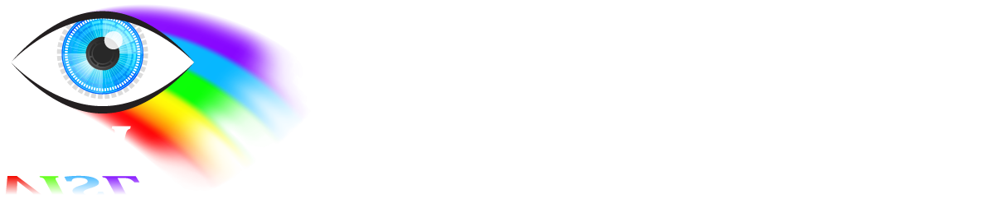

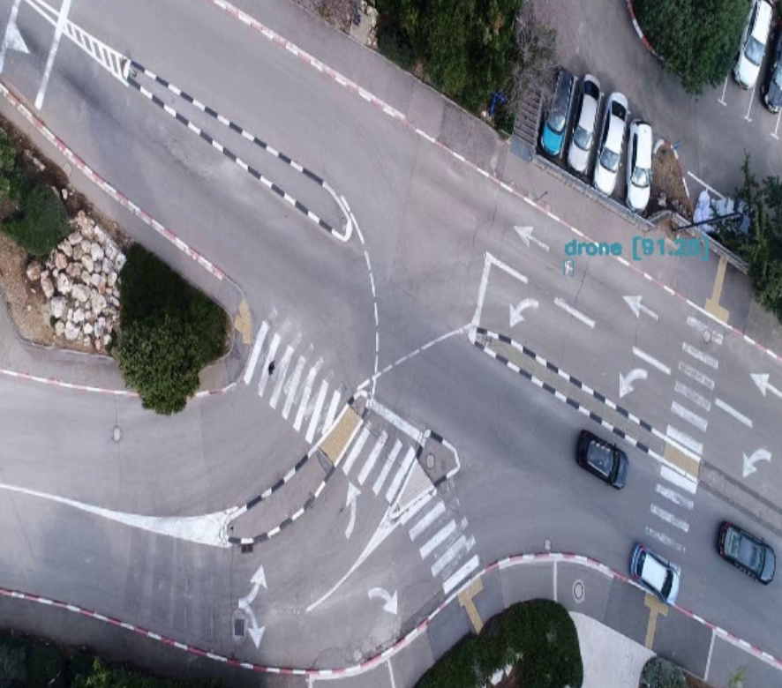
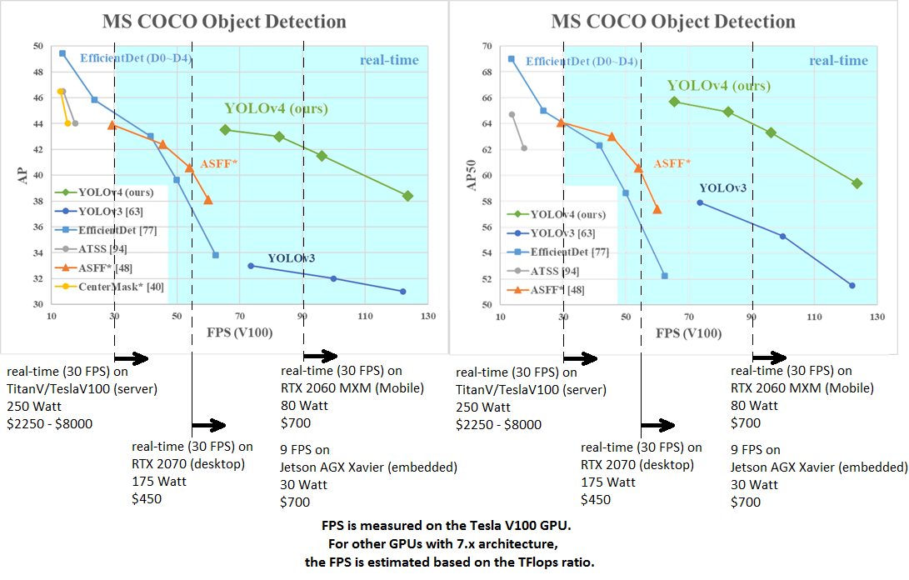
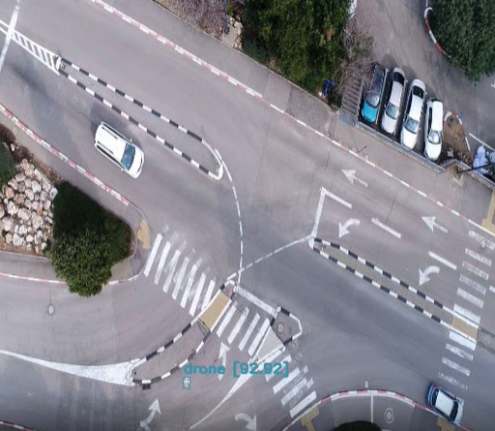
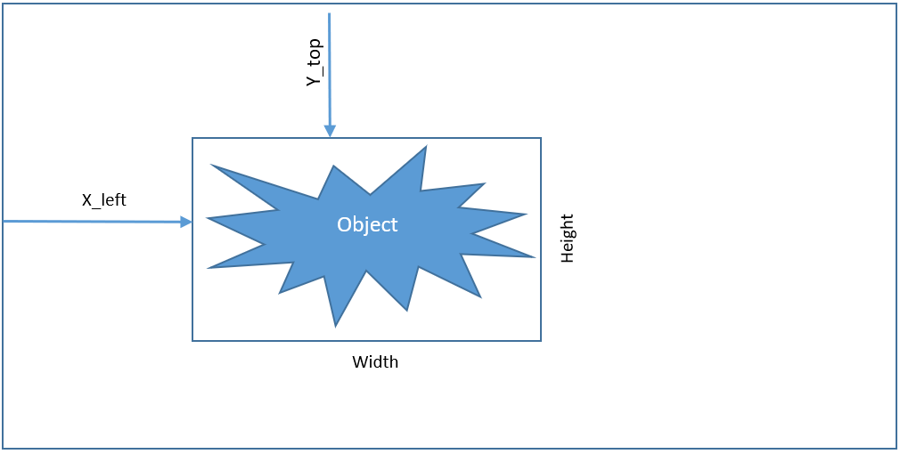
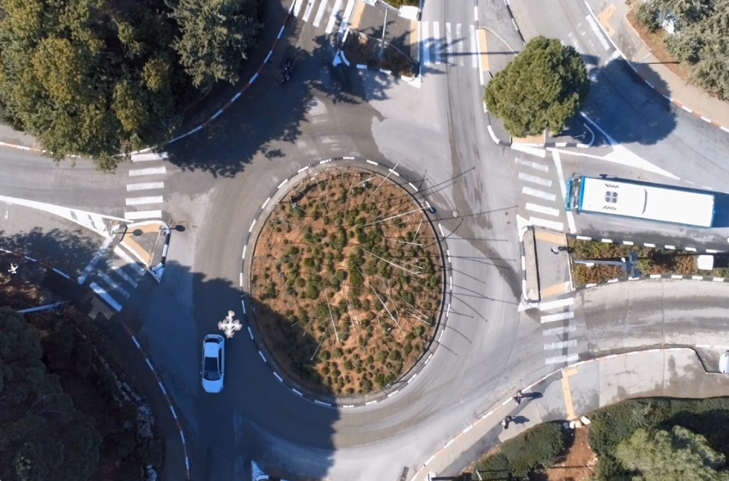
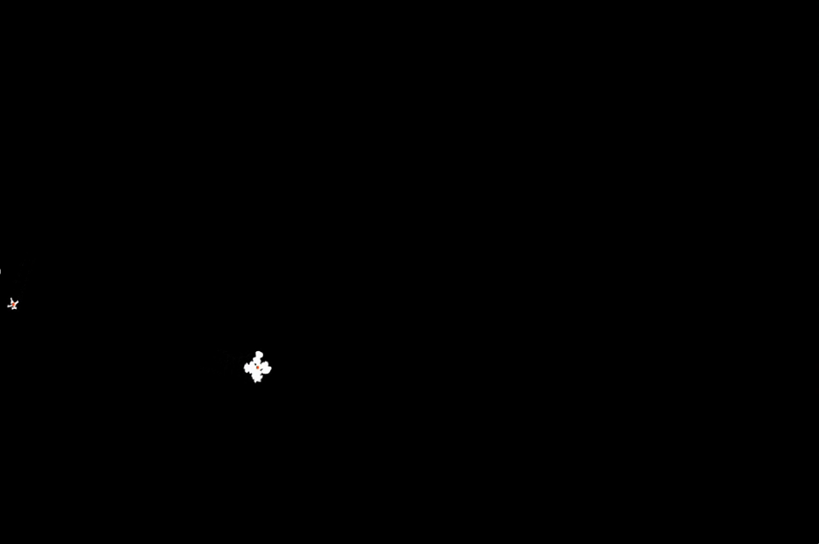
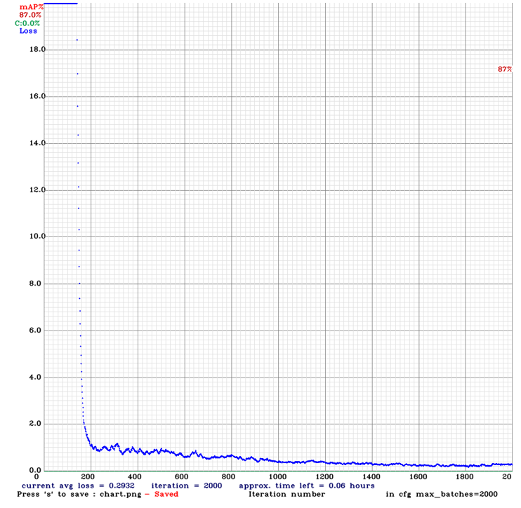
Training a Neural Network for Detecting Drones in an Urban Environment
Aviv Paskaro and Stav Yeger, supervised by Ilya Tcenov
Introduction
The selected Network - YOLOv4
Results
In recent years, drones have entered the world of civilian and military aviation. The drones are small, agile, cheap and have a low signature, and as a result hostile groups find them widely used. Detecting and tracking drones is a challenging task in an open space and even more so in an urban environment. Those kind of tasks are usually solved by using systems with integrated neural networks.
Actual scenes of flying drone in urban area:
YOLOv4 is an object detection network
Best suited to our goals (FPS-Performance-Power)
Human
Drone
YOLOV4
YOLOV4
Goal
Cars
Select compatible neural network
Train the network for detecting drones in urban area
Integrate the network with NVIDIA Jetson TX2 card (installed on a patrol drone)
Example 1
Benchmarks
Dataset
We split the dataset videos into single frames and used the binary map to locate bounding boxes of the objects.
Cars
In the primarily project we’ve created dataset as a base for the training. The dataset is composed from videos the simulate flying drone in urbans scenes.
Drone
Example 2
Yolo input requirement
Pros of YOLOv4
The training used over 160,000 frames of dataset. The average loss change during the training process is shown in this graph:
Light and simple architecture => High FPS
Flexible for various sizes of drones
Easy to retrained for other drones' shapes
Simulated scene
Cons of YOLOv4
Does not use consider the time relation between frames
The dataset created from a specific drone – current weights will not deal with all kinds of drones
Drone only binary map
Conclusions
Network performance requirements
Yolo does really good job in detection objects that she trained for. We will recommend to add system that will try to look at the relation between consecutive detections and help predict the object next steps.
FPS >= 2
Low power consumption
High percentage of detection
Loss
Results for input size of 608X608 is 87% mAP.
April 2020

