Slide 1




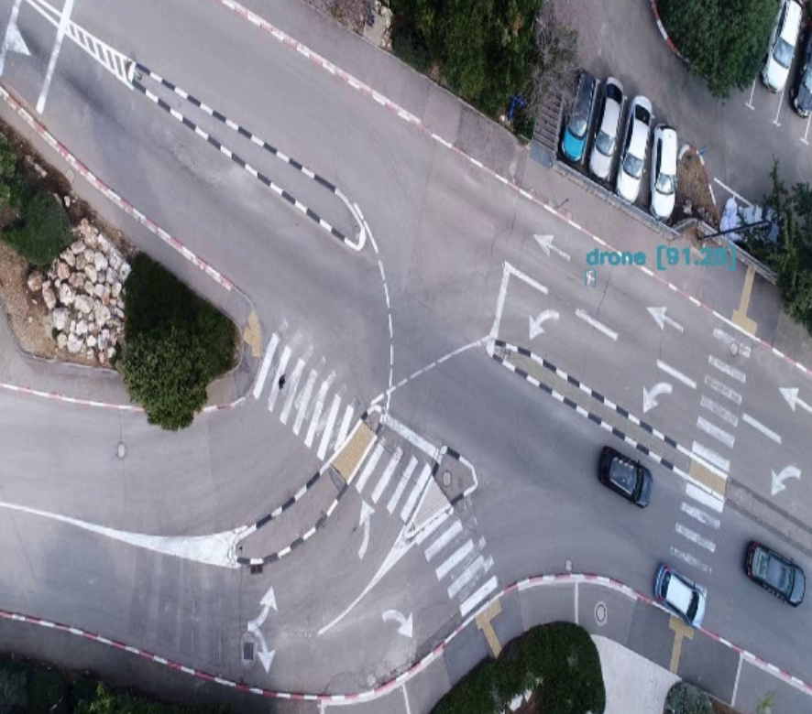
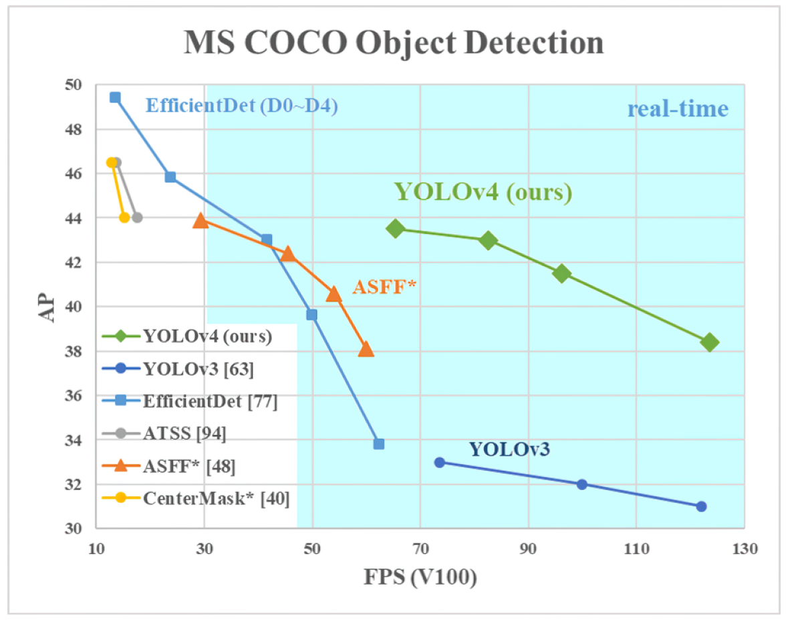
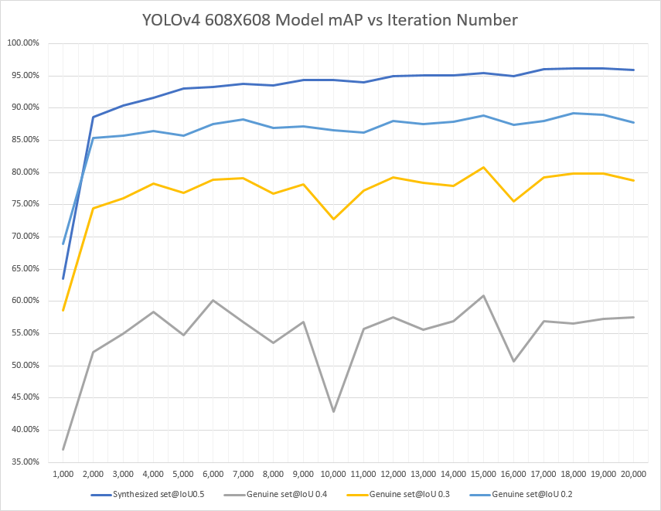
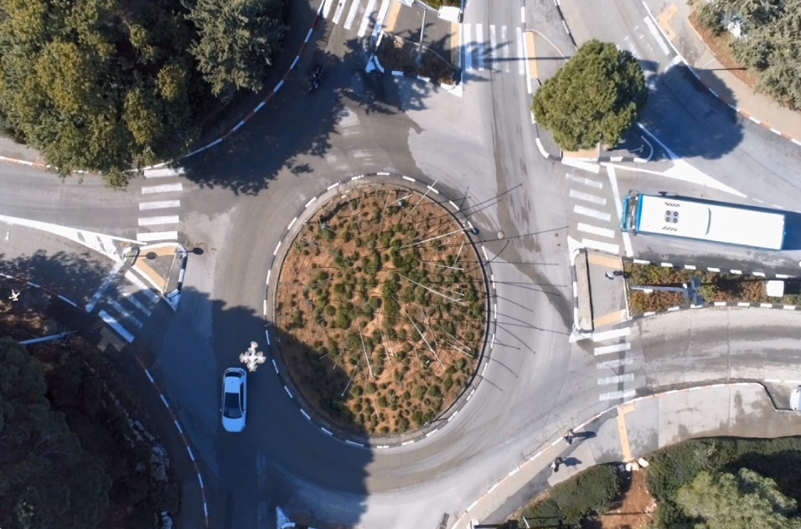
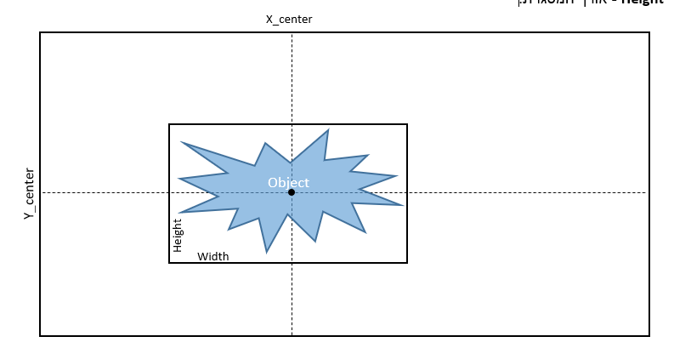
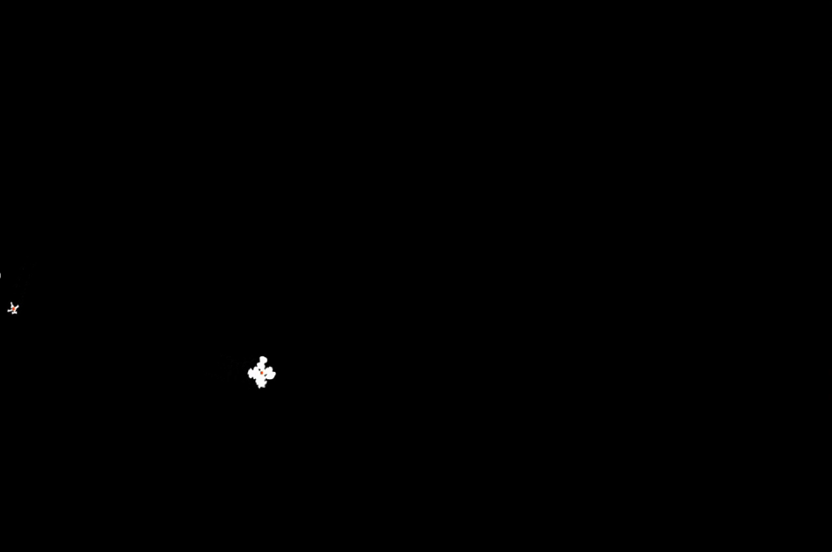
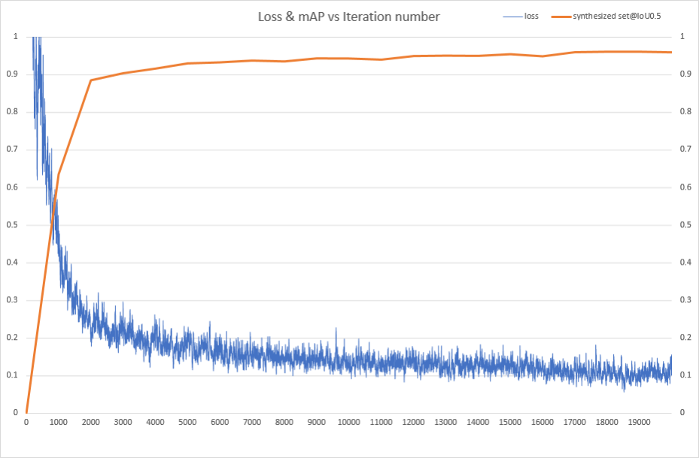
Training a Neural Network for Detecting Drones in an Urban Environment
Aviv Paskaro and Stav Yeger, supervised by Ilya Tcenov
Introduction
The selected Network - YOLOv4
Results
Drones which are small, agile, cheap and have a low signature, are widely used for civilian and military tasks. Detecting and tracking such drones is challenging in open space and even more in urban environment. In a primarily project we created a data base of drone pictures taken from above. Now we use this data base for developing a system to detect drones, using a neural network.
Actual flying drone scenes in urban area:
YOLOv4 is an object detection network
Best suited to our goals: FPS, Performance and Power
Performance-Accuracy tradeoff: Partial use of information - detection per frame and not as a full video-set (loss of information but increased FPS)
Drone
Human
Goals
Cars
Decide on suitable neural network
Train the network to detect drones in urban area
Implement on GPU card to be installed on a patrolling drone (NVIDIA Jetson TX2)
We chose the state (weights) of the model at iteration 15000, since it achieved the highest score (on genuine scenes).
Dataset
Our dataset is composed from simulated videos in urbans scenes that we compiled using videos of a DJI Phantom drone that were taken in open space.
Benchmarks
We’ve split the dataset videos into single frames and used the binary map to locate bounding boxes of the objects.
Synthesized@IoU0.5
Genuine@IoU0.2
Genuine@IoU0.3
Genuine@IoU0.4
Pros of our Network
Light and simple architecture on Jetson TX2 : Performs ~5FPS
Flexible for various drone sizes and colors
Detections (output) are compactly gathered and easy to manipulate
Simulated scene
Yolo input’s requirement
Cons
The training used over 160,000 frames of dataset. The average loss change during the training process is shown in this graph:
The network doesn’t fully utilize the primarily created dataset (data is video sets - time relation between frames)
The dataset created with a specific drone –not ideal with other kinds of drones
Conclusions
Known drone position ground truth
The network meets the requirements that has been set for it. And overall, the system is ready to detect drone within urban environments in real-time
Post processing can be easily applied on the raw output (of the NN) to increase the detection accuracy (Time interpolation or same techniques)
Performance
Light algorithm that can be implemented on a low power system - Jetson TX2, while maintaining reasonable performance:
FPS >= 2, mAP >= 0.7.
Loss
Results for input size of 608X608 is 96% mAP on synthesized validation set
December 2020

