Slide 1
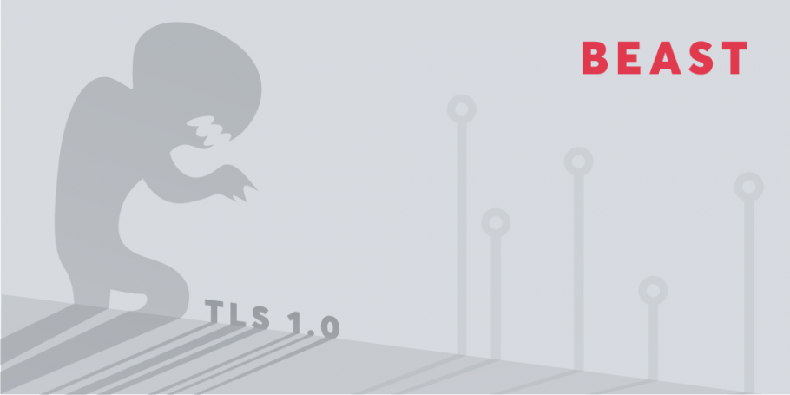

Slide 2
Part 1: Definitions and Background
All the theoretical knowledge you need to know about the BEAST attack in order to play the CTF successfully.

Slide 3
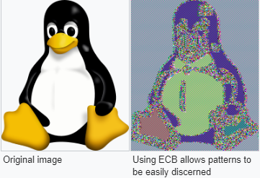
AES
Block cipher
Block size is 128 bits (16 bytes)
Symmetric-key algorithm
What if I want to encrypt more than 16 bytes?
Encrypt using the same key again?
Encrypt using new key?

Slide 4
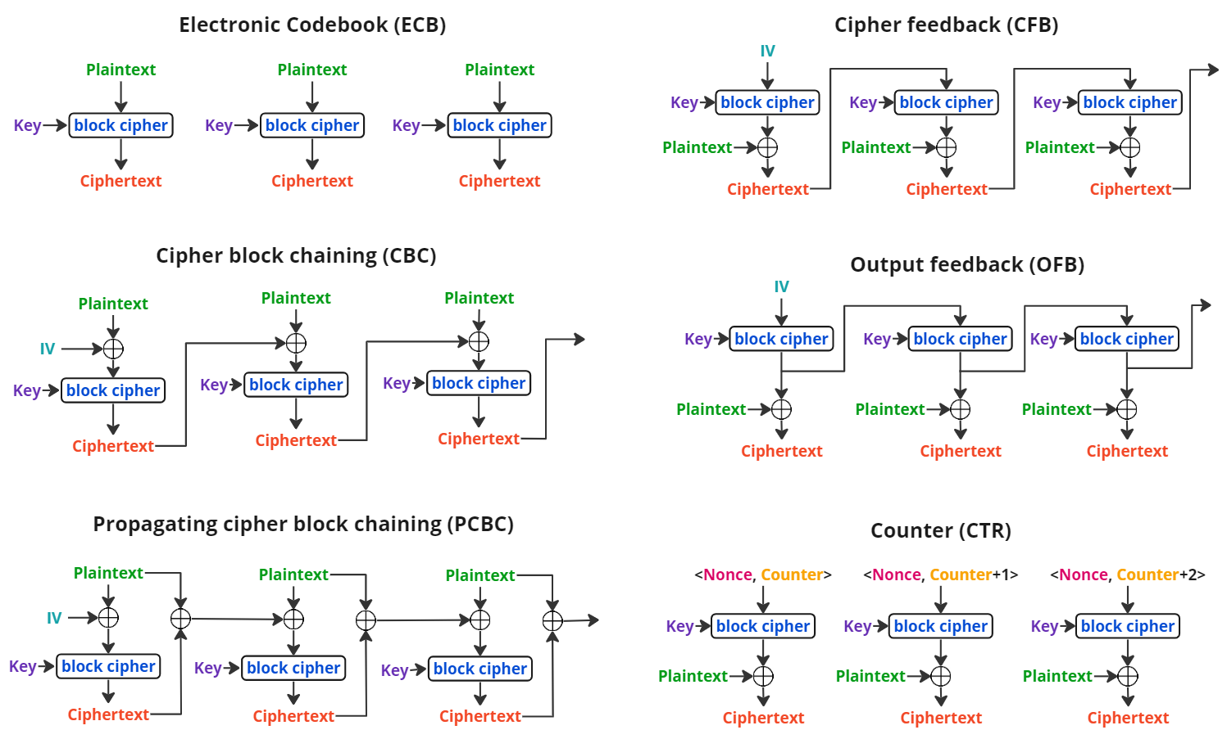
Mode of Operation
Designed to allow the repeated use of block cipher in a secure way.

Slide 5
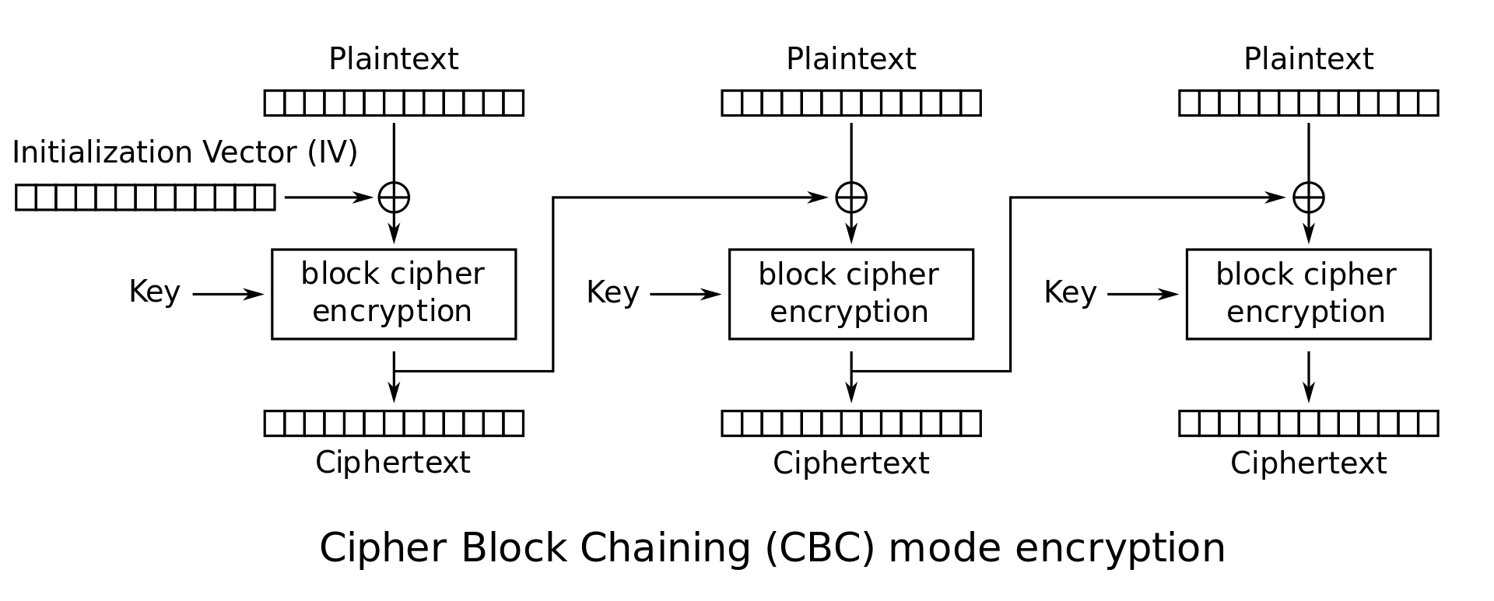
Cipher Block Chaining (CBC)

Slide 6
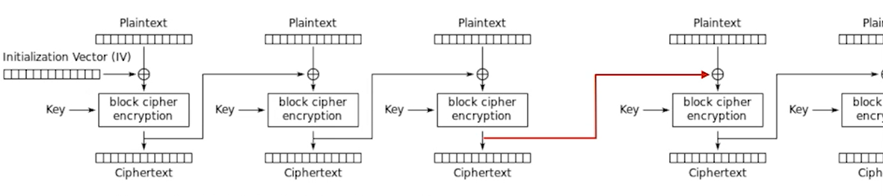
TLS 1.0
In TLS 1.0, next message IV is chosen as the last cipher block of previous message.
Notes:
We act like it is the same message, BUT it’s NOT.
Thus the IV is predictable while it’s suppose to be random.

Slide 7
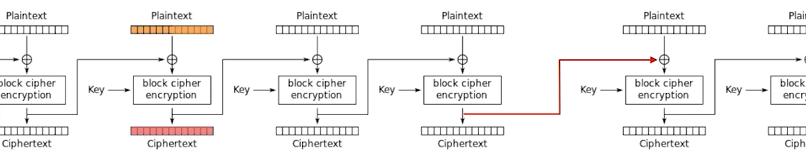
Example of HTTP request
GET /index.html HTTP/1.1
Host: mysite.com
Cookie: Session=12345678
Accept-Encoding: text/html
Accept-Charset: utf-8
Cookie
Notes:
Following images taken from: https://www.youtube.com/watch?v=-_8-2pDFvmg

Slide 8
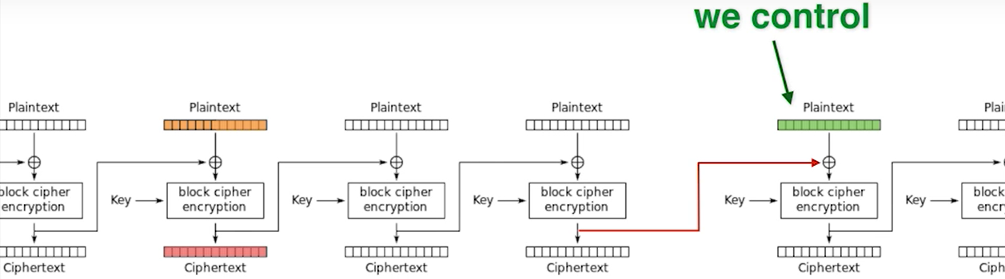
Cookie

Slide 9
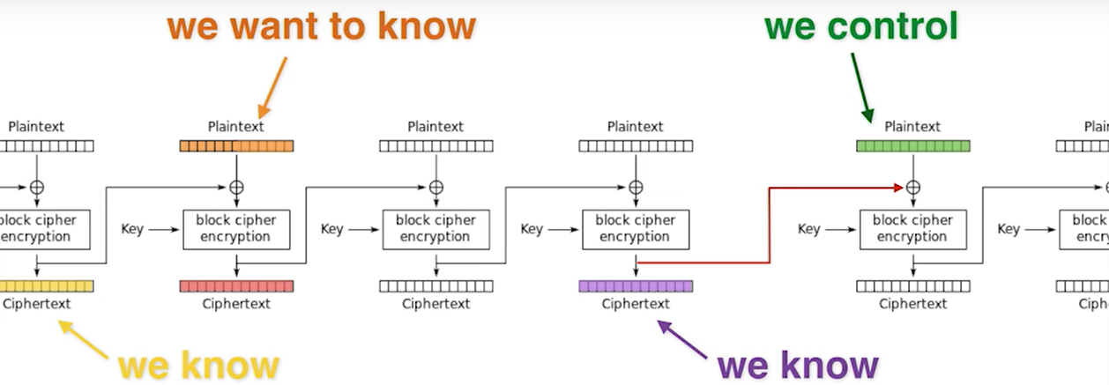

Slide 10
Guess
How can we know if we took the right guess?
Remember that the AES block cipher is deterministic, therefore same input (plaintext) will yield the same output (ciphertext)
Notes:
How can we know if we took the right guess?
Remember that the AES block cipher is deterministic, therefore same input (plaintext) will yield the same output (ciphertext)

Slide 11
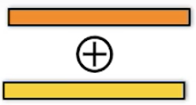
Guess
If we took the right guess the input to the AES block cipher is the same.
Notes:
If we took the right guess the input to the AES block cipher is the same.

Slide 12
Guess
If we guessed right, then we will get the same ciphertext as the cipher block we are trying to decrypt, otherwise – we will change our guess.
Notes:
If we guessed right, then we will get the same ciphertext as the cipher block we are trying to decrypt, otherwise – we will change our guess.

Slide 13

Are we done?
We are left to guess 128 bits
$2^{128}$ options
Notes:
This is too much

Slide 14

Reduce the number of bits we need to guess
Craft a request, where most of the block bytes are known
Make the victim do the request (Injected JS\Java code)
Now we only need to guess 1 byte a time ($2^{8}$ options)
Notes:
The victim will send http request. These type of request have a known structure, using the injected Java Applet we can control the URL path and the content of the POST request.
We will target a block (16 bytes) that we know it is first 15 bytes and then we will guess the last byte.
After we discover that byte, we will change the URL path such that we will have a block with known first 15 bytes, and the last byte will be the byte after the byte we just discovered.

Slide 15
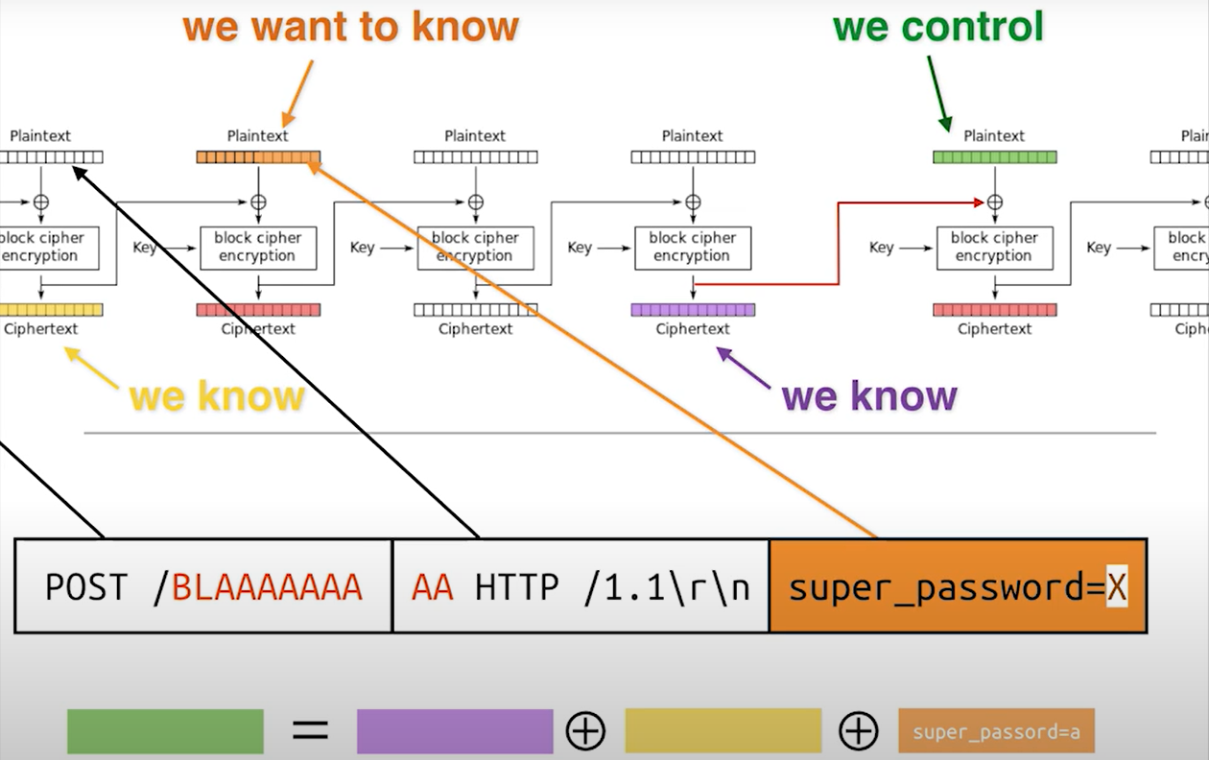
Notes:
The victim will send http request. These type of request have a known structure, using the injected Java Applet we can control the URL path and the content of the POST request.
We will target a block (16 bytes) that we know it is first 15 bytes and then we will guess the last byte.
After we discover that byte, we will change the URL path such that we will have a block with known first 15 bytes, and the last byte will be the byte after the byte we just discovered.

Slide 16
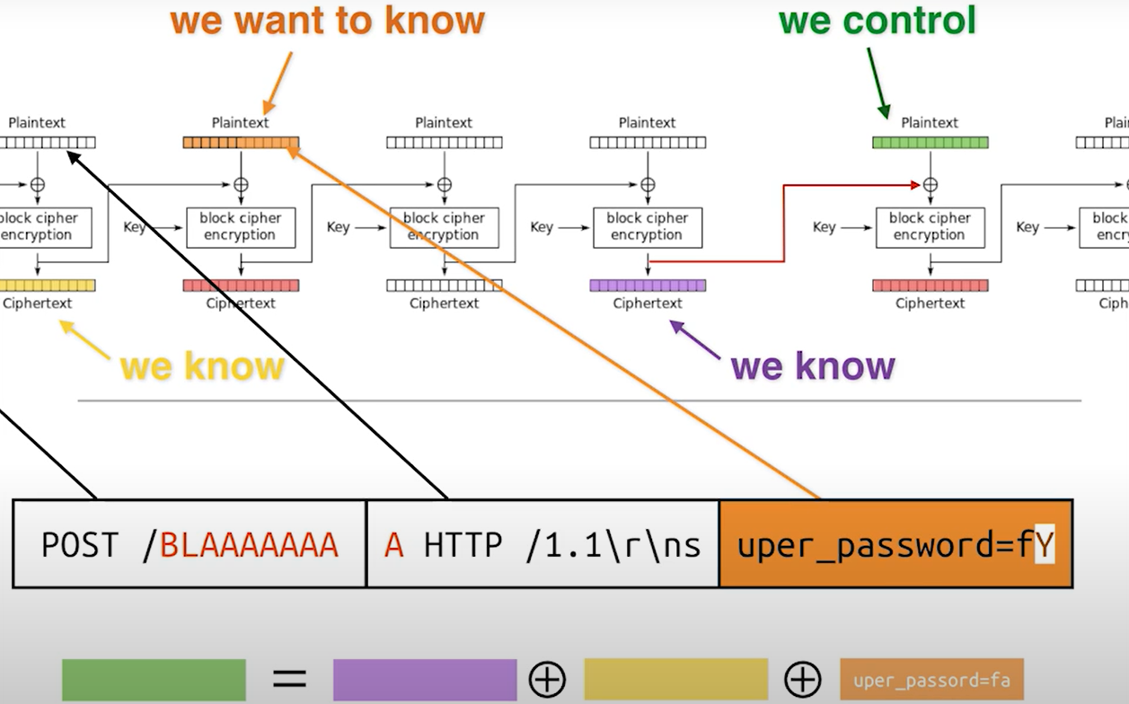
Notes:
Notice the change in the URL path

Slide 17

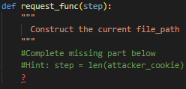
Part 2: CTF instructions
Two CTF challenges: Beginner and Advanced. Each challenge created by removing some code parts of the E2E ’Attacker’ implementation, where the Advanced challenge created by removing more parts than the Beginner.
Participants should add the missing code parts, denoted by '?’.
For example:
Hints: Any hints, if exist, will appear in a remark adjacent to the relevant missing code part, for example:

Slide 18
Instructions
In order to check your solution you should run the script.
If it prints the client's cookie, you have exploited the vulnerability and retrieved the flag.

Slide 19
How to run
Prerequisites: Docker must be installed on your system.
Use 4 different terminals for the bank server, malicious server, client and attacker(this is you).

Slide 20
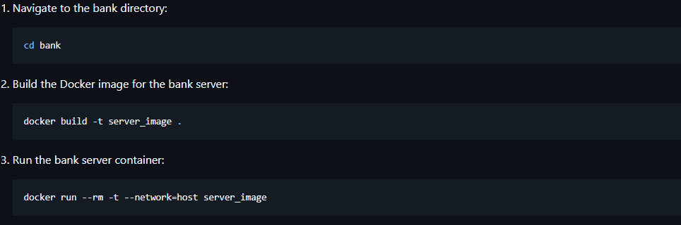
Build and run the Bank server
Notes:
docker build -t server_image .
docker run --rm -t --network=host server_image

Slide 21
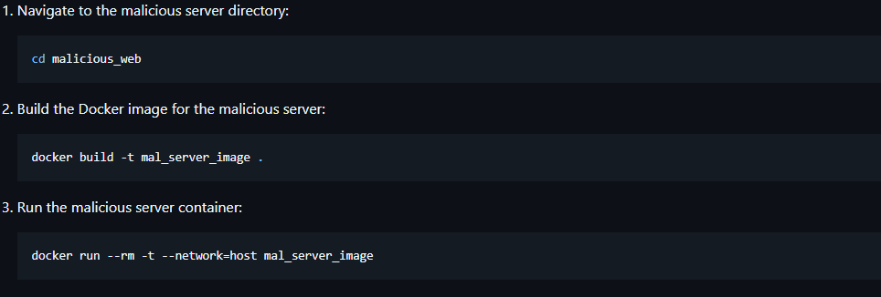
Build and run the Malicious server
Notes:
docker build -t mal_server_image .
docker run --rm -t --network=host mal_server_image

Slide 22
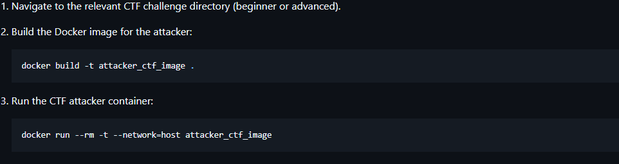
Build and run the Attacker (your implementation)
Notes:
docker build -t attacker_ctf_image .
docker run --rm -t --network=host attacker_ctf_image

Slide 23
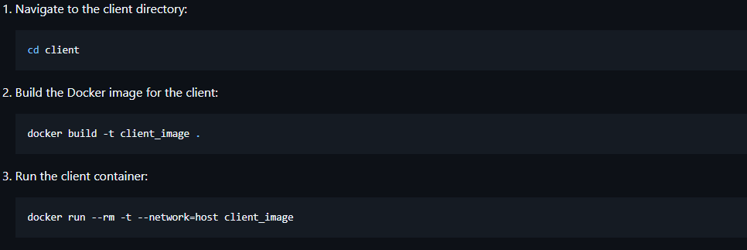
Build and run the Client
Notes:
docker build -t client_image .
docker run --rm -t --network=host client_image

