Slide 1
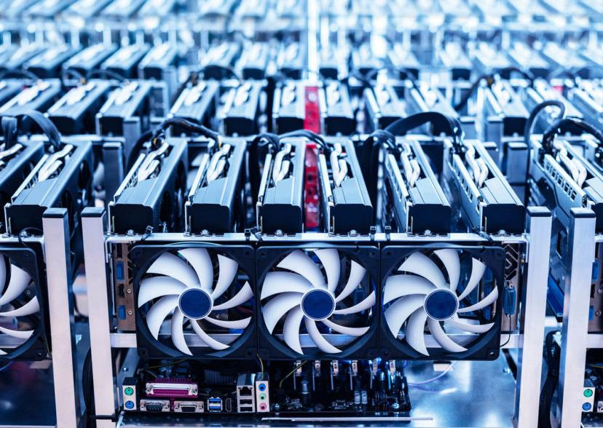
On the Economics of Cryptocurrency Mining
Aviv Zohar
The Hebrew University

Slide 2
Agenda for the talk
In this talk: Focus on cryptocurrency mining
Tomorrow: More about higher layers
Today:
An explanation of the bitcoin protocol
Mining equilibria
The protocol is not an equilibrium
Mining and risk

Slide 3


“Money is memory”
Digital Payments
Cash
Blue: 2
Red: 1
3

Slide 4

Back to decentralization
Digital Payments
Blue: 2
Red: 1
Bitcoin & similar currencies
Blue: 2
Red: 1
Blue: 2
Red: 1
Blue: 2
Red: 1
Blue: 2
Red: 1
Blue: 2
Red: 1
Consensus in a “permissionless” system
Blue: 2
Red: 1
Blue: 2
Red: 1
Blue: 2
Red: 1
4

Slide 5
Block Chain
New Block
Hash
Hash
Hash
Hash
Inconsistency may occur if blocks are created simultaneously by different nodes
(double spend problem)
Another Node’s Block

Slide 6

Block Chain
New Block
Hash
Nonce
Hash
Nonce
Hash
Nonce
Crypt. Hash
Solution:
Make block creation hard
Send blocks to others
Adopt conflicting blocks if they make up a longer chain.
00000001011011001
10101001011011001
Must be a small number for valid block (under some target value)
If not, change Nonce & try again
~ one block per 10 min. in the entire network
Difficulty adjusts once every 2016 blocks (2 weeks)

Slide 7


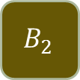


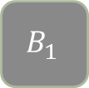






Make block creation hard (once every 10 minutes) via computational “puzzles”
Send blocks quickly to all
Adopt (conflicting) blocks iff they make up a longer chain
A
$${ B}_{1}$$
C
A
$${ B}_{1}$$
C
A
$${ B}_{1}$$
C
A
$${ B}_{1}$$
C
$${ B}_{2}$$
A
$${ B}_{1}$$
C
A
$${ B}_{1}$$
C
A
$${ B}_{1}$$
$${ B}_{2}$$
C
A
$${ B}_{1}$$
C
A
$${ B}_{1}$$
C
$$B_{2}$$

Slide 8
The Double-Spend Attack
A payment can be reversed!
Easy if attacker has >50% of compute power
Possible with less than 50%
Bitcoin’s Guarantee [Satoshi]:
If attacker controls < 50% of compute power, probability of block replacement decreases exponentially with time.

Slide 9


Incentives
Hash
Newly minted coins
“Mining”
Pay nodes for work (makes network large & secure)

Slide 10
From PoW to PoS
Newer approaches: Proof-of-Stake Deposit funds instead of waste compute resources
Bootstrapping using the system’s own currency
Maintains an open system

Slide 11


Tokens
NFTs
Other high level objects
Smart Contracts
Native currency
Sequenced Data
rewards
Sequencing
Consensus
Networking
Layers and how they are broken

Slide 12
Mining equilibria

Slide 13


A tale of two falafel vendors
Price
Price
Profit
Profit
Costs
Costs
Alice
Bob

Slide 14
A tale of two falafel vendors
Price
Price
Profit
Costs
Costs
Alice
Bob

Slide 15









What about miners?
Claim: $h_{2}=0$ is never an equilibrium
$U_{1}=\frac{h_{1}}{h_{1}+h_{2}}R−c_{1}h_{1}$
$U_{2}=\frac{h_{2}}{h_{1}+h_{2}}R−c_{2}h_{2}$
Alice
Bob
[Fiat, Karlin, Koutsoupias, Papadimitriou] Energy equilibria in proof-of-work mining. In EC 2019.

Slide 16






What about miners?
Claim: $h_{2}=0$ is never an equilibrium
$U_{1}=\frac{h_{1}}{h_{1}+h_{2}}R−c_{1}h_{1}$
$$h_{1}→0$$
Alice
$U_{2}=\frac{h_{2}}{h_{1}+h_{2}}R−c_{2}h_{2}$
Bob

Slide 17

What about miners?
Claim: $h_{2}=0$ is never an equilibrium
$U_{1}=\frac{h_{1}}{h_{1}+h_{2}}R−c_{1}h_{1}$
$$h_{1}→0$$
Alice
Bob

Slide 18
Consequences:
In equilibrium the two most efficient miners always mine, and have profit
(Other less efficient miners may also be present)
Alice
Bob

Slide 19
Deviations from the Bitcoin protocol are profitable

Slide 20


The Model (with low delays)
Each block created i.i.d by
Attacker $(prob α)$ or
Honest node $\left(prob 1−α\right)$
Specifies single parent
Pay blocks on longest-chain
H
H
H
A
A

Slide 21
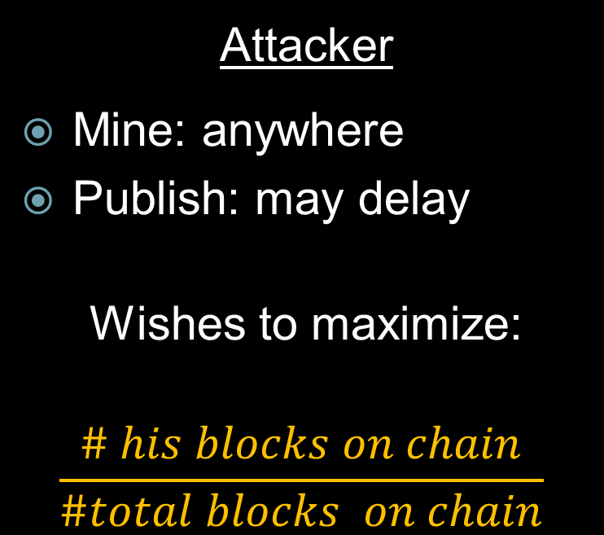
Honest nodes
Mine: longest chain
Ties broken in favor of earliest block received
Publish: Immediately
(as dictated by protocol)
Attacker
Mine: anywhere
Publish: may delay
Wishes to maximize:
$$\frac{\# his blocks on chain}{\#total blocks on chain}$$
H
H
A
A
A

Slide 22
Selfish Mining (SM1) [Eyal & Sirer]
H
H
H
A
A
A
Give up when honest chain is longer.
Override chain when attacker leads by 1

Slide 23
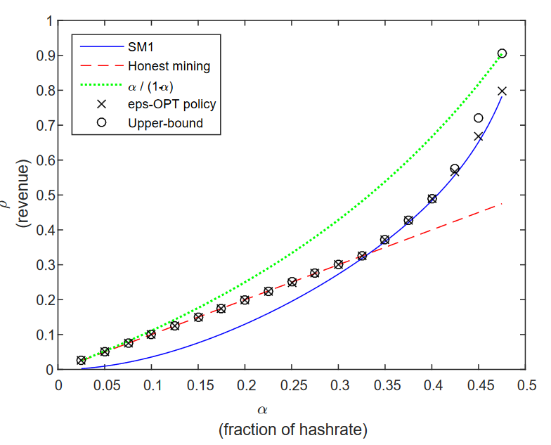

How to optimize attack? [Sapirshtein, Sompolinsky, Zohar]
Find policy $π:states→actions$ that will maximize reward.
Reduction to a series of undiscounted (average reward) Markov decision processes.
Solved by value iteration.

Slide 24

Difficulty adjustment
Hash rate
Bob
time
1 week
2016 blocks 2 weeks
2 weeks
2 weeks
Alice

Slide 25

Deviating from the protocol
Hash rate
Bob
time
2 weeks
4 weeks
1 week
4 weeks
1 week
Hash rate
Alice
time
[Goren, Guy, and Alexander Spiegelman]. "Mind the mining." EC 2019.
[Fiat, Karlin, Koutsoupias, Papadimitriou] Energy equilibria in proof-of-work mining. In EC 2019.

Slide 26





$R$ = block reward for 1008 blocks
Electricity cost = $\frac{7}{16}R$ per week
Hash rate
Reward: $1R⋅2 weeks$
Electric Bill: $\frac{7}{16}R⋅2 weeks$
Profit: $\frac{18}{16}R$
Bob
time
4 weeks
1 week
4 weeks
1 week
Hash rate
Reward: $\frac{1}{2}R⋅10 weeks$
Electric Bill: $\frac{7}{16}R⋅10 weeks$
Profit: $\frac{1}{16}R⋅10=\frac{10}{16}R$
time
Alice

Slide 27




Hash rate
“Time Stretching”
time
4 weeks
1 week
4 weeks
1 week
Hash rate
time
Deposit
Take loan
Fudge the block-rate
Accrues interest per block
Accrues interest per time unit

Slide 28
Selfish / strategic mining
Not observed in the wild. Why?
Speculation: Long-term incentives win over short term gains.
Until….
Yaish, Aviv, Gilad Stern, and Aviv Zohar. "Uncle maker:(time) stamping out the competition in ethereum." Proceedings of the 2023 ACM SIGSAC Conference on Computer and Communications Security. 2023.

Slide 29
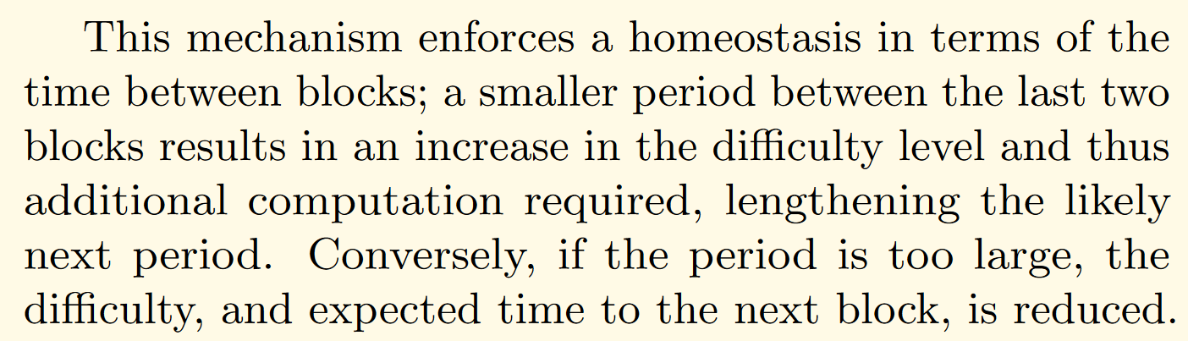
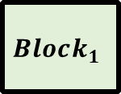


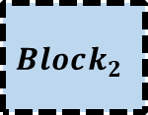

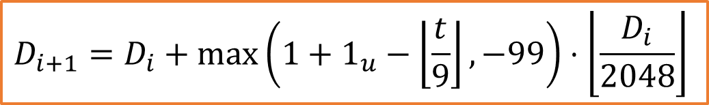
From the Ethereum yellow paper
$$D_{i+1}=D_{i}+\max\left(1+1_{u}−\left\lfloor \frac{t}{9}\right\rfloor ,−99\right)⋅\left\lfloor \frac{D_{i}}{2048}\right\rfloor$$
$$Δt_{1}$$
$$Δt_{2}$$
$$Block_{0}$$
$$Block_{1}$$
$$Block_{2}$$

Slide 30







Ethereum 1.0’s Difficulty Adjustment Algorithm
Dream rate: 1 block / ~13 seconds
Set the current difficulty according to elapsed time since last block
$$D_{i+1}=D_{i}+\max\left(1+1_{u}−\left\lfloor \frac{t}{9}\right\rfloor ,−99\right)⋅\left\lfloor \frac{D_{i}}{2048}\right\rfloor$$
Time: $t=100$
$$Block_{0}$$
$$Block_{1}$$
$$Block_{2}$$
$$D_{i}$$
$$D_{i+1}$$

Slide 31


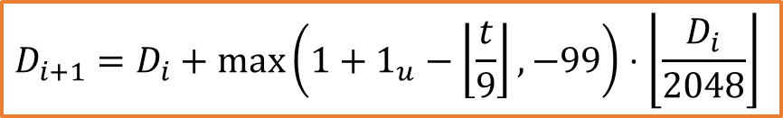
The attack: Riskless Uncle Maker (RUM)
Inter block Time: $$t=9$$
Block
Block
Block
?
Block
Block
$$t=8$$
$$D_{i+1}=D_{i}+\max\left(1+1_{u}−\left\lfloor \frac{t}{9}\right\rfloor ,−99\right)⋅\left\lfloor \frac{D_{i}}{2048}\right\rfloor$$
Protocols choosing the highest-difficulty chain must prefer the attacker’s block
Uncle rewards < Block rewards

Slide 32
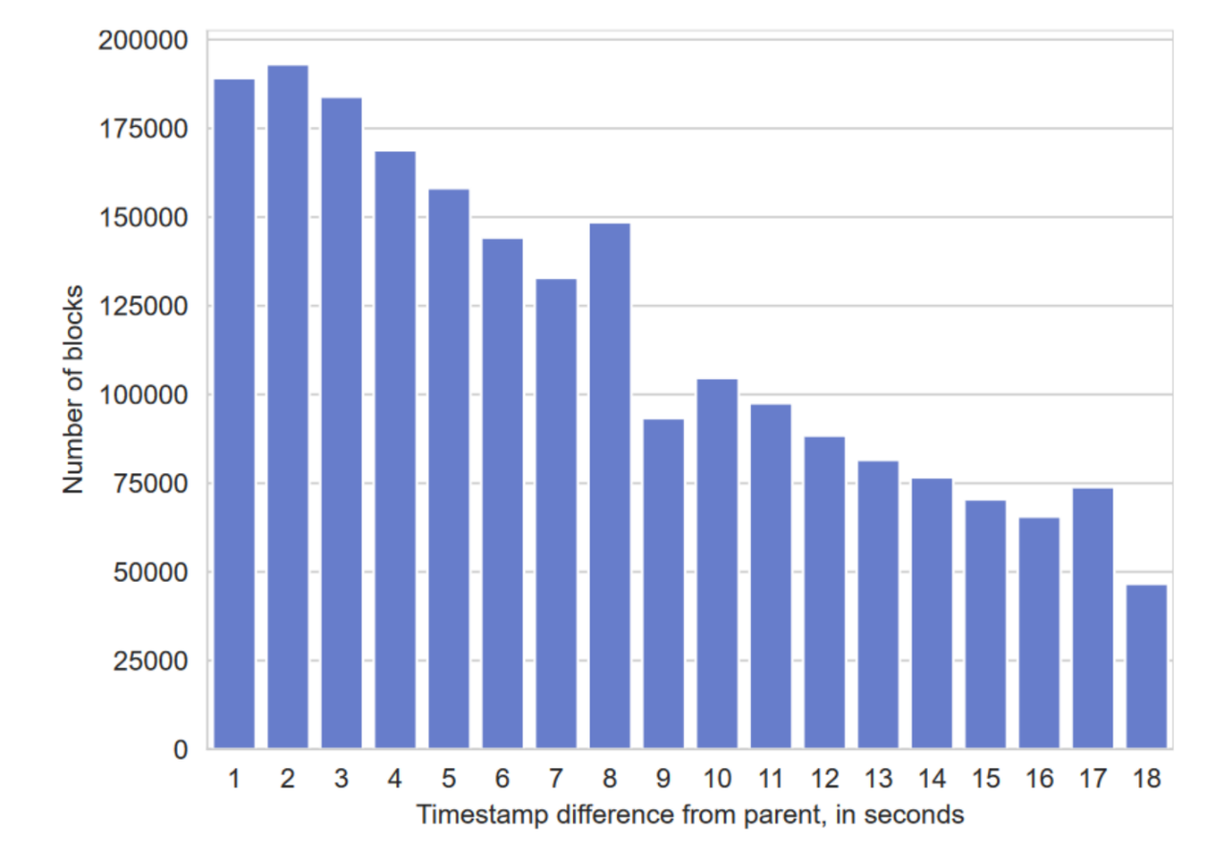
We went looking for timestamp manipulations
Main chain Blocks by time-from-parent
Starting at block 12,000,000 (a little over 500 days)

Slide 33
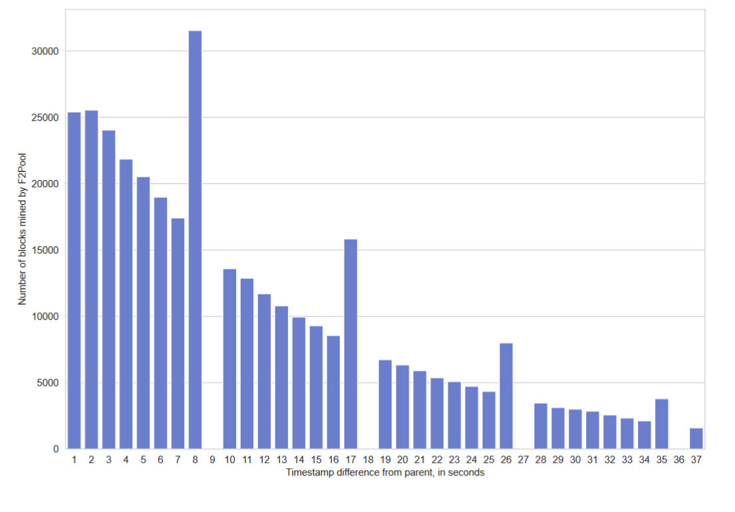
The smoking gun:
F2Pool’s inter-block time:

Slide 34
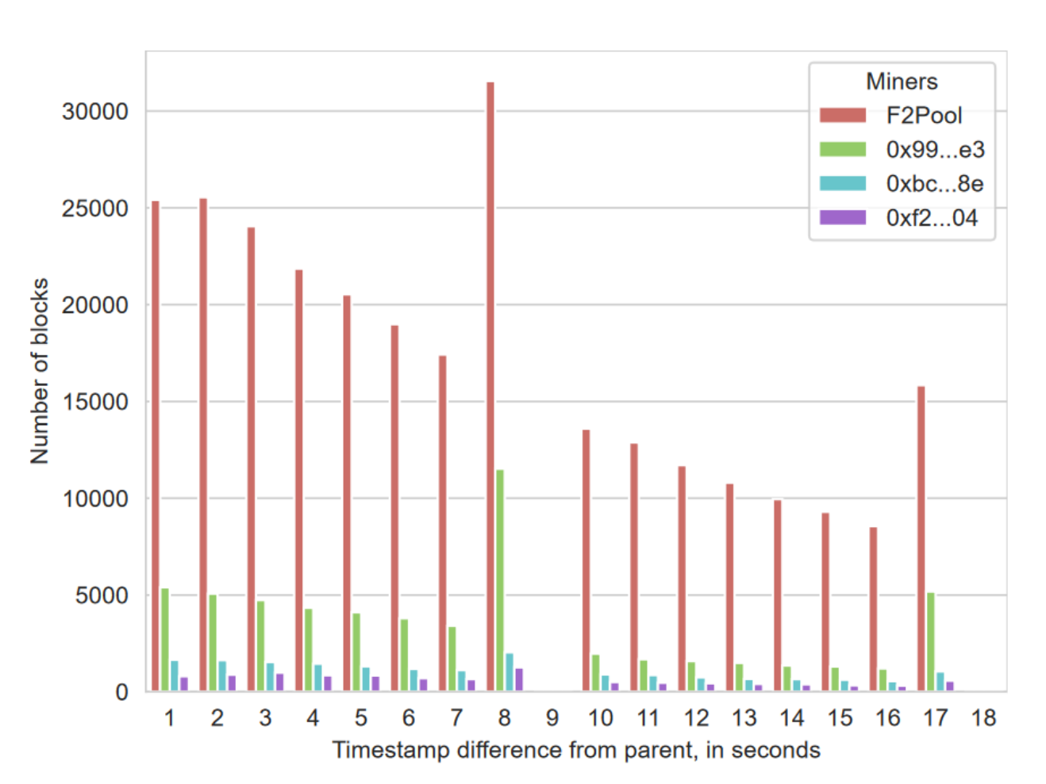
More suspicious behavior

Slide 35
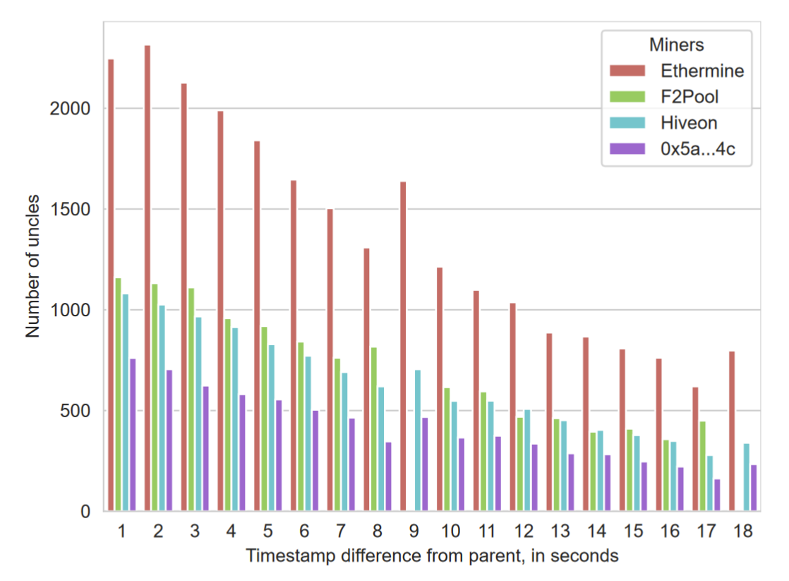
This is not a victimless crime:
Honest pools suffer higher uncle rates

Slide 36
Risk & Mining
Yaish, Aviv, and Aviv Zohar. "Correct Cryptocurrency ASIC Pricing: Are Miners Overpaying?."

Slide 37
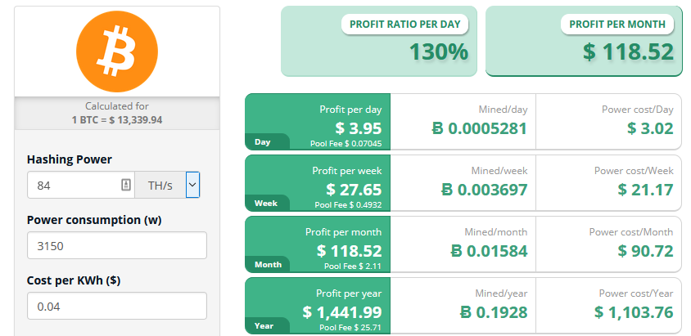
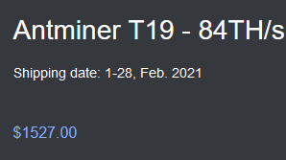
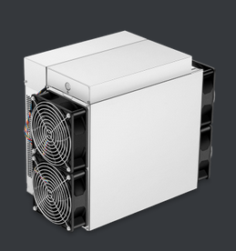
Mining calculators
(from cryptocompare.com)

Slide 38

The Expected Utility Model
Share of total hashrate
Exchange Rate (USD/BTC)
Electricity cost USD/KW
$$V\left(t,t,C_{t}\right)=\max\left(\frac{h}{H\left(t\right)+h }b_{t}⋅C_{t}−h⋅φ⋅e_{t},0\right)$$
Block Reward (BTC)
KW spent over 10 minute mining period
Not mining

Slide 39
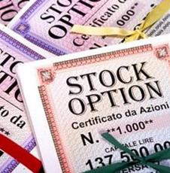

Mining hardware is economically equivalent to [a bundle of] options
A European option
A contract
allowing you to buy an asset
at the “Exercise date”
For a predetermined “strike price”
The option holder may choose not to buy the asset
Bitcoin mining hardware
A machine
Allowing you to obtain Bitcoins
At a different times
In exchange for a fixed amount of electricity
The miner may turn off his machine

Slide 40

Miners:

Slide 41

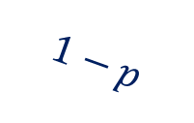












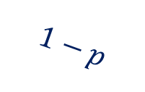
The Binomial Model
$$Δ^{2}C$$
A discrete version
(simpler than stochastic differential equations)
Time proceeds in rounds
Price preforms a multiplicative random walk.
During each round, you can trade bitcoins, and other assets
$$p$$
$$Δ⋅C$$
$$p$$
$$C$$
$$1−p$$
$$δΔC$$
$$p$$
$$1−p$$
$$δ⋅C$$
$$1−p$$
$$δ^{2}C$$
$$t$$
$$t+1$$
$$t+2$$

Slide 42



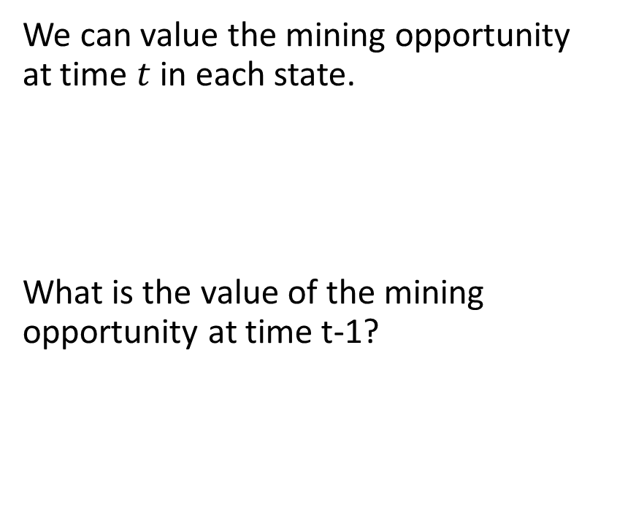



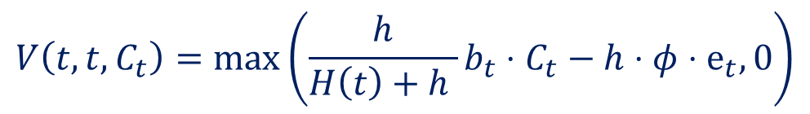


The Binomial Model
Mining opportunity at time t
Value?
We can value the mining opportunity at time $t$ in each state.
What is the value of the mining opportunity at time t-1?
$$Δ⋅C$$
$$p$$
$$V\left(t,t,C_{t}\right)=\max\left(\frac{h}{H\left(t\right)+h }b_{t}⋅C_{t}−h⋅φ⋅e_{t},0\right)$$
$$C$$
$$1−p$$
$$δ⋅C$$
$$t−1$$
$$t$$
$$V\left(t−1,t,C_{t−1}\right)= ?$$

Slide 43

The Binomial Model
Mining opportunity at time t
Value?
You might be tempted to use the expected value of the option:
That would be incorrect.
$$Δ⋅C$$
$$p$$
$$C$$
$$V\left(t−1,t,C_{t−1}\right)=E_{C_{t}}\left[V\left(t,t,C_{t}\right)\right]$$
$$1−p$$
$$δ⋅C$$
$$t−1$$
$$t$$

Slide 44



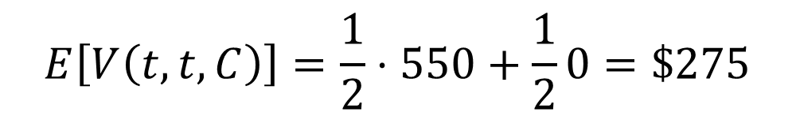

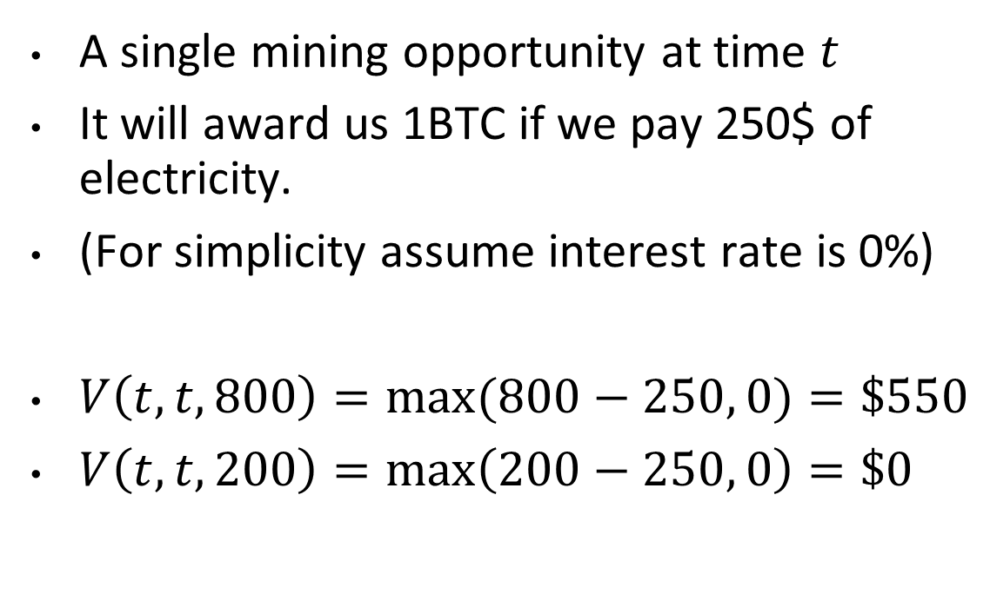


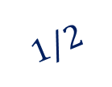


An example
$250
1 BTC
A single mining opportunity at time $t$
It will award us 1BTC if we pay 250$ of electricity.
(For simplicity assume interest rate is 0%)
$V\left(t,t,800\right)=max⁡(800−250, 0)=\$550$
$V\left(t,t,200\right)=\max\left(200−250, 0\right)=\$0$
Mining opportunity
$$800$$
$$1/2$$
$$400$$
$$1/2$$
$$200$$
$$E\left[V\left(t,t,C\right)\right]=\frac{1}{2}⋅550+\frac{1}{2}0=\$275$$
$$t−1$$
$$t$$

Slide 45

An example
$$E\left[V\left(t,t,C\right)\right]=\$275$$
$250
1 BTC
I’ll sell you a mining opportunity for $275
I’ll make a risk free profit
This implies that $275 is overpriced.
Mining opportunity
$$800$$
$$1/2$$
$$400$$
$$1/2$$
$$200$$
$$t−1$$
$$t$$

Slide 46
# | Step | Cash (USD) | Debt | BTC | Mining Opportunities
$$E\left[V\left(t,t,C\right)\right]=\$275$$
0 | Start of day | $$0$ | $$0$ | $$0$$ | $0$
$250
1 BTC
1 | Sell mining op | $$275$ | $$0$ | $$0$$ | $$−1$$
2 | Borrow $$183\frac{1}{3}$ | $$458\frac{1}{3}$ | $$183\frac{1}{3}$ | $$0$$ | $$−1$$
Mining opportunity
3 | Buy $\frac{11}{12}$ BTC | $$91\frac{2}{3}$ | $$183\frac{1}{3}$ | $\frac{11}{12}$ | $$−1$$
$$800$$
$$1/2$$
$$400$$
$$1/2$$
$$200$$
$$t−1$$
$$t$$

Slide 47


# | Step | Cash (USD) | Debt | BTC | Mining Opportunities
$$E\left[V\left(t,t,C\right)\right]=\$275$$
0 | Portfolio from prev day | $$91\frac{2}{3}$ | $$183\frac{1}{3}$ | $\frac{11}{12}$ | $$0$$
$250
1 BTC
1 | Sell Coins | $$275$ | $$183\frac{1}{3}$ | $$0$$ | $$0$$
2 | Repay Loan | $$91\frac{2}{3}$ | $$0$ | $$0$$ | $$0$$
Mining opportunity
$$800$$
$$1/2$$
$$400$$
$$1/2$$
$$200$$
$$t−1$$
$$t$$

Slide 48

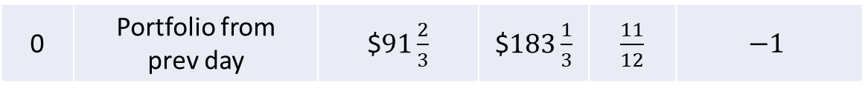

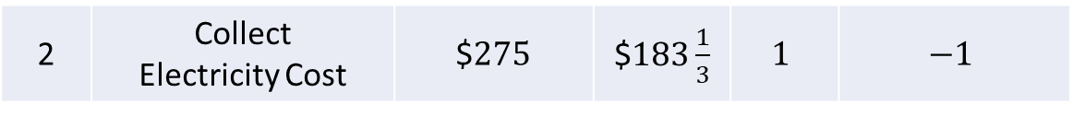
# | Step | Cash (USD) | Debt | BTC | Mining Opportunities
$$E\left[V\left(t,t,C\right)\right]=\$275$$
0 | Portfolio from prev day | $$91\frac{2}{3}$ | $$183\frac{1}{3}$ | $\frac{11}{12}$ | $$−1$$
$250
1 BTC
1 | Buy $\frac{1}{12}$ BTC | $$25$ | $$183\frac{1}{3}$ | $$1$$ | $$−1$$
2 | Collect Electricity Cost | $$275$ | $$183\frac{1}{3}$ | $$1$$ | $$−1$$
Mining opportunity
3 | Redeem Mining Op for 1 BTC | $$275$ | $$183\frac{1}{3}$ | $$0$$ | $$0$$
$$800$$
4 | Repay Loan | $$91\frac{2}{3}$ | $$0$$ | $$0$$ | $$0$$
$$1/2$$
$$400$$
$$1/2$$
$$200$$
$$t−1$$
$$t$$

Slide 49
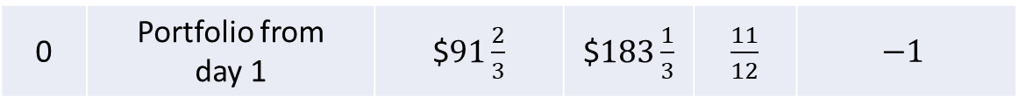
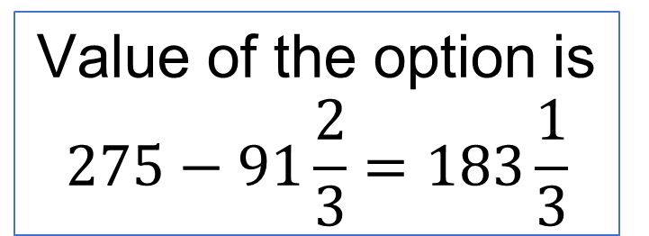
$$E\left[V\left(t,t,C\right)\right]=\$275$$
In both cases:
$250
1 BTC
# | Step | Cash (USD) | Debt | BTC | Mining Opportunities
0 | Portfolio from day 1 | $$91\frac{2}{3}$ | $$183\frac{1}{3}$ | $\frac{11}{12}$ | $$−1$$
Mining opportunity
1 | End of day 2 | $$91\frac{2}{3}$ | $$0$$ | $$0$$ | $$0$$
$$800$$
Risk Free Profit!
$$1/2$$
$$400$$
Value of the option is $$275−91\frac{2}{3}=183\frac{1}{3}$$
$$1/2$$
$$200$$
No arbitrage
$$t−1$$
$$t$$

Slide 50

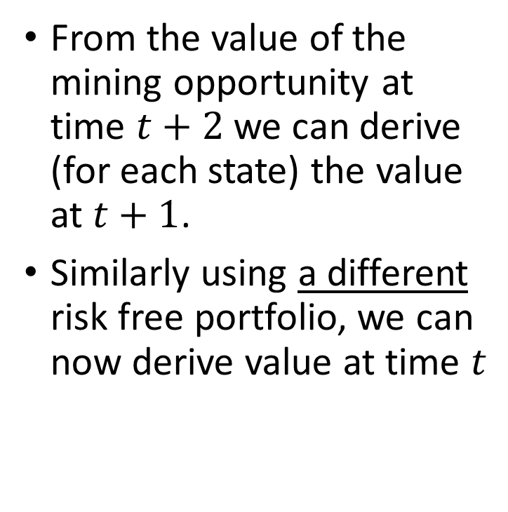










Generalization
$$Δ^{2}C$$
From the value of the mining opportunity at time $t+2$ we can derive (for each state) the value at $t+1$.
Similarly using a different risk free portfolio, we can now derive value at time $t$
$$Δ⋅C$$
$$p$$
$$C$$
$$δΔC$$
$$1−p$$
$$δ⋅C$$
$$δ^{2}C$$
$$t$$
$$t+1$$
$$t+2$$

Slide 51
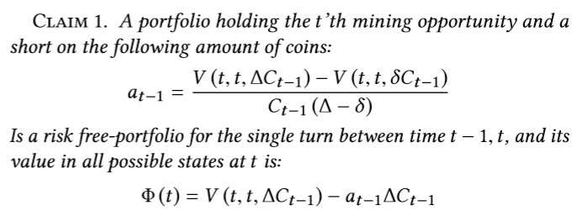
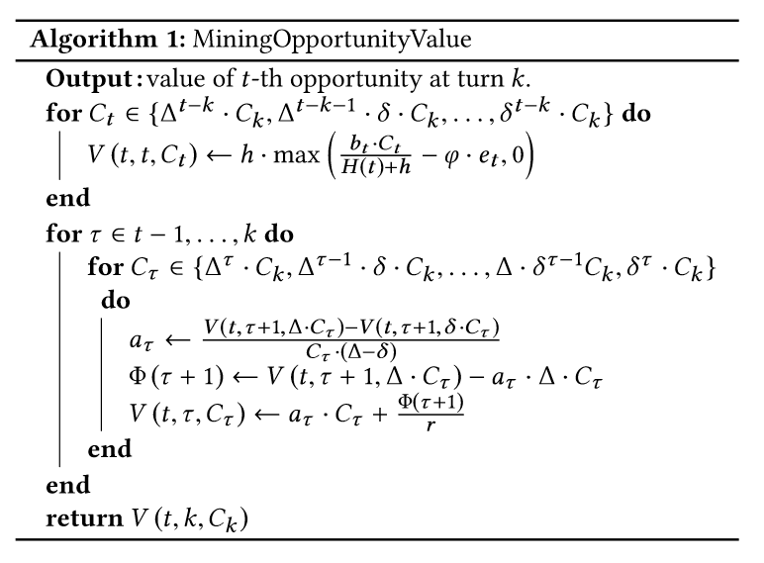
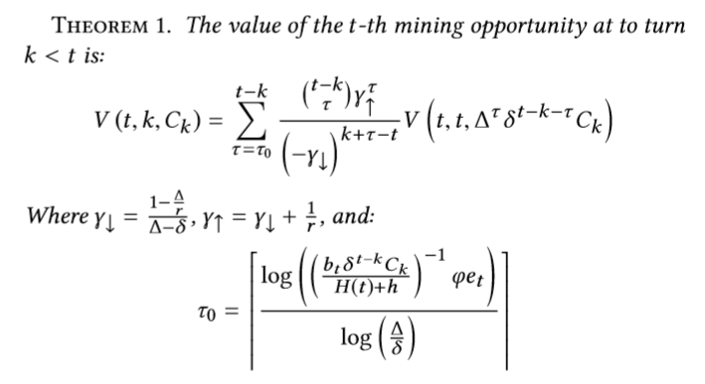
Computing the value of the mining opportunity:
For the single step:
Multiple steps:

Slide 52
Implications:
Bitcoin’s Volatility increases ASIC value!
Indirectly provides more security to the currency for the same cost
Imitating portfolios provide an alternative investment strategy
Gets better as volatility & exchange fees decline
Lower mining incentives?
# | Step | Cash (USD) | Debt | BTC | Mining Opportunities
0 | Portfolio from day 1 | $$91\frac{2}{3}$ | $$183\frac{1}{3}$ | $\frac{11}{12}$ | $$−1$$
1 | End of day 2 | $$91\frac{2}{3}$ | $$0$$ | $$0$$ | $$0$$

Slide 53
