Slide 1
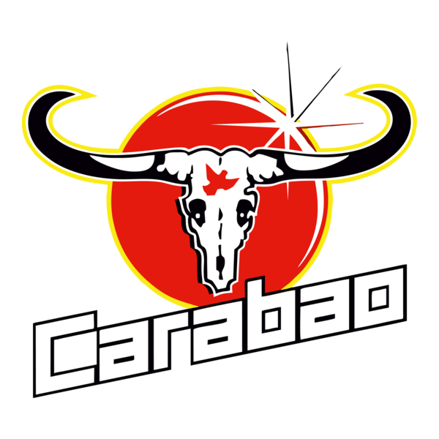
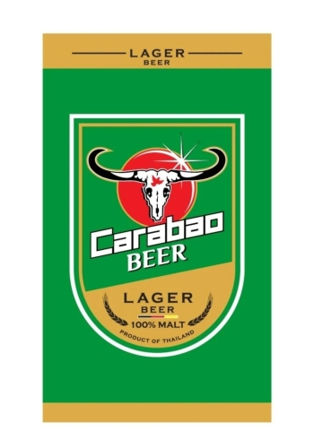
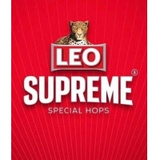
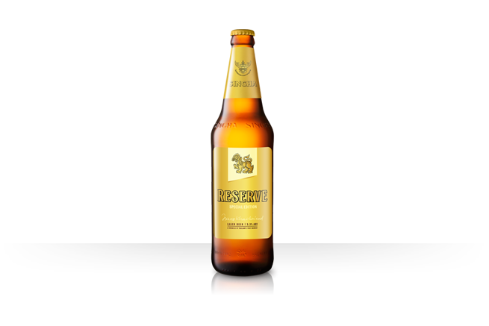
CARABAO BREWERY | LONG-TERM STRATEGY | AVI YASHAYA
Get Brand Identity On Par With Operational Modernization
A focused growth blueprint for Carabao Brewery built by Avi Yashaya, Partner & CEO of Mahanakhon Beverages.
10+ years building beverage systems across Thailand, Vietnam, and Laos.
Global sourcing + regional production model proven in beer, spirits, and RTD.
Direct track record: products generating $2M+ annual retail and on-trade sell-through.
Goal: reposition Carabao beer from volume play to modern relevance and profitable share gain.
Avi Yashaya | aviyashaya@gmail.com

Slide 2
PROBLEM HOOK
The Double-Edged Dilemma in Thai Beer
SME ambition vs. industrial reality
High MOQs, complex logistics, and tight cash cycles punish innovation speed.
Incumbent scale vs. cultural velocity
Large players optimize plants but often launch too slowly for new urban demand patterns.
Growth is constrained by production economics before consumer demand is validated.
Commercial teams discount to move volume instead of improving brand value.
Brand architecture remains traditional while young urban drinkers move to lifestyle-driven choices.
Data arrives late by the time products reach market.
Core identity can become functional and price-led rather than aspirational.
Result: SAM is under-penetrated and SOM growth stalls.

Slide 3
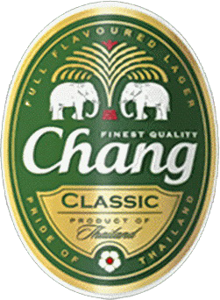

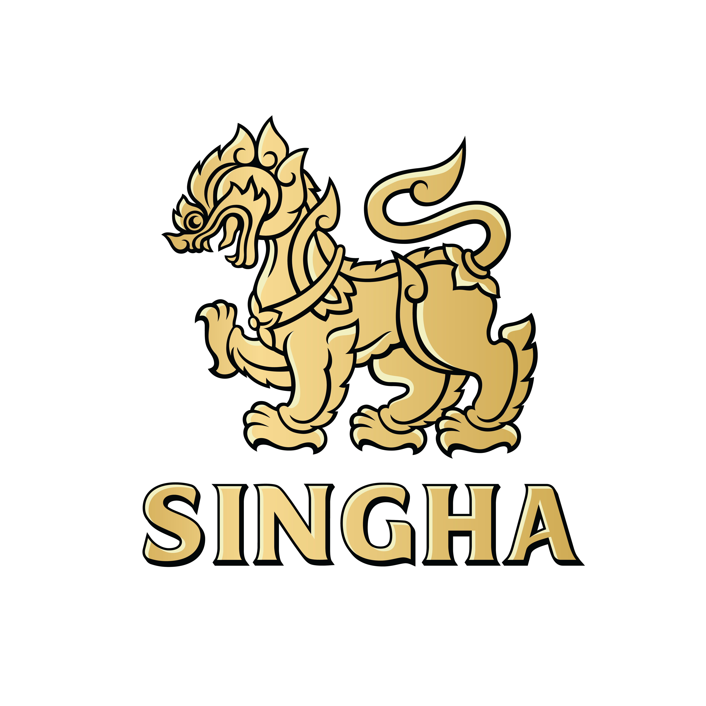
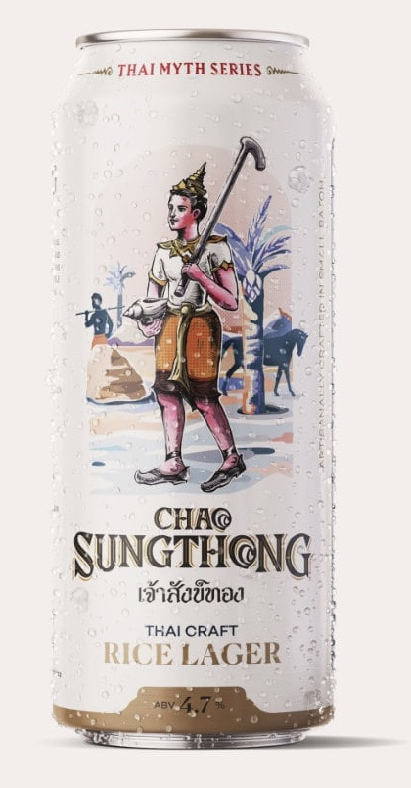
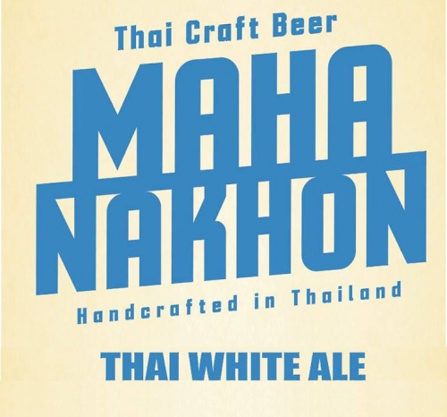
FIVE BRANDING FRAMES
Thai Beer Positioning Is Not One Market, It Is Five Frames
1) Animal / Power
Chang, Leo, Carabao
2) Myth / Heritage
Singha, Chao Sungthong
3) Geographic
Mahanakhon, Chiang Mai
4) Subculture
Outlaw craft, gatekept niches
5) Modern Aspirational
The open growth gap
Masscult/traditional frames still dominate spend, but growth is shifting toward culturally fluent lifestyle positioning.
Frame 5 is where younger urban consumers reward style, social signaling, and daily-luxury accessibility.

Slide 4
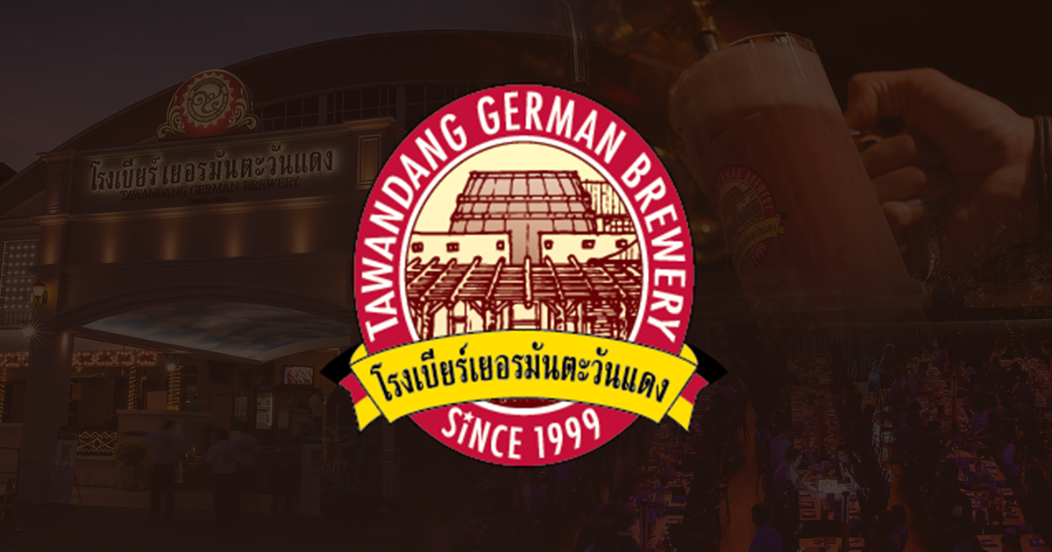
CURRENT LIMITATIONS
Where Current Framing Limits Growth Velocity
Carabao
Strong awareness, but still coded by many younger urbanites as 'heavy worker' or 'cheap night out'.
Tawandang
High familiarity, but can feel rigid or 'what my dad drinks' in modern casual lifestyle spaces.
Pattaya / Phuket / CNX labels
Local relevance can trap brands in a tourist-frame and reduce national scalability.

Slide 5
SAM TO SOM
Carabao Beer Presentation Is Not Optimized for SAM
Current state
Strong distribution logic, weaker lifestyle translation in premium-adjacent urban occasions.
Unlock SAM
Reframe identity into modern-retro aspirational cues without losing Thai mass resonance.
Increase SOM
Product and pack upgrades convert broader addressable audience into repeat buyers.
Price-led
Segment-coded
Limited aspiration cues
Modernized visual language
Occasion-specific proposition
Urban social proof systems
Higher trade-up rate
Better margin mix
Higher share in high-value outlets

Slide 6
PROOF OF PRINCIPLE
Boon Rawd Shows the Playbook Works
Example: Leo Supreme + Singha Reserve
Classic brand equity extended into premiumized, modernized sub-lines.
Strategic implication for Carabao
Retain mass-scale strengths while building a modern aspirational tier to expand profitable share.
Use premium line extensions to reset brand perception without abandoning core volume.
Anchor identity in clearer lifestyle codes (not only traditional category cues).
Build faster innovation loops tied to channel-specific consumer behavior.

Slide 7
RELEVANT CREDIBILITY
Mahanakhon: From Geographic Niche to Aspirational Relevance
We had to solve the same Frame-3 trap: local pride alone was not enough to scale.
Shifted through collaboration, social awareness, and aspirational storytelling.
Linked brand language with commercial systems: sourcing, production, and route-to-market cadence.
Result: sustained product traction and $2M+ annual sell-through across retail and on-trade.
This operating path is directly portable to Carabao's beer reset.

Slide 8
ACTION FRAMEWORK
Action Plan: Identity + Product + Commercial System
Phase 1 | Reframe
Rebuild visual and verbal identity around modern Thai confidence, not low-price cues.
Phase 2 | Product
Launch targeted line upgrades (liquid profile, pack architecture, and occasion fit).
Phase 3 | Route-to-Market
Prioritize outlets where perception and margin uplift can happen fastest.
Phase 4 | Scale
Codify playbook and expand once premium-to-core halo effect is measurable.

Slide 9
PRODUCT DEVELOPMENT TO LIFT SOM
Priority Product Moves to Convert SAM Into SOM
Platform 1: Urban Core
Cleaner lager profile, upgraded pack design, stronger social occasion fit.
Platform 2: Premium Bridge
Limited/seasonal variants that cue craft-quality while staying accessible.
Platform 3: Channel Exclusives
Account-specific SKUs for modern trade, convenience, and on-trade.
Design rule: every SKU must carry both volume logic and identity logic.
Commercial rule: sequence innovation by margin upside and outlet influence, not by internal preference.

Slide 10
ENGAGEMENT MODEL
Execution With Avi Yashaya
Scope
Brand architecture, product strategy, partner orchestration, and route-to-market execution cadence.
KPIs
Perception lift, premium mix growth, repeat purchase, and share gains in priority urban channels.
1) Diagnostic sprint
2) 90-day transformation blueprint
3) Weekly implementation governance
4) Quantified SAM-to-SOM scorecard
Outcome target: move from price-coded beer to modern Thai choice architecture.
Contact: aviyashaya@gmail.com

Slide 11
VISUAL REFERENCES
Web-Sourced Logos and Product References Included
Carabao logo: images.seeklogo.com
Singha logo: Wikimedia Commons (File: Singha_Beer_Logo.png)
Tawandang brand visual: tawandang.com
Product references: Untappd pages for Carabao Lager, Chang Classic, Leo, Singha, Chao Sungthong, Mahanakhon White Ale, Leo Supreme, and Singha Reserve.
Supplemental bottle visual: Wikimedia Commons (File: Thailand-Leo-Beer.jpg).

