Slide 1
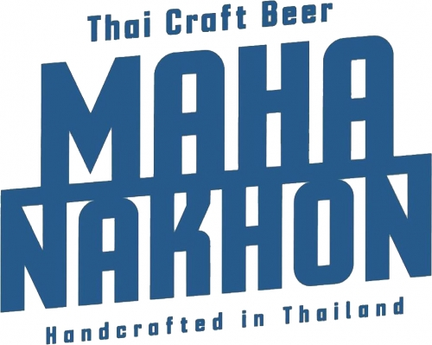
Avi Yashaya
Partner & CEO, Mahanakhon Beverages Co., Ltd NPD Consultant for Beverage Growth Across Southeast Asia Built an operating platform behind products delivering $2M+ annual sell-through
aviyashaya@gmail.com

Slide 2
Market Reality
The Double-Edged Dilemma for Beverage Producers in Southeast Asia
SMEs with ambitions of building Southeast Asia's next big beverage brand collide with industrial MOQs and harsh logistical, supply chain, and cash flow crises.
Institutional players struggle to keep up with fast consumer shifts because their data is often past its best-before date by the end of a slow development timeline.
Result: one side cannot scale efficiently, the other cannot adapt fast enough, and both lose speed, margin, and market relevance.
This is the exact operating gap I help clients close.

Slide 3
Action Plan
Actionable System I Implement (Built from 10+ Years in Market)
Step 1 - Partner stack: leverage the region's strongest strategic partners for R&D, production, packaging, and route to market.
Step 2 - MOQ-aware build plan: sequence pilot-to-scale production in Thailand and Vietnam across Brewery, Distillery, and RTD to avoid cash burn.
Step 3 - Supply continuity by design: lock critical raw material flow, including hops from USA and New Zealand, with quality/spec alignment and dual-lane planning.
Step 4 - Commercial math: build channel-specific price architecture and margin logic before launch, not after discounting pressure starts.
Step 5 - Execution cadence: run launch governance that shortens development-to-shelf cycles and keeps decisions tied to live market signals.
Let's leverage the region's best strategic partners and build systems that bring Asia's next big beverage to life.

Slide 4
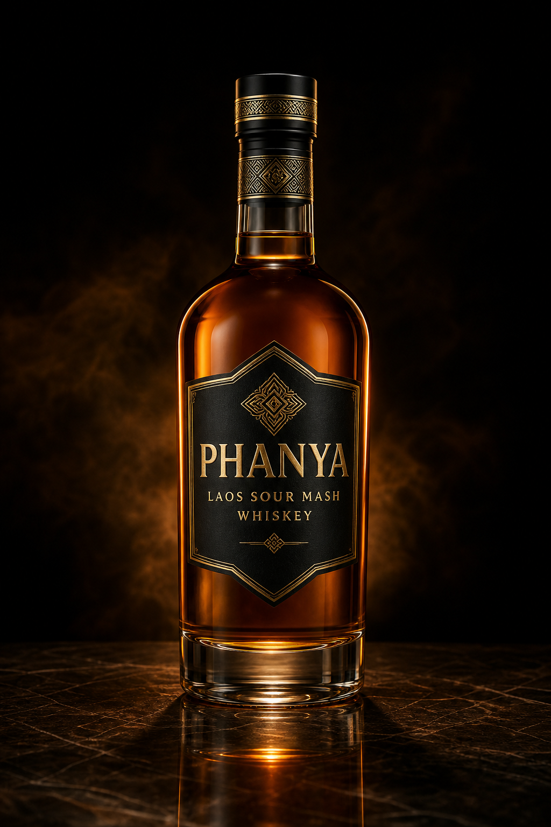
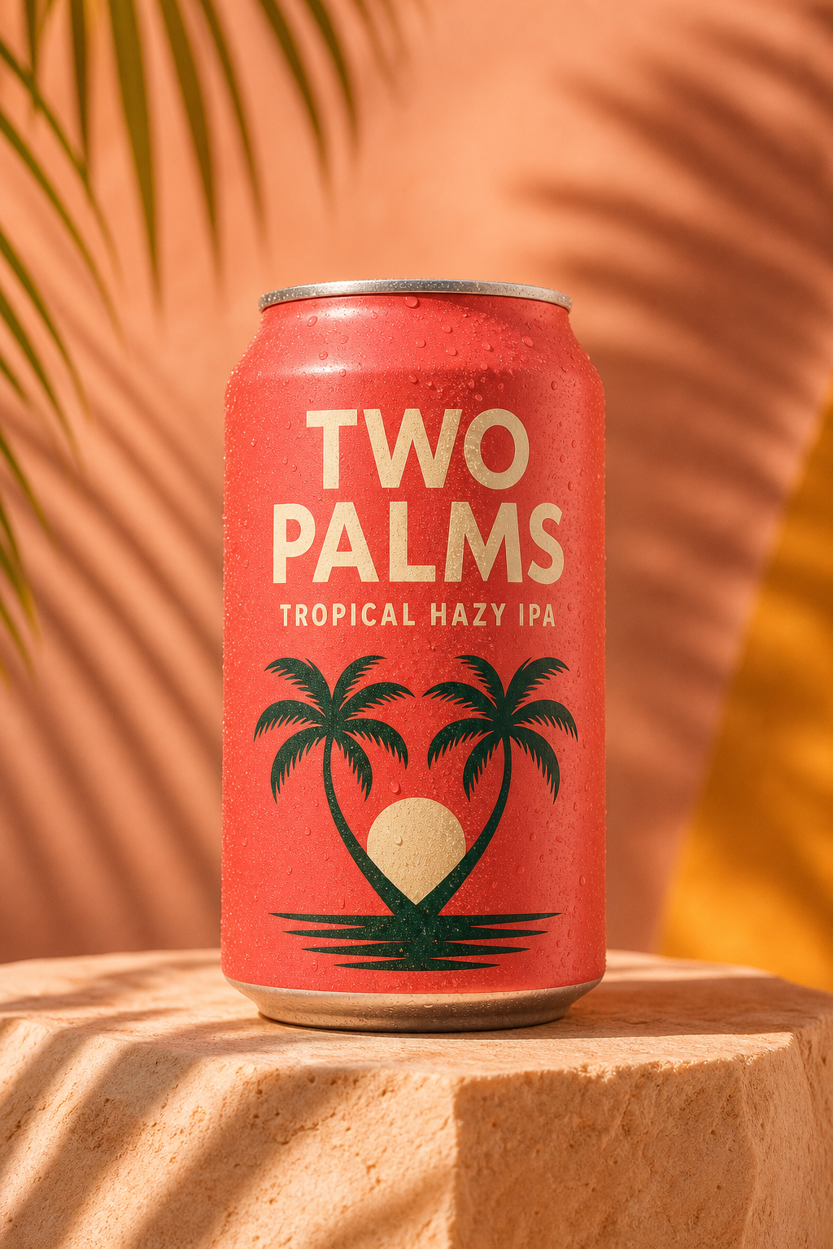

Brand + Concepts
Mahanakhon Brand Identity + Product Concepts
Integrates the sourced Mahanakhon logo and concept-ready product visual placements.
PHANYA
Laos Sour Mash Whiskey
TWO PALMS HAZY
Tropical Hazy IPA
SHIMAPAN
Highball Club

Slide 5
Global Supply Chain
Hyper-Specific Operating Model: Source Global, Produce Local, Sell Regional
Raw materials: hop procurement from the USA and New Zealand with quality/spec alignment and cost controls.
Production backbone: partner plants in Vietnam and Thailand across Brewery, Distillery, and RTD categories.
Packaging network: coordinated can, bottle, closure, and label suppliers to protect lead time and cash flow.
Regional flow: finished goods exported to convenience store channels in Taiwan and Japan.
Market expansion support: launch blueprints for clients opening new beverage markets in Laos.
Result: diversified supply continuity with practical production optionality across countries and categories.

Slide 6
Regional Commercialization
Route-to-Market and Pricing Strategy by Market
Thailand + Vietnam
Laos Market Entry
Position portfolio by channel: modern trade, convenience, and on-trade activation.
Set margin architecture for producers, importers/distributors, and retailers.
Build launch calendars tied to local demand windows, events, and consumer behavior.
Run SKU-by-SKU pricing ladders to protect both velocity and gross margin.
Define import or local production model based on tax and duty realities.
Build first-wave assortment with clear opening price points and premium anchors.
Train distributor teams on product story, outlet pitch, and sell-in mechanics.
Stage rollout by city and outlet class to maximize conversion with controlled risk.

Slide 7
Relationships
A Working Network Built Over a Decade
Supply + Production Partners
Commercial Partners
Hop and ingredient suppliers in the USA and New Zealand.
Manufacturing partners in Thailand and Vietnam covering beer, spirits, and RTD.
Packaging suppliers for cans, bottles, cartons, and labels with scalable capacity.
Quality and operational alignment across partners to speed launch readiness.
Distributors and route-to-market operators across Thailand, Laos, and Vietnam.
Retail and convenience channel relationships in Taiwan and Japan export routes.
On-trade account development through practical pricing and menu placement strategy.
Cross-functional partner management to maintain execution standards and timelines.

Slide 8
Category Scope
Cross-Category Execution Capabilities
Brewery: concept-to-commercialization support for craft and premium beer portfolios.
Distillery: liquid positioning, production planning, and go-to-market design for spirits.
RTD: speed-to-market product development and scalable production transition support.
Integrated portfolio strategy to prevent channel conflict and maximize total account value.

Slide 9
Commercial Evidence
Selected Outcomes Delivered
Built and operated systems behind Mahanakhon products now exceeding $2M annual retail + on-trade revenue.
Structured practical supply chain pathways linking global ingredient sourcing to regional production execution.
Developed export-ready operating flows for convenience store channels in Taiwan and Japan.
Supported market-opening strategy for Laos with channel-specific launch sequencing and price architecture.
All outcomes based on direct operating involvement in sourcing, production, and commercialization.

Slide 10
Engagement Model
How I Work With Beverage Companies
Advisory + Operating Sprint
Fractional NPD Leadership
30-90 day focused engagements for market entry, product launch, or supply chain redesign.
Workstreams: sourcing, plant partner selection, packaging readiness, pricing, and channel plan.
Weekly decision cadence with leadership team and execution owners.
Output: clear operating playbook with accountability and rollout checkpoints.
Embedded support for teams that need senior NPD and commercialization leadership.
Cross-functional bridge between procurement, operations, marketing, and sales.
Focus on profitable scale, not just innovation theater.
Output: repeatable launch process that compounds over multiple product cycles.

Slide 11
Ideal Clients
Best Fit Engagements
Global or regional beverage companies entering Southeast Asia.
Established players needing stronger execution in Thailand, Vietnam, or Laos.
Teams expanding across beer, spirits, and RTD categories with shared infrastructure.
Businesses seeking local operator credibility plus strategic clarity at executive level.

Slide 12
Contact
Let’s Build the Next Profitable Beverage Platform
Avi Yashaya
Partner & CEO, Mahanakhon Beverages Co., Ltd
NPD Consultant
Email: aviyashaya@gmail.com
Let's leverage the region's best strategic partners for R&D, production, and route to market to bring Asia's next big beverage to life.

