Slide 1


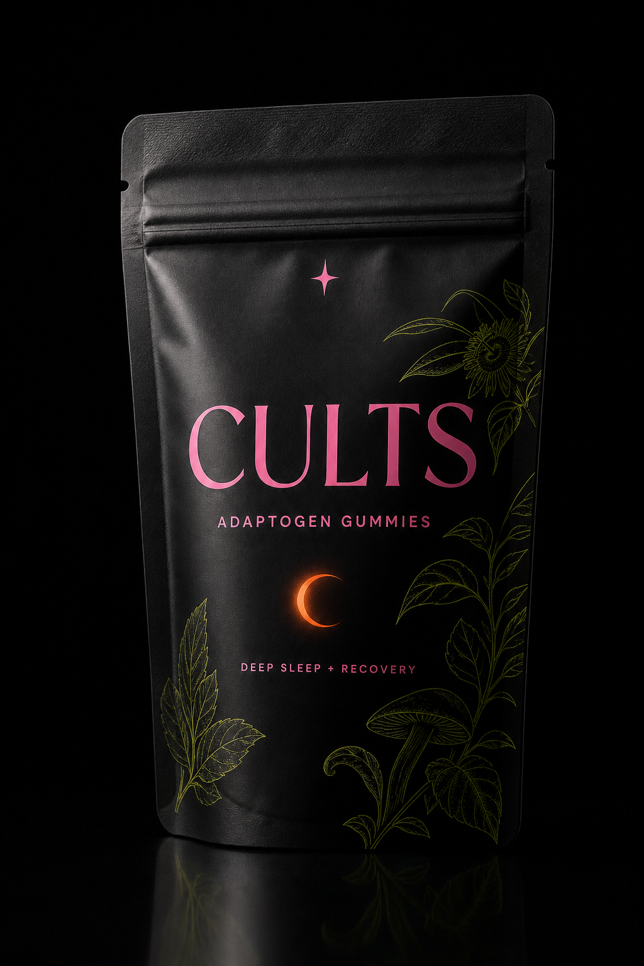
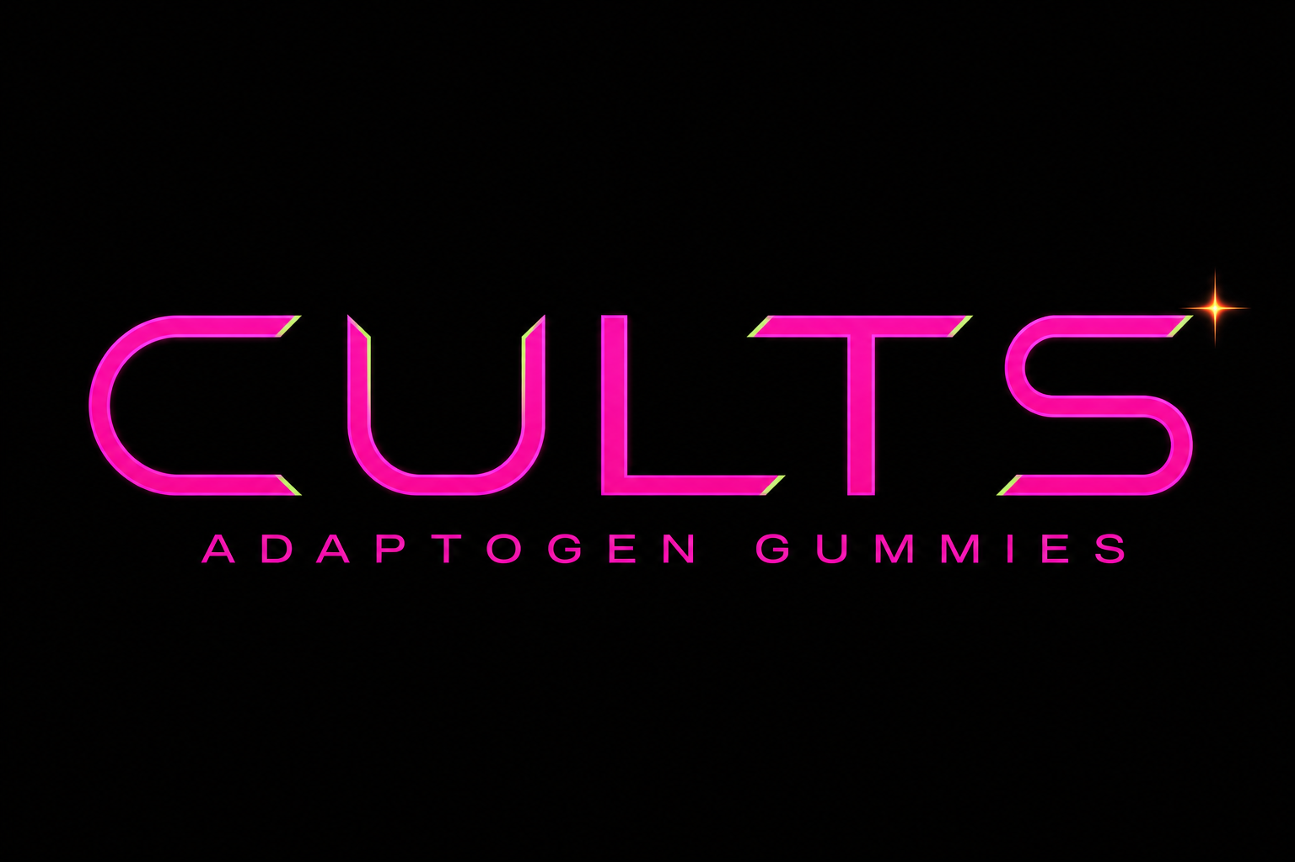
@drinkcults
Business use - Highly confidential
Recovery Ritual - OEM partnership proposal for boutique and luxury hotels
RECOVER LIKE YOU MEAN IT

Slide 2
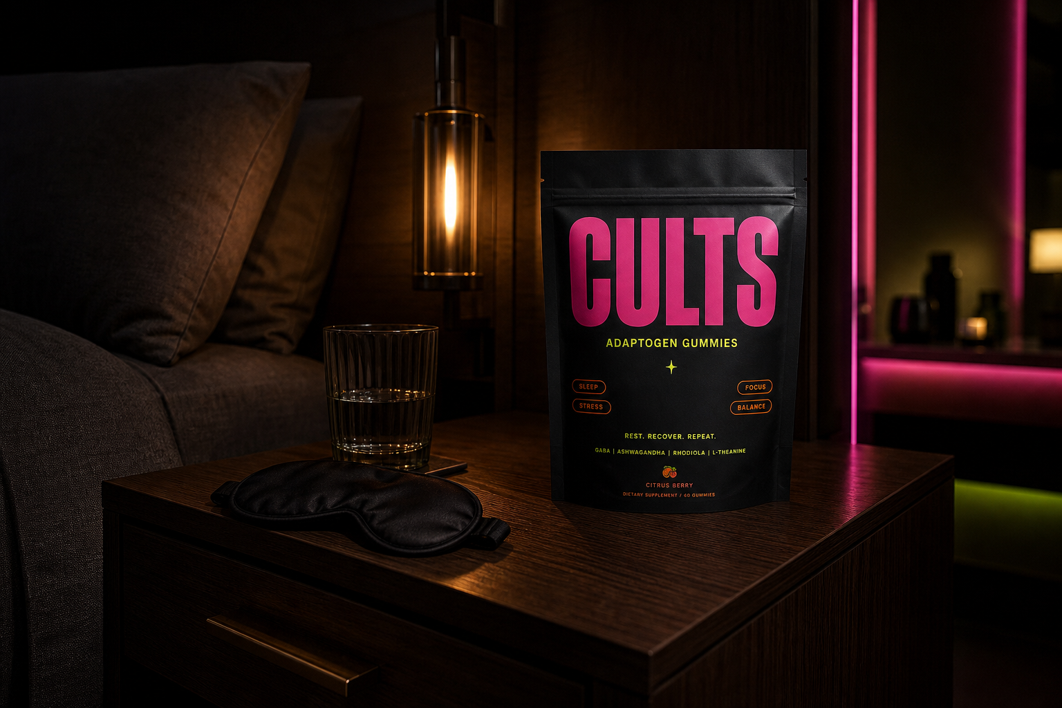
@drinkcults
Business use - Highly confidential
Introduction
Brief business overview
Cults makes functional gummies for modern travelers who want recovery and deeper sleep without the clinical wellness aesthetic.
Vision statement
To become the in-room ritual guests trust the moment their trip starts to tax their body and sleep cycle.
Mission statement
Put one honest, effective pouch in every room that needs a fast, feel-good reset.
What's in the pouch
Deep Sleep blend:
reishi + ashwagandha + magnesium + passionflower + l-theanine
Recovery blend:
cordyceps + tart cherry + turmeric + mangosteen
No powders. No capsules. No fake pharma voice.
Just one premium pouch guests can actually enjoy using.

Slide 3
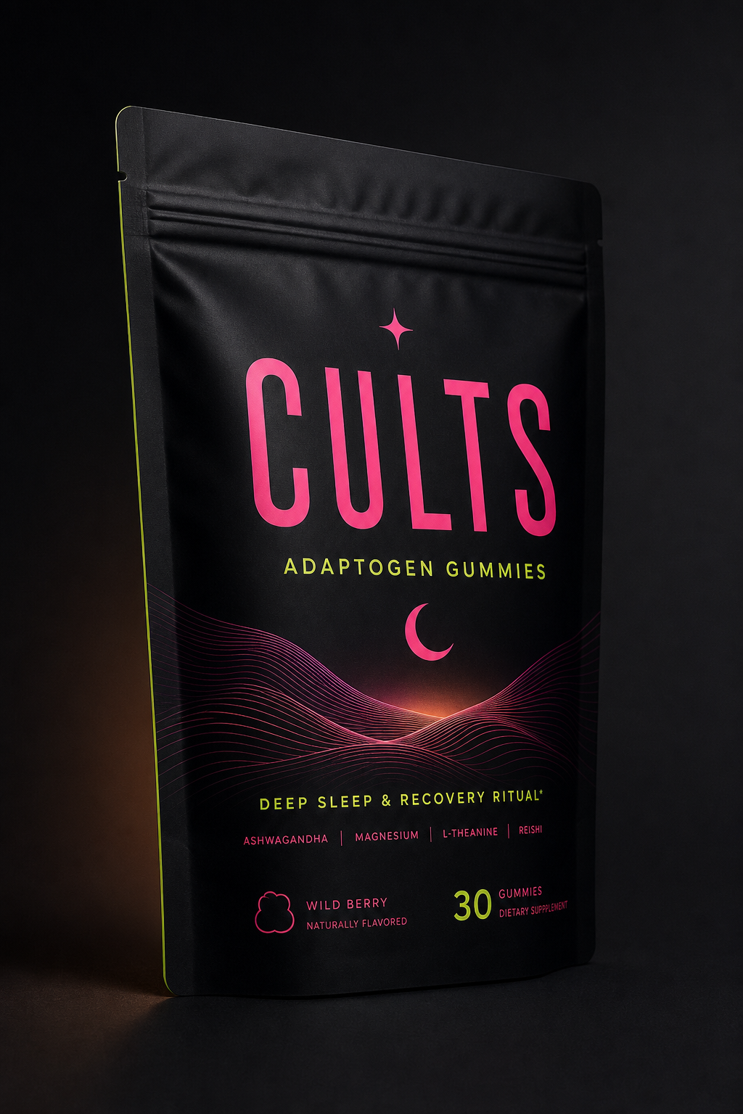
@drinkcults
Business use - Highly confidential
Who we are
Cults is a Thai functional gummy brand built for people who think wellness can be real, stylish, and simple.
For hotels, that becomes a guest-facing amenity that helps jet-lagged, over-worked, over-social guests sleep and recover faster.
Best-fit guest moments:
- First night, post-flight
- Post-gym or spa recovery
- Wind-down after late dinner
- Early call-time, next-day reset
Boutique city hotel
Wellness resort
Amenity drawer, turn-down tray
Spa gift shop, retreat welcome kit
Business hotel
Private villa
Executive floor minibar
Welcome hamper, concierge upsell

Slide 4
@drinkcults
Business use - Highly confidential
Market opportunity
Sleep tourism is now a leading driver of premium-stay booking behavior.
Hotels are actively searching for low-friction in-room wellness amenities.
$369B
global luxury hotel market by 2032
9%
growth in functional wellness beverage/ritual demand
23%
of guests say personalized stay amenities increase satisfaction
Cults gives hotels one SKU that is easy to deploy and easy to talk about.
Why Cults fits now
The shelf is crowded with generic minibar items.
Cults gives properties a premium, photogenic recovery touchpoint.
Crafted in Thailand with real ingredients and modern design language.

Slide 5
@drinkcults
Business use - Highly confidential
Target hotel partners
Primary
Boutique and lifestyle hotels in Bangkok, Phuket, Chiang Mai, Koh Samui
Wellness resorts and spa retreats
Properties already investing in sleep and recovery programming
Independent luxury properties
Fast decision-making, no heavy procurement layers
Secondary
International chain wellness floors and executive tiers
Private villa and estate management
Welcome hampers, concierge bundles, in-villa recovery packs
Corporate wellness retreats and off-sites
Bulk gifting and premium room-drop moments
The guest they're serving
Long-haul arrivals fighting jet lag, wellness-forward travelers, busy executives, and social travelers who want a premium reset without effort.

Slide 6
@drinkcults
Business use - Highly confidential
Our value to the market
The first true in-room recovery amenity in Thailand
Low-cost, high-value
Effortless ritual
Real ingredients
One pouch, priced like a thoughtful add-on, felt like a premium ritual.
No blending. No prep. Tear, eat, and wind down before lights out.
Botanicals, mushrooms, tart cherry, magnesium, and tropical fruit.

Slide 7
@drinkcults
Business use - Highly confidential
Our value to you
1. Guest experience upgrade
2. Low cost, high perceived value
3. A story your team can tell
A recovery ritual that photographs beautifully and genuinely helps guests reset.
Priced like a premium turn-down treat, felt like a top-tier amenity.
Positions the property in sleep-tourism and modern wellness without capital-heavy buildout.
OEM program
Private label: hotel-branded pouch, welcome-note insert, or co-branded Cults x property edition
Low minimums: batch runs through Thai manufacturing partners
Flexible fulfillment: single-property pilot or multi-property rollout

Slide 8
@drinkcults
Business use - Highly confidential
Marketing support
Where to find Cults
Partner-hotel discovery posts across our channels and booking-page referrals.
In-room QR, post-stay flywheel
QR on pouch links guests to your property story and our direct channel.
Always-on content
Founder-led social + creator seeding around real hotel stays.
Marketing approach
High-visibility pilot launch at your property events and wellness moments.
Acquisition:
social + hospitality media + hotel group intros
Engagement:
in-room QR and guest-generated content moments
Repurchase:
direct-to-consumer reorder path with hotel referral credit

Slide 9
@drinkcults
Business use - Highly confidential
Pilot rollout and commercial model
Phase 1 30-day pilot
Phase 2 90-day scale
Commercial terms
2-3 room categories
100-300 pouches
Guest feedback + reorder signal
Full floor or full property
Co-branded inserts and QR journey
Monthly optimization check-ins
OEM or co-branded options
Low MOQs via local production
Simple reorder cadence
Protected margin architecture
Target outcome: one Cults pouch in every room that needs better recovery and deeper sleep.

Slide 10
@drinkcults
Business use - Highly confidential
Be the first hotel to put deep sleep in every room.
Join the sleep-tourism wave with a single, honest pouch guests remember.
RECOVER LIKE YOU MEAN IT - CULTS OEM HOTEL PROGRAM

