Slide 1
Characterizing WLAN Channel Occupancy for Cognitive Networking
A. Vizcaino Luna
Advisor: I. Glaropoulos
Examiner: V. Fodor
School of Electrical Engineering
Kungliga Tekniska Högskolan
June 2012

Slide 2
Contents
Introduction
Scenario
Thesis contribution
Models
WLAN Channel Usage models
Traffic model
Results
Simulation
WLAN channel usage experiments
Conclusions

Slide 3
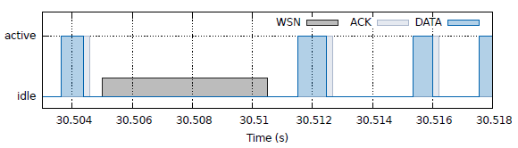
Introduction
Multiple wireless communication systems coexisting in the same spectrum
Need of a control system for the interference between users of different systems.
Possible solutions: orthogonality in space, frequency and time.
No valid solutions for a heterogeneous network.
Solution: take profit of the free spaces in the transmission of one of the users for the other one.
Notes:
Why is not orthogonality in time a solution? There is no cooperation between the systems in the heterogeneous networks.

Slide 4
Scenario
WLAN
Highly common
High Tx power
High coverage
WSN
Low Tx power
Limited detection range
Resource/Hardware limited
Problems
High difference between Tx powers → High interference
WLAN terminals do not detect WSN transmissions
WSN packets are usually long
High degradation in the performance of the WSN system
Solution: Real-time sensing + Prediction of channel usage + adaptation
Need to model the spectrum activity
Collisions + Retransmissions

Slide 5
Thesis Contribution
Test the proposed model for different traffic scenarios
Determine whether and when the proposed model is a realistic modeling option for the WLAN spectrum usage

Slide 6
MODELS

Slide 7
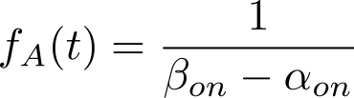
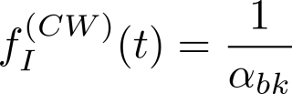

Models
WLAN spectrum activity
Uniform distribution
Mixture: {Uniform + G. Pareto} distributions
Global View model: ideal model. Fully observable.
Local View Model: realistic model. Limited observation.
Notes:
Semi-markovian because the holding times are not exponentially distributed.
Global and Local view models are not model for the spectrum activity but for the observable load of the sensors

Slide 8
Global View
Estimation
Idealistic approach: Unlimited sensing capability
Active distribution
α ➔ determined by shortest active period
β ➔ determined by longest active period.
Idle distribution:
ξ and σ ➔ determined by generalized Pareto distribution through Maximum-likelihood estimation.
p ➔ determined by uniform distribution through Moment Evaluation
Notes:
Global View maintains the same model presented before.

Slide 9
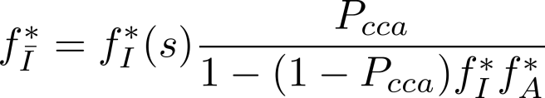
Local View (I)
Realistic approach: limited sensing capabilities due to hardware limitations.
Sensor skips part of the activity .
Active distribution is still the same.
No closed-form for local idle distribution ➔ consecutive idle + un-seen active periods
Solution: Laplace Domain
Notes:
Skipping one part of the activity avoids the usage of the previous model.
We introduce a three-state semi-Markovian model

Slide 10
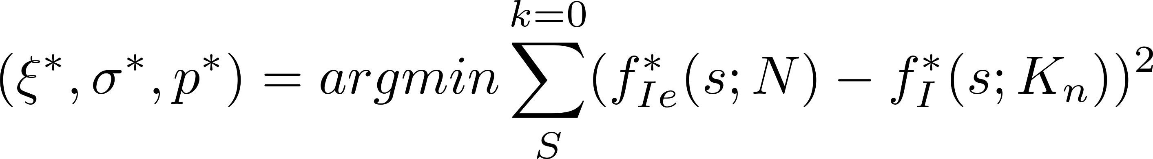
Local View (II)
Estimation
Active distribution
α ➔ determined by shortest active period
β ➔ determined by longest active period.
Idle distribution:
Pcca obtained with:
ξ, σ and p ➔ determined through Laplace estimation
LAPLACE ESTIMATION
Objective: Minimization of the Mean-Square Error between the analytic and empirical idle distributions:

Slide 11
?
Does the previous model really represent a good solution for accurate modeling of WLAN spectrum activity?
Session and Flow Layers
Packet Layer

Slide 12
Multi-layer traffic model
Traffic model based on three levels: session, flow and packet.
Modeled Variable | Distribution | Parameters
Session inter-arrival | Poisson | min = 1, max = 928, median = 11
Flow number | Bi-Pareto | α = 0.07, β = 1.75, c = 295.38, k = 1
Flow inter-arrival | Log-normal | μ = -1.6355, σ = 2.6286
Flow size | Bi-Pareto | α = 0.00, β = 1.02, c = 15.56, k = 111
Notes:
Parameters based on real WLAN traffic measurements

Slide 13
RESULTS

Slide 14
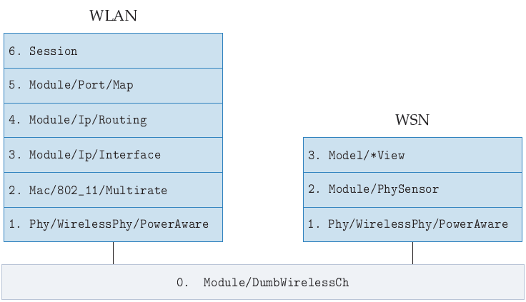
Simulation
NS2: open-source network simulator.
NS-Miracle: provides engine for handling cross-layer messages and multiple modules in each layer of the protocol stack.
dei80211mr: library for the 802.11 protocol over NS2.
Multi-layer traffic model implemented in C++/GSL
Protocol Stack:

Slide 15
Global View – Results
Experiments
OBJECTIVE: determine when and where the proposed models are applicable
Study of the extraction of the idle distribution
Idle distribution sensitivity
Estimation process
Model validation
Session and in-session experiments
Autocorrelation study of the independence of the active periods

Slide 16
Global View – Results (I)
Study of the extraction of the idle distribution
Construct the CDF of the idle distribution:
Generalized Pareto Distribution
Uniform Distribution
0.0007 s

Slide 17
Global View – Results (II)
Idle distribution sensitivity
Objective: test if the packet process affects mixture idle distribution.
Test the idle distribution behavior for different packetization configurations.
The idle distribution shape is not affected for different packet level configurations
Notes:
The mixture still holds

Slide 18
Global View – Results (III)
Estimation process
Test the MLE estimation process for different traffic scenarios
Multiple runs of the same configuration:
Session number, flow number, sizes and inter-arrivals are fixed for all runs.
Packet sizes and inter-arrivals are randomized.
The estimation parameters should be similar for the same configuration
Estimation process is not really affected by the packet level
 | Mean | Std. Deviation
ξ | 0.11704 | 0.01169
σ | 0.00611 | 8.4226e-5
p | 0.13421 | 0.00376

Slide 19
Global View – Results (IV)
Validation process
Test the performance of the Kolmogorov-Smirnov validation test
Determines the Goodness-of-fit between two distributions
The test is performed over the idle distribution
A test is considered valid if p > 0.05
Inter-arrival Distribution | 10 % of samples | All the samples
Exponential (mean: 1000 ms) | 5.15 % | 0 %
Exponential (mean: 100 ms) | 4 % | 0 %
Uniform (mean: 100 ms) | 4.39 % | 3.03 %
Notes:
KS determines the goodness-of-fitness between two distributions, through null-hypothesis, which indicates if a determined distribution follows the same ‘shape’ or ‘behavior’ that the one that we are testing against.

Slide 20
Global View – Results (V)
Session Experiment
Test the effect of different number of sessions in the estimation and validation processes
3 session cases with ≈ 25% of load ➔ distribution of the load in multiple users
Estimation and validation processes are insensitive to the session and packet level
 | 3 sessions |  | 9 sessions |  | 18 sessions
 | Mean | Std. Deviation | Mean | Std. Deviation | Mean | Std. Deviation
ξ | 0.184869 | 0.0109214 | 0.0639 | 0.0095 | 0.025 | 0.0097
σ | 0.00337252 | 4.80725e-05 | 0.0036 | 5.9426e-05 | 0.0045 | 6.27e-005
p | 0.38928 | 0.00444004 | 0.2996 | 0.0057 | 0.2397 | 0.004
Pks | 0.525856 | 0.253306 | 0.6874 | 0.2693 | 0.796 | 0.1874
Fail | 0 % |  | 0 % |  | 0 %

Slide 21
Global View – Results (VI)
In-Session Experiment
Determine the load regions in which our model is suitable
Three session cases: 5, 10 and 15 WLAN users ➔ Multiple load cases
The model can be applied with high success in the 10 – 30% load region

Slide 22
Global View – Results (VII)
Autocorrelation study of the independence of the active periods (I)
Assumption: different active periods are generated from independent sources
Study of the correlation of the active periods for different traffic scenarios
3 session cases with ≈ 25% load

Slide 23
Global View – Results (VII)
Autocorrelation study of the independence of the active periods (II)
10 sessions – Different load cases
Higher number of sessions and load decreases the correlation of the active periods

Slide 24
Local View – Results
OBJECTIVE: determine when and where the proposed models are applicable
Density study of consecutive skipped active periods
Session and in-session experiments

Slide 25
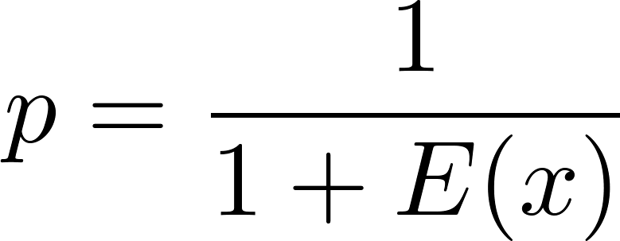

Local View – Results (I)
Density study of the consecutive skipped samples
Generate sequence of consecutive skipped active periods for the sensor
Sequence follows Geometric Distribution

Slide 26
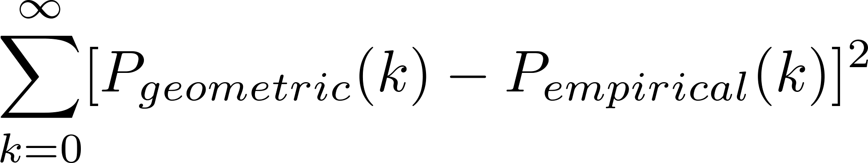
Local View – Results (II)
Goodness-of-fit test for Geometric Distribution (I)
Geometric Distribution is discrete ➔ K-S test is not suitable
Two solutions: MSE or Chi-Squared
Mean Square Error test

Slide 27
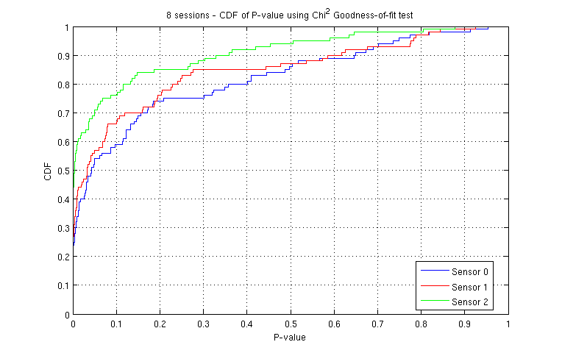
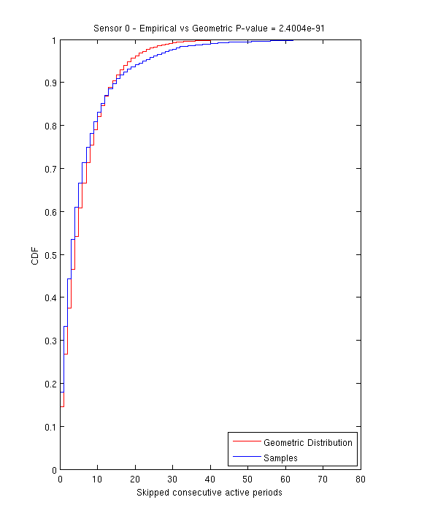
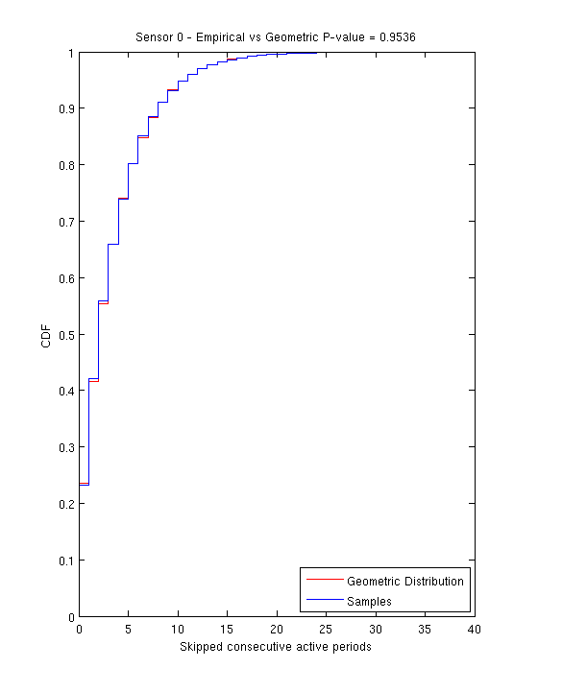
Local View – Results (III)
Goodness-of-fit test for Geometric Distribution (II)
Chi-square test
P(p < 0.05) is too high ➔ test may be too strict

Slide 28
Local View – Results (IV)
Session and In-Session Experiments
Test the performance of the Laplace estimation process
4 different number of sessions ➔ Multiple load cases
Compare the performance with the Global View model
5 sessions
10 sessions
15 sessions
20 sessions
Estimation process performance is improved for higher loads

Slide 29
Conclusions
OBJECTIVE: determine whether and when the proposed models can be applied.
Global View
The proposed mixture idle distribution has been proved.
Estimation and validation tests are insensitive to the packet level randomization and load distribution.
The Global View model can be applied in the load region of 10 – 30 % with high success.
Local View
The correlation of the active periods is decreased for higher loads.
The estimation process performance is improved for higher loads.
Further work
A deeper study in the Local View model is needed:
Deeper study in the correlation assumption of the active periods.
Multiple traffic scenarios to determine when the model is suitable.

Slide 30
Thanks for your attention

