Slide 1
A Mathematician’s Introduction to MATLAB
Robert Langer
UWEC (retired)
July 2007

Slide 2
Plan
Basics
Linear algebra
Ordinary differential equations
Partial differential equations
I can’t teach you how to use Matlab effectively, but I hope that I can show you enough so that when you need Matlab you will know how to start.

Slide 3
Session 2
Solving a linear system
Review of matrix arithmetic, transpose, inverse, etc.
Eigenvalues and eigenvectors
Special matrices
Extracting and inserting rows or columns

Slide 4
Review
Everything is a matrix.
Comma or space separates row elements.
Semicolon separates rows.
Elements are referred to by indices in parentheses (not square brackets as in Maple).
Assignment uses = (not :=)
Terminal semicolon (;) suppresses output.
Variable names are Case sensitive.
Two sets of arithmetic operations – vector, element-wise.
Previous inputs can’t be edited directly.

Slide 5
Solving a Linear System
If Ax = b, then the solution is x = A⁻¹b
Let’s try >> x=(A^(-1))*b

Slide 6
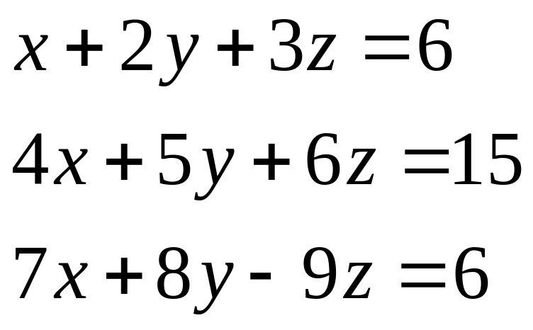
Solving a Linear System
If Ax = c, then the solution is x = A⁻¹c
Let’s try >> x=(A^(-1))*c for the system

Slide 7
A Better Method
Computing the inverse of the coefficient matrix is an inefficient way to solve a linear system
Try Matlab Help

Slide 8
Linear Systems - Summary
X = A\B denotes the solution to the matrix equation AX = B.
X = B/A denotes the solution to the matrix equation XA = B.
You can think of "dividing" both sides of the equation AX = B or XA = B by A. The coefficient matrix A is always in the "denominator."

Slide 9
Underdetermined Systems
(More Variables Than Equations)
We know from linear algebra that if L:V →W is a linear transformation then every solution of Lx = b has the form x = x_{p} + x_{h} where x_{p} is any particular solution and x_{h} is a solution of the homogeneous equation Lx = 0 ; i.e., an element of the null space or kernel of L.
Matlab “knows” this too.

Slide 10
Try the example in the Help file.

Slide 11
Matrix arithmetic, etc.
Product A*B
If either factor is 1X1, i.e., a scalar, then this is scalar multiplication.
Transpose A’
Conjugate-transpose for complex matrix
Inverse A^(-1) or inv(A)
There is also a pseudoinverse, pinv, for nonsquare matrices.
Determinant det(A)

Slide 12
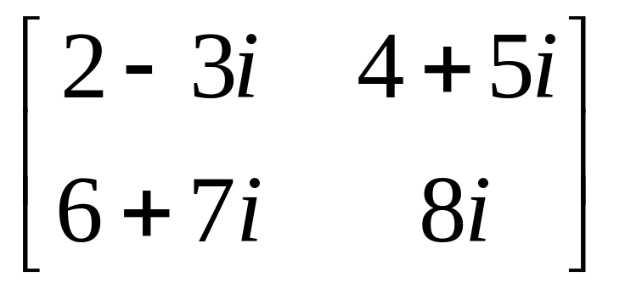
Transpose
For a matrix B with complex entries, Matlab’s B’ is the complex transpose or adjoint. (Note: Some books distinguish between transpose B’ and adjoint B* .) Try

Slide 13
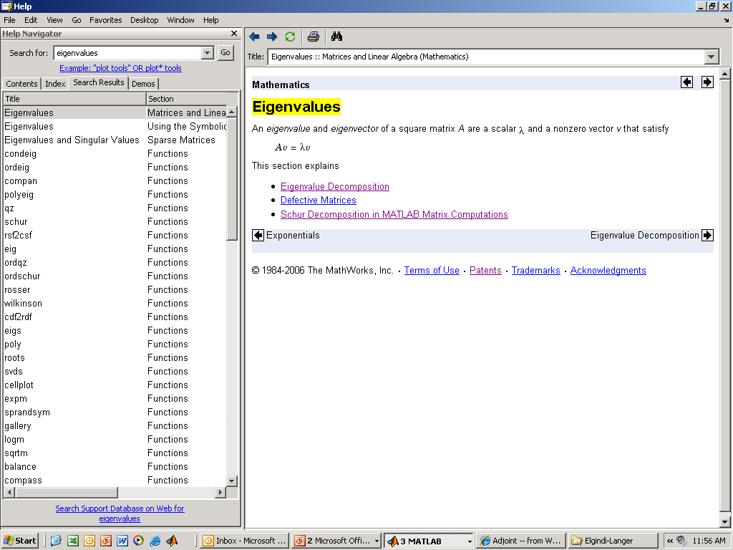
Eigenvalues and Eigenvectors
Let’s ask for help.

Slide 14
Try the example in the Help file.

Slide 15
Matrix Indexing and Special Matrices
Ask Matlab for Help on matrix.

Slide 16
Creating Special matrices
eye
ones
zeros
diag
magic
rand
randn

Slide 17
Indexing
Single element
x(j), A(j,k)
Entire row or column
x(:), A(:,k), A(j,:)
Adjacent rows or columns
x(m:n), A(m:n,k), A(j,m:n)
Nonadjacent rows or columns
These work on either side of =.

Slide 18
Hermitian Matrices and
Positive Definite Matrices
A [complex] matrix A is hermitian if A* = A
A [hermitian] matrix A is positive definite if x^{T}Ax > 0 for all x.
If a matrix is positive definite, all its eigenvalues must be positive.
A matrix is positive definite iff the determinants of the principal minors are all positive.

Slide 19
Hermitian Matrices and
Positive Definite Matrices
A [complex] matrix A is hermitian if A* = A
A [hermitian] matrix A is positive definite if x^{T}Ax > 0 for all x.
For practice with Matlab matrix functions, let’s construct a hermitian matrix and a positive definite matrix from a randomly generated matrix.

Slide 20
Drill and Practice
Create a 4 by 4 random complex matrix
>>RM=round(20*rand(4)-10)
>>IM=round(20*rand(4)-10)
>>M=RM+i*M
A hermitian matrix
>>H=M+M’
A positive definite matrix
>>P=H^2
Compute eigenvalues/vectors of M, H, P and the determinants of the principal minors of P.

