Slide 1

Jenkins

Slide 2
Agenda
• Introduction to Jenkins
Installing Jenkins
• Simple job
Create a simple job
Execute the job
See the logs
Re-execute jobs
Impact of passing and failing jobs on dashboard.
Nodes
Overview of a typical jenkins setup in Organization
Jenkins Architecture
Overview of how does it work?

Slide 3
Agenda
Manage Nodes
Master Slave Architecture
Why do you need Master Slave Architecture?
Adding Node
Different ways to add nodes
Add Node to the Jenkins Master
How it works?
Master to agent connections
Agent to master connections
Choosing which agent pipelines and steps run on
Configuring and Managing Nodes
Launching Agent
Have master launch agent via ssh
Have master launch agent on Windows
Write your own script to launch Jenkins agents
Launch agent via "JNLP" from agent back to master in a browser
Launch agent heedlessly from agent back to master on command line

Slide 4
Agenda
Node labels
Defining labels
Using labels
Example: Configuration on Unix
Kohsuke Kawaguchi's set up
Distributing and Binding jobs to the Nodes
Pipeline
Introduction to Pipeline
Pipeline script
Pipeline script from SCM
Jenkinsfile
Running Pipeline
Pipeline syntax
Pipeline Best Practices
Scaling Pipeline

Slide 5
Agenda
Setup a pipeline
Download the code from git
Build it using Maven
Create a Docker Image
Run a docker container from the image
Execute test cases based on the docker image.
Test Cases
• Introduction to Testing
Unit Testing
Executing unit tests from jenkins (repo. Same as dev)
Integration testing
Executing integration tests from jenkins (repo. Diff. from dev)
Best practices in test execution from Jenkins

Slide 6
Agenda
Jenkins Administration
Configuring Nodes
Controlling Jenkins features with system properties
Managing security
Managing Users
Managing tools
Jenkins CLI
Script Console
Groovy Hook Scripts

Slide 7
Installation of Jenkins
Open source automation server written in java
Installing jenkins
Windows:
https://jenkins.io/download/
https://www.jenkins.io/doc/book/installing/windows/
https://stackoverflow.com/questions/44174587/how-to-restart-jenkins-in-windows
Linux:
CentOS:
https://linuxize.com/post/how-to-install-jenkins-on-centos-7/
Ubuntu:
https://www.digitalocean.com/community/tutorials/how-to-install-jenkins-on-ubuntu-18-04

Slide 8
Installing Jenkins
Initial password
Almost all files are stored inside Jenkins home directory
The command:
sudo cat /var/lib/jenkins/secrets/initialAdminPassword
print the password at console.
Running Jenkins in Docker using the official jenkins/jenkins image
use sudo docker exec ${CONTAINER_ID or CONTAINER_NAME} cat /var/jenkins_home/secrets/initialAdminPassword to print the password
Typical Jenkins home install directory
Linux
/var/lib/jenkins
Windows
C:\Program Files\Jenkins
Mac
/Users/vilas/Desktop/Tools/Jenkins

Slide 9
What is Jenkins
Open source automation server written in java
Continuous integration tool
Perform tasks repeatedly and intelligently
Can detects changes in SCM systems like git
A fork of original hudson project
Plug-in extensibility
http://jenkins-ci.org
Cross Platform
Built using Java
Supports a wide variety of engineering patterns and technologies
Support organization of all sizes
Endless automation possibilities
Vibrant plugin ecosystem
Several jobs can be
Controlled
Monitored
Combined

Slide 10
What is Jenkins
Examples of tasks
pulling code from a repository
performing static code analysis
building your project
executing unit tests
automated tests and/or performance tests
deploying your application.
Jenkins server can execute tasks on Jenkins client machines

Slide 11
What is Jenkins
Examples of tasks
pulling code from a repository
performing static code analysis
building your project
executing unit tests
automated tests and/or performance tests
deploying your application.
Jenkins server can execute tasks on Jenkins client machines

Slide 12
Adv. of Jenkins
Jenkins offers many attractive features for developers:
Easy Installation
Platform-agnostic, Java-based, ready to run.
Easy Configuration
Easily set up and configure using UI, featuring error checks and a built-in help function.
Available Plugins
Hundreds of plugins
Extensible
Extended using plugins, endless possibilities for what it can do.
Easy Distribution
Distribute work across multiple machines/platforms.
Free Open Source
backed by heavy community support.

Slide 13
Installing Jenkins
Jenkins supports two different installations.
Normal install procedures
Already explained
Using java command
Run the WAR file
Jenkins “Web application ARchive (WAR)” file can be started from the command line:
Download the latest stable Jenkins WAR file from following url
https://www.jenkins.io/download
Run the command
java -jar jenkins.war.
Browse to http://localhost< or ip>:8080 and wait until the Unlock Jenkins page appears.
Continue on with the Post-installation setup wizard below.

Slide 14
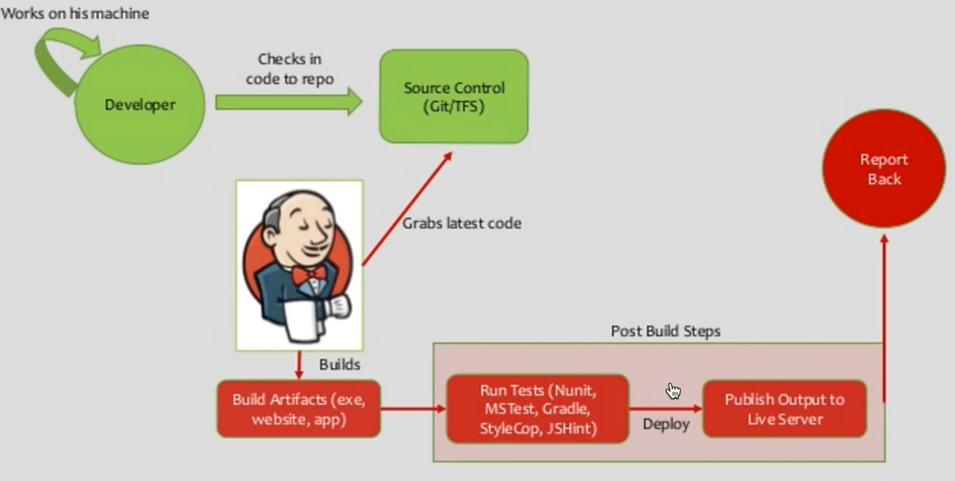
A simple use case in Jenkins

Slide 15
Overview of Jenkins UI
Jenkins Tabs
Lockable Resource
If a build requires a resource which is already locked,
it will wait for the resource to be free.
Resource can be a
Node
Printers
Phones
Computers, etc.
Adding lockable resources
In Manage Jenkins > Configure System go to Lockable Resources Manager
Select Add Lockable Resource
Each lockable resource has the following properties:
Name – e.g Printer_ColorA3_2342
Description - .e.g Printers in the Danish Office
Labels - Space-delimited list of Labels (Not containing spaces) used to identify a pool of resources. i.e. DK_Printers_Office, DK_Printer_Production, DK_Printer_Engineering
Reserved by - If non-empty, the resource will be unavailable for jobs. i.e. All printers are currently not available due to maintenance.

Slide 16
Jenkins Jobs
Hands on
Define First Job
Options in Job setup
Failing Jobs
Create a Job referring to an existing Job
Edit Job
Navigate through Jobs
Delete Job
Configure Job
Scheduling Jobs

Slide 17
Jenkins Architecture
Jenkins includes
jobs
users
Plugins
Credentials
Nodes/Agents
Global Configs
Nodes
Static Slaves (on prem)
VM’s or real machine
Dynamic Slaves (on cloud)
Cloud VM’s or Docker containers
Key Components
Master Node
Slave Node
Web interface

Slide 18
Jenkins Master
Holds all key information
Key components
Jenkins Jobs:
Collection of steps
e.g.
Build source code
Test code
Run shell script
Run Ansible role in a remote host
Good support for CI/CD
Jenkins Plugins:
Generally community-developed modules
Install in your Jenkins server.
lets you add functionalities that are not natively available in Jenkins.
Custom plugins can be developed.
Jenkins Plugin Index can be found at
https://plugins.jenkins.io/

Slide 19
Jenkins Master
Jenkins User:
Jenkins has its own user database.
Can be used for Jenkins’s authentication.
Jenkins Global Security:
Has the following two primary authentication methods.
User data maintained in Jenkins’s own user database
LDAP Integration:-
Jenkins authentication using corporate LDAP configuration.
Authorization data is always stored in Jenkins.
Master reponsible for:
Scheduling build jobs.
Dispatching builds to the slaves for the actual execution.
Manage the slaves (possibly taking them online and offline as required).
Recording and presenting the build results.
Jobs can be executed on Jenkins Master and slaves

Slide 20
Jenkins Slave
Worker nodes/agent/slave for the jobs configured in Jenkins server.
Jenkins slave is not mandatory.
Recommended approach
have segregated Jenkins Slaves for different job requirements
don’t mess up the Jenkins server
No limit on Jenkins slave count
Combination of Mac, Windows & Linux servers supported as slaves.
Can restrict jobs to run on specific slaves
But preferably they should be as replaceable as possible.
Set up a workflow and strategy based on your project needs.

Slide 21
Types of Jenkins slaves
Two types of Slave Nodes
Slave Nodes
Servers (Windows/Linux)
Slaves will be up and running all the time
Stay connected to the Jenkins server.
Use custom scripts to shut down and restart when is not used.
Typically during nights & weekends.
Slave Clouds
Dynamic slaves
Jenkins job will launch this slave as VM/container on demand and
Deleted once the job is completed.
Saves money in terms of infra cost especially at scale.

Slide 22
Types of Jenkins slaves
Jenkins Slaves are responsible for:
Hears requests from the Jenkins Master instance.
Slaves can run on a variety of operating systems.
The job of a Slave is to execute what they are asked to
i.e. executing build jobs dispatched by the Master.
Can configure a project to always run on a
particular Slave machine or
particular type of Slave machine or
simply let Jenkins pick the next available Slave.

Slide 23
Web Framework
Web uses Stapler Framework and follows MVC architecture.
Request Handling
Jenkins classes are bound to URLs by using Stapler.
The singleton Jenkins instance
bound to the context root (most of the time "/") URL,
Rest of the objects
bound according to their reachability from this root object.
Stapler uses reflection
recursively determine how to process any given URL.
E.g /foo/bar could be processed:
1. getFoo(String) should be defined on the Jenkins object
Stapler passes bar as a parameter.
Object returned
should have method doIndex(…) that gets called and renders the response.
Cntd.

Slide 24
Web Framework cntd..
2. getFoo()
Foo: method name getFoo without parameter
bar: return type
returns an object that has a getBar or doBar method.
The object returned from this method
has an associated index.jelly or index.groovy view.
3. getFoo()
returned object has a view named bar.jelly or bar.groovy defined.
A number of additional ways to handle requests exist, but these are the most common.
More details below
https://www.jenkins.io/doc/developer/handling-requests/

Slide 25
Web Framework cntd..
Views
Jenkins' model objects have multiple views
Used to render HTML pages about each object.
Views are written in
Jelly or Groovy
Can be composed of a number of different partial views (or view fragments).
More details on view https://www.jenkins.io/doc/developer/handling-requests/.

Slide 26
Overview of flow of most (CI/CD) jobs
Code stored in SCM
Jenkins plugins integrate with all plugins easily.
Configure scm
download the code automatically from scm
Build the code
Run build related validation
Run static anlaysis
Create an artifact
Mostly a docker image
Deploy the artifact in deployable environment
Mostly create a docker container
Run test cases on the container.
If tests passes
merge the code into git
Run any certification process
Release the product
An option is push to DockerHub
Deploy into Kubernetes environment from DockerHub

Slide 27
Architecting for scale
Topic skipped..

Slide 28
Agent to master connections
Historically, Jenkins master and agents
behaved as if it was like a single distributed process.
Agent can ask a master to do just about anything within the confinement of the operating system
E.g. access files on the master or trigger other jobs on Jenkins.
This exposes security issues,
Recommended sophisticated trust separation model
Agents can be less trusted than the master in enterprises.
Starting 1.587 (and 1.580.1),
Jenkins added a subsystem
A wall between master and agent
Allows less trusted agents to be connected to a master.

Slide 29
Agent to master connections
Since Jenkins 2.0,
this subsystem is enabled for all new installations of Jenkins.
highly recommend you turn this mode on
e.g.Use cases when you need such high security:
Use case 1
Agents are managed by another person (not Jenkins administrator)
because they have special requirement for their build jobs
Use case 2
You have some jobs that are configured to run on a specific agent because it is sensitive
To turn this switch on,
Go to "Manage Jenkins" > "Configure Global Security", and check
"Agent → Controller Security“
Or Agent ports.

Slide 30
How does master-slave work?
"master" operating by itself is the basic installation of Jenkins
master handles all tasks for your build system.
Mostly installing an agent
doesn't change the behavior of the master.
It will serve all HTTP requests,
and it can still build projects on its own.
You might want to remove the executors on the master to
free up master resources
for security reasons
This is not mandatory.
If you start to use Jenkins a lot on master only
you may run out of resources (memory, CPU, etc.).
At this point
either upgrade your master or
setup agents to pick up the load.

Slide 31
How does master-slave work?
An agent
computer that is set up to offload build projects from the master
Distribution of tasks is fairly automatic.
Exact delegation depends on the configuration of each project;
This is transparent of (http://yourjenkinsmaster:8080),
You can still
browse javadoc,
see test results,
download build results from a master,
without ever noticing that builds were done by agents.
Each agent runs a separate program called "agent"
No need to install the full Jenkins on an agent.
There are various ways to start agents,
agent and Jenkins master need to establish a bi-directional communication link
(for example a TCP/IP socket) in order to operate.

Slide 32
Master to agent connections
The most popular ways agents are configured are
via connections that are initiated from the master.
Advantage:
Agents minimally configured
Control lives with the master.
Didadvantage
Master have network access (ingress) to the agent
(typically this is via ssh).
Sometimes not desirable due to security reasons
Solution:
in which case you can use Agent to master connections via "JNLP".

Slide 33
Have master launch agent via ssh
Jenkins has a built-in SSH client implementation
Can use to talk to remote sshd and start an agent.
Most convenient and preferred method for Unix agents,
unix has sshd out-of-the-box.
Setup for sshd
Jenkins will do the rest of the work by itself,
copying the binary needed for an agent
starting/stopping agents.
N.B: project's external dependencies
(like a special ~/.m2/settings.xml,
java version ect),
should be set by ourselves.
The Slave Setup Plugin may be of help.
If you are on Windows and you don't have ssh commands with cygwin
use tool like PuTTY and PuTTYgen to generate your private and public pair of keys.

Slide 34
Using ssh
Pre-requisite
Jenkins server should be running on the master
Security group and port 8080 should be open on the master
Configuration on the slave
yum -y install java-1.8.0-openjdk
# Create user and add the user to wheel group
useradd jenkins-slave-01
sudo su - jenkins-slave-01
# Create SSH Keys
ssh-keygen -t rsa -N "" -f /home/jenkins-slave-01/.ssh/id_rsa
# The private and public keys will be created at these locations
`/home/jenkins-slave-01/.ssh/id_rsa` and `/home/jenkins-slave-01/.ssh/id_rsa.pub`
cd .ssh
cat id_rsa.pub > authorized_keys
chmod 700 authorized_keys

Slide 35
Using ssh
Configuration on Master
Copy the slave node's public key[id_rsa.pub] to Master Node's known_hosts file
mkdir -p /var/lib/jenkins/.ssh
cd /var/lib/jenkins/.ssh
ssh-keyscan -H SLAVE-NODE-PRIVATE-IP >>/var/lib/jenkins/.ssh/known_hosts
# ssh-keyscan -H <ip> >>/var/lib/jenkins/.ssh/known_hosts
chown jenkins:jenkins known_hosts
chmod 700 known_hosts
Configure the Slave using Manage Jenkins
Configure the node as shown here Manage Jenkins > Manage Nodes > New Node

Slide 36
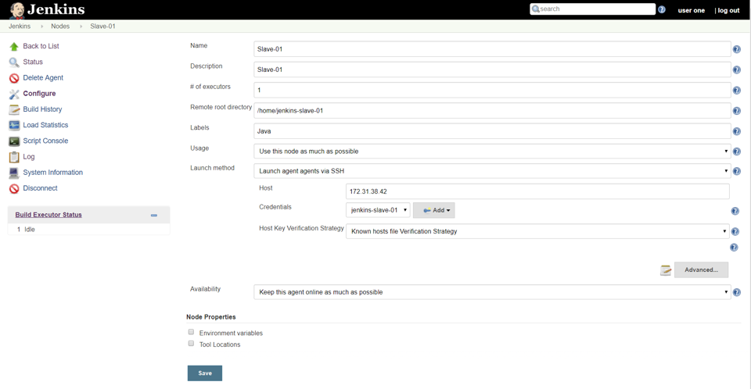
Using ssh
Configure the Slave using Manage Jenkins
Configure the node as shown below Manage Jenkins > Manage Nodes > New Node

Slide 37
Using ssh
Name: CentosSlave1 # of executors: 1
Remote home directory: /home/ jenkins-slave-01 Label: centos1 Launch method: Launch agents via SSH Host: Private IP address of slave node Configure credentials
Click Add -> jenkins
Global credentials (unrestricted)
kind: SSH Username and private key
ID: 1
Username: jenkins-slave-01
Private Key: Enter directly - On the slave in .ssh directory –
vi id_rsa on slave
copy paste the private key from beginning to end save it
select the credential created and click save

Slide 38
Using ssh
Go to the Slave: small X mark may appear
click and go inside
Launch the slave.
Verify if the client has joined

Slide 39
Agent connecting to Jenkins master
In some cases the agent server will not be visible to the master
e.g. agents are behind a firewall
Master can not initiate the agent process.
You can use a different type of agent configuration in this case called "JNLP".
This means that the master does not need network "ingress" to the agent
(but the agent will need to be able to connect back to the master).
Very similar to JNLP,
It runs without using GUI,
making it convenient for an execution as a daemon on Unix.
Steps
configure this agent to be a JNLP agent,
get agent.jar
run a command like below:
$ java -jar agent.jar -jnlpUrl http://yourserver:port/computer/agent-name/slave-agent.jnlp
Make sure to replace "agent-name" with the name of your agent.

Slide 40
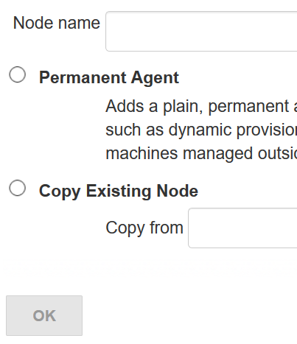
Agent connecting to Jenkins master
https://wiki.jenkins.io/display/JENKINS/Step+by+step+guide+to+set+up+master+and+agent+machines+on+Windows
1. On your master machine go to Manage Jenkins > Manage Nodes.
2. New Node
Enter Node Name
Select Permanent Agent
Press OK.
Node name:

Slide 41
Agent connecting to Jenkins master
Fill out the following:
Set a number of executors : 1/2
Set a Remote FS Root:
a home directory for the master on the agent machine.
For a Windows agent, use something like: "C:\Jenkins\"
For a Linux agent, use something like: /home/centos
Select the appropriate Usage setting:
For an additional worker: Utilize this node as much as possible
For specialized jobs: Leave this machine for tied jobs only
Launch Method:
Windows agent is by using Launch agent via Java Web Start
(Recommended for Windows. In Linux also we will be selecting the same.)
Fill the rest also as appropriate.
Press OK.

Slide 42
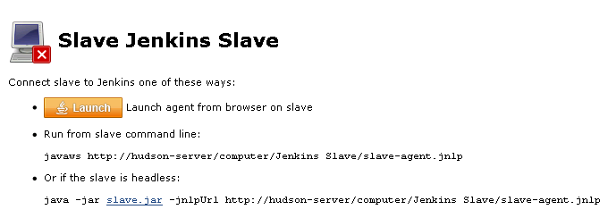
Agent connecting to Jenkins master - Windows
For windows only
Now you need to connect your agent machine to the master using the following steps.
a. For windows
Open a browser on the agent machine and go to the Jenkins master server url
(http://yourjenkinsmaster:8080).
Go to Manage Jenkins > Manage Nodes,
Click on the newly created agent machine. You will need to login as someone that has the "Connect" Agent permission if you have configured global security.
Click on the Launch button to launch agent from browser on agent.

Slide 43
Agent connecting to Jenkins master - Linux
For linux
Open http://yourjenkinsmaster:8080 on any box
Go to the Node. right click on agent.jar and get the url
Go to the worker node
curl -o agent.jar <agent.jar url>
Copy paste the command to join from the Node page in jenkins.
If you get “"JNLP agent port is disabled and agents cannot connect this way“
By default JNLP agent port may be disabled in Jenkins.
Fix this by
Clicking on "Go to security configuration screen link".
Update Agents for TCP port Random.

Slide 44
Different ways of starting agents
Have master launch agent via ssh
We did this
Have master launch agent on Windows
Relatively easy
Write your own script to launch Jenkins agents
Launch agent via "JNLP" from agent back to master in a browser
Launch agent heedlessly from agent back to master on command line
We did this

Slide 45
Have master launch agent on Windows
For Windows agents,
Jenkins can use the remote management facility
built into Windows 2000 or later (WMI+DCOM, to be more specific.)
Enter username/password of user with administrative access to agent
Jenkins will use that remotely create a Windows service and remotely start/stop them.
Advantage
Most convenient set up on Windows,
Disadvantage
Does not allow you to run programs
that require display interaction (such as GUI tests).
Note : Unlike other Node's configuration type,
Node's name is very important
it is taken as the node's address : where service is created

Slide 46
Write your own script to launch Jenkins agents
We can write your own script to start an agent.
You place this script on the master,
tell Jenkins to run this script whenever it needs to connect to an agent.
Typically, our script uses a remote program execution mechanism like SSH,
on Windows, this could be cygwin or tools like psexec),
but Jenkins doesn't really assume any specific method of connectivity.
Our script should be able to
connect to the right agent (e.g. ssh)
execute the agent program like
java -jar agent.jar,
have its stdin/stdout connect to your script's stdin/stdout.
For e.g.,
if ssh is already setup and agent.jar is already downloaded
Below script is good enough
"ssh <agent> java -jar ~/bin/agent.jar" would be good.

Slide 47
Write your own script to launch Jenkins agents
Jenkins uses this stdin/stdout as the communication channel to the agent
Executes the command from the same.
So running this manually from your shell may not work
A copy of agent.jar can be downloaded from
http://yourserver:port/jnlpJars/agent.jar .
agent.jar doesn't change very often.
So downloading it every time when the script runs is an overkill.
Advantage
if connection goes bad
use Jenkins's web interface to re-establish the connection.
because master manages the execution.
Disadvantage:
Launching agents this way may requires an additional initial set up on agents
especially on Windows,
remote login mechanism is not available out of box,

Slide 48
Launch agent via "JNLP" agent browser -> master
Launch agent via "JNLP" from agent back to master in a browser
Another way of doing this is to start an agent through Java Web Start (JNLP).
Server should be configured to appear
So, before attempting to create the build agent,
Go to manage Jenkins->Global Security->TCP port for JNLP agents.
Go to logon to the agent node
open a browser,
and open the agent page.
You'll be then presented with the JNLP launch icon.
Upon clicking it,
Java Web Start will kick in
it launches an agent on the computer where the browser was running.
Advantage
convenient when the master cannot initiate a connection to agents,
e.g. agent runs outside a firewall
Disadvantage
If agent goes down,
the master has no way of re-launching it on its own.

Slide 49
Launch agent via "JNLP" agent browser -> master
On Windows,
do this manually once,
setup launched JNLP agent as a Windows service
don't need to interactively start the agent there after.
To run GUI tests on Windows
If we have dedicated (virtual) test machine
Create a jenkins user account
Enable auto-login
Add shortcut to the JNLP file in the Startup items
(after having trusted the agent's certificate).
This allows one to run tests as a restricted user as well.
Note:
If the master is running behind a reverse proxy
you might need to configure "Tunnel connection through" the "Advanced" section of the JNLP start
method on the agent configuration page to make JNLP work.

Slide 50
Kohsuke Kawaguchi's set up of Jenkins agents
Kohsuke Kawaguchi's set up of Jenkins agents
Used to use inside Sun for his day job.
Master Jenkins node ran on a SPARC Solaris box
Had many
SPARC Solaris agents,
Opteron Linux agents
few Windows agents.
All computers use the same UID and GID.
Not a Jenkins requirement, but it makes the agent management easier.
Unix-like operating systems identify
user by user identifier (UID): an user called jenkins
Identify group by a group identifier (GID): a group called jenkins
determine which system resources a user or group can access.
On each computer,
/var/jenkins: home directory of user jenkins.
Not a hard requirement,
makes things easier to maintain.
All machines run sshd.
Windows agents run cygwin sshd.

Slide 51
Kohsuke Kawaguchi's set up of Jenkins agents
All machines have
/usr/sbin/ntpdate installed, and
synchronize clock regularly with the same NTP server.
Master's
/var/jenkins have all the build tools beneath it ---
a few versions of Ant,
Maven, and
JDKs.

Slide 52
Kohsuke Kawaguchi's set up of Jenkins agents
The directory structure looks like this:
/var/jenkins
+- .ssh
+- bin
| +- agent (more about this below)
+- workspace (jenkins creates this file and store all data files inside)
+- tools
+- ant-1.5
+- ant-1.6
+- maven-1.0.2
+- maven-2.0
+- java-1.4 -> native/java-1.4 (symlink)
+- java-1.5 -> native/java-1.5 (symlink)
+- java-1.8 -> native/java-1.8 (symlink)
+- native -> solaris-sparcv9 (symlink; different on each computer)
+- solaris-sparcv9
| +- java-1.4
| +- java-1.5
| +- java-1.8
+- linux-amd64
+- java-1.4
+- java-1.5
+- java-1.8

Slide 53
Kohsuke Kawaguchi's set up of Jenkins agents
Master's /var/jenkins/.ssh has private/public key and authorized_keys
master can execute programs on agents through ssh,
by using public key authentication.
Setup jobs on master,
to synchronize master's /var/jenkins to agents
(except /var/jenkins/workspace).
Use the script to replicate tools on all agents.
e.g. maven, java etc.
/var/jenkins/bin/launch-agent
Shell script Jenkins uses to execute jobs remotely.
Shell script sets up PATH and a few other things before launching agent.jar.
Below is a very simple example script.
#!/bin/bash
JAVA_HOME=/opt/SUN/jdk1.8.0_152
PATH=$PATH:$JAVA_HOME/bin
export PATH
java -jar /var/jenkins/bin/agent.jar

Slide 54
Debugging node addition
1. java.lang.SecurityException: agent may not create /var/lib/jenkins/foo/bar/...
See http://jenkins-ci.org/security-144 for more details
Agent tried to access a file on the master,
Jenkins has blocked that.
Could be an active attack,
but other probabilities are
plugins aren't yet upgraded to work with SECURITY-144 is attempting something legitimate.
2. java.lang.SecurityException: Sending org.jenkinsci.plugins.gitclient.CliGitAPIImpl$GetPrivateKeys from
agent to master is prohibited.
See http://jenkins-ci.org/security-144 for more details
Agent has asked the master to execute a command
Jenkins has blocked that
because the command isn't classified by plugin developers whether it is safe to be executed from the agent.
Soln: Review plugins versions
https://wiki.jenkins.io/display/JENKINS/Slave+To+Master+Access+Control#SlaveToMasterAccessControl-kill-switch

Slide 55
Debugging node addition
Solution 2: Disable the access control mechanism altogether
https://wiki.jenkins.io/display/JENKINS/Slave+To+Master+Access+Control#SlaveToMasterAccessControl-kill-switch
Search: Disable the access control mechanism altogether
Solution 3: Verify if the agent is whitelisted.
https://wiki.jenkins.io/display/JENKINS/Slave+To+Master+Access+Control#SlaveToMasterAccessControl-whitelist
Check if the updates to plugins are available
Following plugins can have a direct impact on adding nodes
Credentials Plugin
SSH Credentials Plugin
Git Client Plugin
Refer my notes for exhaustive list of debugging (page 950)

Slide 56
Choosing jobs should run on which agent
Restrict where a job can be executed.
Enter the label provided while creating the agent

Slide 57
JENKINS PIPELINE

Slide 58
Jenkins Pipeline
What is continuous deployment pipeline?
Automation of process for getting software
from version control
to your deploying it to production.
Jenkins Pipeline
A suite of plugins
Can implement and integrate continuous delivery pipelines into Jenkins.
Provides lot of tools for modeling simple-to-complex delivery pipelines "as code".
Definition of Jenkins Pipeline is typically written into a text file
called Jenkinsfile
can be checked into a project’s source control repository.

Slide 59
Jenkins Pipeline
Group of events or jobs
Interlinked with one another in a sequence.
Combination of plugins
Support integration and implementation of
continuous delivery pipelines using Jenkins.
Has an extensible automation server
Can create simple or complex delivery pipelines "as code," via pipeline DSL
(DSL: Domain-specific Language).

Slide 60
Advantages Of Jenkins Pipeline
Can define the complete deployment flow through configuration and code.
Standard Jenkins jobs can be written manually
as an entire script
can be managed with a version control system.
Following the discipline of ‘pipeline as code.’
No need to create multiple jobs for each process
Can code entire workflow
Place it in a Jenkins file.
Uses Groovy DSL (Domain Specific Language),
Can model easy to complex pipelines as code.
Code stored in text file called ‘Jenkinsfile’
can be stored in Source Code Management.
Supports
conditional loops, forks, join operations and allow parallel execution tasks.
Allows user feedback into the pipeline.
Resilient in terms of Jenkins’ master down time.
Can resume from checkpoints saved.
Can incorporate multiple additional plugins and add-ins.

Slide 61
Continuous Delivery Pipelines
jobs may have event or
some dependency on at least one or more events.
e.g. Build -> Deploy -> Test -> Release
Sequence of stages to perform the tasks
“continuous”: relative to your application and/or environment:
Releases can be
daily
weekly
ad-hoc etc..
Written using specific DSL (plugin)
follows almost the same structure as Groovy
specify its statements and expressions.
This makes pipelines easy to use for Groovy savants.

Slide 62
Continuous Integration (CI)
Development practices
Maintain a single source repository
Automate the build
Make your build self-testing
Every commit should build on an integration machine
Keep the build fast
Test in a clone of the production environment
Make it easy for anyone to get the latest executable version
Everyone can see what’s happening
Automate deployment

Slide 63
Continuous Integration (CI)
Developers check out code into their private workspaces
When done, commit the changes to the repository
The CI server monitors the repository and checks out changes when they occur
The CI server builds the system and runs unit and integration tests
The CI server releases deployable artefacts for testing
The CI server assigns a build label to the version of the code it just built
The CI server informs the team of the successful build
If the build or tests fail, the CI server alerts the team
The team fixes the issue at the earliest opportunity
Continue to continually integrate and test throughout the project

Slide 64
Continuous Deployment (CD)
Continuous Integration + Release into production of software that passes the automated tests.
Practice of releasing every good build to users
Definition of good: depends on the organization

Slide 65
Advantages Of Jenkins CI/CD
An open community operates Jenkins.
Seek feedback from customers on the progress of the Jenkins initiative.
Jenkins also embraces cloud-based design to facilitate cloud-based platforms.
Jenkins offers over 1500+ extensions in its plugins folder.
Through plugins, Jenkins CI/CD is much more efficient and mature in comparison to other tools.
Jenkins CI/CD offers fantastic support for parallel test execution.
This helps accelerate existing test processes by running them in parallel.

Slide 66
Pain points of using Jenkins
Complicated installation
Customization
Outdated layout
Experience matters.

Slide 67
Jenkins (CI)
Inside Jenkins CI/CD
a pipeline is defined as a series of events or tasks
interconnected in a particular order.
Thus Jenkins pipeline
enable the implementation and CI/CD within Jenkins.
Jenkins pipeline
expandable automation system
build basic or complicated ‘template’

Slide 68
Advantages Of Jenkins Pipeline
Follow the discipline of ‘pipeline as code.’
Define complete deployment flow-through configuration and code.
Entire standard Jenkins jobs can be written as script
can be managed with a version control system.
file: ‘Jenkinsfile’
Reduces need for multiple jobs for each process
Groovy DSL (Domain Specific Language): models easy to complex pipelines as code.
supports conditional loops, forks, or joining operations and allowing parallel execution tasks.
Improves user experience by integrating user feedback into the pipeline.
Resilient in terms of Jenkins’ master unplanned restart.
Can resume from checkpoints saved.
Can incorporate multiple additional plugins and add-ins.

Slide 69
JenkinsFile
Jenkins pipelines can be defined using JenkinsFile.
Name need not be JenkinsFile - although that is mostly observed.
Uses domain specific language (DSL).
Can write the steps needed for running a Jenkins pipeline.
It is a text file
Stores whole process as code.
Can be managed in Source Code Management (SCM) platform such as Git.
Helps developers to view, edit, and test the code whenever required.
Written using the Groovy Domain-Specific Language
Can be written and managed using
text editor or
Jenkins UI configuration tab.

Slide 70
Scripted pipeline
Code written on the Jenkins UI
Old method
More stricter groovy-based syntax
Defined within a ‘node’ block
Runs on the Jenkins master with the help of a lightweight executor.
Uses very few resources to translate the pipeline into atomic commands.

Slide 71
Declarative pipeline
Written in Jenkinsfile/Jenkins UI
relatively new feature
supports code pipeline
Enable reading/writing of pipeline code
Code can be maintained in SCM like Git
Introduced to reduce groovy based complexity.
Flexible groovy based
Defined within a ‘pipeline’ block
Contains a predefined hierarchy to create Jenkins pipelines.
Gives you the ability to control all aspects of a pipeline execution in a simple, straight-forward manner.

Slide 72
Key elements in the script
Scripted
node
Declarative
pipeline
Standard sections are available to both declarative and scripted pipelines.
Agent
Stages
Steps

Slide 73
Pipeline
Declarative pipeline definition starts and is enclosed in pipeline
With pipeline, you can build, test, and deliver the application.
Jenkinsfile
All stages and steps within this block are described.
pipeline {
}

Slide 74
Node
machine/vm running a complete workflow.
Integral part of the syntax of the scripted pipeline.
node {
}

Slide 75
Agent
Agent: like a node/vm/docker instance etc.
Can run multiple builds using just one Jenkins instance.
Helps spread the workload to various agents
Execute multiple projects within Jenkins’s single instance.
Instructs Jenkins to assign the builds to an executor.
A Jenkins pipeline may be executed from one or more agent
Most commonly used Agent parameters are:
Any
Runs stage pipeline on any available agent in Jenkins
None
If present, this parameter is added to the root of the pipeline.
There is no global agent for the entire pipeline
Each stage must define its own agent.
Label
Performs on the labeled agent the pipeline/stage.
Docker
Pipeline is executed on a docker container
e.g. docker can be used to pull an image of Ubuntu.
This image can now be used to run multiple commands as an execution environment.

Slide 76
Agent
Agent example
pipeline {
agent {
docker {
image centos'
}
}
}

Slide 77
Stages
Defines the actual work that needs to be completed.
The work is defined in the form of stages.
There can be multiple levels inside this.
Each stage executes a particular task.
pipeline {
agent any
stages {
stage (‘Pull') {
}
stage (‘Build') {
}
stage (‘Test') {
}
stage (‘Integrate') {
}
stage (Deploy') {
}
}
}

Slide 78
Steps
Within a stage block,
pipeline can be described as a series of steps.
Such steps are performed in sequence for the execution of a level.
Within a Steps guideline
there must be at least one step.
pipeline {
agent any
stages {
stage ('Build') {
steps {
echo 'Running build phase. '
}
}
}
}

Slide 79
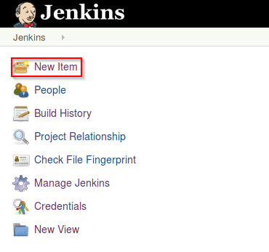
Creating first Jenkins pipeline
Log into Jenkins and click ‘New item’ from the dashboard.

Slide 80
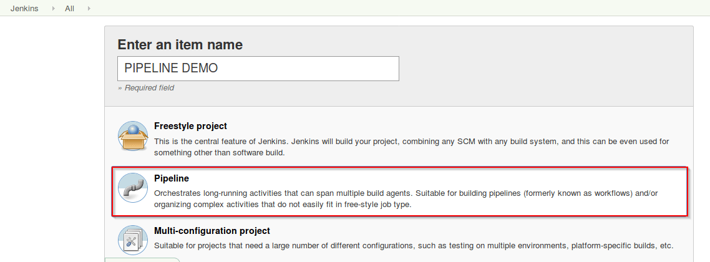
Creating first Jenkins pipeline
Enter a name for your pipeline and select ‘pipeline’ project. Click on ‘ok’ to proceed.

Slide 81
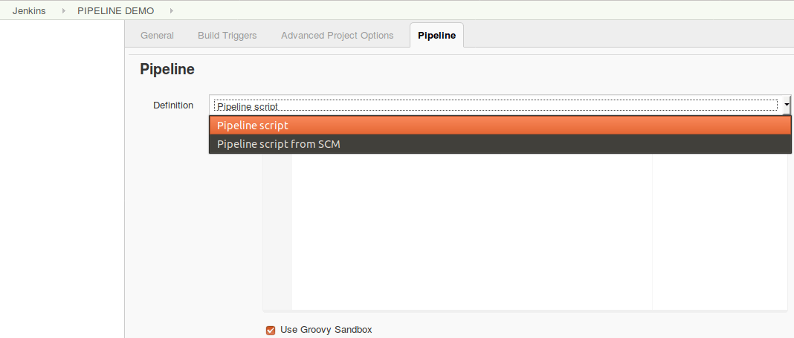
Creating first Jenkins pipeline
Scroll down to the pipeline and choose if you want a declarative pipeline or a scripted one.
Scroll down to the pipeline and chooe if you want a declarative pipeline or a scripted one.

Slide 82
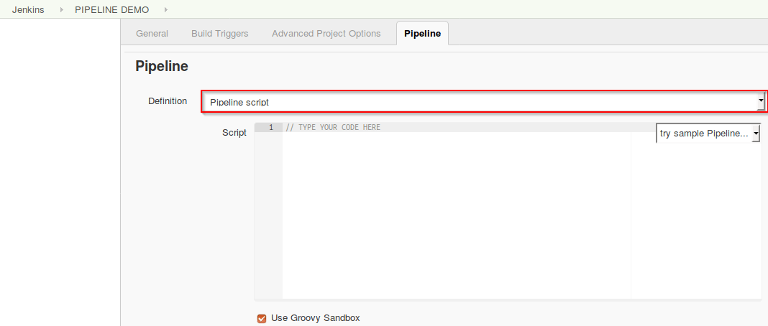
Creating first Jenkins pipeline
If you want a scripted pipeline then choose ‘pipeline script’ and start typing your code.

Slide 83
Default Scripted Pipeline
Select the default “Pipeline Script”
And “Scripted Pipeline”
Data as in : D:\PraiseTheLord\HSBGInfotech\Others\vilas\devops\jenkins\Lab\Pipeline\DefaultScriptedPipeline.txt
Save and Build
It would fail.

Slide 84
Default Scripted Pipeline
Configure Maven in “Global Tool Configuration” Define Maven Home variable as “M3” : That is what our script uses. Maven home can be found by
printenv | grep MAVEN
mvn - -version
Go to the directory and there should be one more directory inside that..
On windows for me MAVEN_HOME was
D:\software\maven\apache-maven-3.6.3-bin\apache-maven-3.6.3
Now Save and build the job again. Default has one failure.
Go back to the job – update the repo to https://github.com/vilasvarghese/devops.git
Save and Execute – now there is only one test in it. That should pass.
Execute all default scripts.

Slide 85
Pipeline Syntax
Excercises : D:\PraiseTheLord\HSBGInfotech\Others\vilas\devops\jenkins\Lab\Pipeline
D:\PraiseTheLord\HSBGInfotech\Others\vilas\devops\jenkins\Lab\Pipeline\PipelineSyntax
Exhaustive list of pipeline syntax: https://www.jenkins.io/doc/book/pipeline/syntax/

Slide 86
Generate Script
Pipeline Scripts can be generated
While attempting to create a pipeline job,
There is a “Pipeline Syntax” link that appears
Click on that
In Sample Step: Select “properties: Set job properties”
Check: “This project is parameterized”

Slide 87
TESTING

Slide 88
Software testing
Evaluate one or more properties of the software component.
Generally how much the system:
meets the requirements that guided its design and development
responds correctly to all kinds of inputs
performs its functions within an acceptable time
is sufficiently usable
can be installed and run in its intended environments
achieves the general result its stakeholders desire

Slide 89
Unit Testing
Tests: verify the functionality of a specific section of code
usually at the function level.
e.g. In an object-oriented environment
this is usually at the class level.
Usually written by developers as they build the code (white-box style)
Ensure that the specific function is working as expected.
One function might have multiple tests
catch corner cases or other branches in the code.
Ensure that the building blocks of the software work independently from each other.
Cost of bug: increases as the time progresses.
Effectiveness of unit tests increases successes of the product.
Performed by software developer during the construction phase
Aim: eliminate construction errors before code is promoted to additional testing;
Lab: Executed along with maven build.

Slide 90
Integration Test
Seeks to verify the interfaces between components against a software design.
Software components may be integrated in
iterative way
better practice
or
("big bang") all together .
Aim: Identify defects in the interfaces and interaction between integrated components.
Progressively larger groups of tested software components corresponding to elements of the architectural design are integrated and tested until the software works as a system.[48]
Integration tests might involve
steps
process
lot of code
traces more than unit tests.
Recommendation:
Separate the process of setup.
Break tests into smaller pieces
may improve fault localization.
Lab: D:\PraiseTheLord\HSBGInfotech\Others\vilas\devops\jenkins\Lab\Pipeline\CICDInstructions1

Slide 91
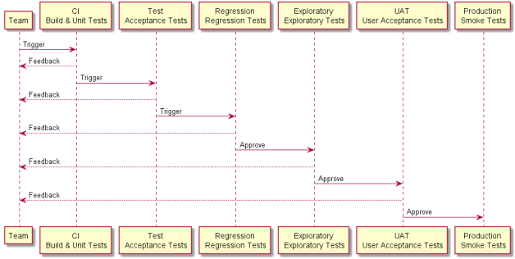
Automation Testing Best Practices

Slide 92
Testing Challenge
Testing in microservices world
Functional testing
E.g. Performance/Security/Technical impact due to functional change
E.g. data coming from cache/backup
Technical testing
Performance/Security/Functional impact due to functional change
Security testing
Performance/Functional/Technical impact due to functional change
Performance testing
Functional/Security/Technical impact due to functional change

Slide 93
Test Automation Strategy
Have a Test Automation Strategy
What Test Cases to Automate?
Test Early and Test Often
Select the Right Automated Testing Tool
Divide Your Automated Testing Efforts
Create Good, Quality Test Data
Create Automated Tests That Are Resistant to Changes
E.g. changes in the UI, data etc..

Slide 94
Test Usage Strategy
TestNG/Nunit ect allows annotation/category based test execution.
Check-in can include the data
Automatic code change analysis
Code coverage based testing
AI
Feedback based definition
Deployment strategy
E.g. Blue/Green deployment
Maintain staging on production

Slide 95
Points to consider
Decide what, why, who, where, when, how of tests
Test Early and Test Often
Select the Right Automated Testing Tool
Divide your Automated Testing Efforts
Create Good, Quality Test Data
Create Automated Tests that are Resistant to Changes in the UI
Points to consider
Identify
Sanity, SRG
NLP
Security
Performance
Functional
Module specific
Technical
Etc (e.g. cluster specific, business specific etc..)

Slide 96
Points to consider
Tests that tend to cause human error.
Tests that require multiple data sets.
Frequently used functionality that introduces high risk conditions.
Tests that are impossible to perform manually.
Tests that run on several different hardware or software platforms and configurations.
Tests that take a lot of effort and time when manual testing.

Slide 97
JENKINS ADMINISTRATION

Slide 98
Configuring Nodes
Already covered

Slide 99
Controlling Jenkins system properties
Jenkins has several "hidden" features
can enable with system properties.
System properties are defined by passing
-Dproperty=value
to the java command line while starting Jenkins.
N.B:
pass all of these arguments before the -jar argument,
else they will be ignored. Example:
e.g.
java -Dhudson.footerURL=http://example.org -jar jenkins.war
List of system properties are really huge.
Entire list can be seen at
https://www.jenkins.io/doc/book/managing/system-properties/

Slide 100
Controlling Jenkins system properties
Properties are generally defined in the format.
Property - Java property name
Default - Default value if not explicitly set
Since - The version of Jenkins the property was introduced in
Description - Other notes
N.B: Compatibility
NO guarantee that system properties will remain unchanged and functional indefinitely.
For e.g.
hudson.diagnosis.HudsonHomeDiskUsageChecker.freeSpaceThreshold
Default:
1073741824 bytes (1 GB, up to 2.39)
Description:
If there’s less than this amount of free disk space on the disk
with the Jenkins home directory, and
the disk is 90% or more full
a warning will be shown to administrators.

Slide 101
Controlling Jenkins system properties
It can be set while jenkins is launched in java <property> -jar jenkins.war
-Dhudson.diagnosis.HudsonHomeDiskUsageChecker.freeSpaceThreshold = 33945093450934
We can modify this after launching the jenkins using
System.setProperty("hudson.diagnosis.HudsonHomeDiskUsageChecker.freeSpaceThreshold", 33333333234)
Above change will not persist a jenkins restart.
To persist
add the setting to the java args.
For e.g. in (CentOS, Jenkins 2.7.1)
Modify /etc/sysconfig/jenkins
(for some distributions it could be /etc/default/jenkins)
add your option to the existing list like this:
JENKINS_JAVA_OPTIONS="-Djava.awt.headless=true -Dhudson....

Slide 102
System Property file
For Debian and Ubuntu :
/etc/default/jenkins
Red Hat, CentOS, Amazon Linux, Oracle Linux:
/etc/sysconfig/Jenkins
or
/etc/default/jenkins
On FreeBSD
/etc/rc.conf
On windows
Edit %INSTALL_PATH%/jenkins/jenkins.xml.
Put -Dargs before –jar
<arguments>-Xrs -Xmx256m -Duser.timezone="Europe/Minsk" -Dhudson.lifecycle=hudson.lifecycle.WindowsServiceLifecycle -jar "%BASE%\jenkins.war" --httpPort=8080</arguments>

Slide 103
System Property file - Change System Time Zone
Default: Jenkins picks the time zone from server.
If you want to set to a different time zone.
Start Jenkins with the following java system property:
java -Dorg.apache.commons.jelly.tags.fmt.timeZone=TZ + (additional properties if any)
TZ is a java.util.TimeZone ID ("Europe/Paris" for example).
Alternatively update the files mentioned in the previous slide.

Slide 104
Managing security
As of Jenkins 2.0,
many of the security options were enabled by default
ensure that Jenkins environments remained secure
unless an administrator explicitly disabled certain protections.
Enabling Security
Beginning with Jenkins 2.214
Jenkins LTS 2.222.1,
"Enable Security" checkbox has been removed.
Jenkins own user database is used as the default security realm.
Before Jenkins 2.214 and Jenkins LTS 2.222.1
when the Enable Security checkbox is checked,
users can log in with a username and password
perform operations not available to anonymous users.
Which operations require users to log in
depends on chosen authorization strategy and its configuration;
Default anonymous users have no permissions
logged in users have full control.
"Enable Security" checkbox should always be enabled for any non-local (test) Jenkins environment.

Slide 105
Managing security
The "Configure Global Security" section
allows a Jenkins administrator to
enable,
configure, or
disable
key security features.

Slide 106
TCP Port
Jenkins can use a TCP port
to communicate with inbound
(formerly known as “JNLP”) agents,
As of Jenkins 2.0, by default this port is disabled.
This option can be seen in “Configure Global Security” ->http://52.14.52.76:8080/configureSecurity/
For using inbound TCP agents, the two port options are:
Random:
TCP port is chosen at random to
avoid collisions on the Jenkins master.
Downside to randomized ports
they are chosen during the boot of the Jenkins controller,
difficult to manage firewall rules allowing TCP traffic.
Fixed:
The port is chosen by the Jenkins administrator
Consistent across reboots of the Jenkins controller.
Easier to manage firewall rules allowing TCP-based agents to connect to the controller.

Slide 107
TCP Port
Jenkins 2.217,
inbound agents may instead be configured to use WebSocket transport
to connect to Jenkins.
In this case no extra TCP port need be enabled
no special security configuration is needed.
This can be done where nodes are configured (like ssh configuration of node after creating it)

Slide 108
Managing security - Access Control
Access Control
Primary mechanism for securing Jenkins environment
Two facets of configuration are necessary for configuring Access Control in Jenkins:
"authentication"
"Authorization"
Authentication
A Security Realm
Support "authentication."
informs the Jenkins environment
how and
where
to pull user (or identity) information

Slide 109
Authorization
Authorization
authenticated user, can access what?
Using both the Security Realm and Authorization configurations
it is possible to setup highly secured auth setup Jenkins.
Additionally,
plugins such as the Role-based Authorization Strategy plugin
can extend the Access Control capabilities of Jenkins
support even more nuanced authentication and authorization schemes.

Slide 110
Security Realm
By default
Jenkins includes support for a few different Security Realms:
Delegate to servlet container
Authentication is handled by
servlet container running the Jenkins controller e.g. Jetty.
If using this option
check servlet container’s authentication documentation.
Jenkins’ own user data store
Use Jenkins’s own built-in user data store
for authentication
Enabled by default with new Jenkins 2.0 or later installations
suitable for smal environments.

Slide 111
Security Realm
By default
Jenkins includes support for a few different Security Realms:
Delegate to servlet container
Authentication is handled by
servlet container running the Jenkins controller e.g. Jetty.
For using this: check servlet container’s authentication documentation.
Jenkins’ own user database
Use Jenkins’s own built-in user data store for authentication
Enabled by default with new Jenkins 2.0 or later installations
suitable for smaller environments.
LDAP
Delegate all authentication to a configured LDAP server
Supports users and groups.
Common for larger installations in organizations
Also supports Active Directory installations.
Installed LDAP plugin for trying this.
Unix user/group database

Slide 112
Security Realm
Cntd..
Delegates the authentication to the underlying Unix OS-level user database on the Jenkins controller.
Unix groups support is also available for authorization.
For e.g.,
We can configure “All in developers group has admin. access."
Jenkins uses PAM : need to be configured outside Jenkins.
Unix allows user and group name to be same.
Use the @ prefix to force the name to be interpreted as a group.
For e.g., @dev is dev group and not the dev user.
Plugins can provide additional security realms
Useful for incorporating Jenkins into existing identity systems, such as:
Active Directory
GitHub Authentication
Atlassian Crowd 2
Etc.

Slide 113
Authorization
Default Jenkins supports a few different Authorization
Anyone can do anything
Legacy mode
Logged in users can do anything
Matrix-based security
Project-based Matrix Authorization Strategy

Slide 114
Authorization
Anyone can do anything
Everyone gets full control of Jenkins
Even anonymous users who haven’t logged in also gets the same access
Legacy mode
Behaves exactly the same as Jenkins <1.164.
Only two options
"admin“ role: granted full control over the system
others (including anonymous users): granted read-only access.
Logged in users can do anything
Every logged-in user gets full control of Jenkins.
Depending on advanced option anonymous users get
read access to Jenkins,
or
no access at all.

Slide 115
Authorization
Matrix-based security
Allows for granular control over
which users and groups are able to perform which actions
in the Jenkins environment.
Project-based Matrix Authorization Strategy
This authorization scheme is an extension to Matrix-based security
allows additional access control lists (ACLs)
to be defined for each project separately.
This allows granting specific users or groups access only to specified projects
instead of all projects in the Jenkins environment.
The ACLs defined with Project-based Matrix Authorization
are additive i.e.
access grants defined in Configure Global Security screen will be
combined with project-specific ACLs.

Slide 116
Authorization
Each row in the table
represents a user or group.
This includes special entries named
"anonymous" and
permissions granted to all unauthenticated users
"authenticated."
permissions granted to all authenticated users
N.B:
The permissions granted in the matrix are additive.
For example, if a user “vilas" is in the groups "developers" and "administrators",
permissions granted to “vilas" will be a UNION of all those permissions granted to
“vilas",
"developers",
"administrators",
"authenticated", and
"anonymous."

Slide 117
SECUIRY CONTINUES
The security vulnerabilities possible on Jenkins include
Format characters
Cross Site Request Forgery

Slide 118
SECUIRY CONTINUES - Markup Formatter
Jenkins allows user-input in a number of different configuration fields
Users by mistake can enter malicious/unsafe HTML and/or JavaScript.
By default the Markup Formatter configuration is set to Plain Text
which will escape unsafe characters such as < and & to their respective character entities.
Using the Safe HTML Markup Formatter allows
users to inject HTML snippets into Project Descriptions and elsewhere.

Slide 119
Cross Site Request Forgery
A cross site request forgery (or CSRF/XSRF) [1]
vulnerability that enables an unauthorized third party
to perform web requests by impersonating another user.
In Jenkins CSRF attack could allow a malicious actor to
delete projects,
alter builds,
modify Jenkins' system configuration.
To protect from these vulnerabilities,
CSRF protection has been enabled by default
with all Jenkins versions since 2.0.
The CSRF settings can be found following this path:
Manage Jenkins > Configure Global Security > Section: CSRF Protection.

Slide 120
Cross Site Request Forgery
Inside the CSRF section it is possible to enable the option
"proxy compatibility"
if HTTP proxies is filtering out
information that the default crumb issuer uses to calculate the nonce value
Then enable this.
If an HTTP proxy sits between your browser client and your Jenkins server
you receive a 403 response when submitting a form to Jenkins
checking this option may help.
Using this option makes the nonce value easier to forge.

Slide 121
Disable CSRF checking
Before Jenkins version 2.176.2
it was possible disable CSRF directly by Configure Global Security.
Now to avoid secure issues since 2.176.2 that option it was removed.

Slide 122
Managing Users
In Jenkins, by default
you can create users,
but not groups.
Following few options if you want groups:
Use OpenLDAP with Jenkins
Use Active Directory with Jenkins
Use Unix user/group database.
This will use PAM library to integrate with Jenkins.
Use “Role-based authorization strategy” plugin for Jenkins
D:\PraiseTheLord\HSBGInfotech\Others\vilas\devops\jenkins\Lab\JenkinsUsers

Slide 123
Managing tools
Preferably setup
build tools and
jdk version
before starting with real use cases.
Click on the Manage Jenkins link on the home page
This will take you to the Manage Jenkins page
one-stop-shop for all your Jenkins configuration.
From this screen, you can
In system configuration section
Configure system (Jenkins server),
Configure global tools
Manage (install and upgrade) plugins,
Manage Nodes and clouds,

Slide 124
Managing tools
In Security
Configure global Security
Manage Credentials
Configure credential providers
Manage users
In Status Information
System Information
System Log
Load statistics
About Jenkins
In Troubleshooting
Manage Old data
In Tools and Actions
Reload Configuration from Disk
Jenkins CLI
Script Console
Prepare for Shutdown

Slide 125
Managing tools
In Global Tool Configuration
The default plugins support configuring
Maven Configuration
JDK
Git
Gradle
Ant
To build a java application using Maven.
So set up JDK and Maven installation.
Jenkins’s contextual help buttons.
blue icon in the right.

Slide 126
Managing tools
Jenkins provides several options to configuring Maven.
If Maven is already installed
provide the path in the MAVEN_HOME field.
Alternatively, install a Maven distribution by extracting a zip file
located in a shared directory
or
execute a home-rolled installation script.
or
let Jenkins download Maven.
tick the Install automatically checkbox.
Jenkins will download and install Maven from the Apache website
Choose the Maven version
Give a name for your Maven
Will refer to it in your build jobs/pipeline using this name.
If behind a firewall provide proxy information

Slide 127
Managing tools
N.B:
Jenkins maven settings.xml can be a pom.xml
JDK configuration
After configuring Maven
Configure a JDK installation
if Java JDK (JDK and JRE are different) is already installed
provide the path in the JAVA_HOME field.
Jenkins can download JDK from the Oracle website
For licensing reasons,
tick checkbox to indicate that you agree with the Java SDK License Agreement.
Git configuration
Git plugin is also one of the default plugin now.

Slide 128
Jenkins CLI
Why CLI
For advanced users
Easier
Faster
Less memory utilized
Better for
Continuous Integration
Security
Typical Jenkins Home directory
Linux
/var/lib/jenkins
Windows
C:\Program Files\Jenkins
Mac
/Users/vilas/Desktop/Tools/Jenkins

Slide 129
Jenkins CLI
Typical Jenkins Home directory
Linux: /var/lib/jenkins
Windows: C:\Program Files\Jenkins
Mac: /Users/vilas/Desktop/Tools/Jenkins
Download jenkins-cli.jar
java -jar jenkins-cli.jar -s http://localhost:8080/ -webSocket help
java -jar /opt/jenkins-cli.jar -s "http://localhost:8080" -auth vilas:vilas who-am-i
java -jar /opt/jenkins-cli.jar -s "http://localhost:8080" -auth vilas:vilas version
List of commands can be found by executing
http://localhost:8080/cli/

Slide 130
Jenkins CLI
To generate token
Manage Jenkins - Manage users - Click on username - "Configure" - API Token (Add new Token) - Enter name - Click on Generate - Copy token
java -jar jenkins-cli.jar -s http://localhost:8080/ -auth vilas:1130a7a11d937ae6b9ef6e4572aeb12198 -webSocket help
built in command line interface called Jenkins CLI
Work with Jenkins from CLI or from shell
Can automate routine tasks
build updates
debugging
We work with Jenkins CLI Client
downloaded from http://jenkinsurl:port/cli
Executing script
Can execute
bat files on windows # our exe
sh files for linux

Slide 131
Jenkins CLI
Refer: D:\PraiseTheLord\HSBGInfotech\Others\vilas\devops\jenkins\Lab\JenkinsCLI\listjobs.sh
D:\PraiseTheLord\HSBGInfotech\Others\vilas\devops\jenkins\Lab\JenkinsCLI\instructions.txt
Further we can
add logic to these files
move variables to config files etc.
That is more of shell/bat/power shell scripting
outside the walls of this training.

Slide 132
Script Console
The Jenkins script console and Groovy inbuilt script console
very useful and powerful Jenkins extension
Suits certain types of tasks.
Allows to run Groovy scripts on
Jenkins instance
or
slave nodes
within the user interface
To access the console navigate to
Manage Jenkins -> select Script Console,
or
Append /script to your Jenkins host and port as follows:
http://jenkinshost:8080/script

Slide 133
Script Console
Very important to understand all of the following points
because it affects the integrity of your Jenkins installation.
The Jenkins Script Console:
Access Control
Access is controlled by the RunScripts permission.
Preferably: Give access only to admins.
If non-admins are allowed to execute script
Take extreme care to not allow non-admins to use RunScripts.
Script Console is a web-based Groovy shell into the Jenkins runtime.
Groovy
Very powerful language
Can do anything Java can do including:
Create sub-processes
Execute arbitrary commands on the Jenkins controller and agents.
Read files that Jenkins controller has access to on the host
(like /etc/passwd)
Decrypt credentials configured within Jenkins.

Slide 134
Script Console
Offers no administrative controls to stop a User (or Admin) after executing the Script Console from affecting all parts of the Jenkins infrastructure.
N.B: Granting a Jenkins user Script Console Access
is same as giving them Administrator rights within Jenkins.
E.g. Can configure any Jenkins setting.
Can
disable security,
reconfigure security,
even open a backdoor on the host operating system completely outside of the Jenkins process.
This could be a security challenge. So be careful.
Originally intended as a debugging interface for Jenkins developers
Now used by Jenkins Admins
to configure Jenkins and
debug Jenkins runtime issues.

Slide 135
Script Console
Jenkins Script Console is very powerful
Jenkins and its agents should never be run as the root user (on Linux) or system administrator on any other flavor of OS. Videos linked in this page demonstrate and discuss security warnings.
Lot more rules.. Kindly refer the documentation for more details.

Slide 136
Groovy Hook Scripts
In several places inside Jenkins,
a series of "hook scripts" get executed in reaction to some key events.
These scripts are written in Groovy,
Get executed inside the same JVM as Jenkins
Allowing full access to the domain model of Jenkins.
For given hook HOOK, the following locations are searched:
WEB-INF/HOOK.groovy in jenkins.war
WEB-INF/HOOK.groovy.d/*.groovy in the lexical order in jenkins.war
$JENKINS_HOME/HOOK.groovy
$JENKINS_HOME/HOOK.groovy.d/*.groovy in the lexical order
HOOK.groovy.d is suitable to avoid conflicts —
Multiple entities can insert stuff into the hook without worrying about overwriting each other’s code.
The following events use this mechanism:
init: Post-initialization script
boot-failure: Boot failure hook

Slide 137
Groovy Hook Scripts - Post initialization script
Post initialization script (init hook)
You can create a Groovy script file
$JENKINS_HOME/init.groovy
or
.groovy file in directory $JENKINS_HOME/init.groovy.d/
to run some additional things right after Jenkins starts up.
Groovy scripts are executed at the end of Jenkins initialization.
This script can access classes in Jenkins and all the plugins.
So for example, you can write something like:
import jenkins.model.Jenkins;
// start in the state that doesn't do any build.
Jenkins.instance.doQuietDown();
Output is logged to the Jenkins log file.
For Debian based users, this is /var/log/jenkins/jenkins.log

Slide 138
Groovy Hook Scripts - Boot failure hook
When Jenkins encounters a fatal problem during boot,
it’ll invoke "boot-failure" hook script
to allow automatic corrective actions to be taken
(e.g. notify somebody, raising alerts, restarting, and so on.)
These scripts get the cause of the problem as the "exception" variable when run.

Slide 139
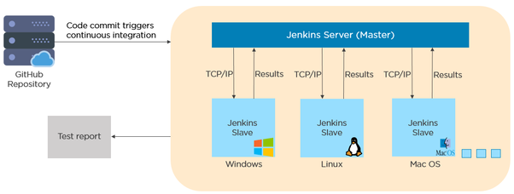
Master/Slave Architecture
Open source automation server written in java

Slide 140
Jenkins Master/Slave
Jenkins master
Jenkins Master schedules a build job.
Master dispatches the build to the slave for execution of job.
It monitors the slaves and record the build result.
Master can also independently executes the job.
Jenkins slave
Slave is a separate program called slave agent which is a java executable which runs on a separate machine.
Slave gets request from the Jenkins master to run jobs.
Jobs may produce logs which are on the worker node. Can be seen on master.
You can always configure project to run on specific slave or let the master decide it.

Slide 141
Views
Creating and Managing Views

Slide 142
Deployments
Automated Deployments

Slide 143
Working Strategy
Automated Deployments

Slide 144
Pipelines
Incorporate User inputs
Restart from saved checkpoint
Run jobs in parallel
Integrate with other plugins
Allows conditional loops (for, when)
Code can be checked into VCS

Slide 145
Pipelines - Jenkinsfile
Pipeline is done using Jenkinsfile
A text file that stores the pipeline as a code.
It can be checked into a VCS on your local system
Enables the developers to access, edit and check the code all the times.
Written using groovy.
Written based on two syntaxes

Slide 146
Pipelines - Jenkinsfile
Two ways of writing Jenkinsfile
Declarative Pipeline
Recent feature
Simpler groovy syntax
Code is written locally in a file and is checked into a SCM
Code is defined with a pipeline block.
Scripted Pipeline
Traditional way of writing the code
Stricter groovy syntax
Code is written on the Jenkins UI
Code is defined with in a 'node' block.

Slide 147
Pipelines
Basic groovy concepts for understanding pipeline
Pipeline
A user defined block which contains all the stages.
Key part of declative pipeline syntax
pipeline {
}
node {
}

Slide 148
Pipelines - Agents
Agent:
instructs jenkins to allocate an executor for the builds.
Can be defined for an entire pipeline or specific stage.
Supports following parameters
Any: Runs pipeline/stage on any available agent.
None: applied only at the root of the pipeline. i.e. doesn't support defining this at stage level.
Indicates that there are global agent.
Each stage should specify its own agent.
Label: Execute the pipeline on a labeled agent.
Docker: Uses docker container as an execution environment for the pipeline or a specific stage.

