Slide 1
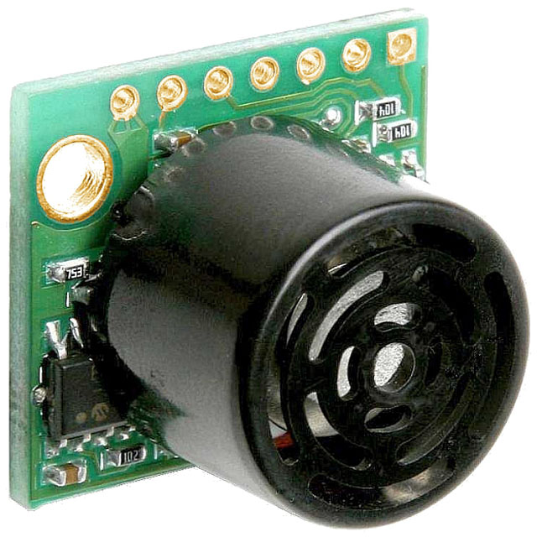
Sonar
MB1000-LV

Slide 2
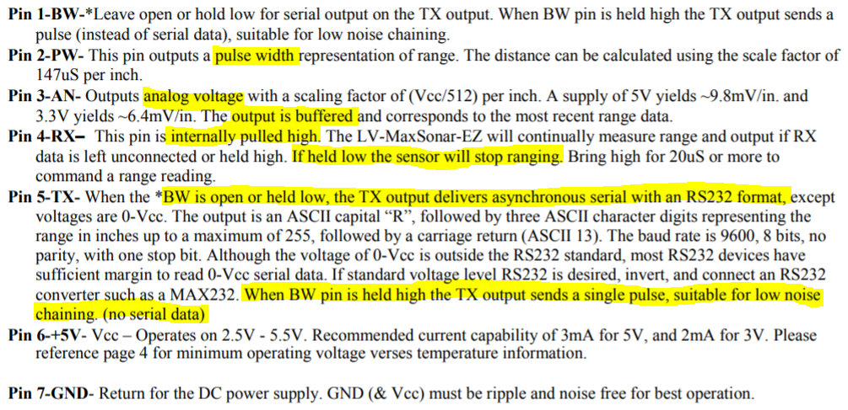
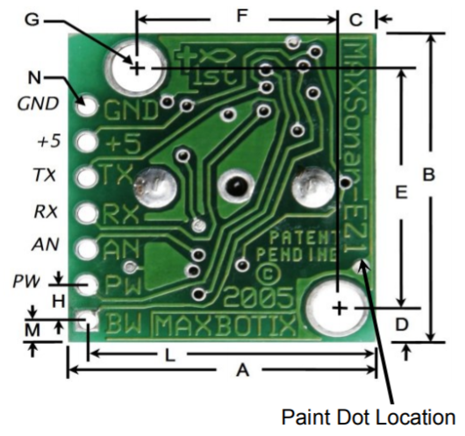
Pin Description

Slide 3
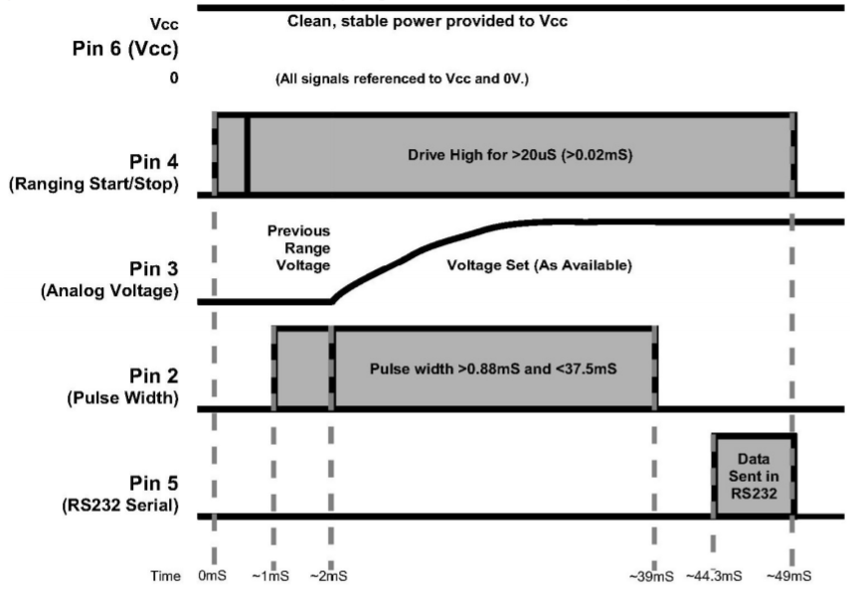
PW vs AN vs Serial
The remainder of the 49mS time (less 4.7mS) is spent adjusting the analog voltage to the correct level. When a long distance is measured immediately after a short distance reading, the analog voltage may not reach the exact level within one read cycle
Burst transmitted – PW set High and echo pulls low
During the last 4.7mS, the serial data is sent.

Slide 4
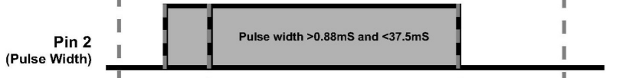
Free Run vs Triggered
Free Run
Pros:
(3) wires per sensor
AN: reading not affected since last one is buffered
Cons:
Multiple sensors will not be synchronized (could range at same time, cross-talk)
PW: long range time (must wait for the next sensor range event for the PW pin to go LOW-HIGH-LOW)
Triggered
Pros:
Options: simultaneous, sequential, loop
PW: decreased read time
Cons:
(4-5) wires per sensor

Slide 5
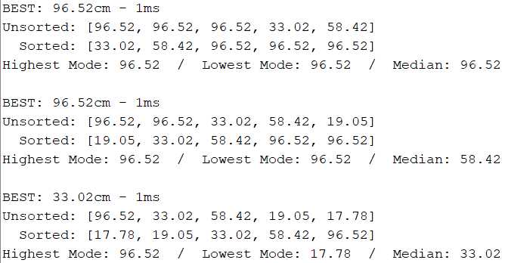
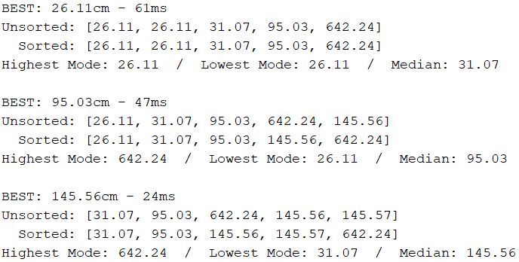
PW vs AN Response Time
AN
PW – free run
Requires non-blocking method

Slide 6
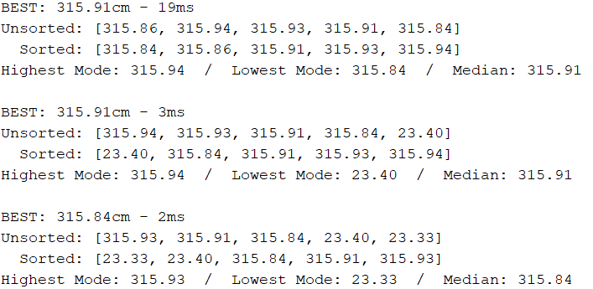
PW vs AN Response Time
PW – free run
PW – triggered
Requires non-blocking method

Slide 7
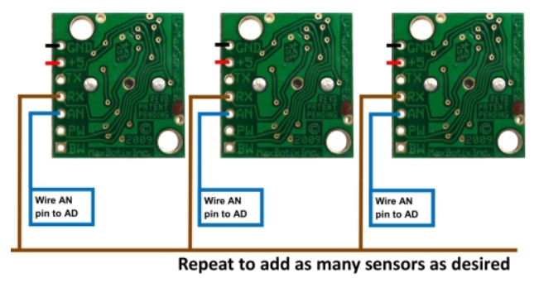
Simultaneous Operation
Pros:
fastest method
AN: buffered readings
Cons:
cross-talk possible
Note: Continuously variable gain – will typically ignore adjacent sensors when running simultaneously.

Slide 8
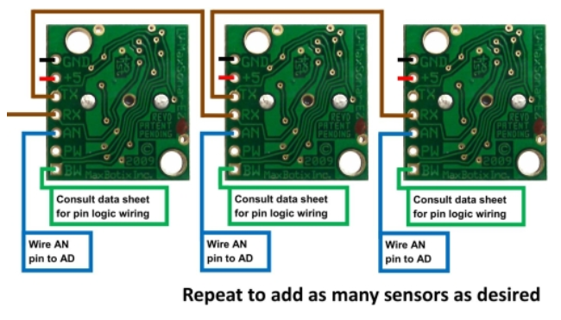
Commanded Sequential Operation
Pros:
PW: each cycle is triggered, no excess time reading PW
AN: quick buffered response
Cons:
(6) wires per sensor
(1) sensor ranging at a time

Slide 9
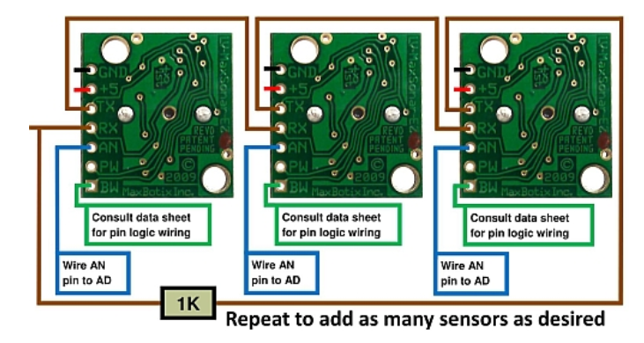
Constant Loop Operation
Pros:
(1) trigger event at setup, continuous loop
Synchronized, no cross-talk
AN: quick buffered response
Cons:
(6) wires per sensor + inline resistor
(1) sensor ranging at a time
PW: no control over trigger event, long read times

Slide 10
Proposed Operation – Individually Triggered Analog Voltage
(1) trigger for each sensor – can control simultaneous / sequential operation via software
Sensor response instantly (AN buffered response)
Function call NO FASTER THAN 50ms (AN will return same buffered value)

