Slide 2
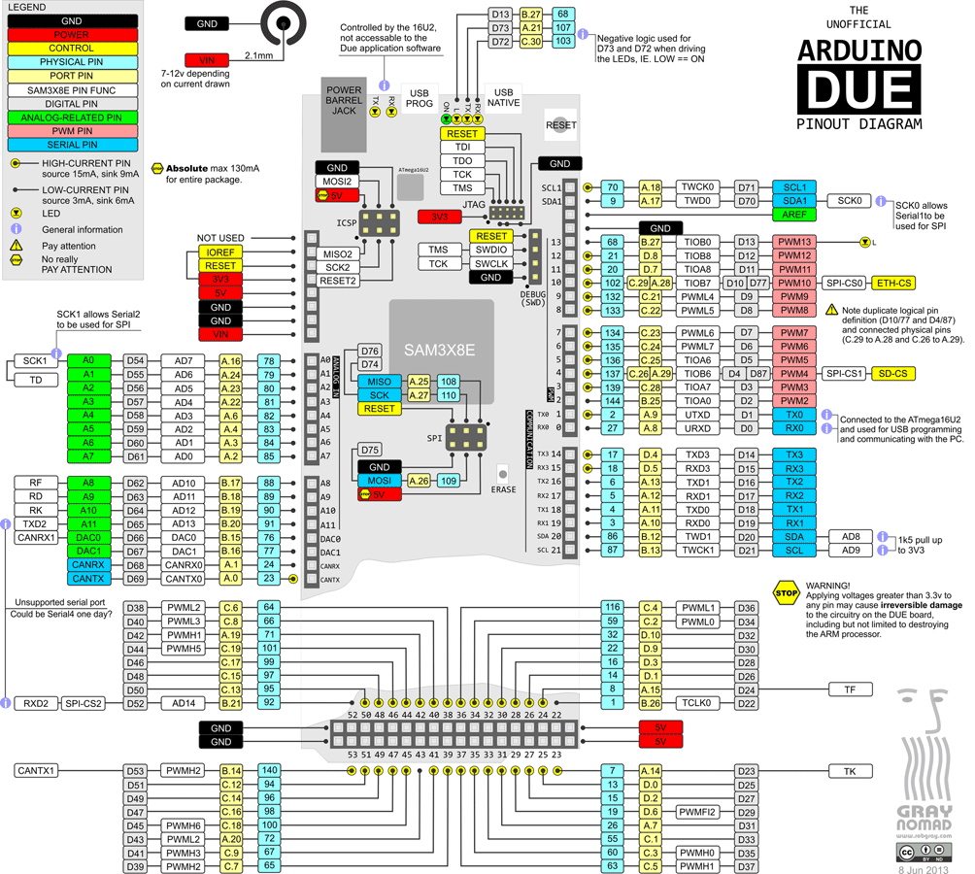
Configurable Hardware PWM pins for DUE
Only one PWM device per color group

