Slide 1


Development of Bioinformatics Tools
ANN Le
le gall lab
JANUARY 5, 2017

Slide 2
Presentation Topics
GibbsCluster
PyMOL
Future Steps

Slide 3
GibbsCluster
Peptide grouping software

Slide 4


Gibbscluster
Software developed by Bioinformatics Dept. at Technical University of Denmark for alignment and clustering of peptide sequences
Program takes input of a list of peptide sequences and attempts to
Andreatta, M., Lund, O., & Nielsen, M. (2012). Simultaneous alignment and clustering of peptide data using a Gibbs sampling approach. Bioinformatics, 29(1), 8-14.

Slide 5
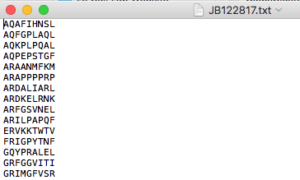
Protocol Overview
Refer to “User Guide for Gibbscluster (MacOSX).docx” inside legalllab/Documents/gibbscluster-2.0 folder
Create .txt file of peptide sequences
Using terminal, type customized command
i.e. ../gibbscluster -f JB122817.txt -P JB122817 > ../results/JB122817results.txt

Slide 6
PyMOL
molecular visualization system

Slide 7

PyMOL
Open-source software to visualize molecular structures
Goal: Observe areas in which the targeted peptides are located within the entire protein
Some areas to question:
Are the peptides commonly located on the surface or specific internal area?
Are the peptides mainly on certain secondary structures (alpha helices, beta sheets, or loops)?

Slide 8
Protocol Overview
Refer to “User Guide for PyMOL (MacOSX).docx” inside legalllab/Documents/PyMOL folder
Create .txt file with protein and corresponding peptide information
Open PyMOL Application
Edit line on Python script
Call Python script on PyMOL command line

Slide 9
Ideas for Future Steps
Implementing further bioinformatics methods

Slide 10
Brainstorming Ideas
Improve Python script
Take in and read multiple proteins/peptides in the text file
Print information into a separate results text file with information on secondary structure
Continue using other software to classify by more biochemical properties and protein structure/folding predictions

