Slide 1


Development of Bioinformatics Tools
ANN Le
le gall lab
July 25, 2017

Slide 2
Presentation Topics
FASTA Files
BLAST+ App
Secondary Structure Tools and Results
Future Ideas/Tool Implementations

Slide 3
Creating FASTA Files
Genomic sequencing techniques

Slide 4
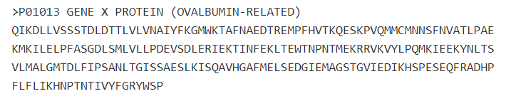
FASTA Files
FASTA format: Text-based format for representing nucleotide/peptide sequences
Has become standard in bioinformatics to manipulate and parse sequences with scripting languages (i.e. Python, Perl) or software
Description line with unique identifiers starts with “>” symbol followed by sequence data in next line

Slide 5
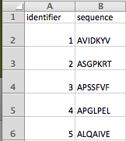
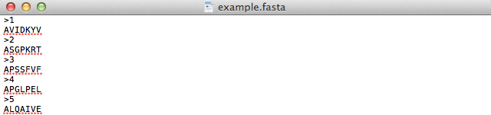
Protocol Overview
Refer to “Excel to FASTA file.doc”

Slide 6
BLAST: Basic Local Alignment Search Tool – NCBI – NIH
Optimization for Protein-protein batches

Slide 7
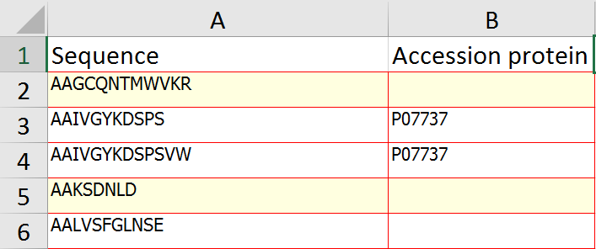
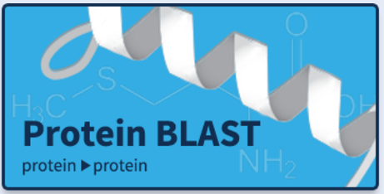
BLAST
Algorithm for comparing similarities and calculating statistical significances between biological sequences
Protein-Protein BLAST in batches to assign peptides to stable identifiers (unique/primary accession numbers) from UniProt Knowledgebase (database of protein information)

Slide 8
Protocol Overview
Create FASTA File
Download BLAST
Installation
Configuration
Database Download
Execution and validation of BLAST Protein-Protein in Batches
Refer to “User Guide for BLAST+ app (MacOSX).doc” for directions on how to configure optimized use in “Protein-Protein BLAST” Folder

Slide 9
Secondary Structure of Peptides
Biochemical property classification

Slide 10
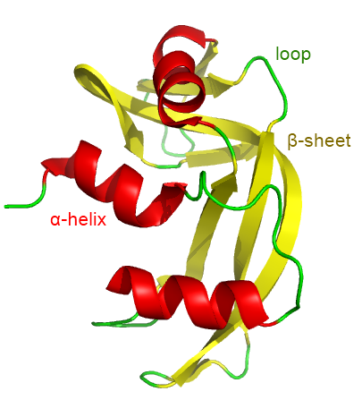
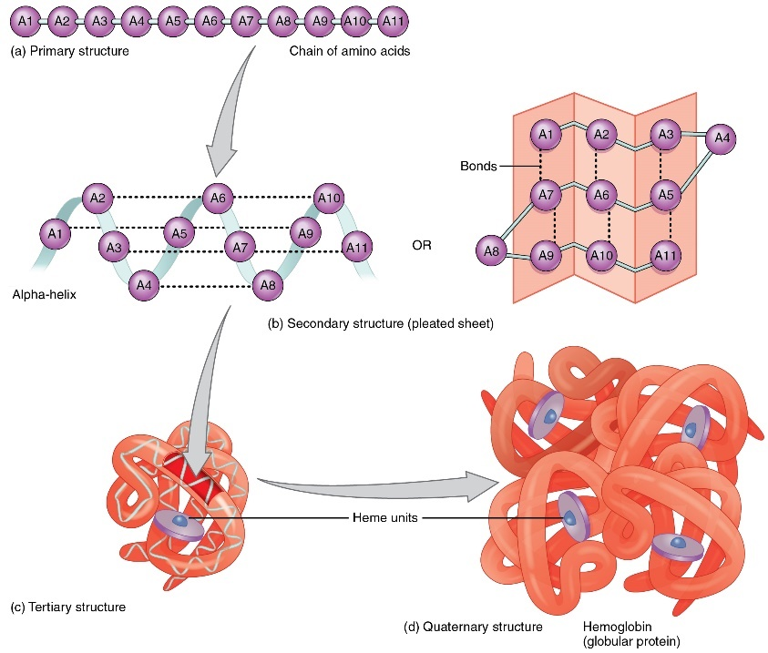
Secondary Structure
Spatial arrangements of primary structures
Certain amino acids prefer specific folding structure
Alpha helix is mostly default; depends on chemical interactions and compatibility of amino acid side chains fitting well
Relative Tendencies of Secondary Structures (2⁰) for Particular Amino Acids
Alpha-helix: Glu, Ala, Leu, Met, Lys, Arg, Gln, His, Phe
Beta-sheet: Val, Ile, Tyr, Cys, Trp, Thr
Turns and loops: Gly, Asn, Asp, Pro, Ser

Slide 11
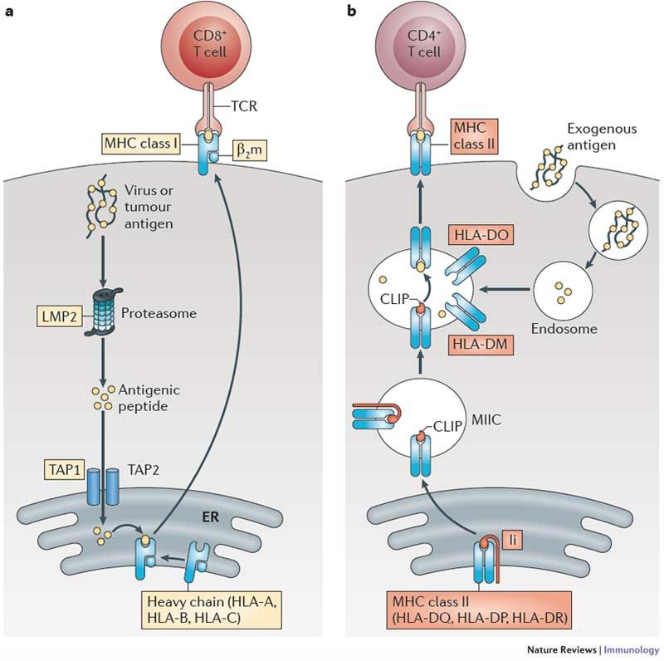
Aim
Question: For the intracellular peptides that are being degraded during antigen processing, where are they specifically located on the complete intact protein?
To analyze specific locations of alpha helices, beta-pleated sheets, and links/turns to be able to determine frequency of certain amino acid residues in areas that are degraded

Slide 12
Protocol Overview
Create .txt file with UniProt URLS
Query UniProt URLS for secondary structure information onto Excel file
Use Macros and Excel formulas on “Matching Secondary Structure.xlsm” to organize data and match peptide ranges
Refer to “Analyzing Secondary Structure Through Multiple UniProt URLS.doc” in “Secondary Structure” Folder

Slide 13
Intracellular Peptides from Julie’s Peptide Database
Dataset: 7107 intracellular peptides from 1568 proteins
868 (55.36%) proteins with no, 700 (44.64%) proteins with: defined structure in UniProt database
3770 (53%) peptides unassigned
3337 peptides (47%) with some secondary structure assigned:
1940 peptides (58.13%) with 1 2⁰ structure motif,
1216 (36.43%) with 2 2⁰ structure motifs,
180 (5.4%) with 3 2⁰ structure motifs
2421 (72.55%) peptides with alpha helix, 1876 (56.22%) peptides with beta strand, 615 (18.42%) in turns

Slide 14
Ideas for Future Tools
Implementing further bioinformatics methods

Slide 15
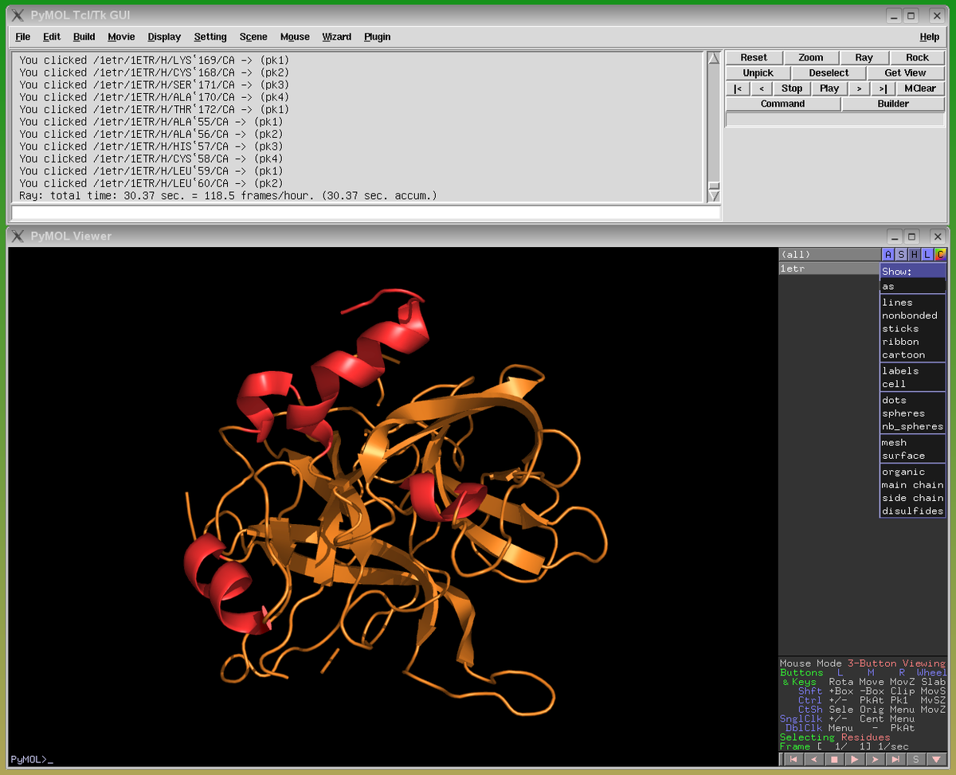
Brainstorming Ideas
Create scripts to automate steps instead of through VBA Macros
Copying and pasting into different sheets
Expanding number ranges åa comma-separated list
Matching similarities between comma-separated lists in two columns
Further analyze protein structure homology to pinpoint/highlight parts of proteins based on matching peptide locations
SWISS-MODEL, SWISS-PDB viewer, PyMOL, STRAP
Continue using other software to classify by more biochemical properties and protein structure/folding predictions
GibbsCluster, Phyre
Notes:
Create scripts to automate steps instead of through VBA Macros
Copying and pasting into different sheets
Expanding number ranges åa comma-separated list
Matching similarities between comma-separated lists in two columns
Further analyze protein structure homology to pinpoint/highlight parts of proteins based on matching peptide locations
SWISS-MODEL, SWISS-PDB viewer, PyMOL, STRAP
Continue using other software to classify by more biochemical properties and protein structure/folding predictions
GibbsCluster, Phyre

Slide 16
ANY QUESTIONS?

