Slide 1


Bioinformatics Tools
Ann Le
June - August 2019

Slide 2
Overview
Databases using SQL/mySQL Workbench
Other continuing side projects

Slide 3
SQL (Structured Query Language)
Standard language to communicate for storing, manipulating, and retrieving data in databases
Examples:
CREATE TABLE PEOPLE (NAME CHAR (20), AGE INT(3));
INSERT INTO PEOPLE VALUES (13, ‘Phoenix’)
SELECT * FROM PEOPLE;

Slide 4

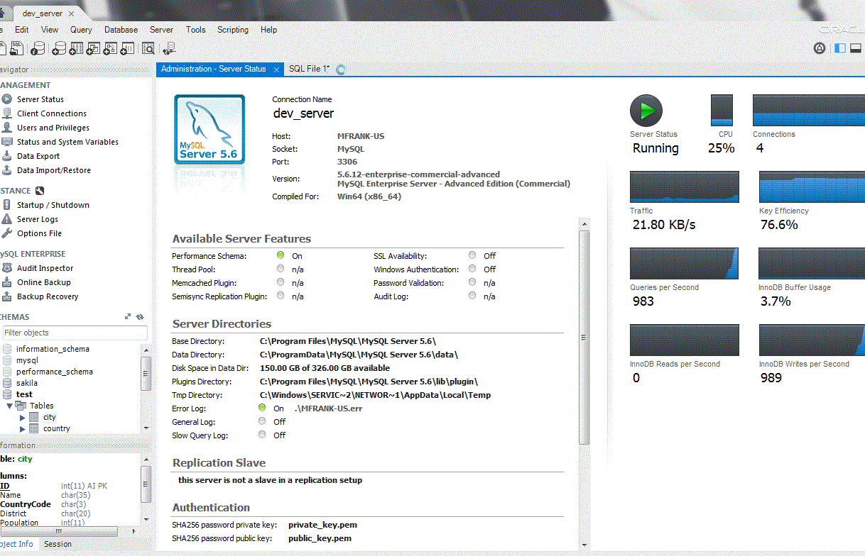
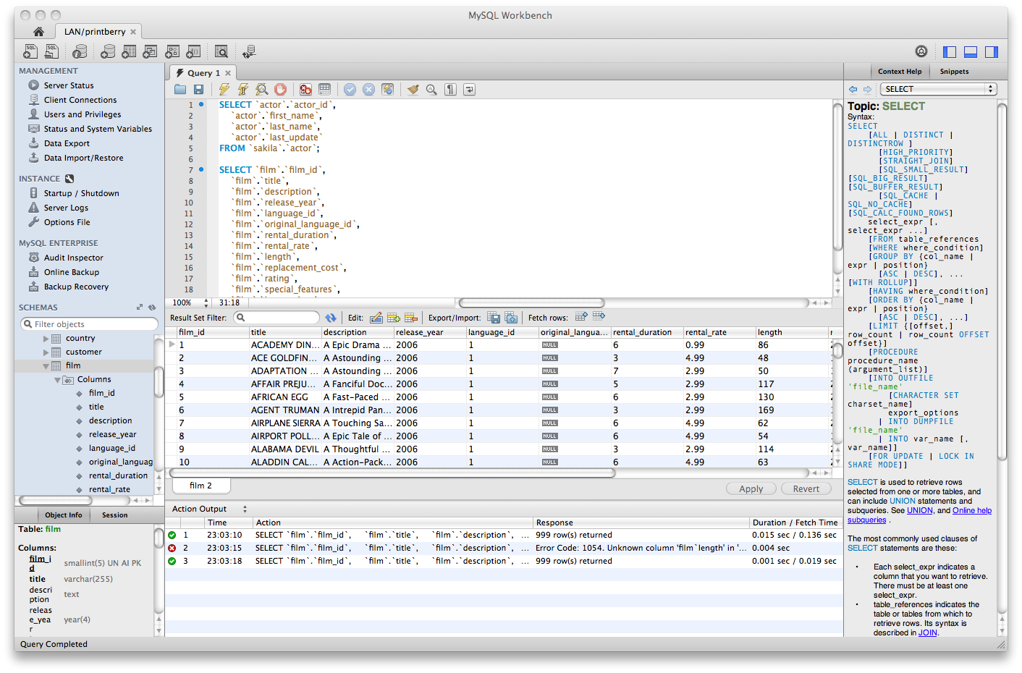
mySQL Workbench
mySQL: An open-source relational database management system
mySQL Workbench: A visual database design tool that integrates SQL into the development of the system

Slide 5
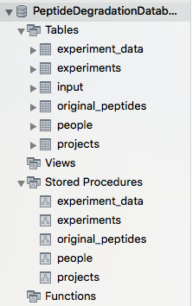
Peptide Degradation Database
Refer to “User Guide for MySQL Degradation Database.docx” protocol
Purpose of database: Store data for peptide degradation experiments
3 main “manual” tables:
‘people’
‘projects’
‘input’ (information from .csv template used for ‘experiments’, ‘experiment_data’, and ‘original_peptides’)
Stored procedures

Slide 6
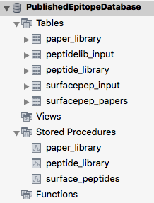
Published Epitope Database
Refer to “User Guide for MySQL Published Epitope Database.docx” protocol
Purpose of database: Store data for published information on epitopes
2 main “manual” tables:
‘peptidelib_input’ stores info for...
‘peptide_library’
‘surfacepep_input’ stores info for…
‘paper_library’
‘surfacepep_papers’
Stored procedures

Slide 7
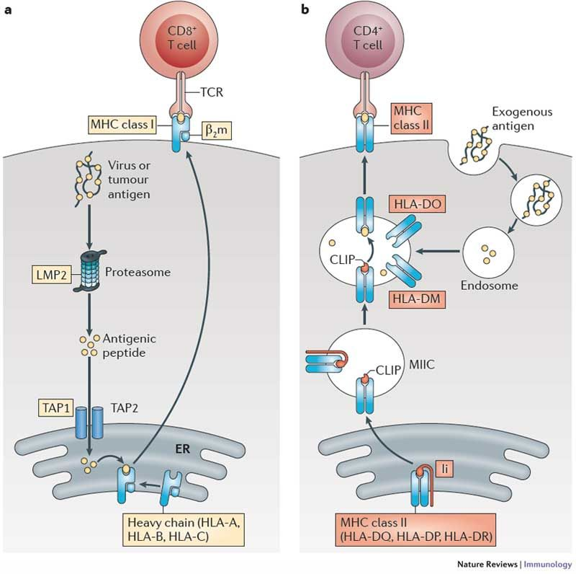
Applications
Big picture biology behind experiment data in databases
Antigen processing and presentation during HIV infection
HIV proteins are degraded into peptides and can be presented at the surface of immune cells by HLA class molecules
Infected cells are then detected by immune cells
Big questions:
How does the virus get degraded into peptides which are then displayed at the cell surface? What features cause peptide production to be efficient or inefficient?
Proteins → Intracellular degradation peptides → surface peptides?
How can we derive info from experiment data in databases?
Identifying patterns in big data through SQL queries
Endogenous and exogenous antigen processing and HLA class-I presentation.
Kobayashi, K. S., & Van Den Elsen, P. J. (2012).

Slide 8
Ongoing work for the future

Slide 9
Other questions project focuses on
Do intracellular peptides correspond to specific 3D structures in original proteins when degraded during peptide processing?
Do the intracellular peptides have specific amino acid motifs at the junction or throughout the sequence where they are enriched/depleted with specific biochemical features/other kinetic properties?
Kobayashi, K. S., & Van Den Elsen, P. J. (2012). NLRC5: a key regulator of MHC class I-dependent immune responses. Nature Reviews Immunology, 12(12), 813.
Access. Num: P69905
VTL AAHLPAEFTPAVHASLDK FLA

Slide 10
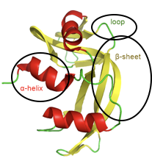
Secondary Structure
Used Python, Excel macros to find ways to analyze specific locations of alpha helices, beta sheets, and turns to determine frequency of aa degradation residues
Results found from past data: 2421 peptides (72.55%) alpha helix, 1874 peptides (56.22%) beta strand, 615 peptides (18.42%) turns
Need to find a way to edit Python script to consider sequence overlaps on similar peptide sequences - more accurate read on overall frequency
AAHLPAEFTPAVHASL | 16 | P69905
AAHLPAEFTPAVHASLD | 17 | P69905
AAHLPAEFTPAVHASLDK | 18 | P69905

Slide 11
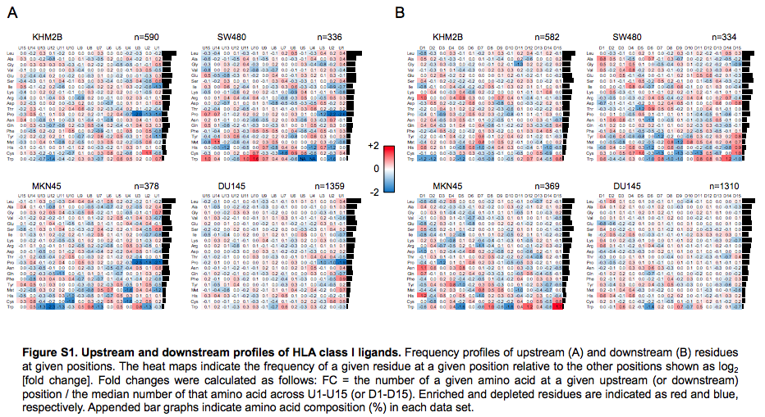
Secondary Structure
Amino Acid Motifs
Access. Num: P69905
AAHLPAEFTPAVHASLDK
VTL
FLA
Using Python script and information from Swissprot/ExPASy to
Take in a .csv/.txt file of peptide sequences
Analyze where the peptides derive from on the protein of origin
Detect what is 3 aa upstream and downstream of the degraded junctions
Record any identified biochemical properties
Perform statistical analyses on any enrichment/depletion bias at the flanking source-protein sequences
Similar to paper read at a June lab meeting
Upstream Position of Proline Defines Peptide-HLA Class I Repertoire Formation and CD8+ T Cell Responses (Hongo et. al. 2019).

Slide 12
ACKNOWLEDGEMENTS
Le Gall Lab
Sylvie Le Gall
Julie Boucau
Neelambri Joshi
Eniola Oladipo
Fabrice Renaud

