Slide 1
Project Presentation of CO-OP Project at Industry (Module-2) (22CS421)
On
Human–AI Collaboration in Decision Making
Avleen Kaur
2210990203
Ruhani Munjal
2210992194
Mimansa
2210991926
Vanshika
2210992505
Supervised By:Shikha Tuteja, Associate Professor, CSE
Department of Computer Science and Engineering,
Chitkara University, Punjab

Slide 2
Contents
Abstract
Introduction & Problem Statement
Objectives & Scope
Methodology
Dataset & Preprocessing
Human–AI Collaborative Framework
Experimental Results & Findings
Conclusion & Future Scope
References
2

Slide 3
Abstract
Artificial Intelligence (AI) is increasingly used in various sectors to improve decision-making processes.
AI systems can analyse large amounts of data quickly and identify hidden patterns efficiently.
However, AI lacks human qualities such as ethical reasoning, contextual understanding, and accountability.
This study proposes a Human–AI collaborative framework that combines machine learning predictions with human judgment.
Loan approval data was used as a case study to evaluate the framework.
Logistic Regression and Random Forest models were implemented for predictive analysis.
The results demonstrate that combining AI capabilities with human expertise improves transparency, trust, and decision quality.

Slide 4
Intoduction
Introduction
Artificial Intelligence (AI) has become an important technology in modern decision-making systems and is widely used in healthcare, finance, education, business analytics, and fraud detection. AI systems can analyse large amounts of data quickly, identify hidden patterns, and improve the speed and accuracy of decision-making. Due to these advantages, AI is increasingly being integrated into critical real-world applications and organisational processes.
Problem Statement
Despite its advantages, AI systems face several limitations and challenges. Many AI models operate as “black-box” systems, making their decisions difficult to understand and interpret. AI systems may also contain bias due to biased training data and lack human qualities such as ethics, accountability, emotional understanding, and contextual reasoning. As a result, fully automated decision-making can reduce trust and create ethical concerns, highlighting the need for Human–AI collaboration where AI supports human decision-makers instead of replacing them.

Slide 5
Objectives & Scope
Objectives
Develop a Human–AI collaborative framework for decision-making.
Improve transparency, trust, and explainability in AI systems.
Compare AI-generated predictions with human decision-making.
Demonstrate how AI can support humans in making accurate and efficient decisions.
Scope
The proposed framework can be applied in various domains such as:
Finance and loan approval systems
Healthcare and medical diagnosis
Recruitment and hiring analysis
Risk assessment and fraud detection

Slide 6
Methodology
Workflow:
Dataset Collection
Data Preprocessing
Feature Encoding & Feature Scaling
Model Training & Testing
Prediction Generation
Human Evaluation & Final Decision
Models Used :
Logistic Regression
Used for binary classification and interpretable predictions.
Helps determine whether a loan application is approved or rejected.
Random Forest
Ensemble learning technique based on multiple decision trees.
Improves prediction accuracy and reduces overfitting.

Slide 7
Dataset & Preprocessing
Dataset
The study uses a loan approval dataset containing important applicant information such as gender, applicant income, loan amount, credit history, education level, and loan status. These attributes help the machine learning models analyse patterns related to loan approval decisions.
Preprocessing
Before training the models, the dataset was preprocessed by handling missing values, converting categorical data into numerical format using Label Encoding, and applying Feature Scaling to normalize numerical values for better model performance.

Slide 8
Human–AI Collaborative Framework
AI Role
Analyse large volumes of structured data
Detect hidden patterns and relationships
Generate predictive insights and recommendations
Human Role
Interpret AI-generated results
Apply ethics and contextual understanding
Make the final decision based on both AI predictions and human judgment
Goal
The main goal of the framework is to create a collaborative system where AI assists humans in decision-making rather than replacing them completely.

Slide 9
Experimental Results
Findings
Logistic Regression achieved slightly higher accuracy than Random Forest.
Credit history was one of the most influential factors in loan approval prediction.
Machine learning models successfully identified hidden patterns within the dataset and provided useful predictive insights.
Model Performance
Model | Accuracy
Logistic Regression | 78.86%
Random Forest | 78.04%

Slide 10
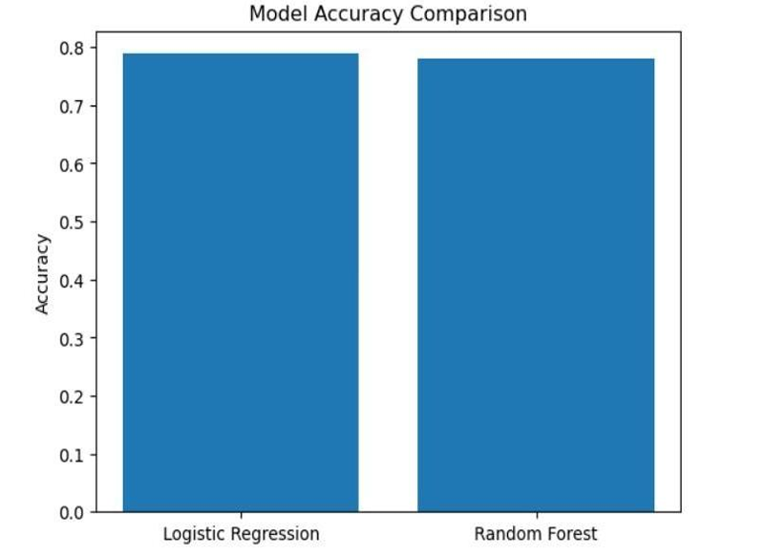
Accuracy Comparison Graph

Slide 11
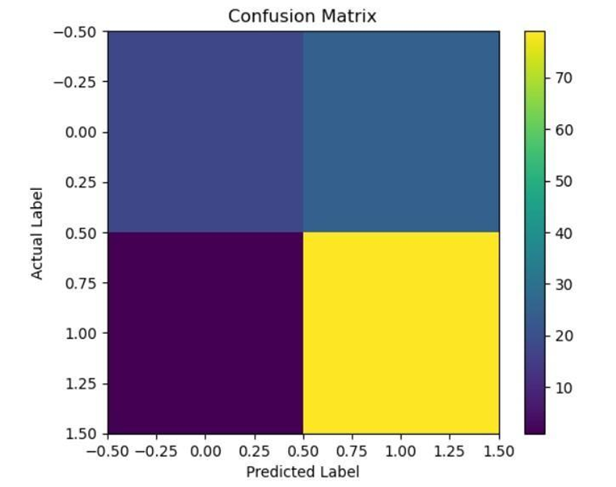
Confusion Matrix & Findings

Slide 12
Confusion Matrix & Findings
Key Findings:
Most approvals predicted correctly.
Some errors still occur.
Human validation remains necessary.
Actual / Predicted | Rejected | Approved
Rejected | 18 | 25
Approved | 2 | 79

Slide 13
Conclusion & Future Scope
Conclusion
Human-AI collaboration improves decision-making.
Explainable AI increases trust.
Hybrid Intelligence provides better outcomes.
Future Scope
Larger datasets
Real-time systems
Advanced AI models
Multi-domain applications

Slide 14
References
[1] S. Dolgikh and O. Mulesa, “Collaborative Human AI Decision-Making Systems,” in Proc. II Int. Scientific Symposium Intelligent Solutions (IntSol 2021), Kyiv-Uzhhorod, Ukraine, 2021, pp. 96–105.
[2] S. Eisbach, M. Langer, and G. Hertel, “Optimizing human-AI collaboration: Effects of motivation and accuracy information in AI-supported decision making,” Computers in Human Behavior: Artificial Humans, vol. 1, p. 100015, 2023.
[3] S. A. Shukkoor, “Human-AI collaboration in decision-making,” World Journal of Advanced Engineering Technology and Sciences, vol. 15, no. 1, pp. 2434–2440, 2025.
[4] E. A. Etuk and O. C. B. Omankwu, “Human-AI Collaboration: Enhancing Decision-Making in Critical Sectors,” Communication in Physical Sciences, vol. 12, no. 2, pp. 426–433, 2025.
[5] E. Brynjolfsson and A. McAfee, Machine, Platform, Crowd: Harnessing Our Digital Future. New York, NY, USA: W.W. Norton, 2017.

Slide 15
Thank You
15

