Slide 1
Project Title : Spellchecker
Name and Roll No: Avleen Kaur
2210990203

Slide 2
Index
Objective
Introduction
Methodology, Approach & Techniques
Algorithm
Result
Source Code (screenshots)
Conclusion
Reference

Slide 3
Objective
The objective of the spell_check function is to perform automated spell checking on a given text input.
Also this code prints corrected sentences after spellcheck.

Slide 4
Introduction
It is a spellchecker project using Python programming language.
Prints correct spelling of wrong words at the end of code.
Tools: Python, SpellChecker library.

Slide 5
Methodology, Approach & Techniques
The methodology involves leveraging an external spell-checking library to ensure accuracy and efficiency.
Word-by-word iteration through the input text to detect misspellings.
Output presentation of both original and corrected text for user reference.
Utilizing the correction() method of the SpellChecker module to identify misspelled words and suggest corrections.

Slide 6
Algorithm
Input
Initialize Spell Checker
Split Text
Initialize Corrected Text List
Flag Initialization
Iterate Through Words
Join Corrected Text
Output

Slide 7
Result
The result of running the spell_check function would be the original text along with any corrections made for misspelled words. If no misspelled words are found, the original text would be printed without any modifications.

Slide 8
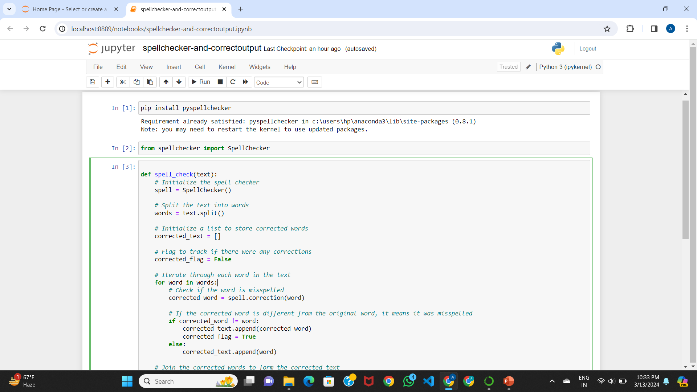
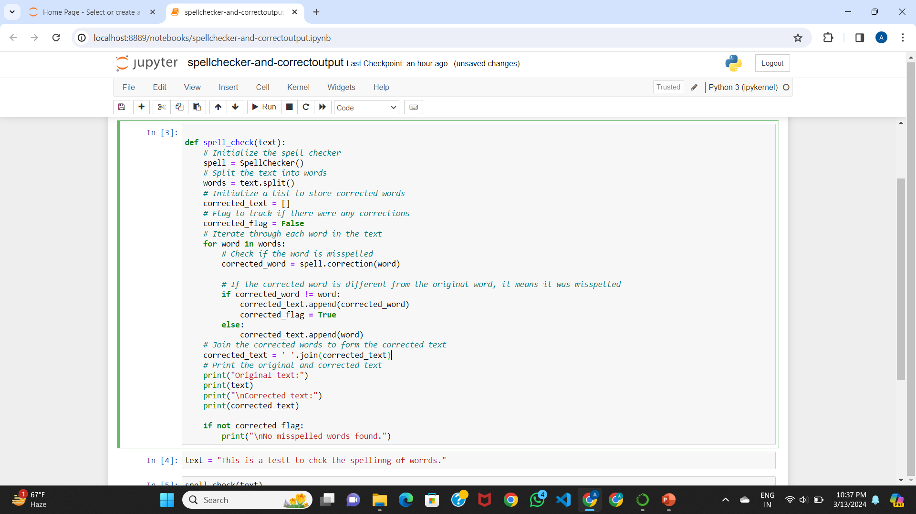
Source Code (screenshots)

Slide 9
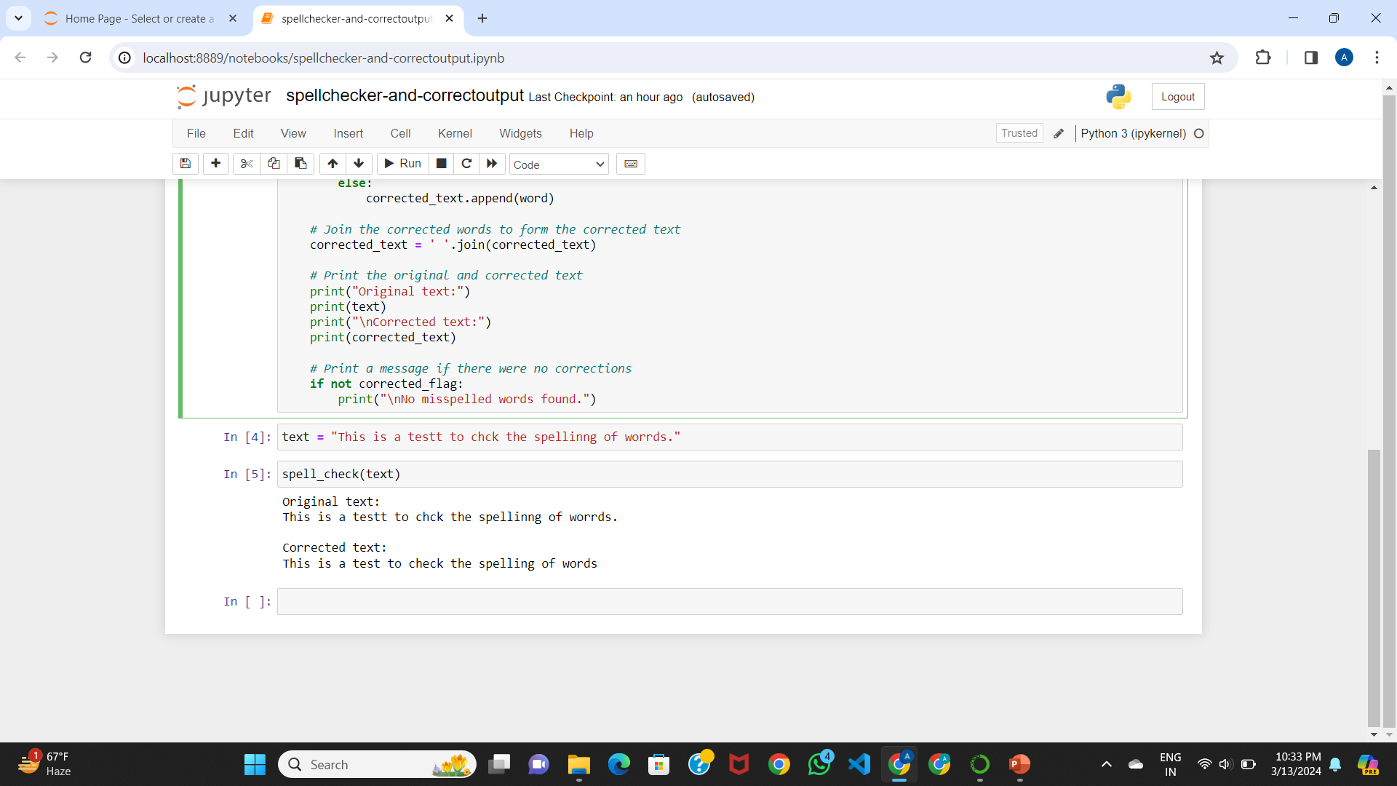

Slide 10
Conclusion
The spell_check function provides a robust solution for automating spell checking tasks within textual data. Through the utilization of a spell-checking module, it efficiently identifies and corrects misspelled words, thereby enhancing the overall accuracy and readability of text-based content.

Slide 11
Reference
GeeksForGeeks
Javapoint

Slide 12
The End

