Slide 1
Decorator pattern

Slide 2



Problem
Add or alter component behavior

Slide 3
Solution - Decorator
Flexible class creation
Decorate just certain methods
Dynamically enabled

Slide 4
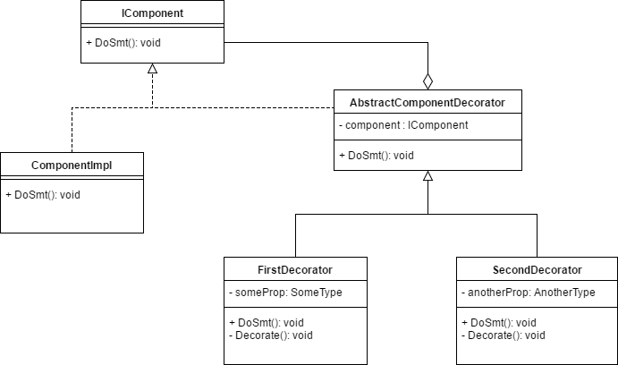

Slide 5

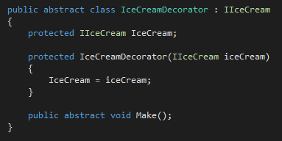
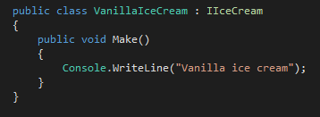
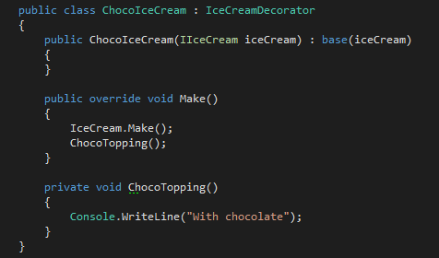
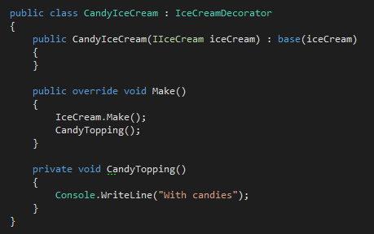

Slide 6
