Slide 1
A Unified Evaluation of Translation and Algorithmic
Impacts in Hardware Verification
Éva Mária Szabó
Supervisor: Zsófia Ádám
Notes:
A Unified Evaluation of Translation and Algorithmic
Impacts in Hardware Verification

Slide 2
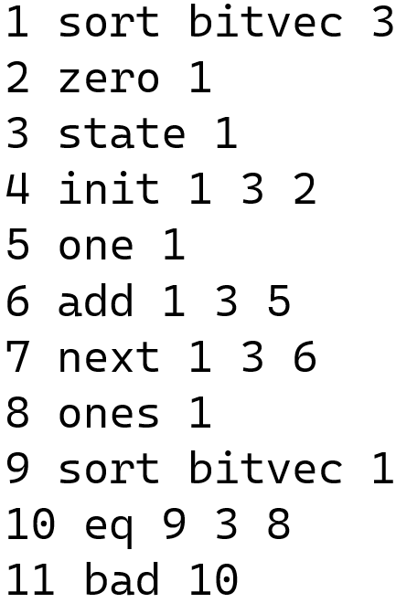
BTOR2
SOTA word-level, bit-precise
model checking format adapted by the HWMCC
Sequential circuits
SMT-LIB semantics
Simple, sorted, line-based syntax
<node id> <op> <sort id0>
<node id1> [<node id2 [node id3]>].

Slide 3
Verification via Transformation
Verilog
v2c
HW Analyzer
Yosys
Yosys
SW Analyzer
C
AIGER
Btor2Aiger
BTOR2
Btor2C
Results? Software verifiers uncovered more bugs missed by SOTA hardware tools, yet overall performance remains mixed (Btor2C + CBMC)
Why? Different algorithms, optimizations, heuristics, non-trivial transformations …

Slide 4

Verification via Transformation
Verilog
v2c
HW Analyzer
Yosys
Yosys
SW Analyzer
C
AIGER
Btor2Aiger
BTOR2
Btor2C
How to find out more? A unified verification framework with the same backend solver
Thus evaluating:
→ Pure algorithmic performance
→ Structural complexity and representational bloat

Slide 5
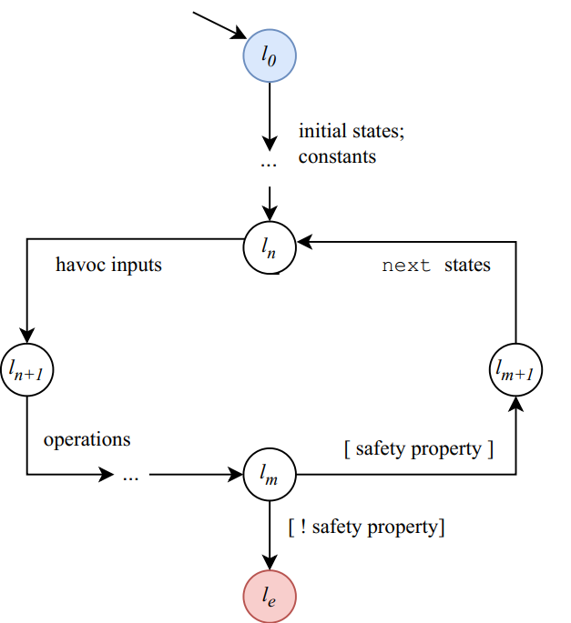
Transformation to CFA
Initial states (init)
Constants (one, ones, constant etc.)
Havoc assignments (input)
Operations (add, and, eq etc.)
Safety property (bad)
Next states (next)
  If a state has no next state then it
  gets havoced
Notes:
Havoc: nem determinisztikus értékadás

Slide 6
Comparing the transformations
Category | Btor2CFA | C2CFA
Variable dependencies | Straightforward variable relations | Many extra variables created when calling functions
Temporary variables | No extra temporary variables | Lots of temporary variables needed for copying values and parameters
State handling | State updated directly | State changed indirectly through function calls and parameters
Bit-level operations | Bit-sizes handled automatically | Bit-sizes handled manually using masks
Procedures and structure | One simple procedure | Several procedures, causing call overhead
Instrumentation and semantics | Very little additional logic | More complex logic due to C semantics and assertion checks

Slide 7
Evaluation
Experimental setup:
  698 safety benchmarks from HWMCC (safety property, array-free bit-vector circuits)
  Unified backend: MathSAT 5.6.10
Metric | BTOR2CFA |  | C2CFA
 | Avg | Median | Avg | Median
Variables | 1,153.93 | 928.0 | 3,241.07 | 2,561.0
Statements | 1,321.20 | 1,068.0 | 7,543.92 | 6,025.0
Dataset | CPU Time (s) |  | Memory (MB) |  | Success (%)
 | Avg | Median | Avg | Median
C2CFA | 141.02 | 54.89 | 1,878.00 | 984.34 | 75.43%
BTOR2CFA | 22.42 | 10.46 | 461.02 | 316.43 | 98.71%

Slide 8
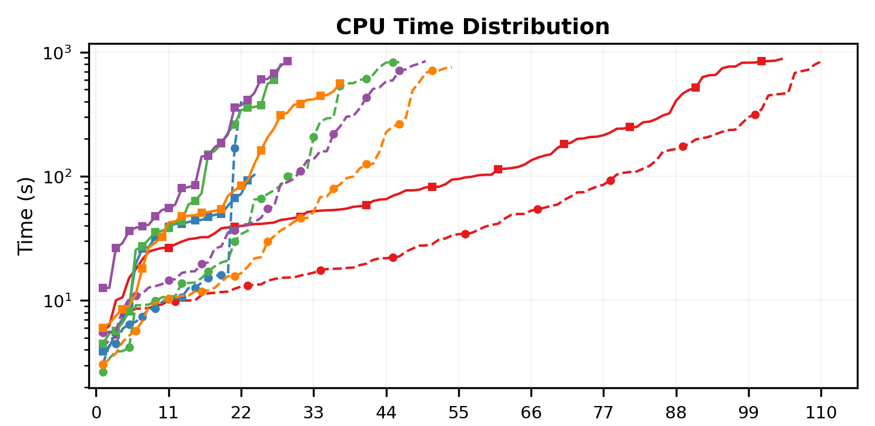
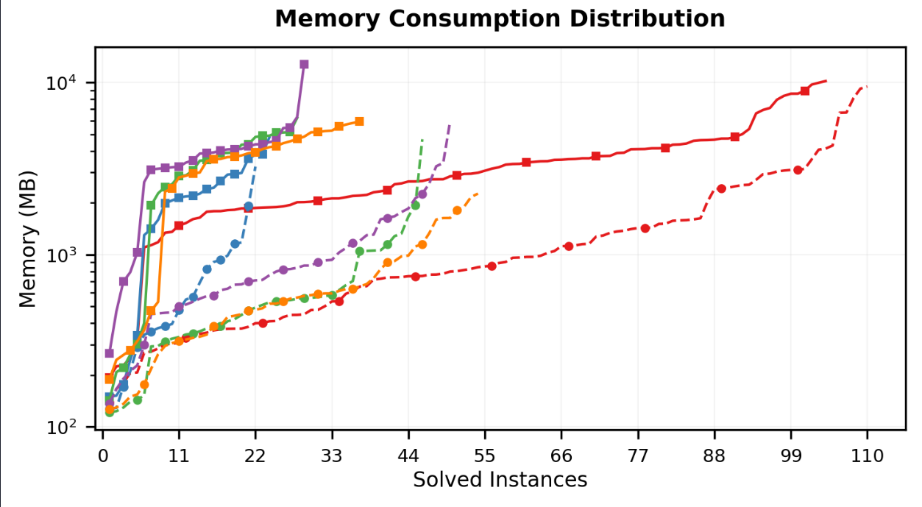
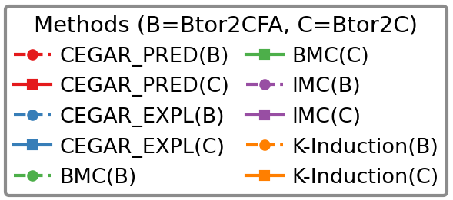
Evaluation
Key findings:
  Structural bloat from C transformation affects verification
  Resource Consumption is 3-5 × greater
  Algorithmic winner so far CEGAR with predicate abstraction (CEGAR_PRED)
Notes:
We evaluated 698 HWMCC safety benchmarks.
The quantile plot tracks logarithmic CPU time against solved instances—lower and further right is better. Dashed curves show our direct BTOR2 frontend, while solid curves show the intermediate C pipeline.
In every case, direct encoding dominates. Red CEGAR with predicate abstraction emerges as the clear winner, solving more than double the instances of any other method.
As the table shows, translating through C triples variables and multiplies statements six-fold, leading to rapid solver exhaustion.
Looking ahead, our future work focuses on extending the direct BTOR2 frontend to support array sorts, arithmetic overflow predicates, and liveness properties. Furthermore, we plan to deepen our qualitative trace analysis to pinpoint precisely which circuit characteristics make hardware benchmarks challenging, ultimately paving the way for unified, cross-domain benchmarking across both hardware and software systems.

Slide 9
Future Work
Technical Development
  Language Completeness:
    Implement support for array types
    Add overflow detection and reduce operations
  Extended Property Verification:
    Expand capabilities to support liveness properties
Academic Milestones & Qualitative Analysis
  Upcoming competitions and conferences: HWMCC, FMCAD’27
  Research Questions:
    What are the specific characteristics that make hardware benchmarks challenging?
    Which algorithms scale most effectively?

Slide 10
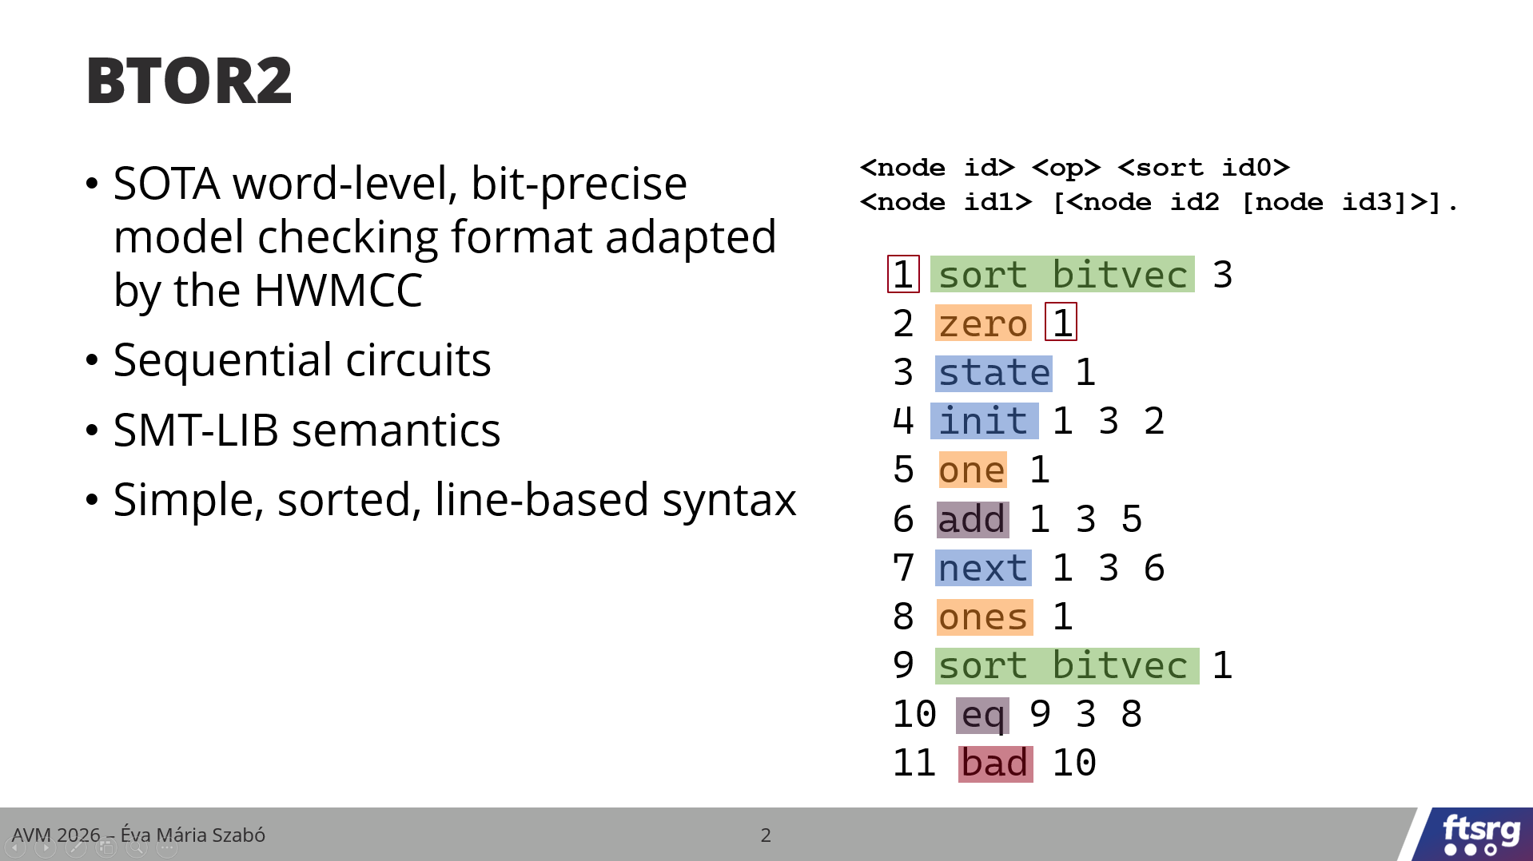
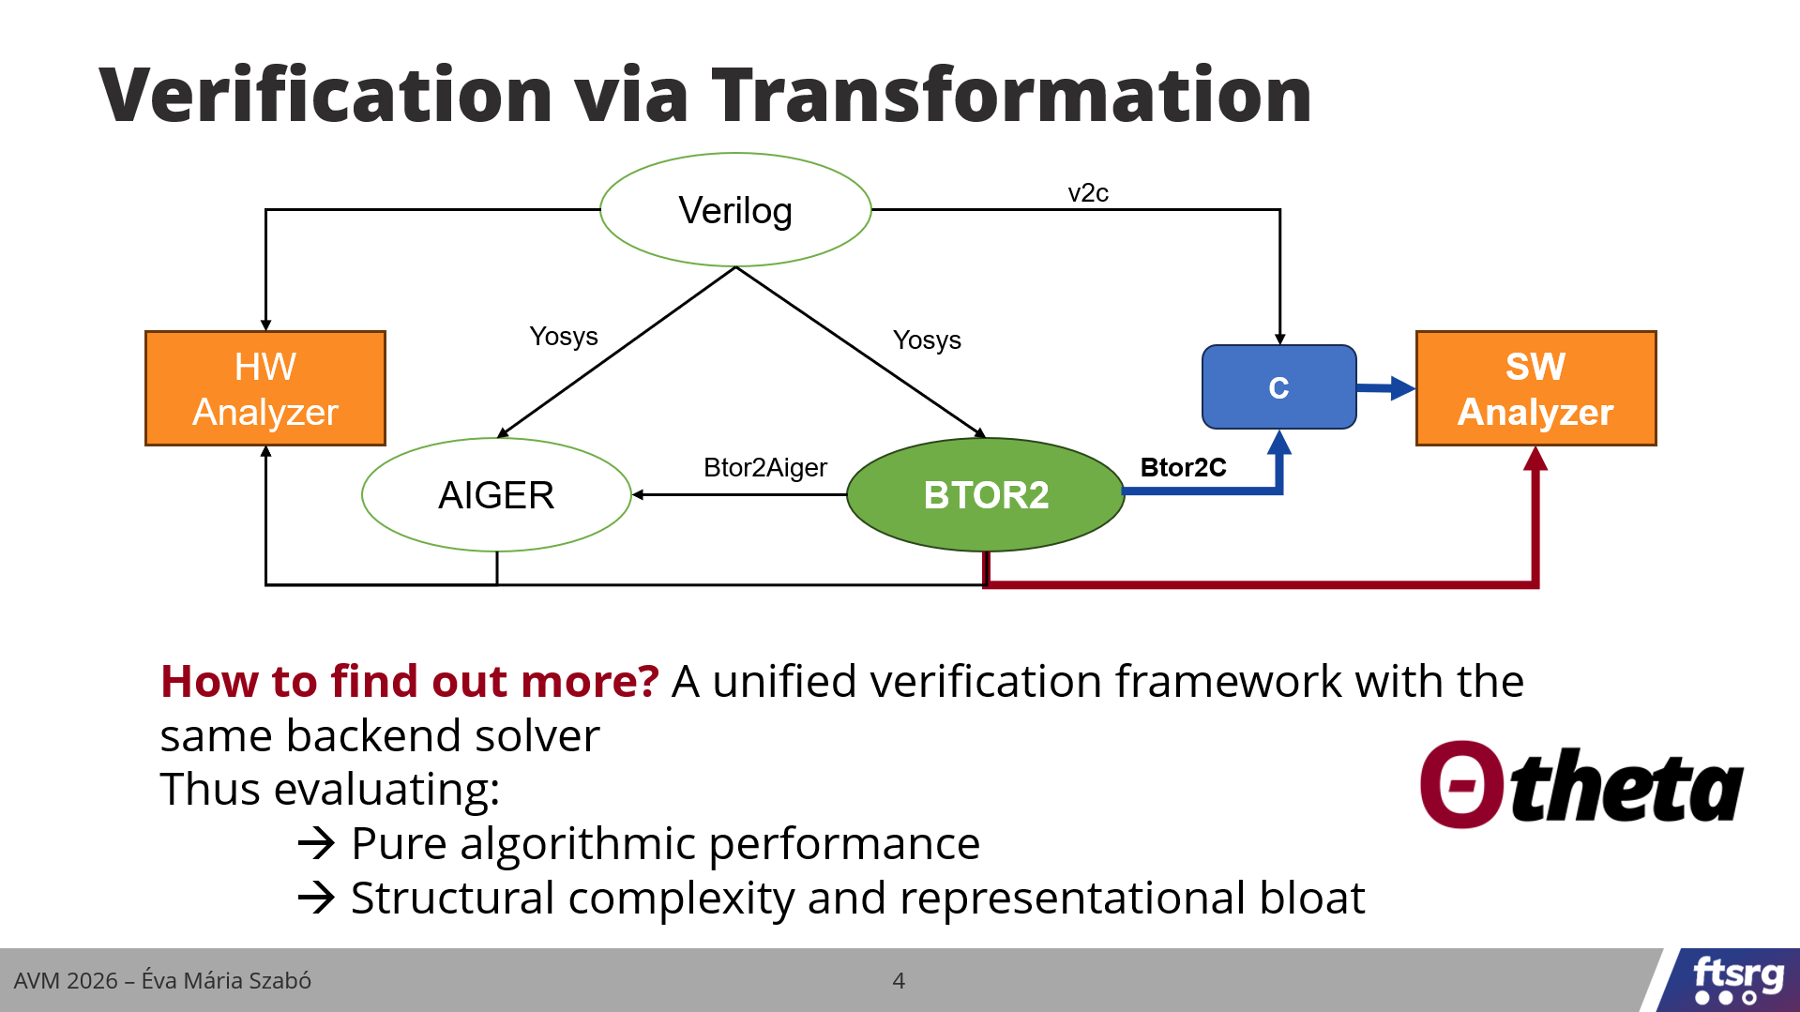
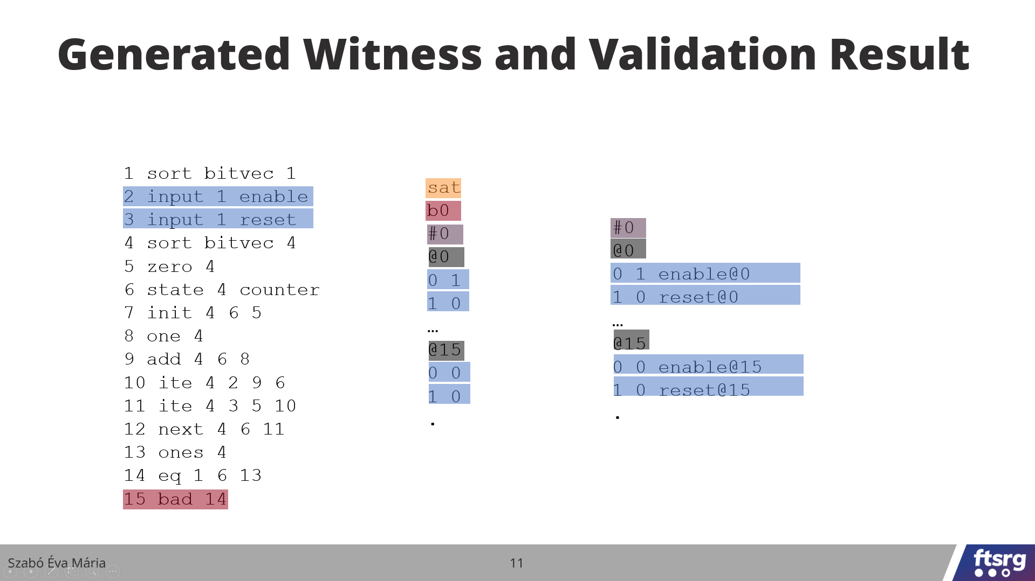
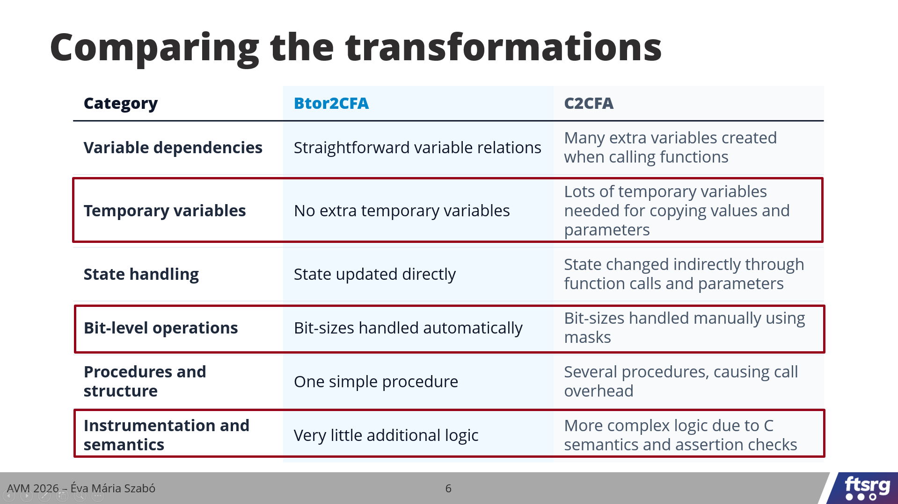
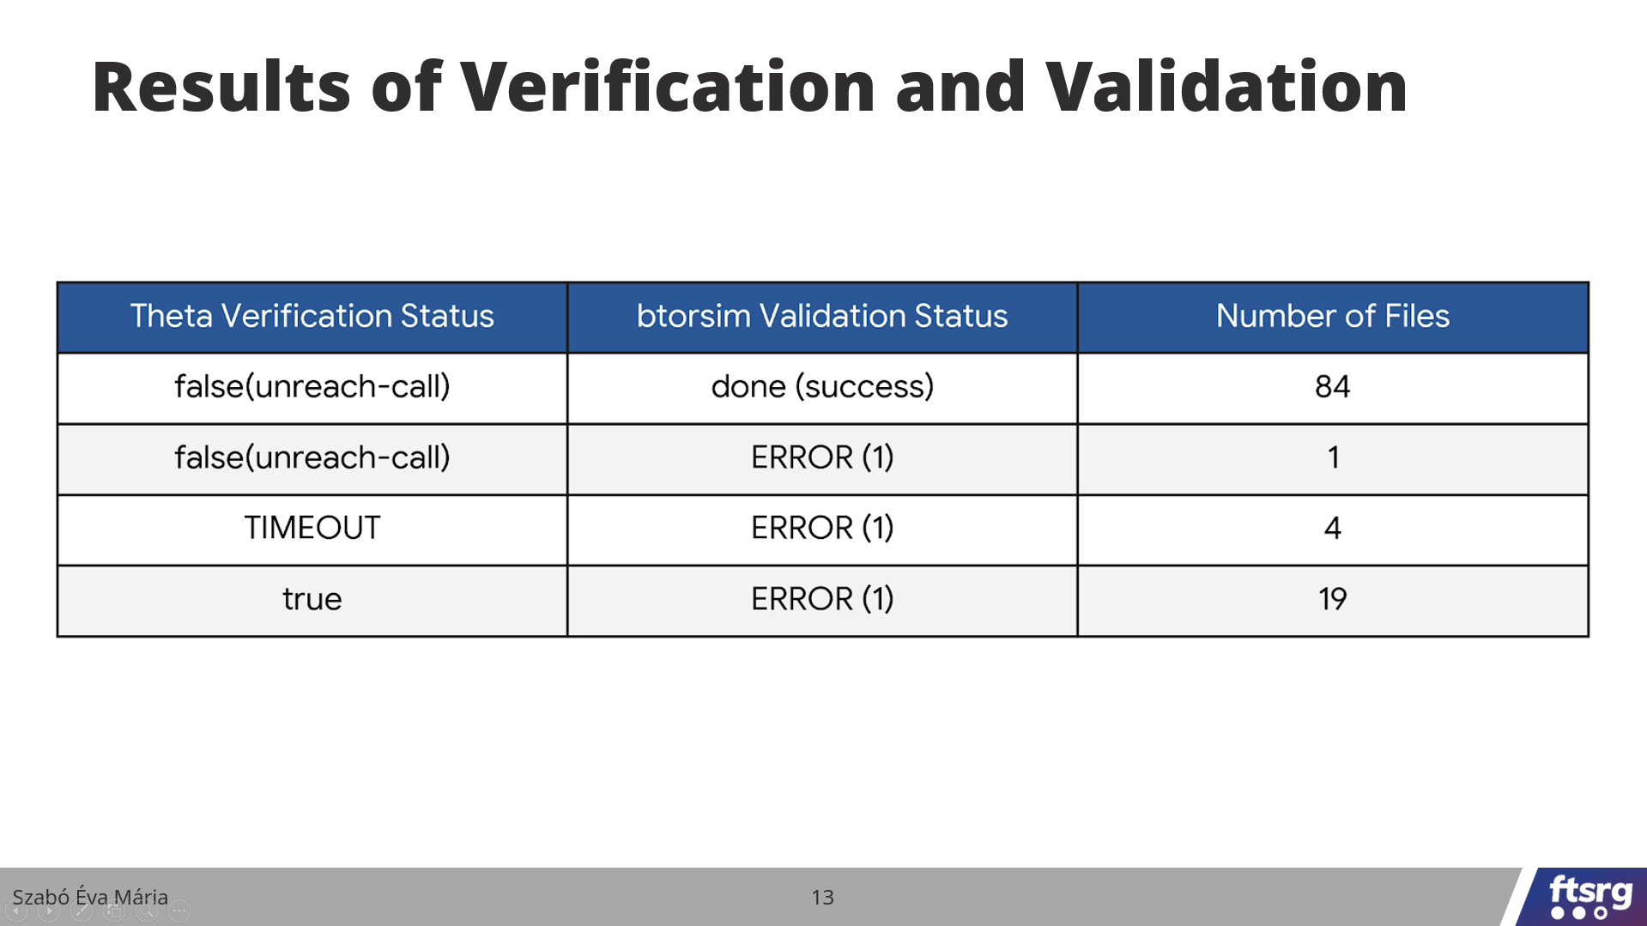
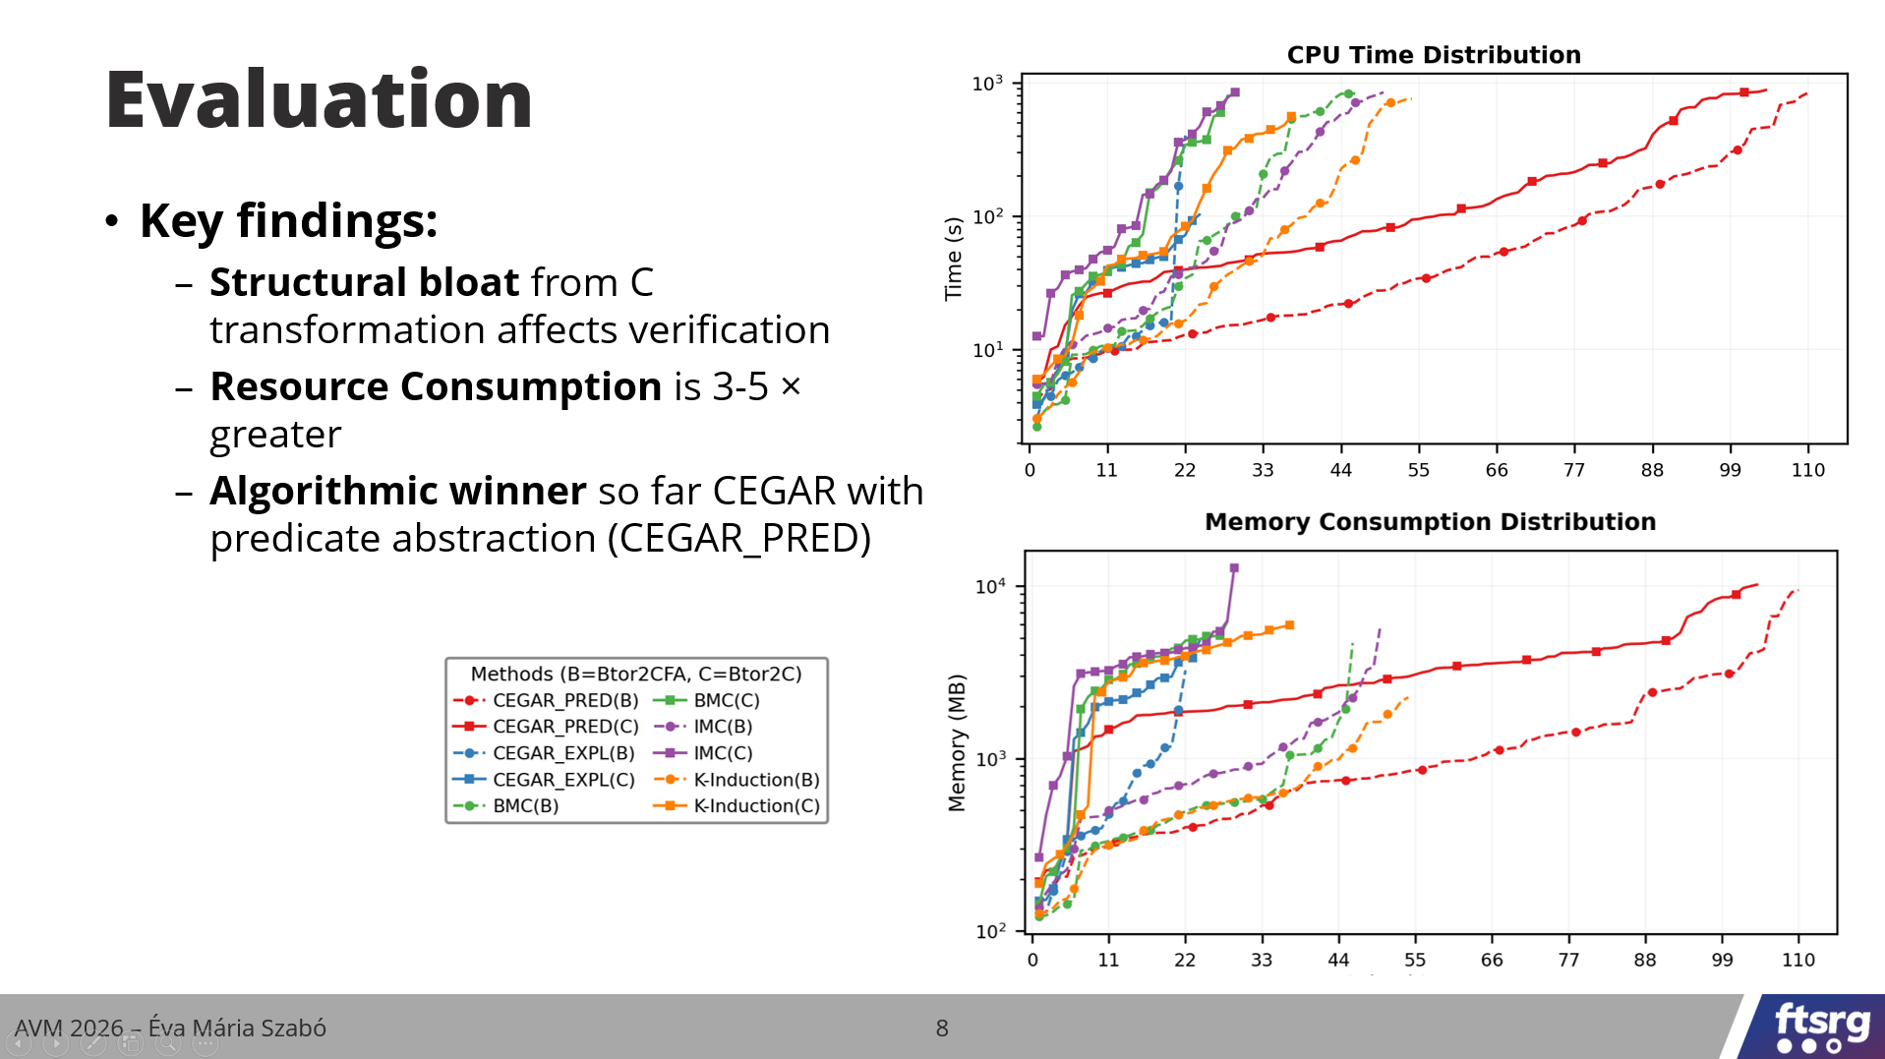
Summary

