Slide 1
Bridging testing and formal methods: equivalence detection and test generation for mutation testing in PLC software
Andrada Alexia Serban
Notes:
I’m name,msters student at ftsrg and my research so far has focused on mutation testing in embedded, safety critical systems and industry case studies on using this methodology.
A large part of that focused on PLCs specifically, and I ended up using a model checking tool, PLCverif to solve some problems coming up during the process.

Slide 2

Context
Programmable Logic Controllers: industrial control systems
Software: cyclic nature, specialized languages
Application: often safety-critical
  manufacturing, pharmaceuticals, transportation
Formal verification: not widespread practice
Software testing: notoriously challenging
  Further hindered by underdeveloped tooling
    (e.g. debugger, coverage measurement)
→ Mutation testing for test improvement
Notes:
PLCs are specialized industrial control systems
Their software is written in specialized languages, and is executed in a loop
They’re often used in safety critical environments, such as …
This would motivate the adoption of formal verification, but
unfortunately it is not widespread practice,
requires domain specific knowledge or is constrained by the tooling used
Testing is still the primary solution, but in this case, a lot more challenging because
it also requires domain specific knowledge (specialized languages)
tooling is less well developed, e.g. in my case study no coverage measurement, debugging had limited capabilities
I ended up using mutation testing to make software testing more efficient

Slide 3
Mutation testing
How to measure the fault detection ability of a test suite?
Input
SUT
Mutants
operators
Live mutants
Yes
Mutation score
Original results
==
Mutant's results
Test cases
Killed mutants
No
Notes:
A method to measure fault detection ability of test suite
[how it works]
But there are some problems that come up, all of them related to live mutants☺

Slide 4

Mutation testing – questions, problems
    Prove its equivalence
    Write a test for it
What should we do with live mutants?
  Can the mutant even be killed?
    Prove its equivalence
  How can the mutant be killed?
    Write a test for it
Live mutant
Live mutants
Notes:
All our problems can be traced back to live mutants and handling them :D
Problems can be solved with a model checker, in this case specifically PLCverif.

Slide 5
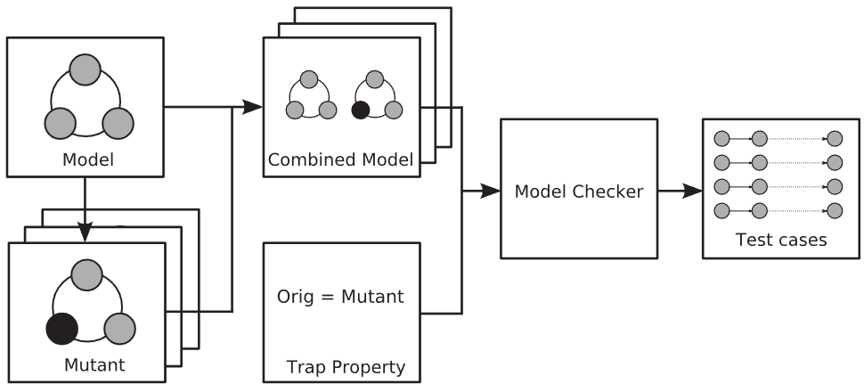
Background: State machine duplication-based test case generation
source code orchestration
SUT
Live mutant
https://doi.org/10.1002%2Fstvr.402
Notes:
The theoretical background is smdbtcg, which isn’t new, my contribution is how PLCverif can be sued to achieve this.
[how it works]
And now I1ll show you a very simple example of this in action

Slide 6
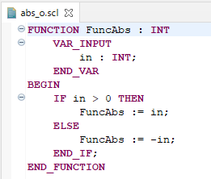
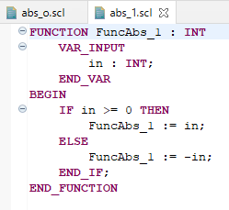
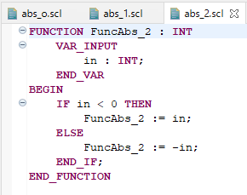
Example: absolute value function
SUT
Live mutant
source code orchestration
Notes:
Lets take the abs val function, in this case we’ll only mutate one line
These two mutants can be created
Now the code orchestration

Slide 7
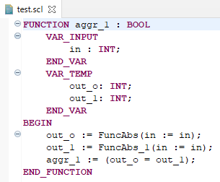
Example: absolute value function
SUT
out_o[t]
in[t]
Live mutant
out_m[t]
source code orchestration
Notes:
First, we take a single input and wire it into both the mutant and the original code
Then we capture their outputs
And compare them to eachother
From here on, we’ll be using PLCverif.

Slide 8
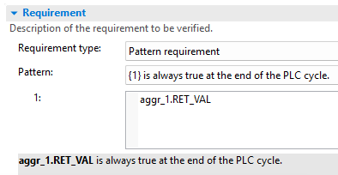
Example: absolute value function
SUT
out_o[t]
Always =
in[t]
Live mutant
out_m[t]
source code orchestration
Notes:
In PLCverif, we can define pattern requirements, which are the easiest to create for those less versed in model checking.
We’ll check the value at the end of the PLC cycle (when outputs are written to physical output pins on an actual plc), and verify if it’s always true, so if the outputs always match
This can go two ways

Slide 9
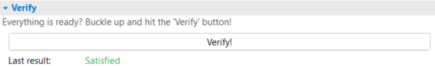
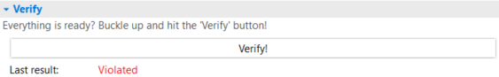
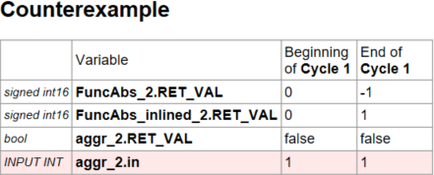
Example: absolute value function
SUT
out_o[t]
Always =
in[t]
Live mutant
out_m[t]
source code orchestration
Notes:
In the first case, it’s easy to see that they will, indeed match. This is an equivalent mutant that cannot be distinguished with any input combination.
In the second case, it’s quite trivial to see that this is indeed a live mutant. PLCverif can tell us so too.
Because of the simplicity of the problem, coming up with a killing test for it shouldn’t be difficult either. The counterexample also provides such a test.

Slide 10
Example: absolute value function
SUT
Live mutant
res := FuncAbs(1);
assertEquals(res, 1);
Notes:
From this counterexample, we can see what test input can differentiate the mutant.
What the original function will return
And what the mutant will return
The test code would look something like this.

Slide 11
Example: absolute value function
SUT
Killed mutant
res := FuncAbs(1);
assertEquals(res, 1);
Notes:
And that will have killed our mutant.

Slide 12
PLCverif for mutant analysis and test case generation
Works on small examples
Does it scale?
  Real brake control software component(s)
    Input: 7 BOOL, 1 BYTE
    Output: 1 BOOL, 1 INT
Notes:
So this works in theorz, and on the small example
But does it scale
Tried it in the industry case study, multiple larger examples, one of them …

Slide 13
Industry example: brake control software
 | Variable | Beginning of C1 | End of C1 | Beginning of C2 | End of C2 | … | Beginning of C158 | End of C158 | Beginning of C159 | End of C159
INPUT BOOL | instance. AvailabilityChanged | false | false | false | false |  | false | false | false | false
INPUT BOOL | instance.Component Setup_Done | true | true | true | true |  | true | true | false | false
INPUT BOOL | instance. DemandAvailability | false | false | false | false |  | false | false | false | false
INPUT BOOL | instance. Orientation_Valid | false | false | false | false |  | false | false | true | true
INPUT BOOL | instance. Sig1_from_Type2 | false | false | false | false |  | false | false | true | true
INPUT BOOL | instance. Sig2_from_Type2 | false | false | false | false |  | false | false | true | true
INPUT BOOL | instance. Unit_is_Type1 | true | true | true | true |  | true | true | true | true
INPUT BYTE | instance. CommandIn | 120 | 120 | 120 | 120 |  | 120 | 120 | 251 | 251
OUTPUT BOOL | instance. outputs_match | false | true | true | true |  | true | true | true | false
Notes:
In this case the killing test would be a little less straightforward☺

Slide 14
PLCverif for mutant analysis and test case generation
Works on small examples
Does it scale?
  Real brake control software component(s)
    Input: 7 BOOL, 1 BYTE
    Output: 1 BOOL, 1 INT
  Execution time: <1 min
  Porting from CODESYS was a challenge
Can it be automated?
  Orchestration & test generation are both trivial, template-based generation tasks
  Execution automation depends on environment
Notes:
Verification time was still under a minute, of course, more non bool inputs and actual logic influences it.
The more challenging part was the different environments used (PLCverif siemens, vs codesys)
On a more practical note, this can be fully automated, I made a POC for that too
Execution is more complex and influenced by the wonderful world of PLC IDEs and language flavours

Slide 15





















Integration into testing workflow
Notes:
How the analysis integrates into the rest of my work
The presumed input is some kind of test set and a tester and/or AI trying to improve it
Prior to this I built the mutation testing engine for plc software, along with some visualization and categorization of mutants to account for the lack of code coverage measurement
This will be wired together with the mutant analysis
Together used as feedback for test set improvement.

Slide 16
Conclusions
Done
Mutation testing engine for PLC software
  Industry case study → usability and visualization improvements
  Reworked to support open access tooling
State machine duplication-based test case generation
  Doesn’t require model-checking domain knowledge thanks to PLCverif
  Easy automation through template-based code generation
In progress
Harness for agentic orchestration
  Enables a measurement campaign to evaluate both method and model capabilities

