Slide 1



A proof assistant-based formalisation of Core Erlang
Péter Bereczky, Dániel Horpácsi, Simon Thompson et al.
Alpine Verification Meeting 2026
Supported by the New National Excellence Program of the Ministry for Culture and Innovation from the source of the National Research, Development and Innovation Fund (ÚNKP-21-3, ÚNKP-22-3, ÚNKP-23-3, EKÖP-26-4).

Slide 2
Motivation: Correctness of refactoring
C[ ]
e
e'
C[ ]
transformation
expressions

Slide 3
Motivation: Correctness of refactoring
static
dynamic
C[ ]
e
e'
C[ ]
transformation
instance
is a refactoring if
expressions
e
≈
e'
definition
congruent program equivalence

Slide 4
Motivation: Correctness of refactoring optimisation
static
dynamic
C[ ]
e
e'
C[ ]
transformation
instance
is a refactoring if
expressions
e
≈
e'
definition
congruent program equivalence

Slide 5
Motivation: Correctness of refactoring optimisation
static
dynamic
C[ ]
e
e'
C[ ]
transformation
instance
is a refactoring if
expressions
e
≈
e'
definition
congruent program equivalence in Core Erlang

Slide 6
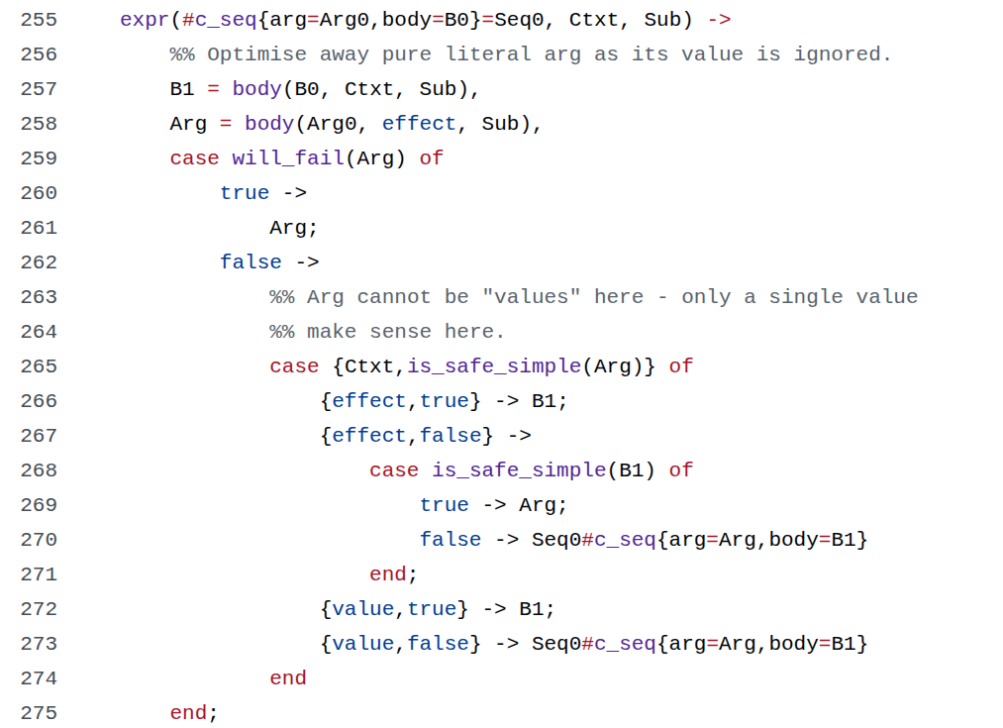
https://github.com/erlang/otp/blob/master/lib/compiler/src/sys_core_fold.erl

Slide 7






The target language: Core Erlang
Gleam
Elixir
LFE
Erlang source code
Erlang Abstract Format
Core Erlang
BEAM VM bytecode

Slide 8
Function closures
let X = 42 in
let F = fun() -> X in
let X = 0 in
apply F()

Slide 9
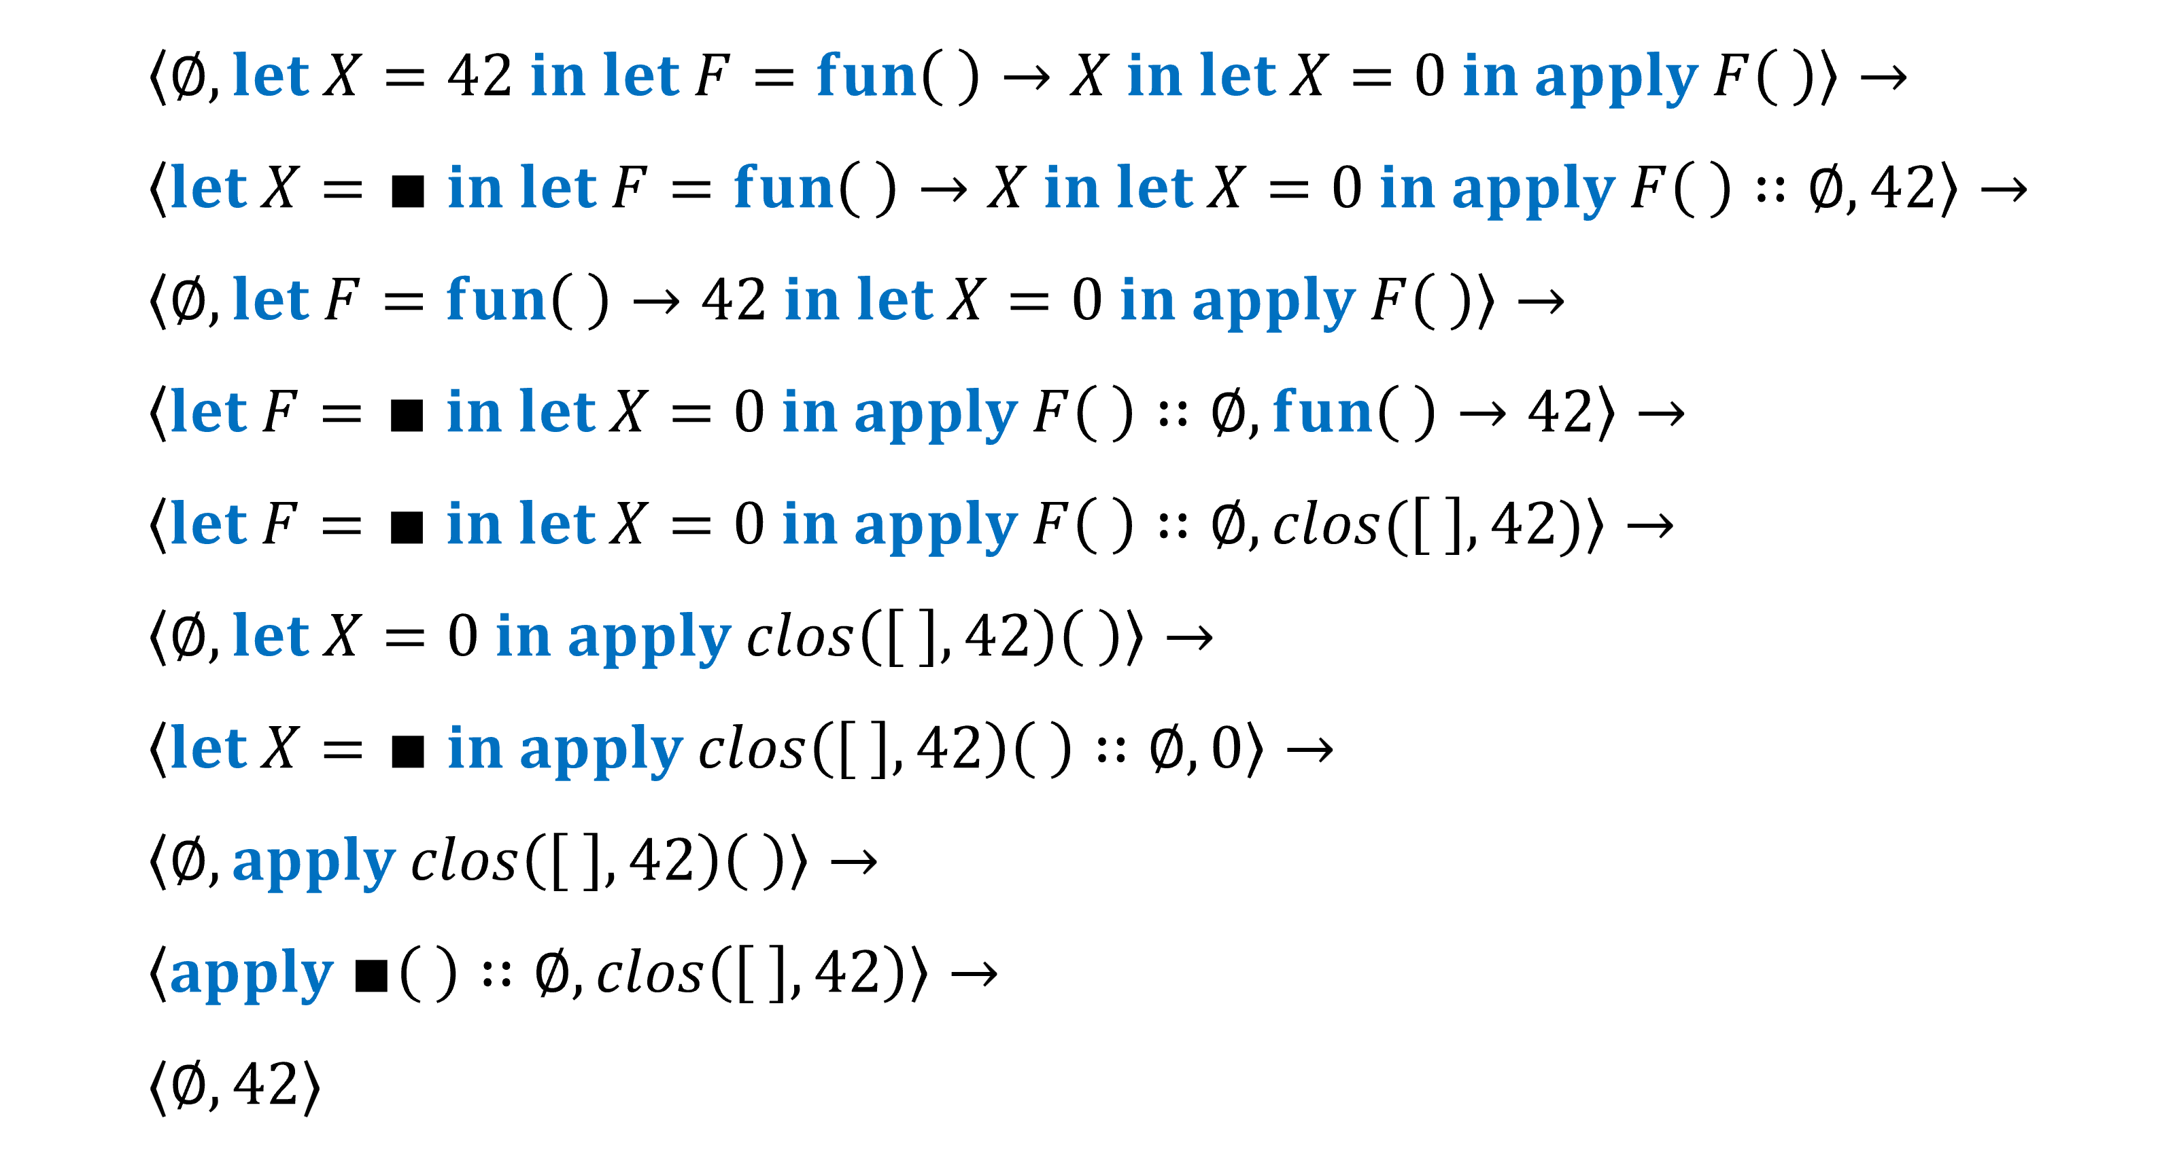
Frame stack semantics

Slide 10
Frame stack semantics

Slide 11
Frame stack semantics

Slide 12
Frame stack semantics

Slide 13

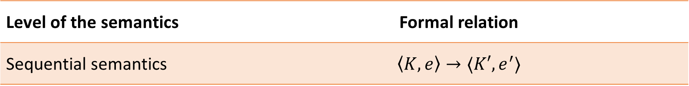



Modular semantics
Level of the semantics | Formal relation
Sequential semantics | $$\left\langle K, e\right\rangle →⟨K′, e^{′}⟩$$
$$ι_{0}$$
$$ι_{1}$$
Mailbox
Mailbox
$$ι_{2}$$
$$ι_{3}$$
Mailbox
Mailbox

Slide 14


Modular semantics
Level of the semantics | Formal relation
Sequential semantics | $$\left\langle K, e\right\rangle →⟨K′, e^{′}⟩$$
$$ι_{0}$$
$$ι_{1}$$
Mailbox
Mailbox
$$ι_{2}$$
$$ι_{3}$$
Mailbox
Mailbox

Slide 15
Modular semantics
Level of the semantics | Formal relation
Sequential semantics | $$\left\langle K, e\right\rangle →⟨K′, e^{′}⟩$$
$$ι_{0}$$
$$ι_{1}$$
Mailbox
Mailbox
$$ι_{2}$$
$$ι_{3}$$
Mailbox
Mailbox

Slide 16

Modular semantics
Level of the semantics | Formal relation
Sequential semantics | $$\left\langle K, e\right\rangle →⟨K′, e^{′}⟩$$
$$ι_{0}$$
$$ι_{1}$$
Mailbox
Mailbox
$$ι_{2}$$
$$ι_{3}$$
Mailbox
Mailbox

Slide 17
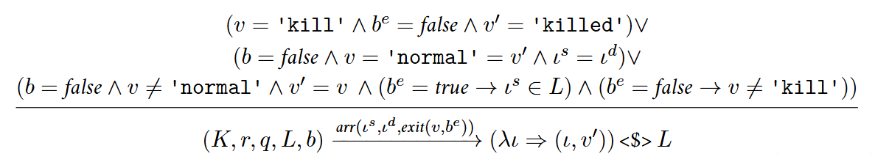

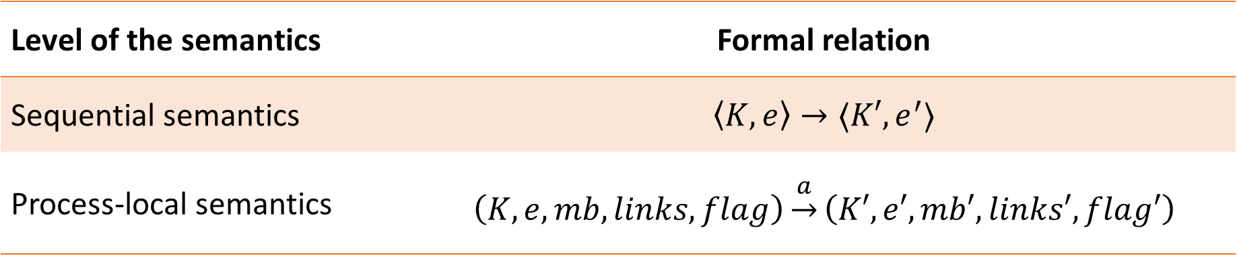

Modular semantics
Level of the semantics | Formal relation
Sequential semantics | $$\left\langle K, e\right\rangle →⟨K′, e^{′}⟩$$
Process-local semantics | $$\left(K, e, mb, links, flag\right)\underset{→}{a}\left(K′, e′, mb′, links′, flag′\right)$$
$$ι_{2}$$
$$ι_{3}$$
Mailbox
Mailbox

Slide 18
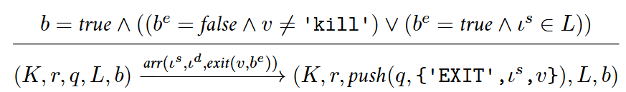

Modular semantics
Level of the semantics | Formal relation
Sequential semantics | $$\left\langle K, e\right\rangle →⟨K′, e^{′}⟩$$
Process-local semantics | $$\left(K, e, mb, links, flag\right)\underset{→}{a}\left(K′, e′, mb′, links′, flag′\right)$$
$$ι_{2}$$
$$ι_{3}$$
Mailbox
Mailbox

Slide 19
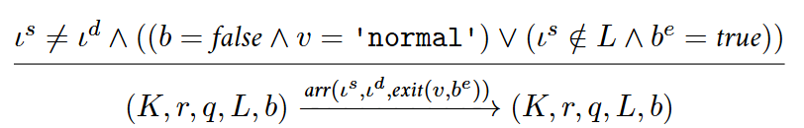
Modular semantics
Level of the semantics | Formal relation
Sequential semantics | $$\left\langle K, e\right\rangle →⟨K′, e^{′}⟩$$
Process-local semantics | $$\left(K, e, mb, links, flag\right)\underset{→}{a}\left(K′, e′, mb′, links′, flag′\right)$$

Slide 20
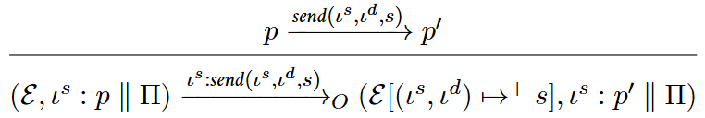
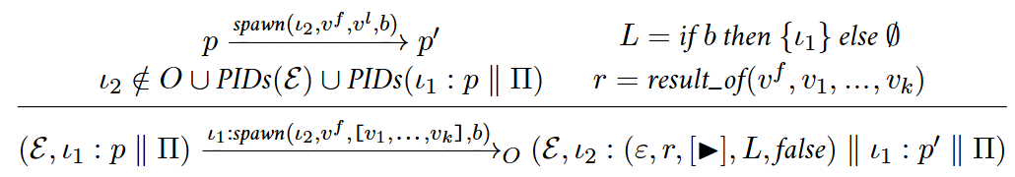
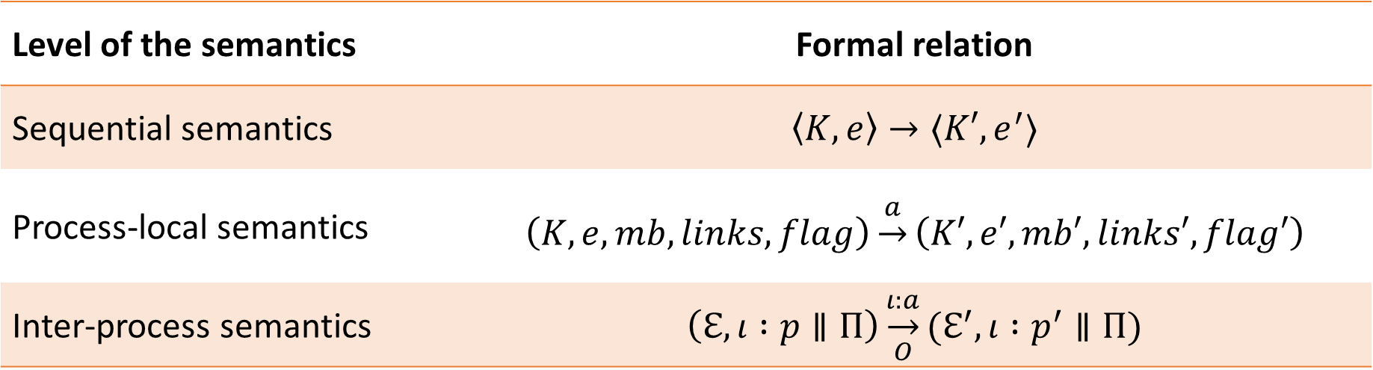
Modular semantics
Level of the semantics | Formal relation
Sequential semantics | $$\left\langle K, e\right\rangle →⟨K′, e^{′}⟩$$
Process-local semantics | $$\left(K, e, mb, links, flag\right)\underset{→}{a}\left(K′, e′, mb′, links′, flag′\right)$$
Inter-process semantics | $$\left(ℇ,ι :p∥Π\right)\underset{O}{\underset{→}{ι:a}}(ℇ^{′}, ι :p^{′}∥Π)$$

Slide 21
Program equivalence
C[ ]
e
e'
C[ ]
transformation
is a refactoring if
e
≈
e'
$$e_{1}≤_{ctx}^{Γ}e_{2} ≔ \\ ∀\left(C:Context\right):\left\langle ε, {C[e}_{1}]\right\rangle ↘ ⇒\left\langle ε, {C[e}_{2}]\right\rangle ↘$$

Slide 22

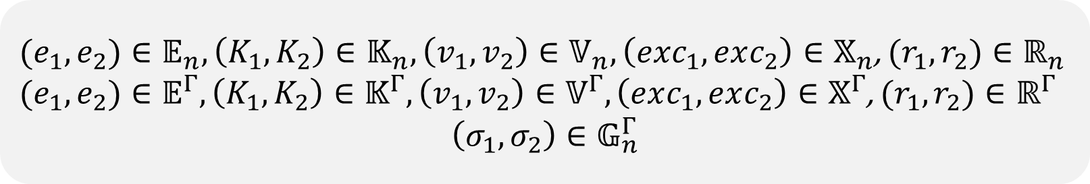
Program equivalence
$$e_{1}≤_{ctx}^{Γ}e_{2} ≔ \\ ∀\left(C:Context\right):\left\langle ε, {C[e}_{1}]\right\rangle ↘ ⇒\left\langle ε, {C[e}_{2}]\right\rangle ↘$$
${(e}_{1}, e_{2})∈𝔼_{n},\left(K_{1},K_{2}\right)∈𝕂_{n},\left(v_{1},v_{2}\right)∈𝕍_{n}, \left(exc_{1}, exc_{2}\right)∈𝕏_{n}$, ${(r}_{1}, r_{2})∈ℝ_{n}$
${(e}_{1}, e_{2})∈𝔼^{Γ},\left(K_{1},K_{2}\right)∈𝕂^{Γ},\left(v_{1},v_{2}\right)∈𝕍^{Γ}, \left(exc_{1}, exc_{2}\right)∈𝕏^{Γ}$, ${(r}_{1}, r_{2})∈ℝ^{Γ}$
$$\left(σ_{1},σ_{2}\right)∈𝔾_{n}^{Γ}$$
$$r_{1}≤_{ciu}r_{2}≔∀\left(K:FrameStack\right), \\ \left\langle K, r_{1}\right\rangle ↘ ⟹\left\langle K, r_{2}\right\rangle ↘$$
$$r_{1}≤_{ciu}^{Γ}r_{2}≔∀σ, r_{1}\left[σ\right]≤_{ciu}r_{2}\left[σ\right]$$
$${\left(e_{1},e_{2}\right)∈𝔼}^{Γ}⇔e_{1}≤_{ciu}^{Γ}e_{2}⇔e_{1}≤_{ctx}^{Γ}e_{2}$$

Slide 23
Program equivalence and refactorings
f(x) when
length(x) == 0 -> e₁;
f(x) -> e₂.
transformation
f([]) -> e₁;
f(x) -> e₂.
is a refactoring if
f(x) when
length(x) == 0 -> e₁;
f(x) -> e₂.
≈
f([]) -> e₁;
f(x) -> e₂.
∀ f, x, e_{i}:
if x ∉ vars(e₁)
Standard translation to Core Erlang + equivalence in Core Erlang

Slide 24
Program equivalence and refactorings
f(x) when
length(x) == 0 -> e₁;
f(x) -> e₂.
f([]) -> e₁;
f(x) -> e₂.
f/1 = fun (_0) ->
case (_0) of
<x> when try let <_1> =
call 'erlang':'length’(x)
in call 'erlang':'=='(_1, 0)
of <Try> -> Try
catch <T,R> -> 'false’
-> e₁
<_3> when 'true' -> e₂
<_2> when 'true’ ->
primop 'match_fail'({'function_clause',_2})
end
f/1 = fun (_0) ->
case (_0) of
<[]> when 'true' -> e₁
<x> when 'true’ -> e₂
<_1> when 'true’ ->
primop 'match_fail’({'function_clause',_1})
end
≈

Slide 25

Formal semantics and proofs…
📖
… on paper
While a paper-based semantics is precise, it is manual. Proofs are written and checked manually; thus, errors can easily slip through.
… in a proof assistant
Formalising a semantics in a proof assistant is a major effort. But, proofs are machine-checked, there is no room for imprecision, while proving is interactive.

Slide 26
🎯 So, goal achieved, right?
Sadly, people do not seem to be that interested in refactorings.
🤔 What else can we do with the semantics?

Slide 27
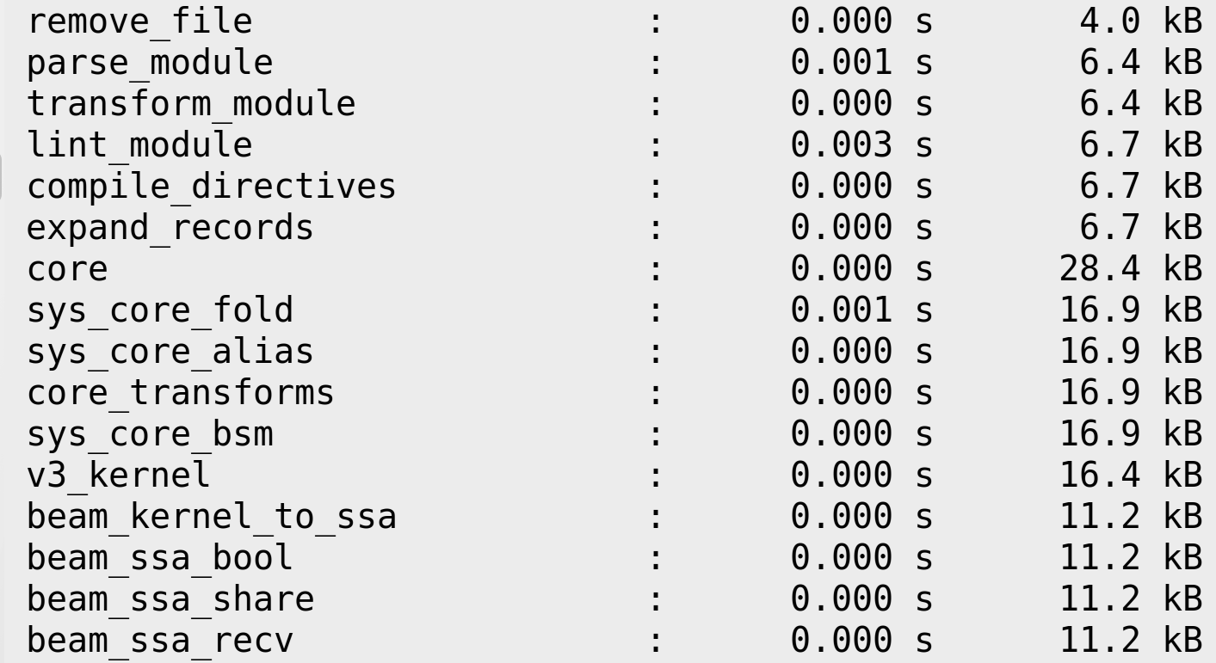
Program equivalence – constant folding

Slide 28
https://github.com/erlang/otp/blob/master/lib/compiler/src/sys_core_fold.erl
Not formalised yet

Slide 29

Reference interpreter
Inductive
definitions
Sequential
Process-local
Inter-process
≈
≈
≈
Scheduler
Interpreter
Function
definitions
Sequential
step function
Process-local
step function
Inter-process
step function
Extracted semantics
Node simple
step function
Extracted Erlang code
program.erl
Pretty printer
program.v
Languages:
Rocq
Erlang
Haskell

Slide 30
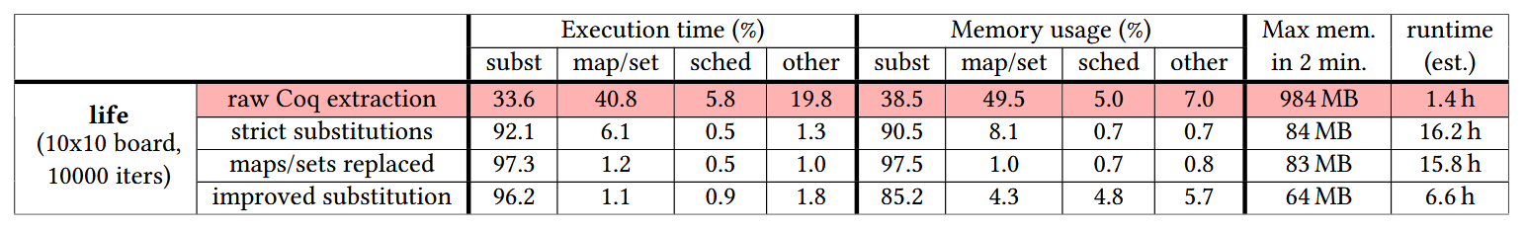
Performance issues

Slide 31
Performance issues
Strictly evaluating substitutions

Slide 32
Performance issues
Strictly evaluating substitutions
Using strict data structures

Slide 33
Performance issues
Strictly evaluating substitutions
Using strict data structures
Simplifying substitution

Slide 34
Performance issues
Strictly evaluating substitutions
Using strict data structures
Simplifying substitution
Further possible improvements:
Using environments instead of substitutions

Slide 35

A verified, optimising compiler for Erlang
Erlang source code
Core Erlang
Erlang SSA
BEAM bytecode
compile
compile
optimise
optimise
optimise
$$∀C,D:compile\left(C\right)=D→C≈D$$
$$∀C,D:optimise\left(C\right)=D→C≈D$$
☂️ NKKP STARTING
👥 D. Horpácsi, P. Bereczky, D. Lukács, G. Turán, S. Thompson

Slide 36
Current work: a verified compiler for Erlang
{function, fact, 1, 2}.
{label,1}.
{line,[{location,"m.erl",4}]}.
{func_info,{atom,m},{atom,fact},1}.
{label,2}.
{test,is_eq,{f,3},[{x,0},{integer,0}]}.
{move,{integer,1},{x,0}}.
return.
{label,3}.
{line,[{location,"m.erl",5}]}.
{gc_bif,'-',{f,0},1,[{x,0},
{integer,1}],{x,1}}.
...
'fact'/1 = fun (_0) ->
case _0 of
<N> when call 'erlang':'=='(_0,0) -> 1
<N> when 'true’ ->
let <_1> = call 'erlang':'-'(N, 1)
in let <_2> = apply 'fact'/1(_1)
in call 'erlang':'*'(N, _2)
end
fact(N) when N == 0 -> 1;
fact(N) -> N * fact(N - 1).
c
c
☂️ NKKP STARTING
👥 D. Horpácsi, P. Bereczky, D. Lukács, G. Turán, S. Thompson

Slide 37
Conclusions
We have an open source formal semantics of Core Erlang in a proof assistant
Formal semantics is the infrastructure for trustworthy tools
Reference interpreter
Static analysis
Equivalence verification
Further proven-correct refactorings and optimisations
A verified compiler for Erlang

Slide 38

Thank you for your attention!
Contact
berpeti@inf.elte.hu
harp-project.github.io
Supported by the New National Excellence Program of the Ministry for Culture and Innovation from the source of the National Research, Development and Innovation Fund (ÚNKP-21-3, ÚNKP-22-3, ÚNKP-23-3, EKÖP-26-4).

