Slide 1
Unified Timing-Aware Program Verification
Dóra Cziborová, Mihály Dobos-Kovács,
Kristóf Marussy, András Vörös
The project supported by the Doctoral Excellence Fellowship Programme (DCEP) is funded by the National Research Development and Innovation Fund of the Ministry of Culture and Innovation and the Budapest University of Technology and Economics.

Slide 2
Program Verification
Approach | Strengths | Missing
Software model checkers | Efficiently verifies complex source code | Timing-related properties Spurious error traces which would be excluded by timing
Recursive functions
Multi-threading
Memory operations
Arrays, pointers
…

Slide 3
Program Verification
Approach | Strengths | Missing
Software model checkers | Efficiently verifies complex source code | Timing-related properties Spurious error traces which would be excluded by timing
Timed automata model checkers | Reasoning about timing and scheduling | Support for C language features

Slide 4
Program Verification
Approach | Strengths | Missing
Software model checkers | Efficiently verifies complex source code | Timing-related properties Spurious error traces which would be excluded by timing
Timed automata model checkers | Reasoning about timing and scheduling | Support for C language features
Worst-case execution time (WCET) analyzers | Accurate low-level models of instruction timing | Cannot verify safety properties

Slide 5
Motivating Example
int main() {
pthread_t t1, t2;
pthread_create(&t1, 0, thr1, 0);
__VERIFIER_elapsed(tc, 100, 120);
__VERIFIER_elapsed(tc, 80, 100);
pthread_create(&t2, 0, thr2, 0);
__VERIFIER_elapsed(tc, 100, 120);
__VERIFIER_elapsed(tc, 80, 100);
pthread_join(t1, 0);
pthread_join(t2, 0);
if (ERR) reach_error();
}
...
_Atomic int x = 0, ERR = 0;
void ∗thr1(void∗ arg) {
__VERIFIER_elapsed(tc, 5, 5);
x = __VERIFIER_nondet32();
__VERIFIER_elapsed(tc, 0, 5);
do_work();
__VERIFIER_elapsed(tc, 1000, 2000);
x = __VERIFIER_nondet32();
}
void ∗thr2(void ∗arg) {
int i = x;
int j = x;
__VERIFIER_elapsed(tc, 15, 20);
if (i != j) ERR = 1;
}

Slide 6
Vision for Unified Timing-Aware
Program Verification
C source code
Unified timing-aware program verification
Proof of safety
or
Error trace
Property
Timing invariants, reachability properties
Timing of synchronization primitives, I/O, scheduling of threads
Execution times of
instructions,
caches, pipelines, etc.
Hardware model
Runtime
environment model

Slide 7
Vision for Unified Timing-Aware
Program Verification
WCET analysis
Source code annotation
Timed formal model
Timed model checking

Slide 8
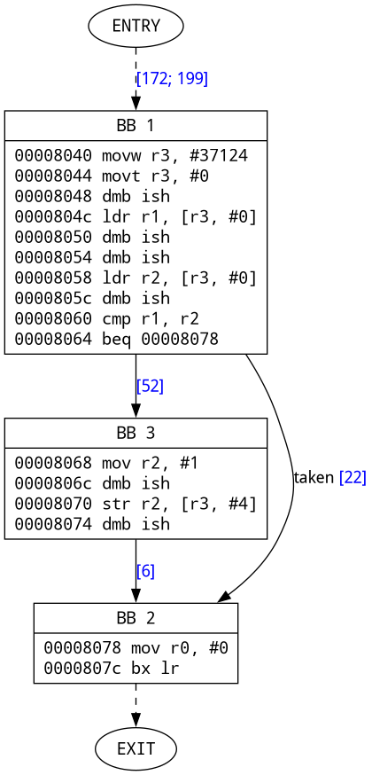
WCET Analysis
Binary
…
WCET analysis
Execution timing constraints of BBs
Execution timing constraints of BBs
Execution timing constraints of BBs
Basic blocks (BB)
Basic blocks (BB)
Basic blocks (BB)
WCET analysis
Source code annotation
Timed formal model
Timed model checking

Slide 9
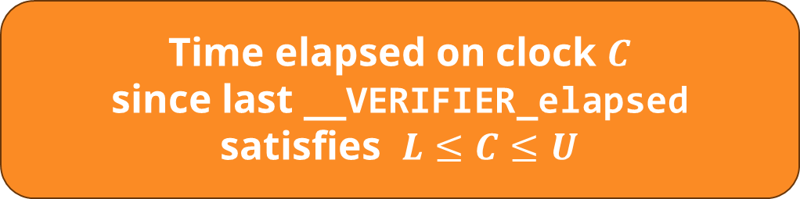
Source Code Annotation
Annotation by execution timing constraints (WCET results)
Extension of C language by clock variables and annotations
__cpu_clock C;
__VERIFIER_elapsed(C,L,U);
__VERIFIER_assume(clock_guard );
__VERIFIER_reset(C);
Time elapsed on clock $C$
since last __VERIFIER_elapsed
satisfies $L≤C≤U$
WCET analysis
Source code annotation
Timed formal model
Timed model checking

Slide 10
Motivating Example
int main() {
pthread_t t1, t2;
pthread_create(&t1, 0, thr1, 0);
__VERIFIER_elapsed(tc, 100, 120);
__VERIFIER_elapsed(tc, 80, 100);
pthread_create(&t2, 0, thr2, 0);
__VERIFIER_elapsed(tc, 100, 120);
__VERIFIER_elapsed(tc, 80, 100);
pthread_join(t1, 0);
pthread_join(t2, 0);
if (ERR) reach_error();
}
...
_Atomic int x = 0, ERR = 0;
void ∗thr1(void∗ arg) {
__VERIFIER_elapsed(tc, 5, 5);
x = __VERIFIER_nondet32();
__VERIFIER_elapsed(tc, 0, 5);
do_work();
__VERIFIER_elapsed(tc, 1000, 2000);
x = __VERIFIER_nondet32();
}
void ∗thr2(void ∗arg) {
int i = x;
int j = x;
__VERIFIER_elapsed(tc, 15, 20);
if (i != j) ERR = 1;
}
WCET analysis
Source code annotation
Timed formal model
Timed model checking

Slide 11
Motivating Example
int main() {
pthread_t t1, t2;
pthread_create(&t1, 0, thr1, 0);
__VERIFIER_elapsed(tc, 100, 120);
__VERIFIER_elapsed(tc, 80, 100);
pthread_create(&t2, 0, thr2, 0);
__VERIFIER_elapsed(tc, 100, 120);
__VERIFIER_elapsed(tc, 80, 100);
pthread_join(t1, 0);
pthread_join(t2, 0);
if (ERR) reach_error();
}
_Thread_local __cpu_clock tc;
_Atomic int x = 0, ERR = 0;
void ∗thr1(void∗ arg) {
__VERIFIER_elapsed(tc, 5, 5);
x = __VERIFIER_nondet32();
__VERIFIER_elapsed(tc, 0, 5);
do_work();
__VERIFIER_elapsed(tc, 1000, 2000);
x = __VERIFIER_nondet32();
}
void ∗thr2(void ∗arg) {
int i = x;
int j = x;
__VERIFIER_elapsed(tc, 15, 20);
if (i != j) ERR = 1;
}
WCET analysis
Source code annotation
Timed formal model
Timed model checking

Slide 12
Source Code Annotation
Semantic gap between WCET analysis and formal verification
Challenge 1: How to back-annotate WCET results
to C source code
Optimization, unfolding
by complier before WCET
SW model checkers that work on source code directly
Basic blocks
annotated by WCET analysis
CFA nodes
used in formal verification
WCET analysis
Source code annotation
Timed formal model
Timed model checking

Slide 13
Timed formal model
XCFA: Control Flow Automaton + procedures + processes
  Multi-threaded analysis
Extension of XCFA with clock variables and clock operations
  Timed automata as semantic basis: guards, invariants, resets, delays
Timed code execution demands semantics beyond standard TA
Source code
Mapping
Timed formal model (XCFA)
WCET analysis
Source code annotation
Timed formal model
Timed model checking

Slide 14
Timed formal model
Assumptions in timed automata and time abstraction:
  All clock variables exist from the beginning
  Clocks are always incremented (equally)
Function calls, dynamic thread initiation
→ Creating and destroying (clock) variables on the fly
Suspending threads (e.g., by synchronization primitives)
→ Stopping CPU clocks of the thread
Challenge 2: How to represent the
influence of advanced language features on time
WCET analysis
Source code annotation
Timed formal model
Timed model checking

Slide 15
Timed model checking
Timed
formal model
Model checker
SMT-based approach: transform clocks to rational variables
Timed automata model checkers: simple data operations
Proof of safety
or
Error trace
Property
WCET analysis
Source code annotation
Timed formal model
Timed model checking

Slide 16
Timed model checking
SMT-based approach: transform clocks to rational variables
  No efficient time abstraction
Timed automata model checkers: simple data operations
  Lacking support for program semantics
Split to TA and discrete state verification
  Not scaling well for many different clock constraints (WCET)
Challenge 3: How to combine efficient and expressive
abstractions for time and data
WCET analysis
Source code annotation
Timed formal model
Timed model checking

Slide 17
Preliminary results
Prototype implementation in the Theta verification framework
UPPAAL timed model checker: limited C semantics (manual abstraction)
Theta without timing: spurious counterexamples
Theta CEGAR (counterexample-guided abstraction refinement): proves safety
Tool | Time sem. | C semantics | Complete | Exec. time (s) | Result
UPPAAL | Zone | Limited | ✓ | > 600 | TIMEOUT
UPPAAL | Zone | Very limited | ✓ | 0.01 | SAFE
Theta BMC | - | Full | ✗ | 2.19 | UNSAFE
Theta CEGAR | - | Full | ✓ | 2.67 | UNSAFE
Theta BMC | Rational | Full | ✗ | > 600 | TIMEOUT
Theta CEGAR | Rational | Full | ✓ | 471.46 | SAFE
Theta CEGAR | Zone | Full | ✓ | 11.61 | SAFE

Slide 18
Summary
Timed program verification using WCET analysis results
Identified challenges:
  How to back-annotate WCET results to C source code
  How to represent the influence of advanced language
  features on time
  How to combine efficient and expressive abstractions
  for time and data
WCET analysis
Source code annotation
Timed formal model
Timed model checking

