Slide 1

Concurrent Software meets Saturation
Bringing an algorithm from Petri nets to software
Milán Mondok,
Supervisor: Vince Molnár

Slide 2
Motivation: Concurrent Systems
Software, distributed systems, communication protocols, …
Components that act largely locally (on their own) with occasional interaction
  E.g., Threads with events over local variables and some global synchronization
Independence blows up the state space, but is what we will exploit with saturation

Slide 3
Running Example
#include <pthread.h>
#define N 3
int x = 0, y = 0;
void *thread1(void *arg) {
while (x < N) x++;
return NULL;
}
void *thread2(void *arg) {
while (y < N) y++;
return NULL;
}
int main() {
pthread_t t1, t2;
pthread_create(&t1, NULL, thread1, NULL);
pthread_create(&t2, NULL, thread2, NULL);
pthread_join(t1, NULL);
pthread_join(t2, NULL);
}
(0,3)
(3,3)
y (thread 2)
(0,0)
x (thread 1)
(3,0)

Slide 4
Running Example
#include <pthread.h>
#define N 3
int x = 0, y = 0;
void *thread1(void *arg) {
while (x < N) x++;
return NULL;
}
void *thread2(void *arg) {
while (y < N) y++;
return NULL;
}
int main() {
pthread_t t1, t2;
pthread_create(&t1, NULL, thread1, NULL);
pthread_create(&t2, NULL, thread2, NULL);
pthread_join(t1, NULL);
pthread_join(t2, NULL);
}
(0,3)
(3,3)
y (thread 2)
(0,0)
x (thread 1)
(3,0)
Goal: Avoid re-exploring the state space of y (thread 2) for each new value of x (thread 1)

Slide 5
Saturation
Decision tree with equivalent subtrees merged
States: MDD
0
x
0
y
1
A path from root to terminal 1:
A state that is included in the set

Slide 6
Saturation
States: MDD
Transitions: 2k-MDDs
0
2
0
1
x
1
2
3
x’
Variable ordering:
fewer levels an event spans, the better
0
2
y
0
1
1
2
3
y’
1
1
1
y’ = y + 1
x’ = x + 1

Slide 7
Saturation
States: MDD
Transitions: 2k-MDDs
0
2
0
1
x
1
2
3
x’
0
2
y
First saturate level y:
Fire the transitions that affect only levels <=y until fixed point
0
1
2
3
1
1
2
3
y’
1
1
1
Motto: Stick to a submodel and finish what we can before moving on

Slide 8
Saturation
States: MDD
Transitions: 2k-MDDs
0
2
0
1
2
3
1
x
On level x, pull the values of y out of the cache
1
2
3
x’
For x=1,2,3, same node reused
0
2
y
0
1
2
3
1
1
2
3
y’
1
1
1
Local behavior is explored independently
Generalized saturation (Vince Molnár, 2019): can achieve the same effect without partitioning the transition relation, one monolithic transition works too

Slide 9
From Petri Nets to Software
Established technique on Petri nets
  Can beat BFS with several order of magnitudes on the right models
  Limited language
Concurrent software: much richer language, infinitely large transition relation
  Transitions are described with SMT formulae
if (z > 0) x = x + y;
z > 0 ∧ x' = x + y ∧ y' = y ∧ z' = z
C statement
SMT formula

Slide 10
From Petri Nets to Software
Problem 1: Transition relation must be a decision diagram
  For finite domain: enumerate all transitions and build diagram
  For infinite domain: can’t enumerate
  Solution: Substitution Diagrams

Slide 11
Saturation with Substitution Diagrams
States: MDD
Transitions:
Nodes: SMT formulae
(x’=x+1 ∧ y’=y) ∨ (y’=y+1 ∧ x’=x)
0
1
x
0
substitute x with 0
(x’=1 ∧ y’=y) ∨ (y’=y+1 ∧ x’=0)
(x’=2 ∧ y’=y) ∨ (y’=y+1 ∧ x’=1)
0
1
x’
Top-down on-demand enumeration with an SMT solver
(y’=y+1)
0
0
Merge nodes syntactically
y
(y’=1)
1
y’
1
true
Paths leading to terminal 1: models of the root formula
Substitution diagrams: already presented at AVM’24 in Freiburg

Slide 12
From Petri Nets to Software
Problem 1: Transition relation must be a decision diagram
  For finite domain: enumerate all transitions and build diagram
  For infinite domain: can’t enumerate
  Solution: Substitution Diagrams
Problem 2: Transition relation must have certain structure
  “The next value of x can only depend on the previous value of x”
  Or else the recursive enumeration won’t terminate
  Solution: Look-Ahead

Slide 13
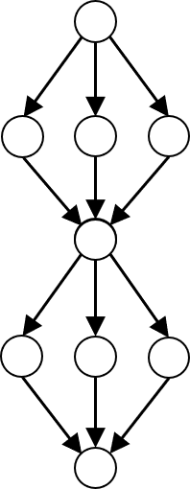
Look-Ahead
Problem: Saturation requires certain 2k-MDD structure (Kronecker-consistent)
Software does not fit: or
Solution: constrain with the states reached so far
  Express them as SMT formula and append
  Bounds current state variables x,y
Other places can only disable t
Must collapse after each level
Number of tokens after firing t only depends on how many were here
t
x' = x + y
x’ = 2 + y
x' = x + y ∧ constraint

Slide 14

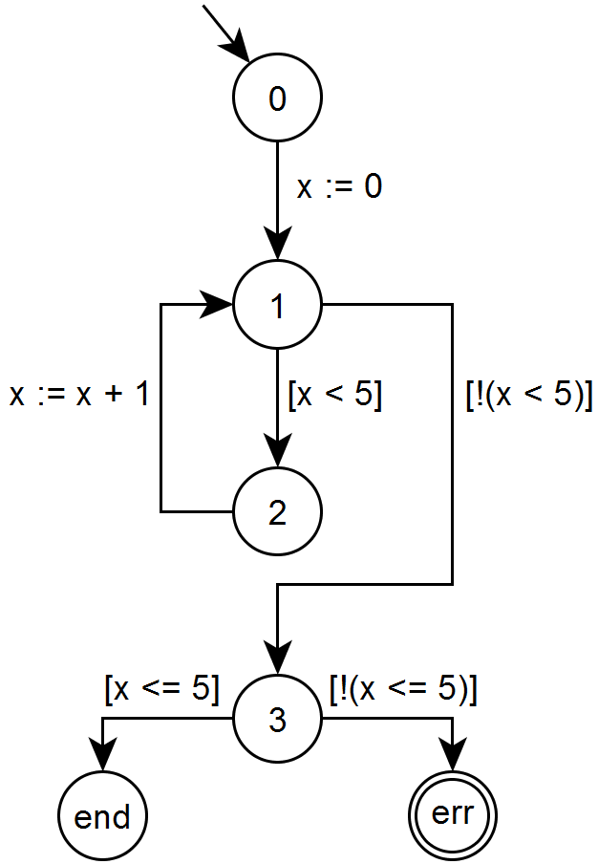
Evaluation
github.com/ftsrg/theta
Implementation in Theta
SV-COMP’26 C Concurrency
  726 unreach-call tasks
  Static thread unrolling: try to determine number of threads statically, introduce separate location variable for each (best-effort)
#include <pthread.h>
#define N 3
int x = 0, y = 0;
void *thread1(void *arg) {
while (x < N) x++;
return NULL;
}
void *thread2(void *arg) {
while (y < N) y++;
return NULL;
}
int main() {
pthread_t t1, t2;
pthread_create(&t1, NULL, thread1, NULL);
pthread_create(&t2, NULL, thread2, NULL);
pthread_join(t1, NULL);
pthread_join(t2, NULL);
}
I: x = 0 ∧ y < 100
T: x’ = x + 1 ∧ y’ = y
P: x < 50
Control Flow
Automaton (XCFA)
Symbolic Transition System (STS)
C program

Slide 15
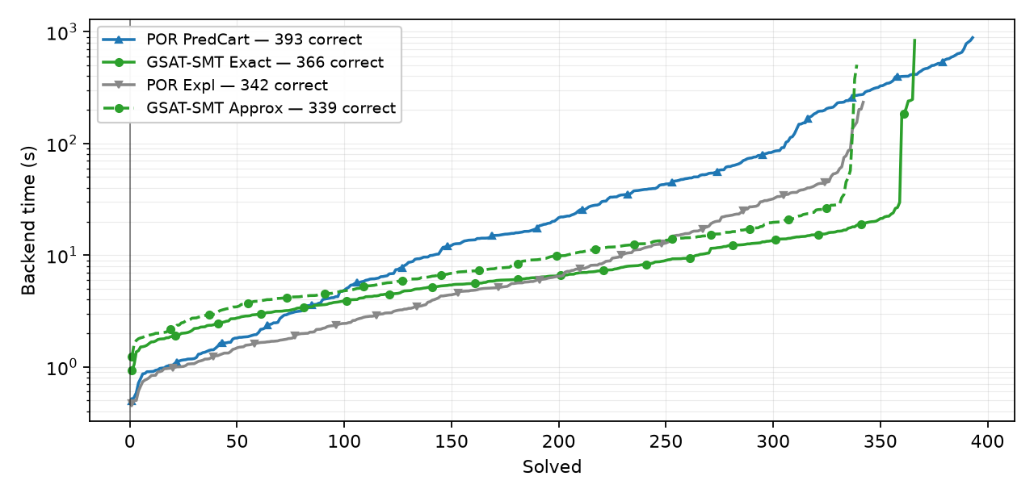
Evaluation: Saturation vs POR
Predicate abstraction: 393
Explicit-value: 342
Our approach: 366
Our approach is faster on the tasks it solves
Algorithm | #Solved | Median time (s) | p90 (s)
POR (Pred Cart) | 393 | 20.0 | 346.9
POR (Expl) | 342 | 5.2 | 36.0
Our approach (Exact LA) | 366 | 6.1 | 16.4
Our approach (Approx LA) | 339 | 7.6 | 20.8

Slide 16
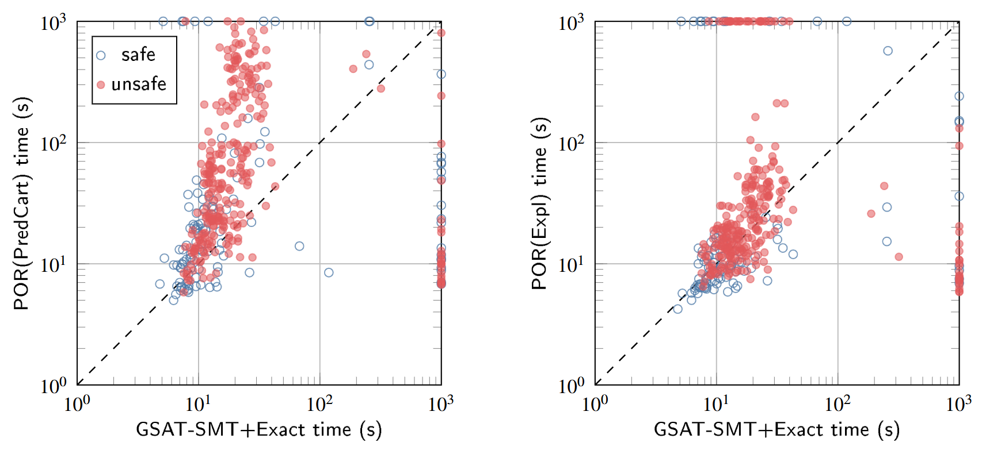
Evaluation: Saturation vs POR
Our approach is faster on 297/353 instances both solve
Our approach
Our approach

Slide 17
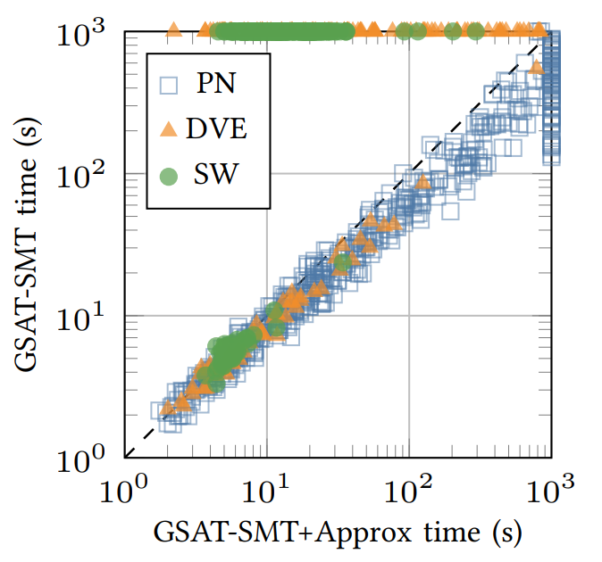
Evaluation: Look-ahead
Look-ahead is relatively low-cost, but recovers termination where needed
Termination recovered
Small overhead
Domain | No look-ahead | Exact look-ahead | Approximate look-ahead
SW | 55 | 366 | 339
DVE | 61 | 142 | 147
PN | 516 | 398 | 441

Slide 18
Limitations/Awkwardness of Saturation
Created for state space enumeration (whole state space), not safety (is error state reachable?)
  Solution: Encode on-the-fly reachability in the transition relation

Slide 19
Saturation with Substitution Diagrams
Transitions:
Negated property:
States: MDD
Traverse in lockstep
(x’=x+1 ∧ y’=y) ∨ (y’=y+1 ∧ x’=x)
(x = 0) ∧ (y = 1)
0
0
x
(x’=1 ∧ y’=y) ∨ (y’=y+1 ∧ x’=0)
0
0
x’
(y’=y+1)
(y = 1)
0
0
y
(y’=1)
1
1
y’
1
true
true
If terminal reached, property is violated

Slide 20
Limitations/Awkwardness of Saturation
Created for state space enumeration (whole state space), not safety (is error state reachable?)
  Solution: Encode on-the-fly reachability in the transition relation
Each variable value manifests as an edge:
  The array literal assigning values to all indices is one edge, . . .
Only finite reachable state spaces are supported
  Initial state set must be finite, havocs are mostly not supported
  Idea 1: Apply an edge-cap (e.g., max 1000 edges/node). If reached, then either:
    Underapproximate: Continue with only these 1000 edges, only accept unsafe verdict
    Overapproximate: Replace with level-skip (= try proving without this variable)
[0 -> 2, 1 -> 3, default -> 4]

Slide 21
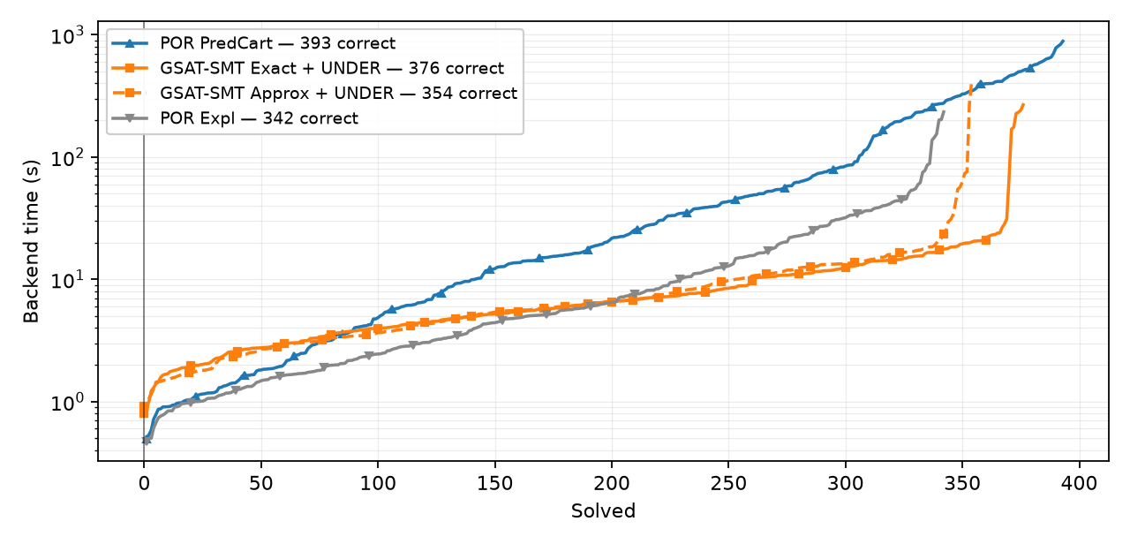
Evaluation: Edge-cap underapproximation
We gain 10 additional models: 376 solved

Slide 22
Limitations/Awkwardness of Saturation
Only finite reachable state spaces are supported
  Idea 2: Implicit Predicate abstraction
    We can put any SMT formula into the substitution diagram
    Many further ideas: Do you reorder between iterations? How do you transfer knowledge between iterations? (Constrained saturation using previous iteration’s state space)?
    Partial abstraction (Track most variables explicitly, predicates for the problematic ones)?
I: x = 0 ∧ y < 100
T: x’ = x + 1 ∧ y’ = y
P: x < 50
Activation literals to track predicates
STS
I_{abs}: I ∧ (p₁ ⟺ (x < 2))
T_{abs}: T ∧ (p₁ ⟺ (x < 2)) ∧ (p’₁ ⟺ (x’ < 2))
P_{abs}: ¬(¬P ∧ (p₁ ⟺ (x < 2)))
+
Precision
{ (x < 2) }
Abstract STS

Slide 23
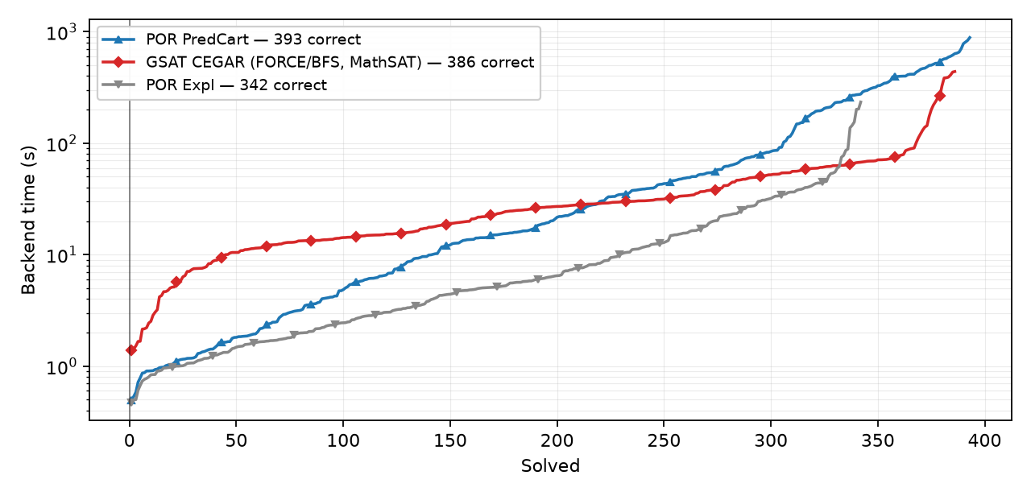
Evaluation: Predicate abstraction
Can even reach 386 tasks solved and is faster on the harder models than POR

Slide 24
Advantages of Saturation
Can exploit independence of components well (also if they are mostly independent with some synchronization)
We get the entire reachable state space as an MDD
  Relatively cheap to run CTL labeling afterwards on the result
    We need only E p U q, EX p, EG p
  We can produce very detailed correctness witnesses

Slide 25
Summary
We lifted saturation from Petri nets to a much wider set of domains (Symbolic Transition Systems)
  Subsitution diagrams allow reasoning on infinite relations
  Look-ahead allows cross-variable dependencies
  Handling havocs:
    Edge-cap and underapproximation
    CEGAR + Saturation
  We can now solve nearly as many models as POR (Expl and PredCart), and are faster on the ones we both solve
Substitution diagrams are mostly unexplored, this is only the first application

Slide 26
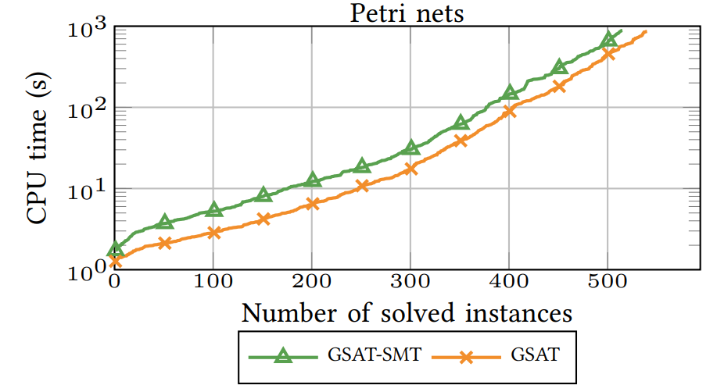
Evaluation
On Petri nets, we scale identically to the native algorithm

Slide 27
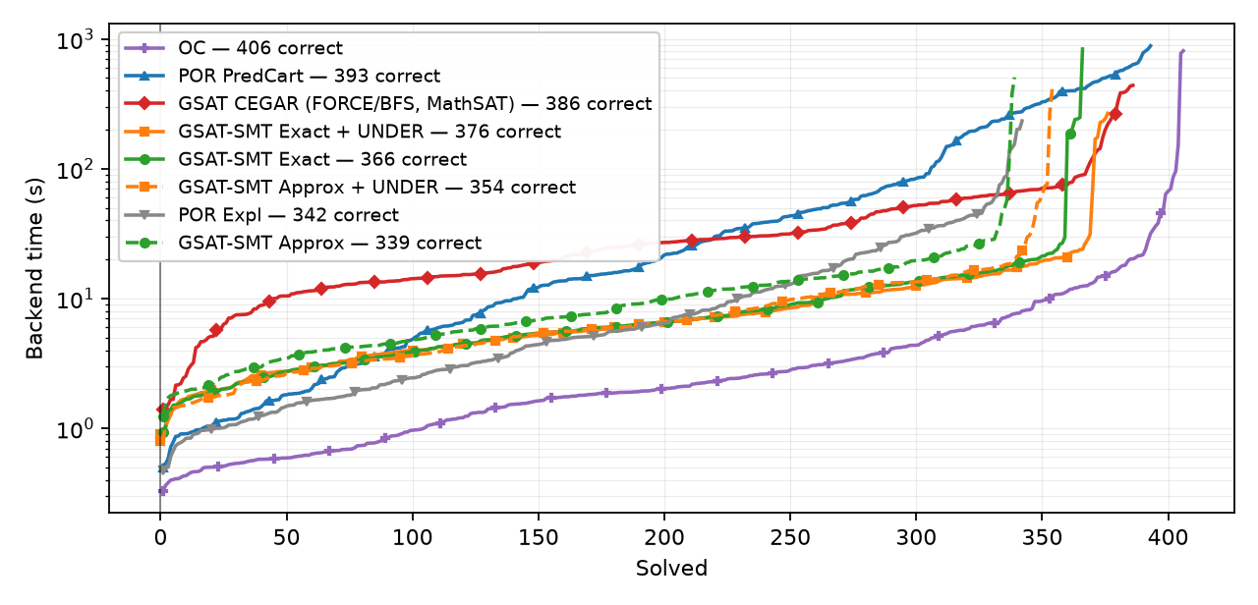
The full picture
If you include the OC (Ordering Consistency) checker, it still beats Saturation
  ~BMC that reasons over happens-before relations

