Slide 1
Bootstrapping

Slide 2
Bootstrapping is a statistical procedure that resamples a dataset to create many simulated datasets.
Uses technique called resampling with replacement
Allows us to estimate confidence intervals, standard errors, hypothesis testing of numerous sample statistics
First published by Bradley Efron in 1979

Slide 3
Technical Jargon:
Resampling
Sample Statistic
Sampling Distribution

Slide 4
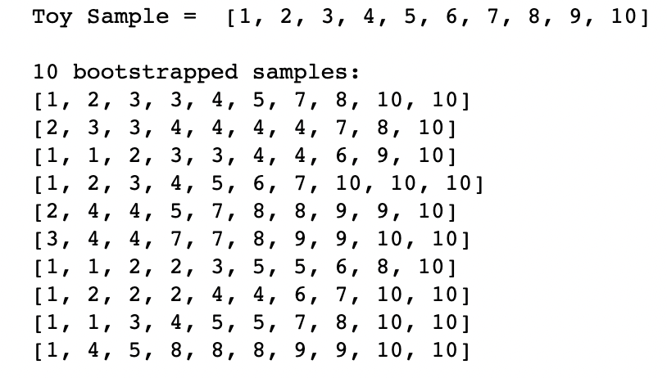
Resampling with Replacement

Slide 5
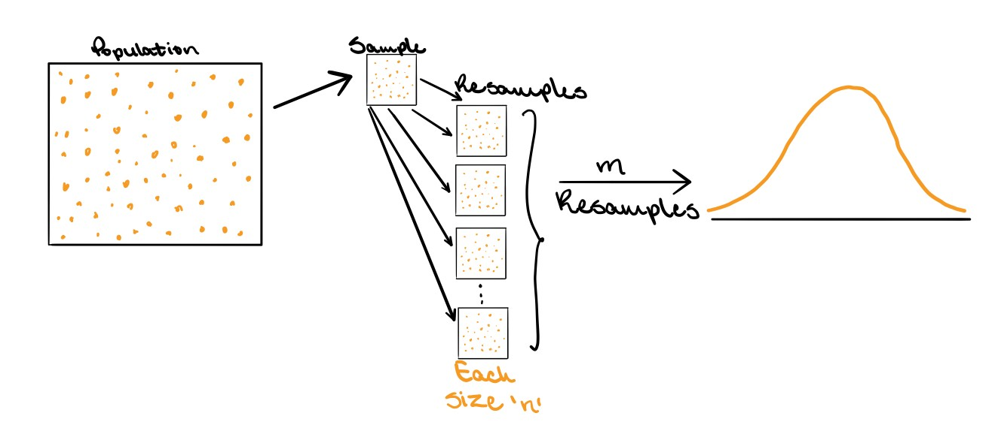
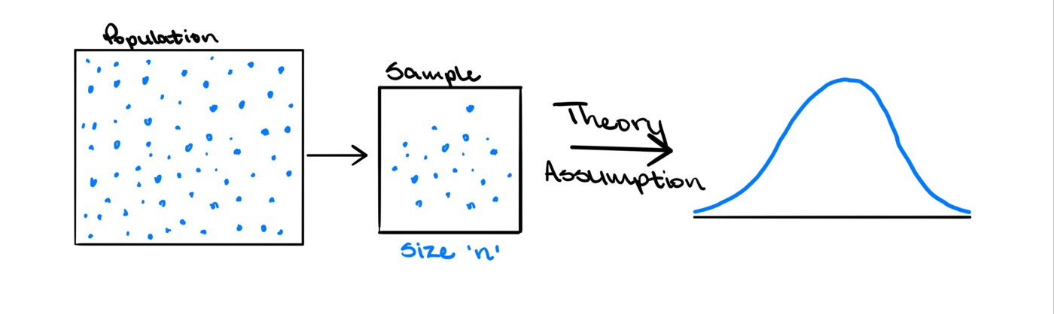
Bootstrapping vs Traditional Approach
Advantages of Bootstrapping:
Easy to understand
Doesn’t make any assumptions about the distribution of the data

Slide 6
Applications of Bootstrapping
Means
Median
Decision Trees (Bagging)

Slide 7
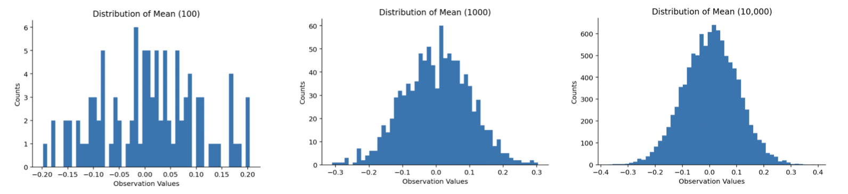
Means
Sample: 100 random samples from a standard normal

Slide 8
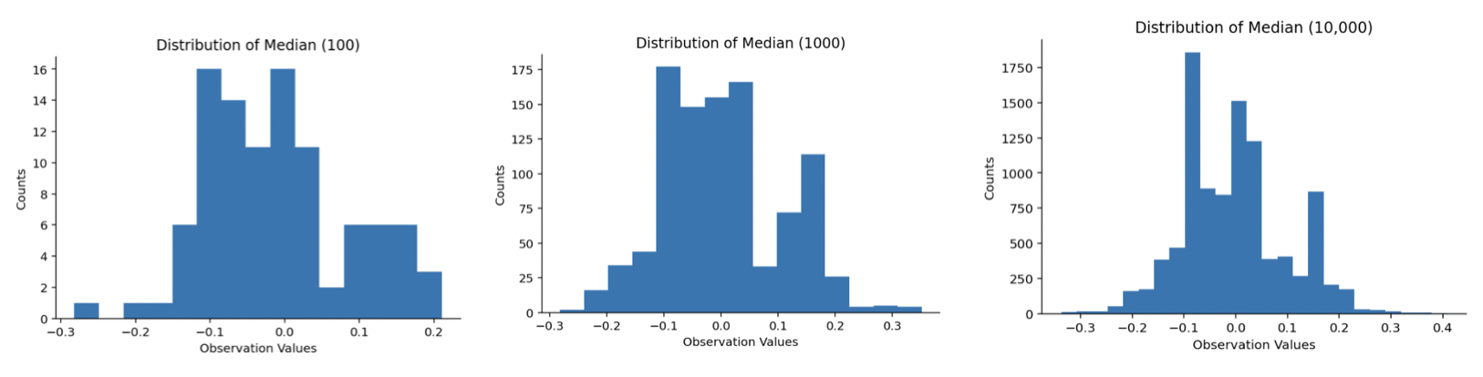
Medians
Sample: 100 random samples from a standard normal

Slide 9
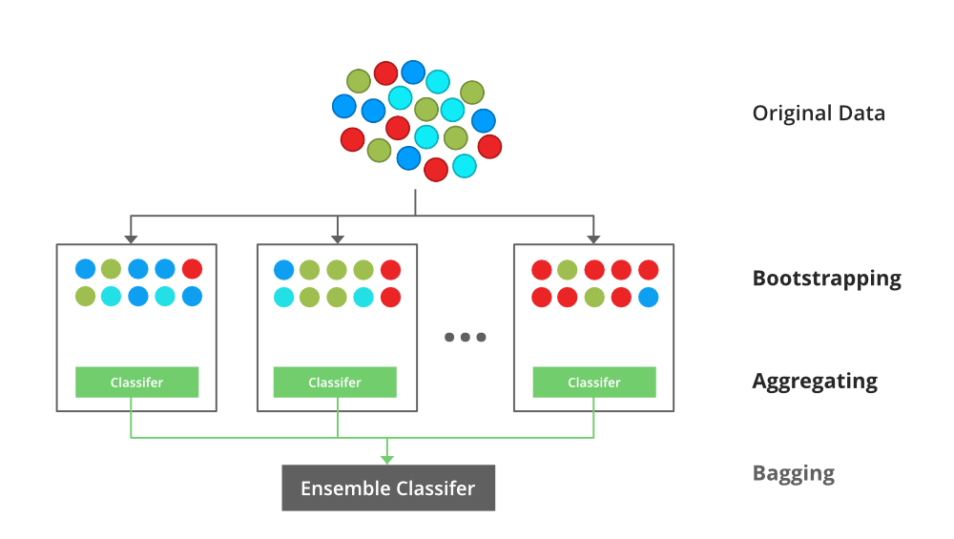
Bagging or Bootstrap Aggregation

Slide 10
Questions?

