Slide 1
Bootstrapping

Slide 2
Bootstrapping is a statistical procedure that resamples a dataset to create many simulated datasets.
Uses technique called resampling with replacement
Allows us to estimate confidence intervals, standard errors, hypothesis testing of numerous sample statistics

Slide 3
Technical Jargon:
Resampling
Sample Statistic
Sampling Distribution

Slide 4
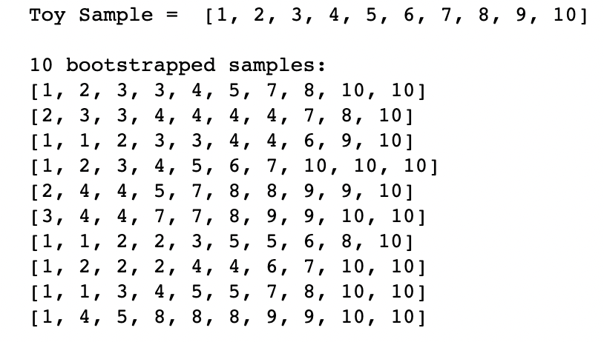
Resampling with Replacement

Slide 5
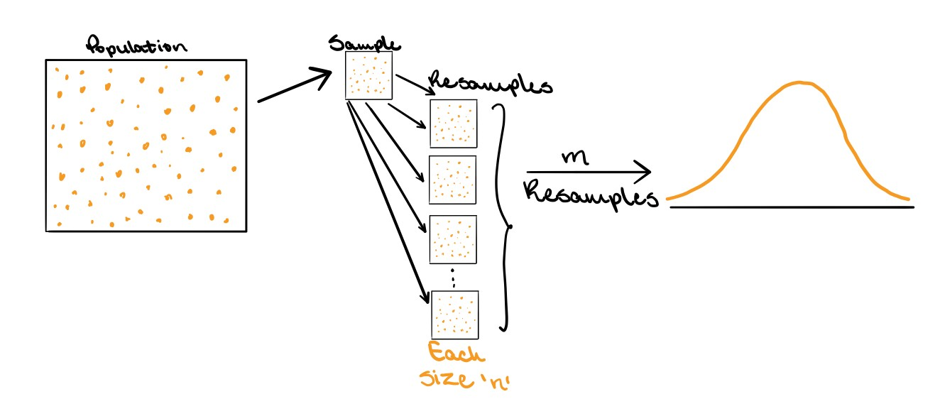
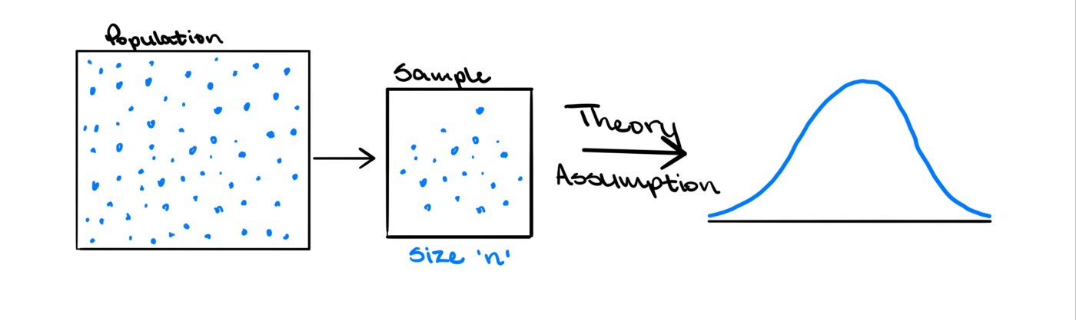
Bootstrapping vs Traditional Approach
Advantages of Bootstrapping:
Easy to understand
Doesn’t make any assumptions about the distribution of the data

Slide 6
Applications of Bootstrapping
Means
Median
Linear Regression coefficients
Decision Trees (Bagging)

Slide 7
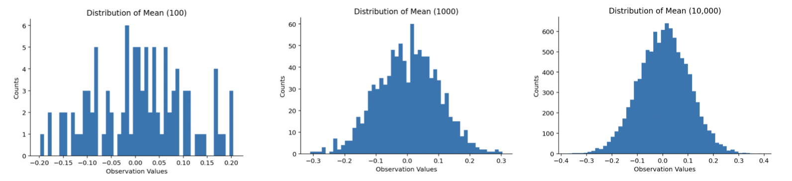
Means
Sample: 100 random samples from a standard normal

Slide 8
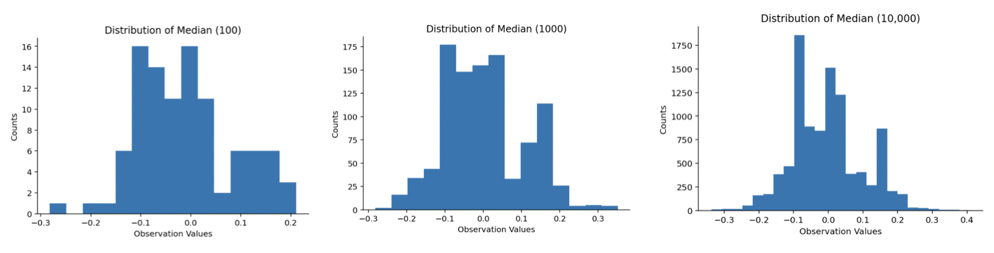
Medians
Sample: 100 random samples from a standard normal

Slide 9
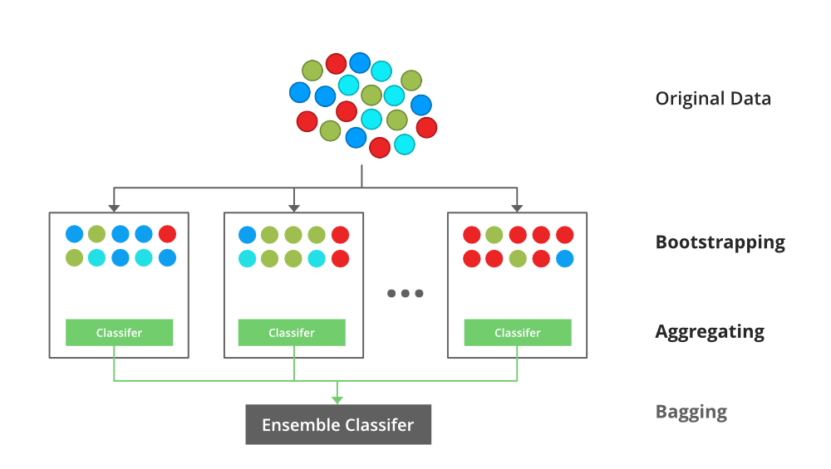
Bagging or Bootstrap Aggregation

Slide 10
Questions?

