Slide 1
Distributed Algorithms
2024
3
Port-numbering model

Slide 2
Port-numbered network N = (V, P, p)
Distributed algorithm A = (init, send, receive)
Output of algorithm A in network N

Slide 3
Bipartite maximal matching

Slide 4
Input: proper 2-coloring
Output: maximal matching
Model of computing: PN model

Slide 5
Algorithm
Orange nodes send proposals to their neighbors, one by one
order by port numbers
Blue nodes accept the first proposal they get, reject everything else
break ties by port numbers

Slide 6
Vertex cover

Slide 7
Input: nothing
Output: 3-approximation of minimum vertex cover
Model of computing: PN model

Slide 8
Algorithm
Construct bipartite double cover G’
one node in G: two virtual copies in G’
one edge in G: two virtual copies in G’
Find a maximal matching M’ in G’
Take all original nodes of G whose virtual copies are matched in M’

Slide 9
Graph G

Slide 13
Graph G’

Slide 14
Maximal matching M’

Slide 18
Set of edges M

Slide 19
Set of nodes C

Slide 20
Distributed Algorithms
2024
4
LOCAL model: Unique identifiers

Slide 21
LOCAL model = port-numbering model + unique identifiers
Nodes have distinct labels from {1, 2, …, poly(n)}

Slide 22
LOCAL model
Everything can be solved in diam(G)+1 rounds!
Universal algorithm: “each node tells its neighbors everything it knows”
1 round: everyone aware of its adjacent nodes and incident edges
T rounds: everyone aware of all nodes and edges within distance T
diam(G)+1 rounds: everyone knows G

Slide 23
LOCAL model
Not so interesting:
“What can be computed?”
Very interesting:
“What can be computed efficiently?”
(efficient ≈ o(diam(G)) rounds)

Slide 24
Coloring
Input | Output | Rounds | Algorithm
Unique IDs | O(Δ²)-coloring | O(log* n) | Cover-free families
O(Δ²)-coloring | O(Δ)-coloring | O(Δ) | Rotating clocks
O(Δ)-coloring | (Δ+1)-coloring | O(Δ) | Greedy color reduction
Unique IDs | (Δ+1)-coloring | O(Δ + log* n) | Combine these algorithms

Slide 25
Coloring
Input | Output | Rounds | Algorithm
Unique IDs | O(Δ²)-coloring | O(log* n) | Cover-free families
O(Δ²)-coloring | O(Δ)-coloring | O(Δ) | Rotating clocks
O(Δ)-coloring | (Δ+1)-coloring | O(Δ) | Greedy color reduction
Unique IDs | (Δ+1)-coloring | O(Δ + log* n) | Combine these algorithms

Slide 26
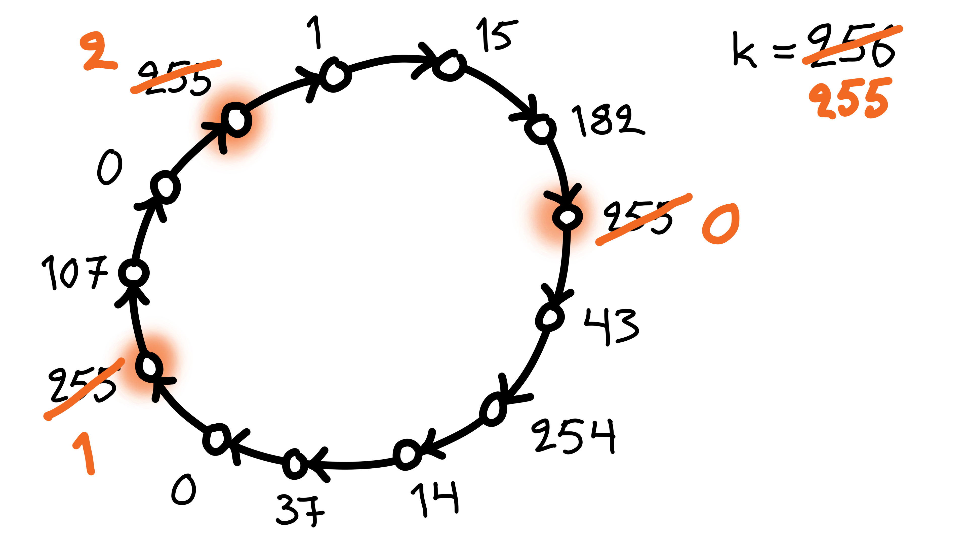
Greedy color reduction
If I am a local maximum:
pick the smallest free color that is not used by any of my neighbors
k+1 colors → k colors
provided that k ≥ Δ+1

Slide 27
Coloring
Input | Output | Rounds | Algorithm
Unique IDs | O(Δ²)-coloring | O(log* n) | Cover-free families
O(Δ²)-coloring | O(Δ)-coloring | O(Δ) | Rotating clocks
O(Δ)-coloring | (Δ+1)-coloring | O(Δ) | Greedy color reduction
Unique IDs | (Δ+1)-coloring | O(Δ + log* n) | Combine these algorithms

Slide 28
Rotating clocks
(2, 3)
q = prime, q > 2Δ
q² colors → q colors in q rounds
If no conflicts:
(a, b) → (0, b)
Otherwise:
(a, b) → (a, b+a mod q)
3
(2, 5)
5

Slide 29
Coloring
Input | Output | Rounds | Algorithm
Unique IDs | O(Δ²)-coloring | O(log* n) | Cover-free families
O(Δ²)-coloring | O(Δ)-coloring | O(Δ) | Rotating clocks
O(Δ)-coloring | (Δ+1)-coloring | O(Δ) | Greedy color reduction
Unique IDs | (Δ+1)-coloring | O(Δ + log* n) | Combine these algorithms

Slide 30
Cover-free families
Old color of node v is a set S(v) ⊆ {1, 2, …, m}
Promise:
new color of v is an element of S(v)
Safe:
pick an element of S(v) that is not in any S(u) for any neighbor u
{1, 2, 3}
v
{1, 4, 7}
{2, 4, 6}

Slide 31
Cover-free families
Old color of node v is a set S(v) ⊆ {1, 2, …, m}
Bad:
sets of neighbors cover all values in my set
no safe choice left
{1, 2, 3}
v
{1, 4, 6}
{2, 4, 6}

Slide 32
Cover-free families
Old color of node v is a set S(v) ⊆ {1, 2, …, m}
Good:
my set is not fully covered by my neighbors
there is a safe choice
{1, 2, 3}
v
{1, 4, 7}
{2, 4, 6}

Slide 33
1-cover-free family
For up to 1 neighbor these sets are good:
S₁ | = | { | 1, | 2 |  |  | }
S₂ | = | { | 1, |  | 3 |  | }
S₃ | = | { | 1, |  |  | 4 | }
S₄ | = | { |  | 2, | 3 |  | }
S₅ | = | { |  | 2, |  | 4 | }
S₆ | = | { |  |  | 3, | 4 | }

Slide 34
2-cover-free family
For up to 2 neighbors these sets are good:
S₁ | = | { | 1, | 2, | 3 |  |  |  |  | }
S₂ | = | { |  |  | 3, | 4, | 5 |  |  | }
S₃ | = | { |  |  |  |  | 5, | 6, | 7 | }
S₄ | = | { | 1, |  |  | 4, |  |  | 7 | }
S₅ | = | { |  | 2, |  | 4, |  | 6 |  | }

Slide 35
Cover-free families
Assume: x-coloring, maximum degree Δ
Assume: a Δ-cover-free family S₁, S₂, …, S_{x}
all subsets of {1, 2, …, m}
Nodes of color c pick set S_{c}
There is always a safe choice for any node!
Color reduction from x to m

Slide 36
Cover-free families
Δ-cover-free family S₁, S₂, …, S_{x}
all subsets of {1, 2, …, m}
Good if:
Δ large → works in high-degree graphs
x large → tolerates many input colors
m small → produces a good output coloring
E.g. x = m is trivial (why?)

Slide 37
Constructing cover-free families

Slide 38
q = prime, GF(q) ≈ integers modulo q
f = degree-d polynomial over GF(q)
at most d points where f(x) = g(x)
q^{d+1} possible polynomials
S_{f} = { (x, f(x)) | x = 0, 1, …, q−1 }
base set: all q² possible pairs (x, y)
q^{d+1} possible subsets, each with q elements
intersection of S_{f} and S_{g} has size at most d
If q > Δd: a Δ-cover-free family
why?

Slide 39
Cover-free families
Construct Δ-cover-free families with suitable parameters
n → ≈ Δ² log² n n → ≈ Δ² log² log n n → ≈ Δ² log² log log n n · · · n → ≈ Δ² log² Δ n → ≈ Δ²
O(log* n) steps

Slide 40
Coloring
Input | Output | Rounds | Algorithm
Unique IDs | O(Δ²)-coloring | O(log* n) | Cover-free families
O(Δ²)-coloring | O(Δ)-coloring | O(Δ) | Rotating clocks
O(Δ)-coloring | (Δ+1)-coloring | O(Δ) | Greedy color reduction
Unique IDs | (Δ+1)-coloring | O(Δ + log* n) | Combine these algorithms

