Slide 1
Distributed Algorithms
2024
5
CONGEST model: Bandwidth limitations

Slide 2
LOCAL model = port-numbering model + unique identifiers
Nodes have distinct labels from {1, 2, …, poly(n)}

Slide 3
CONGEST model = LOCAL model + bandwidth limitation
Messages at most O(log n) bits

Slide 4
LOCAL · unbounded messages
everything trivial to solve in O(diameter) rounds: gather full input and solve locally
CONGEST · bounded messages
gathering everything is way too expensive
O(diameter) and O(n) is nontrivial

Slide 5
Designing efficient algorithms in CONGEST model

Slide 6
Pipelining
Washing machine
Dryer

Slide 7
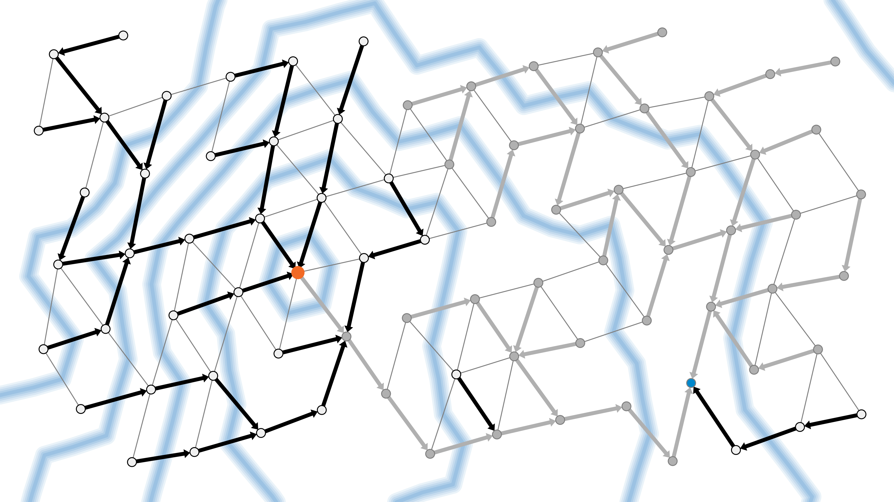
Pipelining
Multiple operations in progress simultaneously
Using different resources
In APSP algorithm:
multiple waves
using different communication links

Slide 8
Pipelining
Does not reduce the total number of messages
only removes idle periods between messages
If all communication links are already sending useful data every round, no room for pipelining

Slide 9
What kind of problems cannot be solved fast in CONGEST model?

Slide 10
Typical hard problems
A: complicated, lots of information
B: bottleneck
can only send small number of bits per round from A to C
C: need to know A
A
B
C

Slide 11
Proving hardness
Counting argument
Many possible inputs in A
Few possible messages across bottleneck B
A
B
C

Slide 12
Proving hardness
Counting argument
Many possible inputs in A
Few possible messages across bottleneck B
Contradiction:
different inputs in A
same messages across B
same output in C
A
B
C

Slide 13
Distributed Algorithms
2024
6
Randomized algorithms

Slide 14
Recap
Deterministic algorithms in PN model
init_{d}(…), send_{d}(…), receive_{d}(…)
Deterministic algorithms in LOCAL model
add unique identifiers
Deterministic algorithms in CONGEST model
add bandwidth constraints

Slide 15
Randomized algorithms
Randomized algorithms in PN model
init_{d}(…), receive_{d}(…): probability distribution
Randomized algorithms in LOCAL model
add unique identifiers
Randomized algorithms in CONGEST model
add bandwidth constraints

Slide 16
Guarantees
Monte Carlo
guaranteed running time
probabilistic output quality
Las Vegas
probabilistic running time
guaranteed output quality

Slide 17
Guarantees
Monte Carlo
guaranteed running time
probabilistic output quality
Las Vegas
probabilistic running time
guaranteed output quality
“With high probability” (w.h.p.)

Slide 18
Role of randomness
Sometimes randomness is the only way to design fast distributed algorithms
Example: sinkless orientation
deterministic LOCAL: O(log n) is best possible
randomized LOCAL: O(log log n) w.h.p. is best possible

Slide 19
Role of randomness
Sometimes randomness is just one of many ways to break symmetry
Example:
PN model + randomness + knowledge of n: you can construct unique identifiers w.h.p.

Slide 20
Video

Slide 21
Pretty simple idea:
nodes are active with probability 1/2
only active nodes try to pick a random free color
stop if successful

Slide 22
Simplest possible idea:
everyone tries to pick a random free color
stop if successful

Slide 23
Distributed Algorithms
2024
1–6
Recap

Slide 24
Models of computing
PN
LOCAL — unique identifiers
CONGEST — bandwidth constraints
Deterministic and randomized algorithms

Slide 25
Canonical problems
Vertex coloring
coloring = schedule
coloring breaks symmetry
Used to solve many other problems
Coming later: used to show that other problems are hard
Demonstrates different algorithm design ideas

Slide 26
Algorithm ideas
Conflict avoidance & coordination
Process nodes by color classes
Send proposals one by one
Random subset of nodes is active
Pipelining
Algebraic techniques

Slide 27
New kinds of challenges
Unknown systems
algorithms that work in any network
Partial information
making decisions based on local information
Parallelism
many nodes act simultaneously

