Slide 1
Distributed Algorithms
2024
0
About this course

Slide 2
Algorithms for networks
How can individual nodes in a large computer network work together towards a common goal?

Slide 3
Learning objectives
Understand models of distributed computing
Design and analyze efficient distributed algorithms
Prove impossibility results
Use standard graph-theoretic concepts
Practiced in exercises
Tested in the exam

Slide 4
Zero to research-level
No prior knowledge on distributed systems expected
We will reach topics close to current research by the end of the course
Good start for a Master’s thesis or PhD studies

Slide 5
Intensive course
5 credits in 6 weeks ≈ 22 working hours/week

Slide 6
This is a theory course
100% mathematics
definitions
theorems
proofs …
0% practice
programming
hardware
protocols …
Prerequisite:
Introduction to Mathematical Reasoning for Computer Scientists

Slide 7
Grading
To pass the course:
you need to pass the exam
For a good grade:
you need to solve exercises
quiz + exercises = max 96 points in total
80 points = grade 5/5

Slide 8
 |  |  | Week 1 | Week 2 | Week 3 | Week 4 | Week 5 | Week 6 | Week 7 | Week 8
Tue | 16.15 | Exercise deadline |  | 1 + 2 | 3 + 4 | 5 + 6 | 7 + 8 | 9 + 10 | 11 + 12
 | 16.15 | Lecture | 1 + 2 | – | 5 + 6 | 7 + 8 | – | 11 + 12
Wed | 10.15 | Quiz deadline | 1 | 3 | 5 | 7 | 9 | 11
 | 10.15 | Exercise session | 1 + 2 | 3 | 5 | 7 | 9 | 11
Thu | 9.00 | Exam |  |  |  |  |  |  |  | 1–12
 | 14.15 | Lecture | 3 + 4 | – | recap | 9 + 10 | – | recap
Fri | 12.15 | Quiz deadline | 2 | 4 | 6 | 8 | 10 | 12
 | 12.15 | Exercise session | – | 4 | 6 | 8 | 10 | 12

Slide 9
 |  |  | Week 1 | Week 2 | Week 3 | Week 4 | Week 5 | Week 6 | Week 7 | Week 8
Tue | 16.15 | Exercise deadline |  | 1 + 2 | 3 + 4 | 5 + 6 | 7 + 8 | 9 + 10 | 11 + 12
 | 16.15 | Lecture | 1 + 2 | – | 5 + 6 | 7 + 8 | – | 11 + 12
Wed | 10.15 | Quiz deadline | 1 | 3 | 5 | 7 | 9 | 11
 | 10.15 | Exercise session | 1 + 2 | 3 | 5 | 7 | 9 | 11
Thu | 9.00 | Exam |  |  |  |  |  |  |  | 1–12
 | 14.15 | Lecture | 3 + 4 | – | recap | 9 + 10 | – | recap
Fri | 12.15 | Quiz deadline | 2 | 4 | 6 | 8 | 10 | 12
 | 12.15 | Exercise session | – | 4 | 6 | 8 | 10 | 12

Slide 10
 |  |  | Week 1 | Week 2 | Week 3 | Week 4 | Week 5 | Week 6 | Week 7 | Week 8
Tue | 16.15 | Exercise deadline |  | 1 + 2 | 3 + 4 | 5 + 6 | 7 + 8 | 9 + 10 | 11 + 12
 | 16.15 | Lecture | 1 + 2 | – | 5 + 6 | 7 + 8 | – | 11 + 12
Wed | 10.15 | Quiz deadline | 1 | 3 | 5 | 7 | 9 | 11
 | 10.15 | Exercise session | 1 + 2 | 3 | 5 | 7 | 9 | 11
Thu | 9.00 | Exam |  |  |  |  |  |  |  | 1–12
 | 14.15 | Lecture | 3 + 4 | – | recap | 9 + 10 | – | recap
Fri | 12.15 | Quiz deadline | 2 | 4 | 6 | 8 | 10 | 12
 | 12.15 | Exercise session | – | 4 | 6 | 8 | 10 | 12

Slide 11
 |  |  | Week 1 | Week 2 | Week 3 | Week 4 | Week 5 | Week 6 | Week 7 | Week 8
Tue | 16.15 | Exercise deadline |  | 1 + 2 | 3 + 4 | 5 + 6 | 7 + 8 | 9 + 10 | 11 + 12
 | 16.15 | Lecture | 1 + 2 | – | 5 + 6 | 7 + 8 | – | 11 + 12
Wed | 10.15 | Quiz deadline | 1 | 3 | 5 | 7 | 9 | 11
 | 10.15 | Exercise session | 1 + 2 | 3 | 5 | 7 | 9 | 11
Thu | 9.00 | Exam |  |  |  |  |  |  |  | 1–12
 | 14.15 | Lecture | 3 + 4 | – | recap | 9 + 10 | – | recap
Fri | 12.15 | Quiz deadline | 2 | 4 | 6 | 8 | 10 | 12
 | 12.15 | Exercise session | – | 4 | 6 | 8 | 10 | 12

Slide 12
 |  |  | Week 1 | Week 2 | Week 3 | Week 4 | Week 5 | Week 6 | Week 7 | Week 8
Tue | 16.15 | Exercise deadline |  | 1 + 2 | 3 + 4 | 5 + 6 | 7 + 8 | 9 + 10 | 11 + 12
 | 16.15 | Lecture | 1 + 2 | – | 5 + 6 | 7 + 8 | – | 11 + 12
Wed | 10.15 | Quiz deadline | 1 | 3 | 5 | 7 | 9 | 11
 | 10.15 | Exercise session | 1 + 2 | 3 | 5 | 7 | 9 | 11
Thu | 9.00 | Exam |  |  |  |  |  |  |  | 1–12
 | 14.15 | Lecture | 3 + 4 | – | recap | 9 + 10 | – | recap
Fri | 12.15 | Quiz deadline | 2 | 4 | 6 | 8 | 10 | 12
 | 12.15 | Exercise session | – | 4 | 6 | 8 | 10 | 12

Slide 13
 |  |  | Week 1 | Week 2 | Week 3 | Week 4 | Week 5 | Week 6 | Week 7 | Week 8
Tue | 16.15 | Exercise deadline |  | 1 + 2 | 3 + 4 | 5 + 6 | 7 + 8 | 9 + 10 | 11 + 12
 | 16.15 | Lecture | 1 + 2 | – | 5 + 6 | 7 + 8 | – | 11 + 12
Wed | 10.15 | Quiz deadline | 1 | 3 | 5 | 7 | 9 | 11
 | 10.15 | Exercise session | 1 + 2 | 3 | 5 | 7 | 9 | 11
Thu | 9.00 | Exam |  |  |  |  |  |  |  | 1–12
 | 14.15 | Lecture | 3 + 4 | – | recap | 9 + 10 | – | recap
Fri | 12.15 | Quiz deadline | 2 | 4 | 6 | 8 | 10 | 12
 | 12.15 | Exercise session | – | 4 | 6 | 8 | 10 | 12

Slide 14
 |  |  | Week 1 | Week 2 | Week 3 | Week 4 | Week 5 | Week 6 | Week 7 | Week 8
Tue | 16.15 | Exercise deadline |  | 1 + 2 | 3 + 4 | 5 + 6 | 7 + 8 | 9 + 10 | 11 + 12
 | 16.15 | Lecture | 1 + 2 | – | 5 + 6 | 7 + 8 | – | 11 + 12
Wed | 10.15 | Quiz deadline | 1 | 3 | 5 | 7 | 9 | 11
 | 10.15 | Exercise session | 1 + 2 | 3 | 5 | 7 | 9 | 11
Thu | 9.00 | Exam |  |  |  |  |  |  |  | 1–12
 | 14.15 | Lecture | 3 + 4 | – | recap | 9 + 10 | – | recap
Fri | 12.15 | Quiz deadline | 2 | 4 | 6 | 8 | 10 | 12
 | 12.15 | Exercise session | – | 4 | 6 | 8 | 10 | 12

Slide 15
 |  |  | Week 1 | Week 2 | Week 3 | Week 4 | Week 5 | Week 6 | Week 7 | Week 8
Tue | 16.15 | Exercise deadline |  | 1 + 2 | 3 + 4 | 5 + 6 | 7 + 8 | 9 + 10 | 11 + 12
 | 16.15 | Lecture | 1 + 2 | – | 5 + 6 | 7 + 8 | – | 11 + 12
Wed | 10.15 | Quiz deadline | 1 | 3 | 5 | 7 | 9 | 11
 | 10.15 | Exercise session | 1 + 2 | 3 | 5 | 7 | 9 | 11
Thu | 9.00 | Exam |  |  |  |  |  |  |  | 1–12
 | 14.15 | Lecture | 3 + 4 | – | recap | 9 + 10 | – | recap
Fri | 12.15 | Quiz deadline | 2 | 4 | 6 | 8 | 10 | 12
 | 12.15 | Exercise session | – | 4 | 6 | 8 | 10 | 12

Slide 16
Distributed Algorithms
2024
1
Warm-up

Slide 17
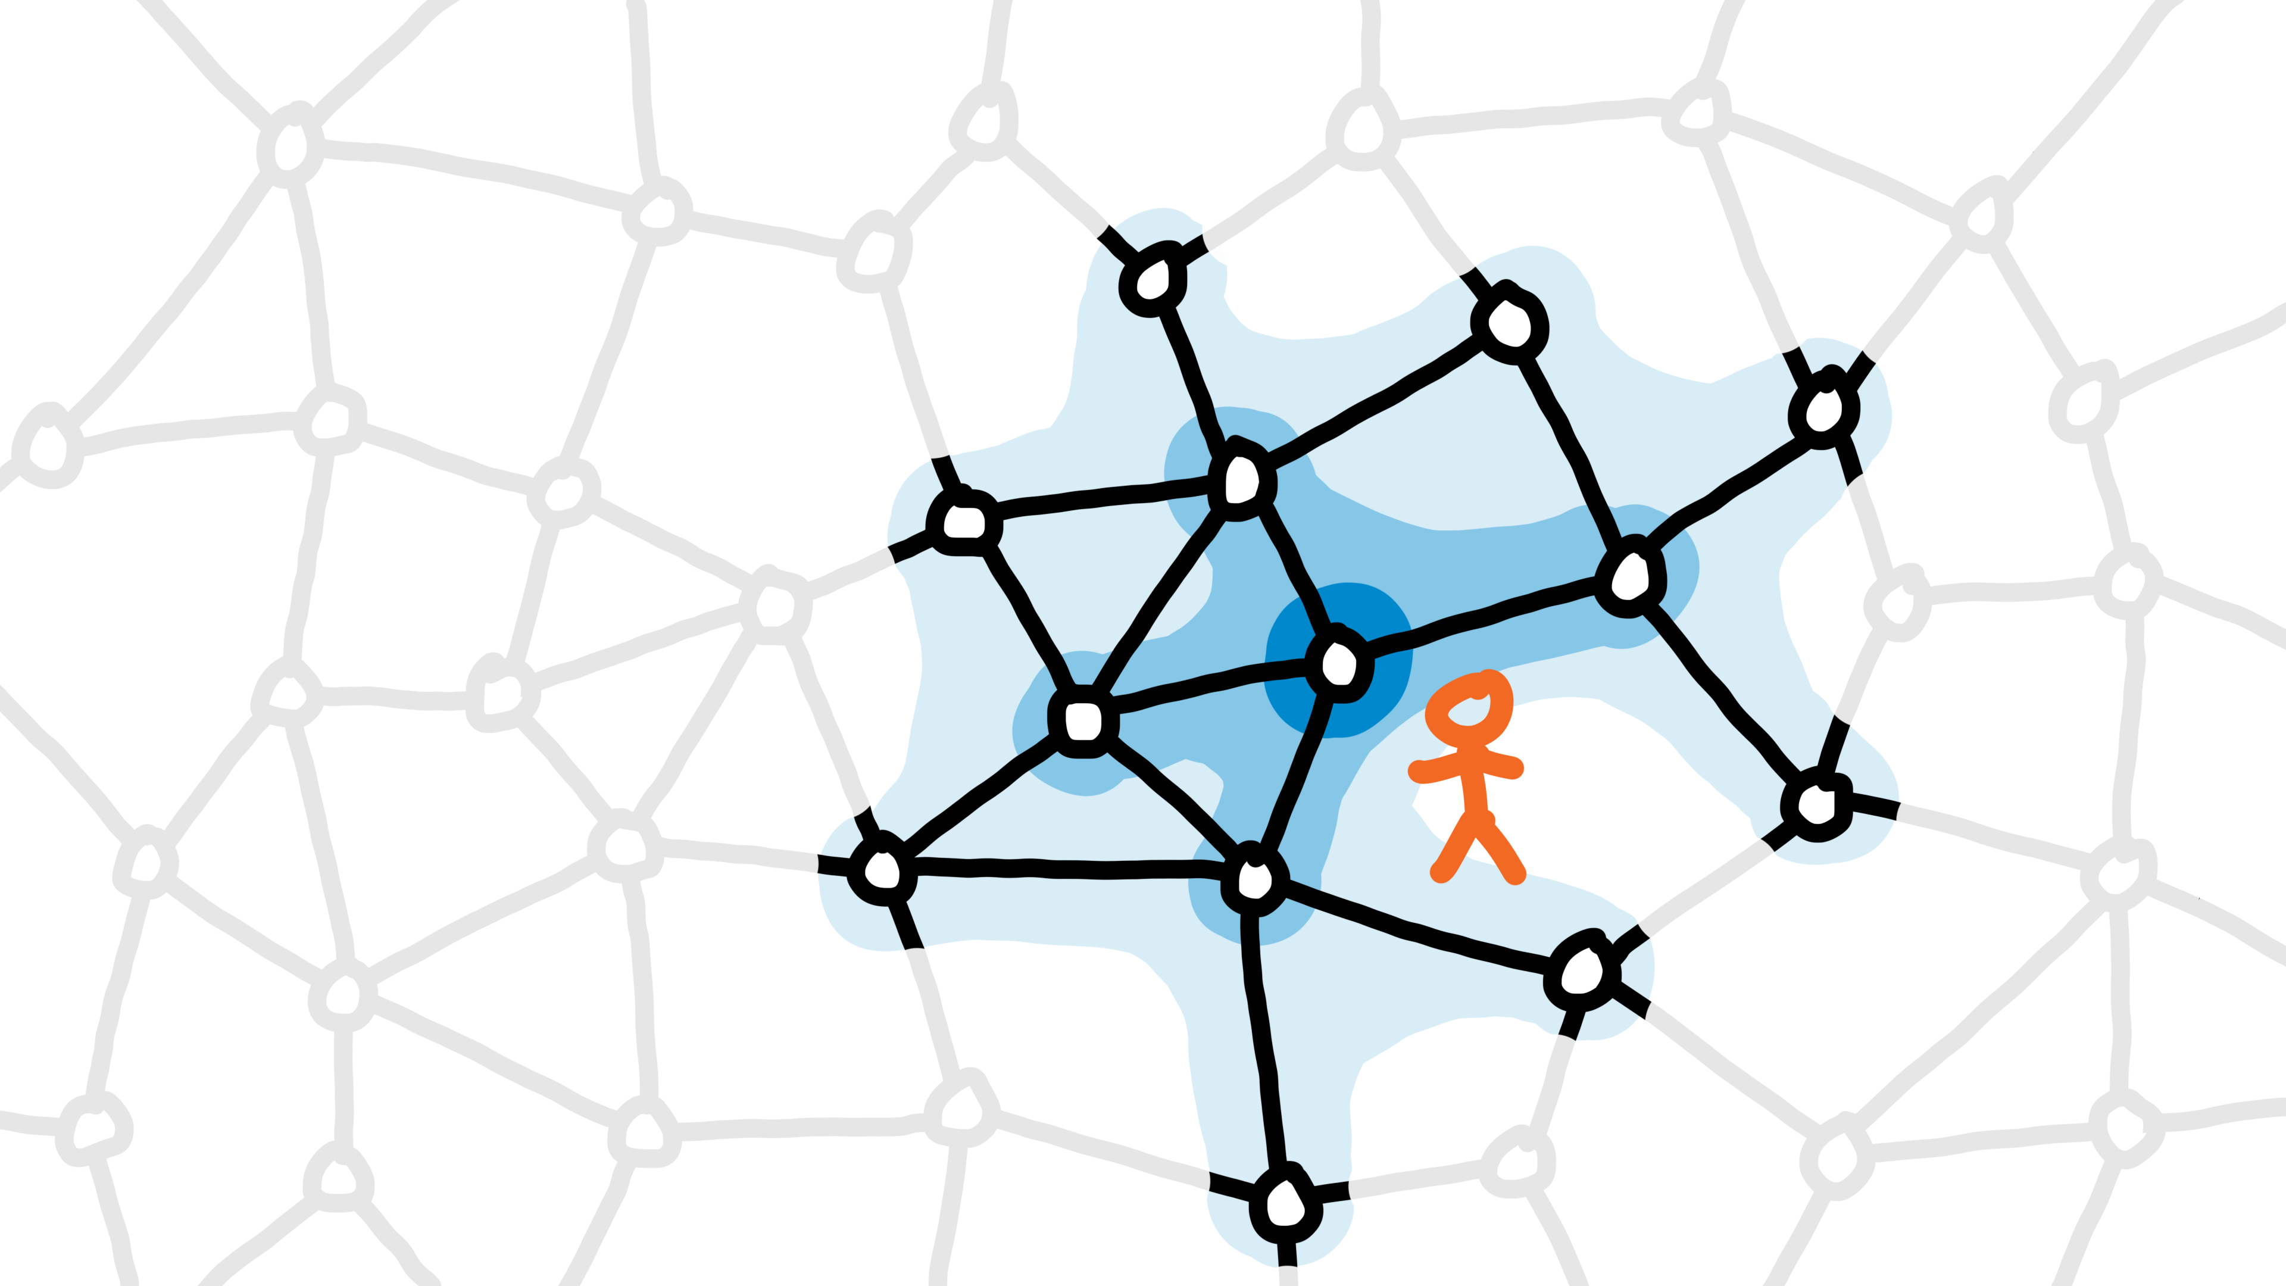
Video 1a: introduction

Slide 18
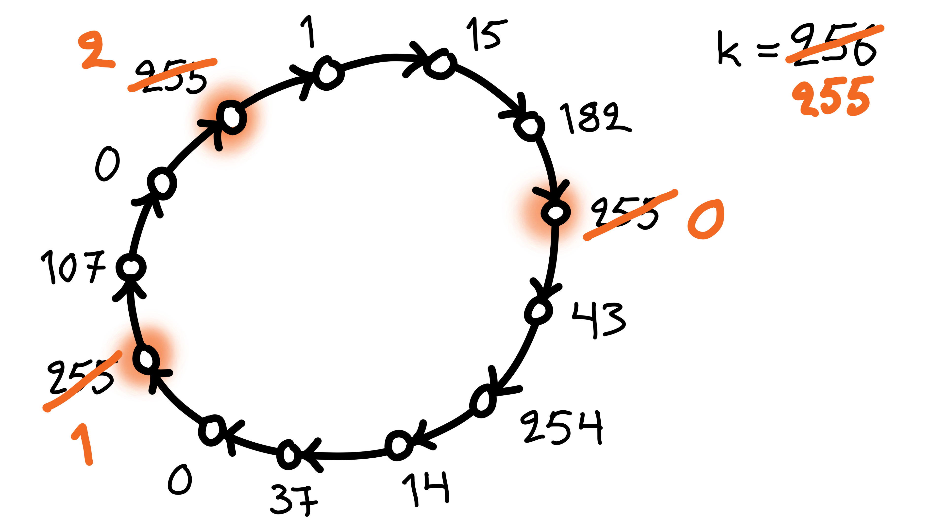
Video 1b: coloring

Slide 19
Slow color reduction
Algorithm idea:
all nodes with the largest color are active
active nodes pick the smallest color that is not used by their neighbors

Slide 20
Puzzle 1
Consider a simpler algorithm idea:
all nodes pick the smallest color that is not used by their neighbors
What would go wrong?
construct an example in which this algorithm fails!

Slide 21
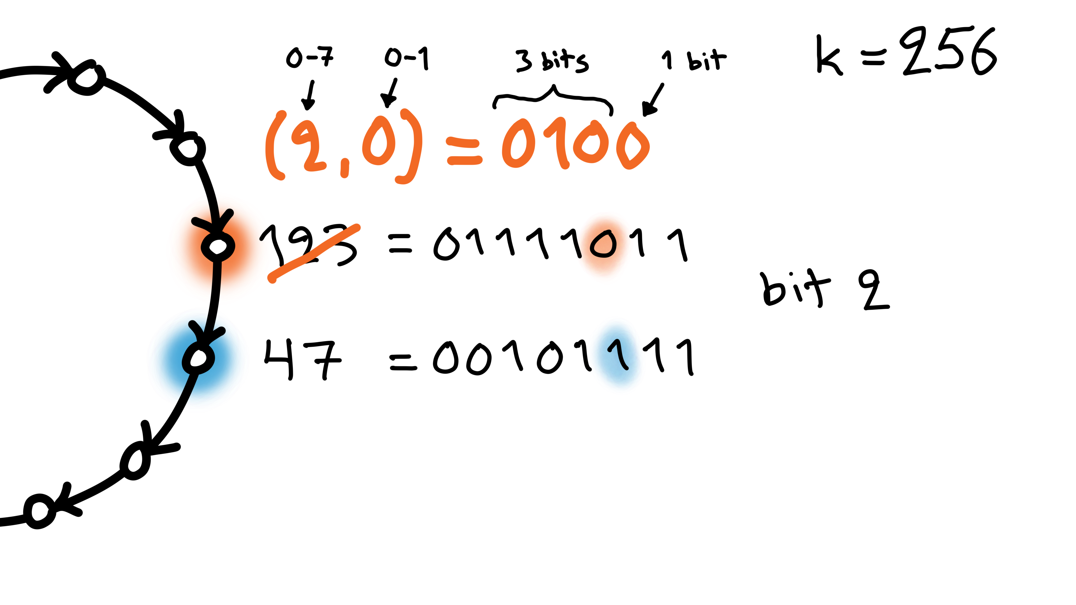
Video 1b: coloring fast

Slide 22
Fast color reduction
Algorithm idea:
find the first bit that differs in successor
index i, bit value b
new color is (i, b)

Slide 23
Puzzle 2
Algorithm idea:
find the first bit that differs in successor
index i, bit value b
new color is (i, b)
What would go wrong if the new color was just b ?
construct an example in which it fails!

Slide 24
Puzzle 3
Algorithm idea:
find the first bit that differs in successor
index i, bit value b
new color is (i, b)
What would go wrong if the new color was just i ?
construct an example in which it fails!

Slide 25
Puzzle 4
Algorithm idea:
find the first bit that differs in successor
index i, bit value b
new color is (i, b)
Why does the algorithm work correctly?
why is my new color always different from the new colors of my successor and my predecessor?

Slide 26
Distributed Algorithms
2024
2
Graph-theoretic foundations

Slide 27
Graphs in this course
Defining:
models of distributed computing
what we want to solve
what are the assumptions
Designing & analyzing algorithms
Proving impossibility results
Often: graph ≈ network, node ≈ computer

Slide 28
Please do not confuse
Maximal
not a subset of another solution
very easy to find: add greedily
Maximum
largest possible solution
often hard to find

Slide 29
Please do not confuse
Minimal
not a superset of another solution
very easy to find: remove greedily
Minimum
smallest possible solution
often hard to find

Slide 30
Minimum vertex cover

Slide 31
Minimum dominating set

Slide 32
Maximum independent set

Slide 33
Smallest set of nodes that is both an independent set and a dominating set

Slide 34
Largest set of nodes that is both an independent set and a dominating set

Slide 35
Maximum matching

Slide 36
Minimum edge cover

Slide 37
Minimum edge dominating set

