Slide 1
Equation Solver
American University of Armenia
CS120: Introduction to Object-Oriented Programming
12/05/2022

Slide 2
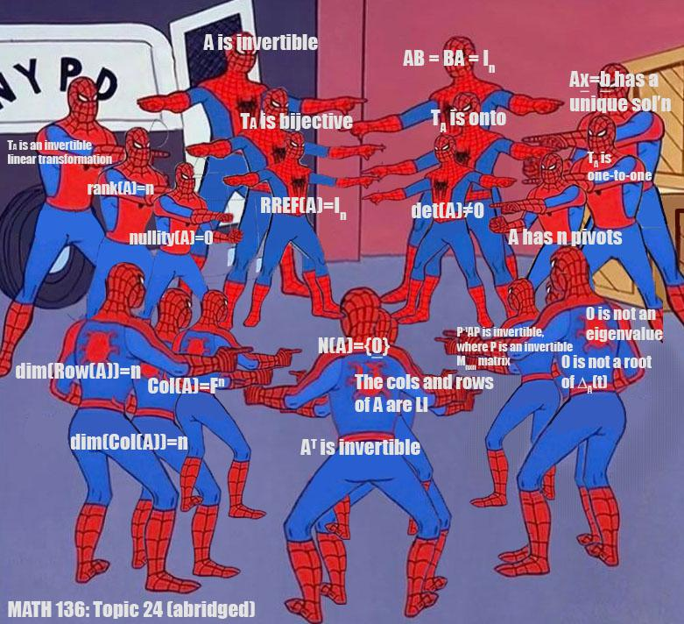
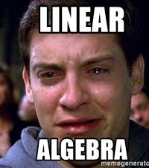
Why Equation Solver?

Slide 3
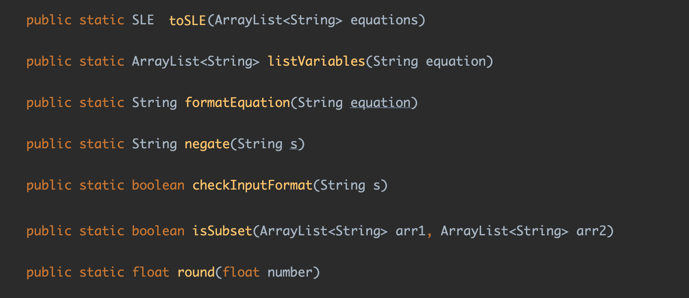
Parser

Slide 4
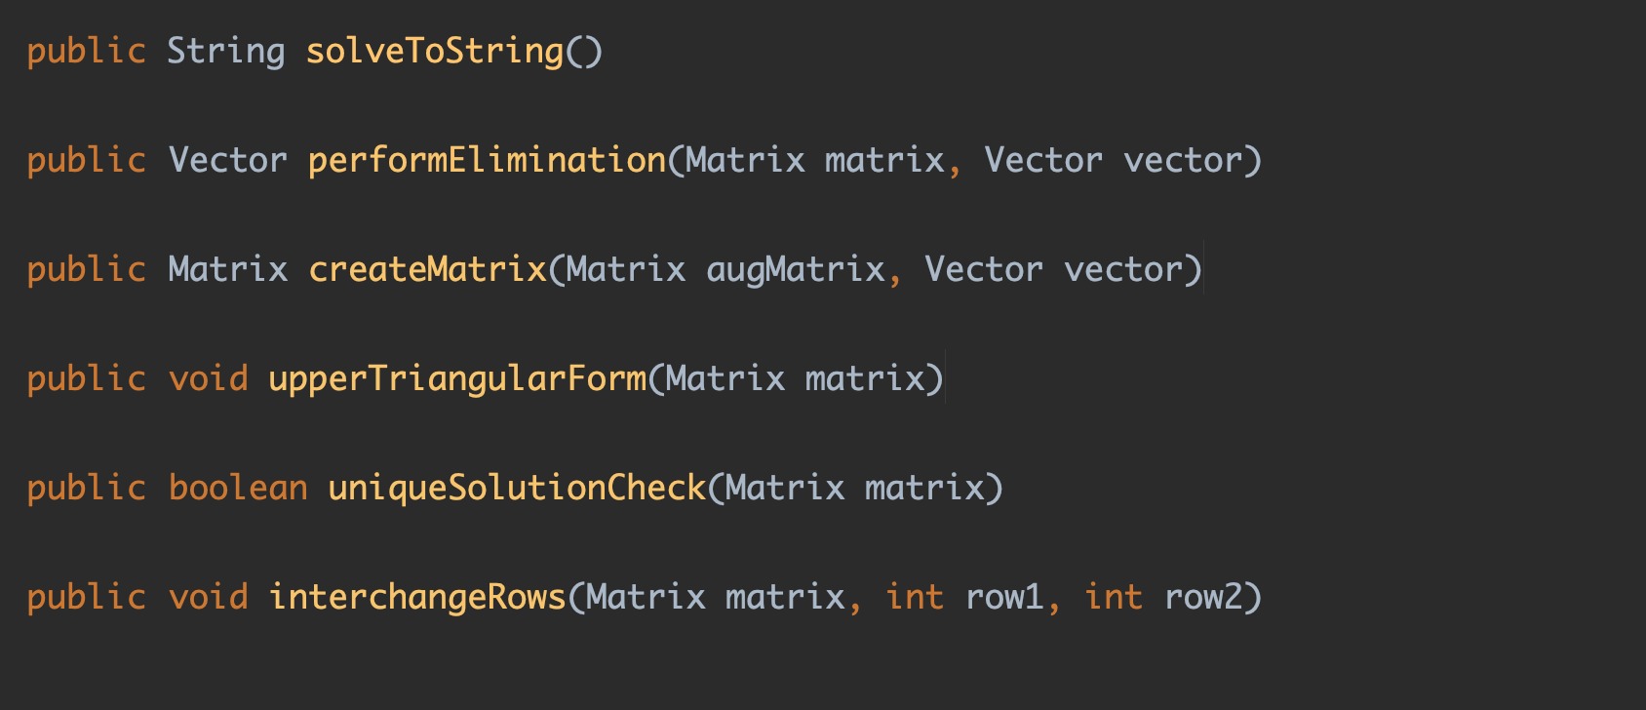
Gauss-Jordan Elimination Algorithm

Slide 5
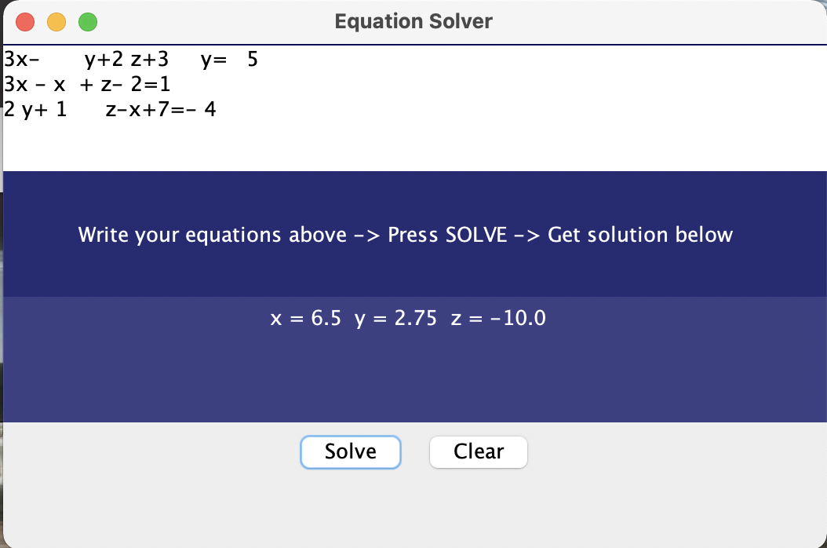
GUI
Used Java Swing
JLabel
JButton
JFrame
JTextArea

Slide 6
What’s next?

Slide 7
Thank you!

