Slide 1
Deep Sample
A Study of Audio Segmentation
Andrew Moore, Hue Truong, Alex Reno
Quinsigamond Community College

Slide 2
Background

Slide 3
What is Audio Segmentation?
Preprocessing step in signal analysis
Breaks signal into component parts
Modern practices use multiple segmentation algorithms, often paired with machine learning techniques.
Deep Sample focuses on the Zero Crossing, Spectrum Centroid, Spectrum Flux, and Real Cepstrum algorithm.

Slide 4
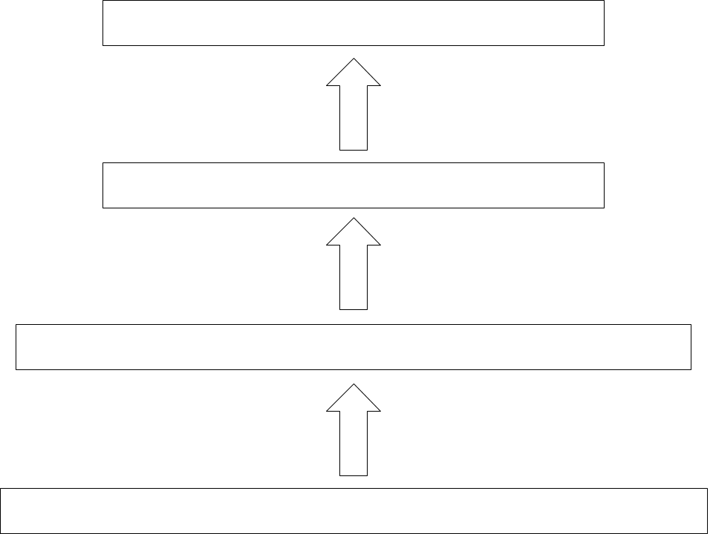
Audio Segmentation Pipeline

Slide 5
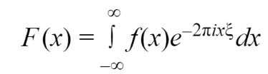

Fourier Transform
Real
Cepstrum
Decomposes a signal into its component frequencies
Derived from the fourier series, where the limit of its periodicity approaches infinity
Useful for looking at the frequency of a signal
Transformation of the Fourier Transform
Defines real parts of the signal
Used to analyze amplitude of a spectrum over time

Slide 6
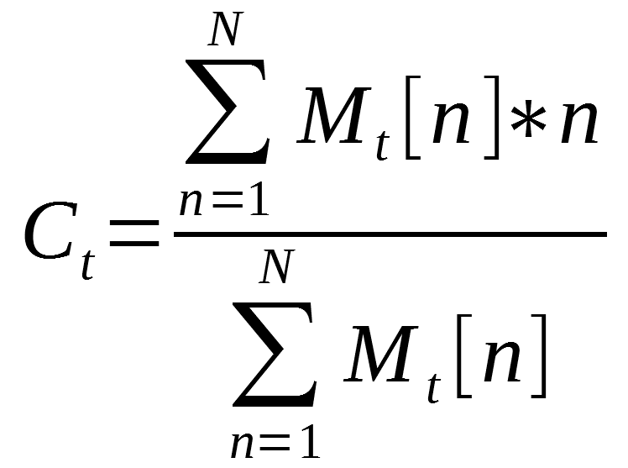
Spectrum Centroid
Center of gravity of the spectral distribution, or the weighted average of frequencies

Slide 7
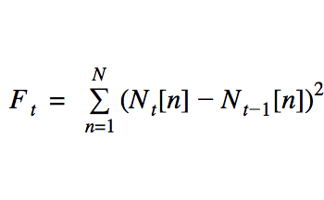
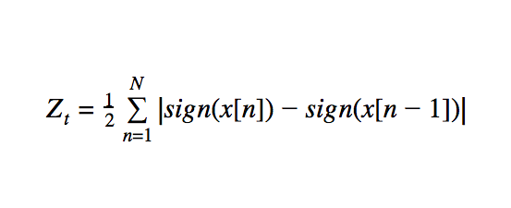
Spectrum Flux
and Zero Crossing
Spectral Flux is the measure of the average signal change across an audio wave.
The Zero Cross is a measure of the noisiness of the signal.

Slide 8
Methods

Slide 9
Fast Fourier Transform
And Real Cepstrum
Fast Fourier Transform:
Precursor for zero-crossing and spectral algorithms
Implemented using direct model of Fourier equation
Real Cepstrum:
Raw signal passes through Fourier Transform
Passed through hamming window to taper off data at each end
Loops through each vector element to take its logarithm
Passed through an inverse Fourier algorithm

Slide 10
Spectrum Centroid
Spectrum Centroid runs in a single loop:
Find the FFT if not already generated
Loop over each channel:
Calculate the numerator term
Sum the numerator terms
Sum the denominator terms
Take the quotient
O(n) runtime, bounded by the size of the Fourier transform

Slide 11
Spectrum Flux
and Zero Crossing
Spectrum Flux is implemented as follows:
Loop through each channel
Calculate normals
Sum the differences squared.
O(n) runtime
Bounded by sample set size.
The zero cross is runs over each channel in a nested loop
Calculates the sign of each element and sums the differences
Takes ½ the sum as the zero cross value of that frame.
O(n²) runtime
Bounded by the square of the sample set size.

Slide 12
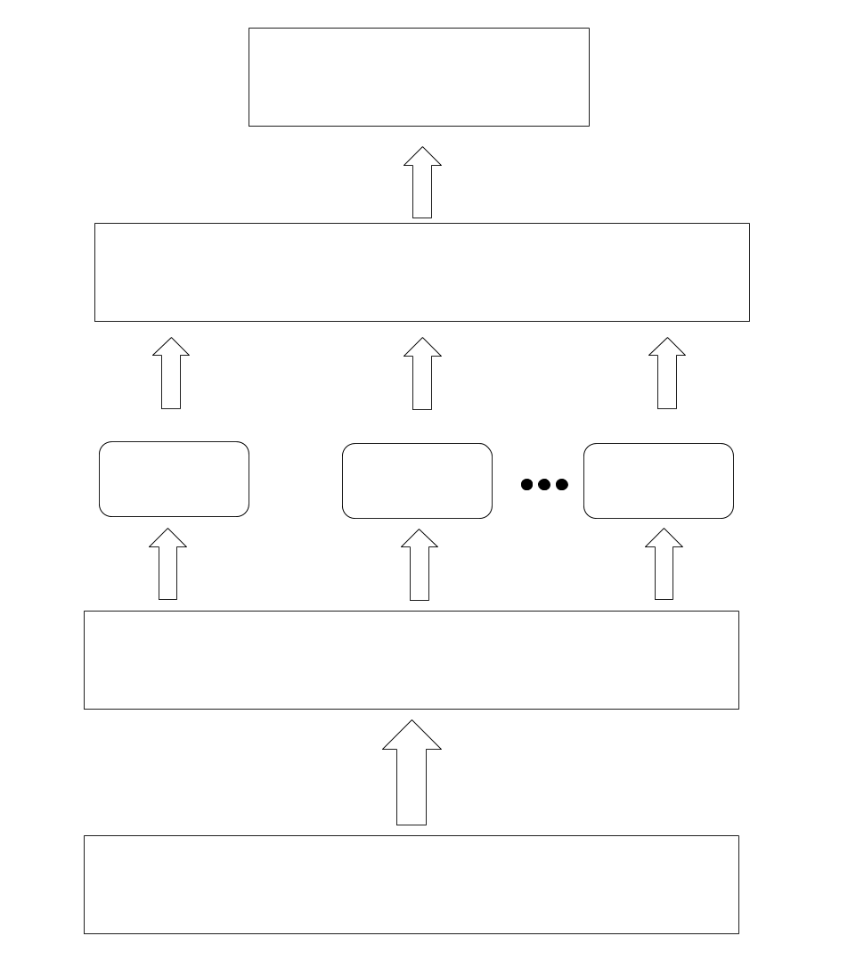
Deep Sample ANN

Slide 13
Results

Slide 14
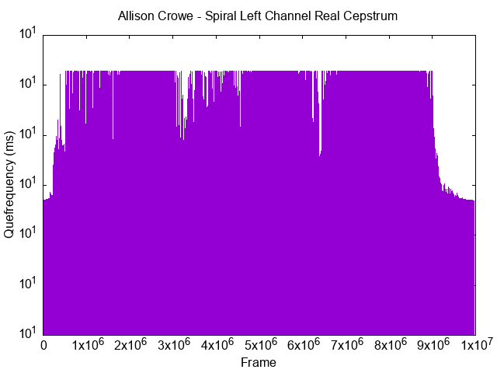

Real Cepstrum

Slide 15
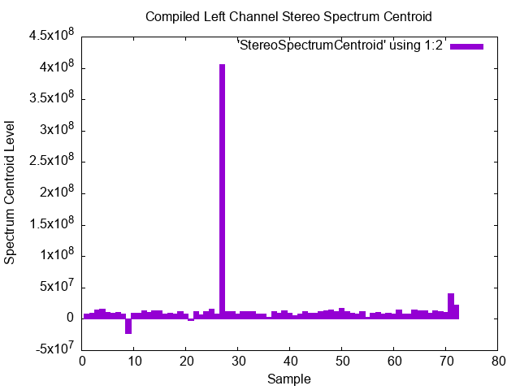
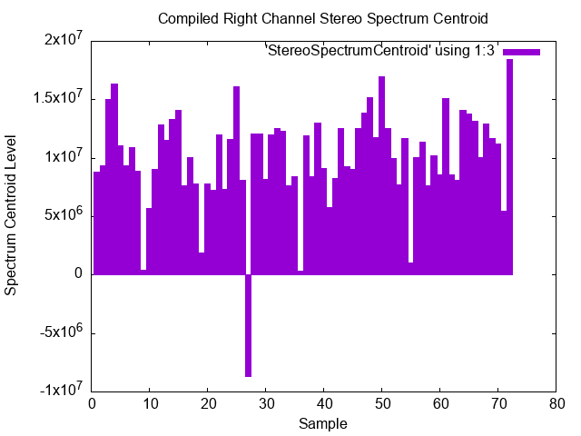
Spectrum Centroid

Slide 16
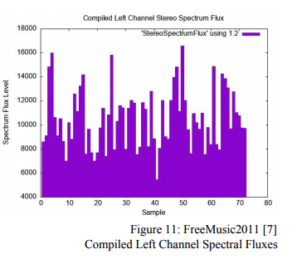
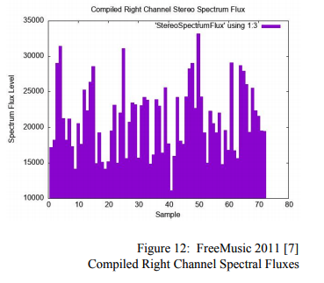
Spectrum Flux

Slide 17
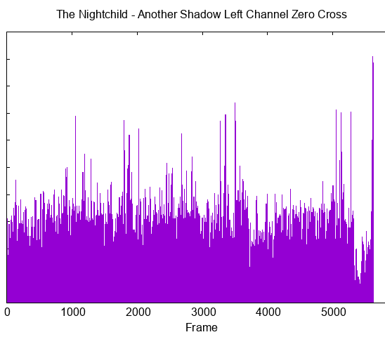
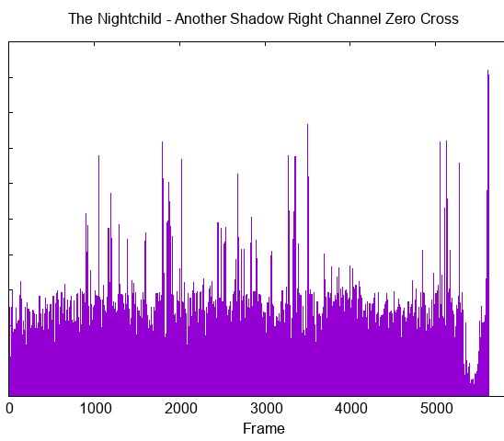
Zero Crossing

Slide 18
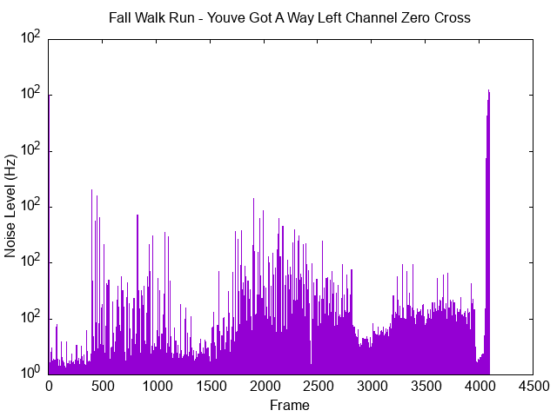
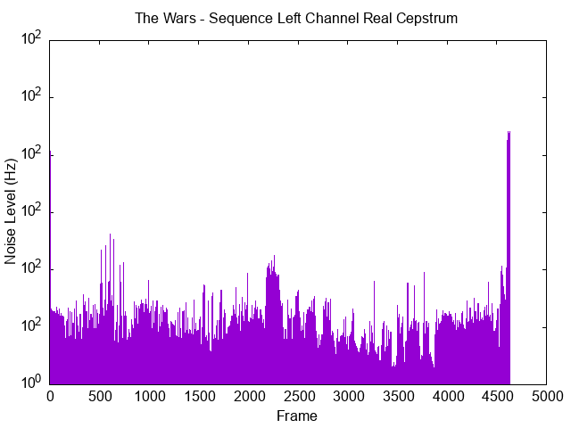
Deep Sample
Unknown Sample Being Analyzed [7]
Proposed Match From Database [7]

Slide 19
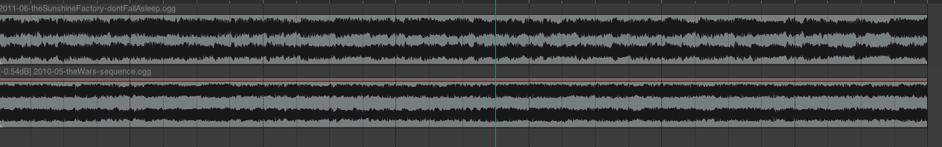


Deep Sample Match
The Sunshine Factory - Don’t Fall Asleep [7] Unknown
The Wars - Sequence [7] Known
Combined Samples:

Slide 20
Future Work
Move to mixed implementation with Matlab
Expand the training set
Enable DeepSample to learn
Add additional segmentation algorithms
Improve existing algorithms
Improve data transfer methods or data compression methods

Slide 21
Works Cited
[1] Zahid, S., Hussain F., Rahid M., Yousaf M.H., & Habib H.A. (2015). “Optimized Audio Classification and Segmentation Algorithm by Using Ensemble Methods”. Mathematical Problems in Engineering, 2015, 1-11.
doi: 10.1155/2015/209814
[2] Steeb, W.H., Steeb W.H. (2005). “Mathematical Tools in Signal Processing with C and Java Simulations”. Hackensack, NJ: World Scientific.
doi: 3-8-2020
[3] Giannakapoulos, T., Pikrakis, A. (2014). “Spectral Flux”. Introduction to Audio Analysis. https://www.sciencedirect.com/topics/engineering/spectral-flux
[4] Chu, W.T. (2014). “Musical Genre Classification”. Multimedia Content Analysis. https://www.cs.ccu.edu.tw/~wtchu/courses/2014f_MCA/Lectures/Lecture%209%20Audio%20and%20Music%20Analysis%202.pdf
[5] Tzanetakis, G., Cook, P. (2002). “Musical genre classification of audio signals”. IEEE Trans. On Speech and Audio Processing, vol 10, no. 5, pp. 293-302
[6] Brownlee, J. (2016 Nov 14). How to Implement Learning Vector Quantization (LVQ) From Scratch with Python. machinelearningmastery. https://machinelearningmastery.com/implement-learning-vector-quantization-scratch-python/
[7] Multiple. (2009 Apr 26). Free Music Charts. https://archive.org/details/free-music-charts?tab=collection

Slide 22
Questions?

