Slide 1
Customer Shopping Behavior Analysis
DATA ANALYST PORTFOLIO PROJECT
What 3,900 purchases tell us about who buys, what they buy and why they come back
A V N Harshith
Python
PostgreSQL
Power BI

Slide 2
The question and the data
A retail business wants to know who its customers are, what drives spending, and whether subscriptions and discounts are worth it. I took one transaction file and tried to answer that.
3,900
18
37
purchases
columns: demographics, purchase details, shopping habits
missing review ratings to deal with
Questions I asked
Who spends more? Do subscribers spend more? Which products rely on discounts? Which age group brings the most revenue?

Slide 3
How I got the data ready
1
2
3
4
Check
Fix
Build
Query
Looked at structure and summary stats with pandas
Filled the 37 missing ratings with the median for each product category
Added age groups and a purchase frequency column, dropped a duplicate promo column
Loaded it into PostgreSQL and wrote 10 SQL queries for business questions
Why it mattered
Using the category median kept ratings realistic without pulling averages around. Snake case column names kept the SQL easy to read.

Slide 4
What the numbers showed
68%
$59.49
$62.1K
of revenue came from male customers: $157,890 against $75,191
average spend for subscribers, versus $59.87 for everyone else
from young adults, the top age group. Seniors were lowest at $55.8K
80%
$60.48
3.86
of customers are in the Loyal segment (3,116 of 3,900)
average order with Express shipping, against $58.46 for Standard
top average rating, for Gloves. Sandals and Boots follow at 3.84 and 3.82

Slide 5
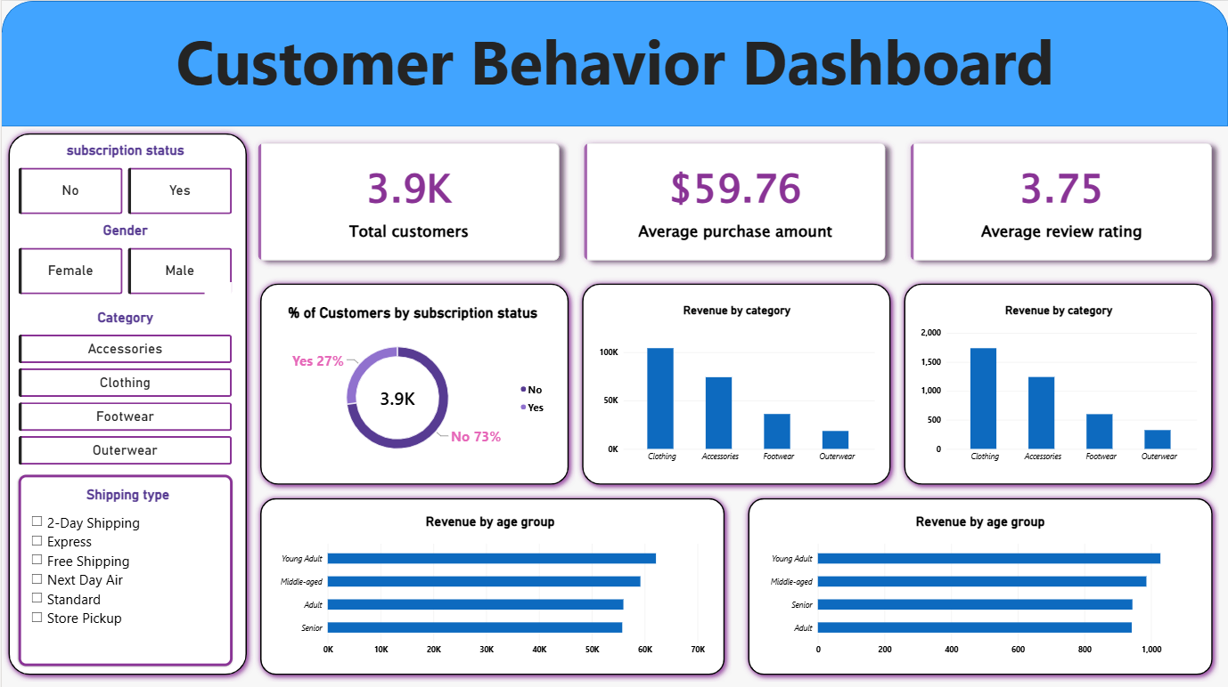
The Power BI dashboard
At a glance: 3.9K customers, $59.76 average purchase, 3.75 average rating.
Split by: subscription (27% yes, 73% no), category and age group.
Slicers: subscription, gender, category and shipping type, so anyone can explore it without SQL.

Slide 6
What I would suggest
Finding | Evidence | Suggestion
Subscribers spend about the same | $59.49 vs $59.87 average | Add a real perk, like free shipping, so joining pays off
Most customers are already Loyal | 3,116 of 3,900 | Run a rewards program and move Returning customers up
Some products lean on discounts | Hats 50%, Sneakers 49.7% | Check margins before discounting them so often
Young adults spend the most | $62,143 of $233,081 | Aim campaigns at them first, plus Express shippers

Slide 7
What I took from this project
Cleaning the data took more thought than any chart. I now think about the question first and the tool second.
Python
SQL
Power BI
Cleaning, missing values, new features
10 queries in PostgreSQL
An interactive dashboard

