Slide 1
1M1B AI FOR SUSTAINABILITY VIRTUAL INTERNSHIP
EcoMitra
An AI Copilot for Campus Sustainability
Prediction, retrieval-augmented guidance, and agentic reporting — built to turn everyday campus resource use into measurable, sustained behavior change.
Avneet Jutla | B.Tech CSE, Lovely Professional University
In collaboration with IBM SkillsBuild & AICTE

Slide 2
PROBLEM STATEMENT
Resource use on campus is invisible — so no one improves it
How might we use AI to track and interpret everyday resource usage on campus so that students and hostels can make measurably more sustainable choices?
PRIMARY
SECONDARY
SECONDARY
SDG 12
SDG 13
SDG 7
Responsible Consumption
& Production
Climate Action
Affordable & Clean Energy
02

Slide 3
FRAMING
The four questions a strong AI + sustainability project must answer
1
What problem?
2
Who is affected?
Students & hostel blocks have zero visibility into their own electricity, water, and waste footprint — no feedback loop exists to improve it.
Hostel residents, the campus facilities/eco-club team, and eventually the wider institution once usage becomes comparable across blocks.
3
Why is AI needed?
4
How does it create impact?
Raw meter numbers mean nothing on their own. AI is needed to spot patterns, generate context-aware recommendations, and answer freeform policy questions.
A visible, personalized feedback loop drives measurable behavior change — tracked weekly per user and in aggregate per hostel block.
03

Slide 4
AI SOLUTION OVERVIEW
Four AI patterns working as one system, not four separate demos
1
2
3
4
5
Usage Logging
→
Vector Store
(RAG)
→
Gemini
Reasoning Layer
→
Weekly Agent Job
→
Dashboard
Students log daily/weekly electricity, water, waste & travel data
SDG & campus policy docs embedded via Gemini, stored in MongoDB Atlas Vector Search
Pattern reads, personalized recommendations, RAG-grounded chat answers
Vercel Cron aggregates data & auto-generates a campus sustainability digest
React UI: usage charts, weekly tip, chat assistant
Product Feature | AI Technique | Why it's genuinely AI-necessary
Usage trend view | Lightweight time-series pattern detection | Surfaces trends a raw log table hides
Personalized tips | Gemini, prompted with the user's own data | Generic tip lists can't do this — context is the point
Policy chatbot | RAG over SDG + campus sustainability documents | Answers are grounded and citable, not hallucinated
Weekly digest | Agentic scheduled job (Vercel Cron + Gemini) | Automation the guideline explicitly calls out
04

Slide 5
PROCESS
Built through the five-stage design-thinking journey
Empathize
Define
Ideate
Prototype
Test & Refine
Hostel residents interviewed informally on what stops them from tracking usage
Problem statement, target users & current gaps in visibility written explicitly
Brainstormed automation, prediction & decision-support options; kept feasibility in mind
Flowchart, RAG pipeline & sample chat inputs/outputs built end-to-end
Mentor feedback loop to sharpen clarity, ethics & usefulness before submission
›
›
›
›
05

Slide 6
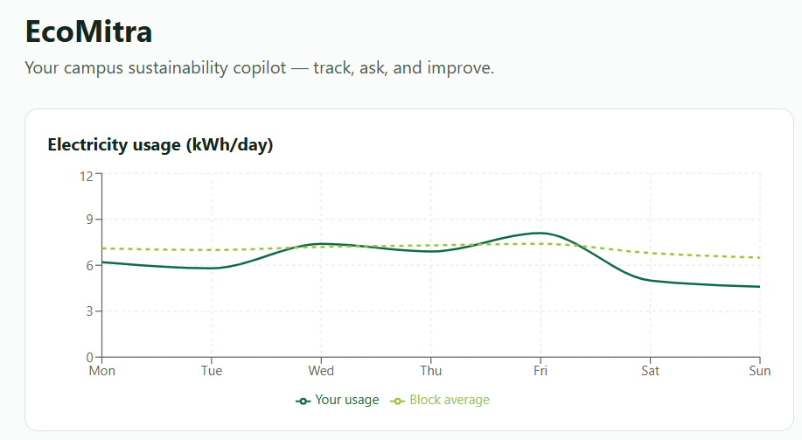
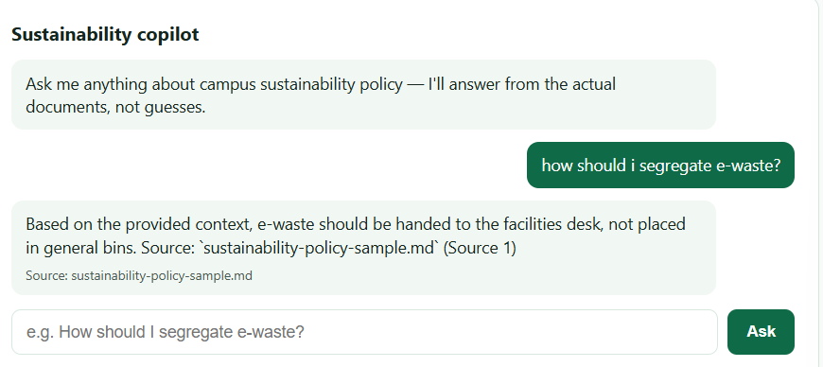
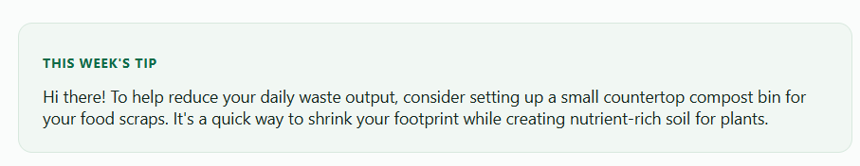
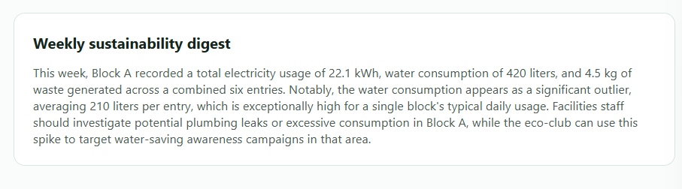
PROTOTYPE
What the working demo shows
1
Dashboard
2
Sustainability Copilot Chat
Weekly usage charts per category (electricity, water, waste, travel) vs. the resident's own history and hostel-block average.
Ask 'How do I cut hostel water use?' — answer is retrieved from actual SDG/campus policy documents, with the source cited.
3
This Week's Tip
4
Sustainability Digest
One personalized, non-judgmental recommendation generated from the resident's own last two weeks of data.
Auto-generated weekly summary flagging anomalies, e.g. 'Block C water use rose 18% this week.'
06

Slide 7
RESPONSIBLE AI CONSIDERATIONS
Mandatory — and treated as a design constraint, not an afterthought
Fairness
Transparency
Ethics
Privacy
Recommendations compare a resident against their own history, never used to rank or penalize individuals against each other.
Every chatbot answer names the source document it drew from, so recommendations are never a black box.
No gamification or shaming mechanics — nudges are framed as opportunities, never as judgment of the person.
Usage logs are pseudonymized; no personally identifying data is stored beyond what the dashboard needs to function.
07

Slide 8
EXPECTED IMPACT
Who benefits, and how the change is measured
If adopted campus-wide
Why this outlasts the internship
Residents gain weekly, personalized visibility into their own footprint for the first time
Same architecture scales into a B.Tech final-year project: swap manual logging for real IoT sensors
Hostel blocks can be compared on a common metric, motivating friendly, non-punitive improvement
RAG layer generalizes to any policy corpus — not locked to sustainability content
Facilities/eco-club teams get an aggregated weekly digest instead of raw meter data
Agentic weekly-digest pattern is directly reusable in placement-facing portfolio projects
Behavioral-nudge literature suggests visibility-driven feedback loops of this kind typically produce measurable (not dramatic) reductions in per-capita utility use over a semester
Demonstrates four distinct AI patterns in one coherent product — a stronger signal to recruiters than four separate single-purpose demos
08

Slide 9
Thank You
EcoMitra — AI Copilot for Campus Sustainability

