Slide 1

Guide to Operating Systems, 6th Edition
Module 10: Account and Resource Management
©2021 Cengage Learning. All Rights Reserved. May not be scanned, copied or duplicated, or posted to a publicly accessible website, in whole or in part.
Notes:
Add slide notes here

Slide 2
Learning Objectives
By the end of this module, you should be able to:
Configure file and printer sharing
Manage user and group accounts
Secure shared resources
Notes:
Add slide notes here

Slide 3
File and Printer Sharing
The dominant file-sharing protocol is Server Message Block (SMB)
It is the native Windows file-sharing protocol but is supported by Linux and Mac OSs
Network File System (NFS) is the native Linux file-sharing protocol; Windows can support NFS with the right software installed
Printer sharing also uses SMB
The native Linux printer-sharing protocol is line printer daemon/line printer remote (LPD/LPR)

Slide 4
Sharing Files in Windows (1 of 8)
File sharing in Windows is based on Client for Microsoft Networks (client side) and File and Printer Sharing for Microsoft Networks (server side)
To see these components
View the properties of your network connection
To share files in Windows
You share the folder in which the files are located

Slide 5
Sharing Files in Windows (2 of 8)
Methods to Configure Folder Sharing in Windows
File Sharing Wizard – to start this wizard, right-click a folder, click Share with, and click Specific people
Shared Folder snap-in – a component of the Computer Management console
Advanced Sharing dialog box – to open this dialog box, click Advanced Sharing in the Sharing tab of a folder’s Properties dialog box

Slide 6
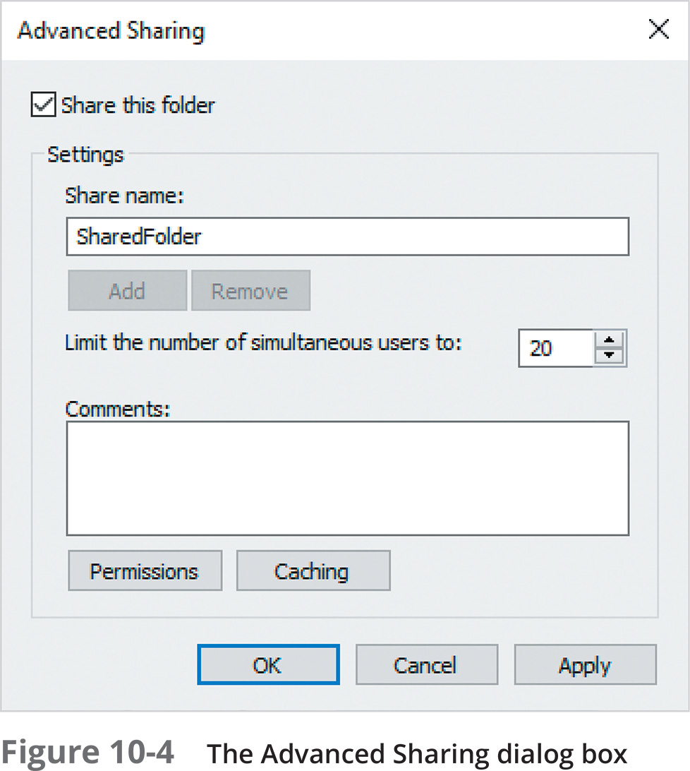
Sharing Files in Windows (3 of 8)

Slide 7
Sharing Files in Windows (4 of 8)
Accessing Shared Files in Windows
When a user or application requests a resource, a redirector intercepts the request and examines it to determine whether the resource is local (on the computer) or remote (on the network)
If local, the redirector sends the request to the local software component
If remote, the redirector sends the request over the network to the server hosting the resource
With redirectors, network resources can be accessed as though they were local

Slide 8
Sharing Files in Windows (5 of 8)
Accessing Shared Files in Windows (continued)
The Universal Naming Convention (UNC) path is used to access a shared folder with the syntax \\server-name\sharename
In Windows, you can map a drive in order to simplify access to shared folders
Associates a drive letter with the UNC path to a shared folder
Drives are usually mapped using File Explorer or the net command

Slide 9
Sharing Files in Windows (6 of 8)
Components of a shared printer:
Print device – There are two basic types of print devices:
A local print device is connected to an I/O port on a computer
A network print device is a printer attached to and shared by another computer
Printer – The icon in the Printers folder that represents print devices
Print server – A Windows computer sharing a printer
Print queue – Storage for print jobs awaiting printing

Slide 10
Sharing Files in Windows (7 of 8)
Benefits of using a shared printer:
Access control
Printer pooling
Printer priority
Print job management
Availability control
To configure a print server, you need to share a printer
After installation, open the Printers and Scanners Settings window, click the printer, click Manage, and then click Printer properties
Click the Sharing tab to see available options

Slide 11
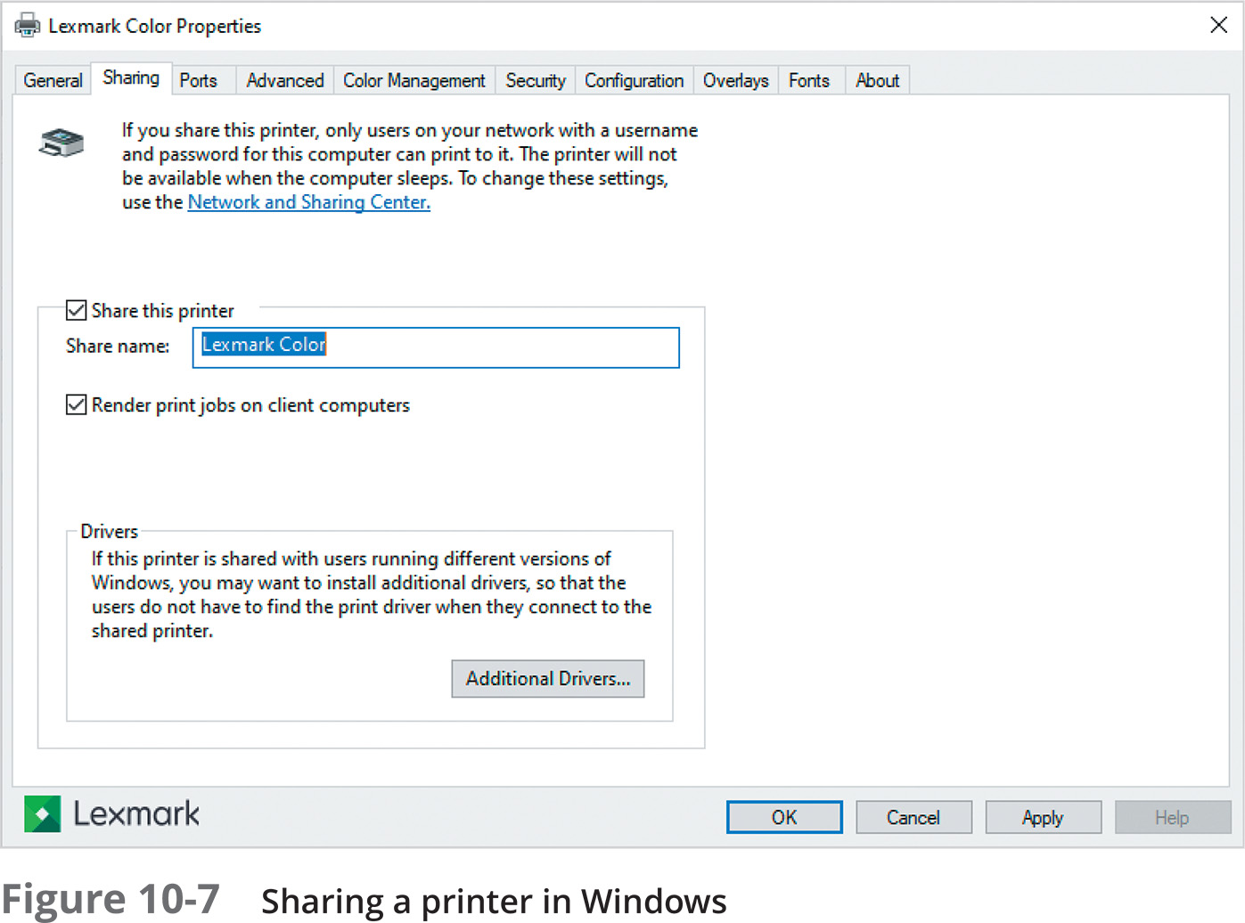
Sharing Files in Windows (8 of 8)

Slide 12
Sharing Files and Printers in Linux (1 of 3)
Linux supports Windows file sharing by using SMB in a software package called Samba
You can share a folder using the Samba Server Configuration GUI tool
Or by editing the /etc/samba/smb.conf file
When you use the GUI tool to configure Samba
Changes to the smb.conf file are made automatically
Printer sharing in Linux is straightforward after Samba has been installed
When you create a new printer in Linux, it is shared automatically

Slide 13
Sharing Files and Printers in Linux (2 of 3)
To access shared files via a Linux client:
Use the Files tool and browse the network
Click on the computer’s icon and enter your credentials
You can also click Other Locations in the left pane and enter the path to the server in the Connect to Server box
You must preface the path with smb: so Linux knows you are trying to connect to an SMB share
Linux also comes with a command-line program called smbclient for accessing SMB shares

Slide 14
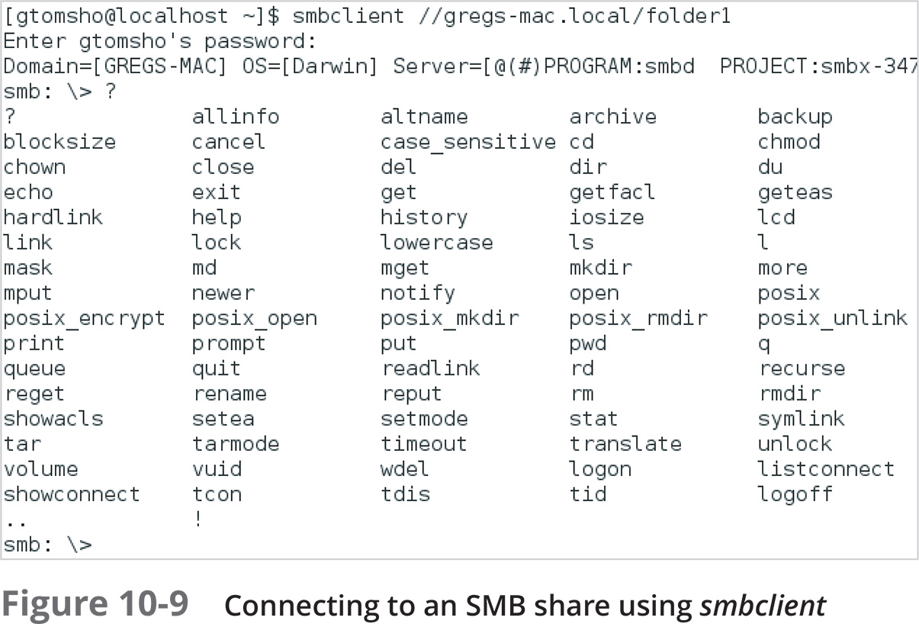
Sharing Files and Printers in Linux (3 of 3)

Slide 15
Sharing Files and Printers in macOS (1 of 3)
macOS supports Windows file sharing using the SMB protocol
To share a folder with another user, turn on File Sharing in System Preferences by clicking Sharing
In the Sharing dialog box, click File Sharing
After you have chosen the folder you want to share and set the permissions:
Click Options to turn on sharing for SMB if you want to share your files with Windows or Linux users
For Windows file sharing, enable sharing for each user

Slide 16
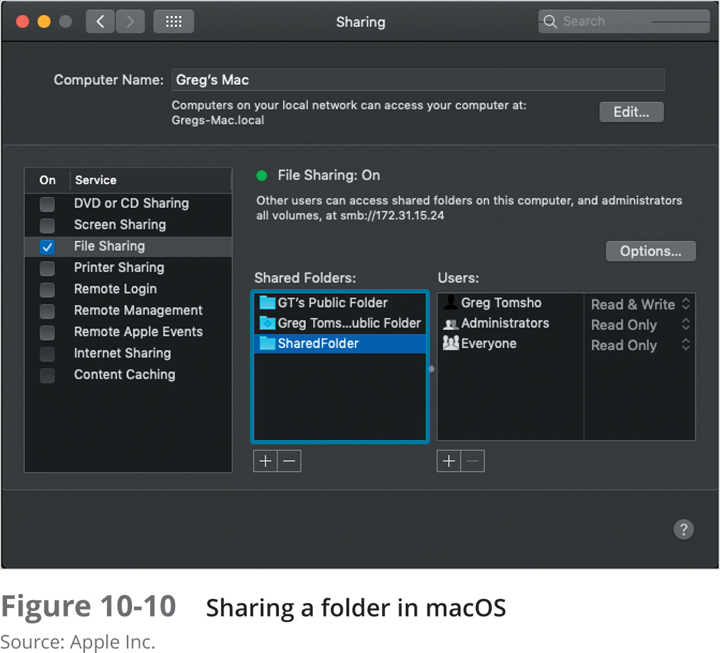
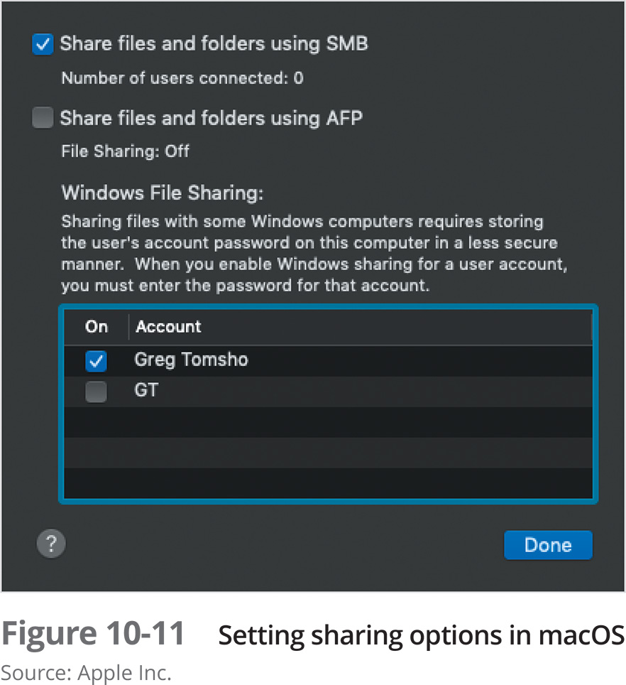
Sharing Files and Printers in macOS (2 of 3)

Slide 17
Sharing Files and Printers in macOS (3 of 3)
To share printers
Use the Sharing dialog box and click the box next to Printer Sharing
To access shared files on another computer from a macOS client, click Go and then click Network
If you see the computer that contains the shared files, click its icon and enter your credentials
You can also click Go, click Connect to Server, and enter the path to the server
Preface the path with smb:

Slide 18

Knowledge Check 1
Which of the following is the native Linux/UNIX file sharing protocol?
A) SMB
B) UNC
C) NFS
D) FTP

Slide 19

Knowledge Check 1: Answer
Which of the following is the native Linux/UNIX file sharing protocol?
C) NFS

Slide 20
Managing User and Group Accounts
User accounts have two main functions:
Provide a method for users to authenticate themselves to the network
Provide detailed information about a user
Group accounts are used to organize users so that assignment of resource permissions and rights can be managed more easily than working with dozens or hundreds of individual user accounts

Slide 21
Account and Password Conventions (1 of 2)
In a large network, a scheme for naming user and group accounts as well as network devices is crucial. Consider the following:
Should user account names have a minimum and maximum number of characters?
Should the username be based on the user’s real name, or if security is important, should names be more cryptic?
Some OSs distinguish between uppercase and lowercase letters. Should usernames contain both as well as special characters?

Slide 22
Account and Password Conventions (2 of 2)
Considerations for password naming conventions:
Minimum length
Complexity requirements
Created by user or administrator
Password change frequency
Group account names should reflect the group membership or the resource to which the group is assigned permissions
Once naming conventions have been established, stick to them

Slide 23
Working with Accounts in Windows (1 of 5)
When Windows is first installed, two users are created:
Administrator and Guest
On a Windows Server 2016 domain controller, the Guest account is disabled
In Windows 10
Both Administrator and Guest are disabled
The Administrator account has full access to a computer
In a Windows domain, the domain administrator account’s access is extended to all computers that are domain members

Slide 24
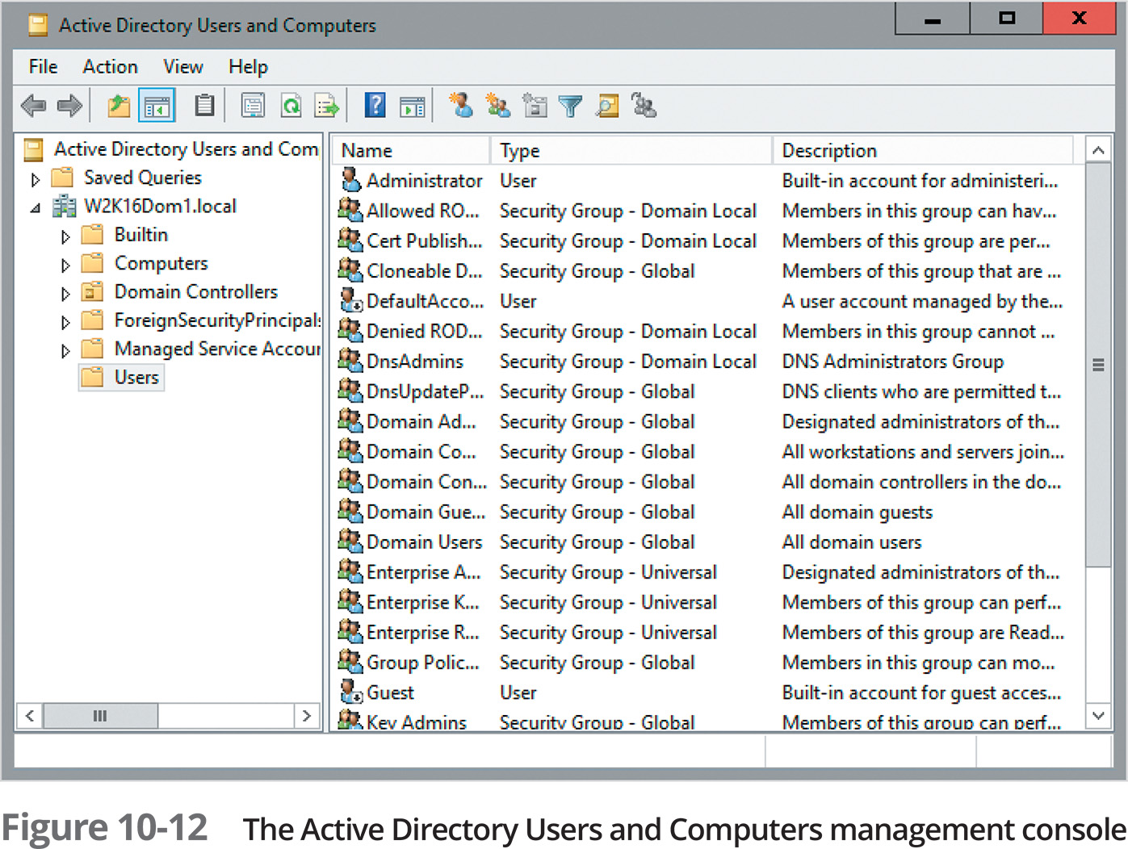
Working with Accounts in Windows (2 of 5)
Windows domain users are created in Active Directory Users and Computers
Also in Active Directory Administrative Center (ADAC), or with command-line tools
You can create folders for organizing users and groups (called organizational units or OUs)

Slide 25
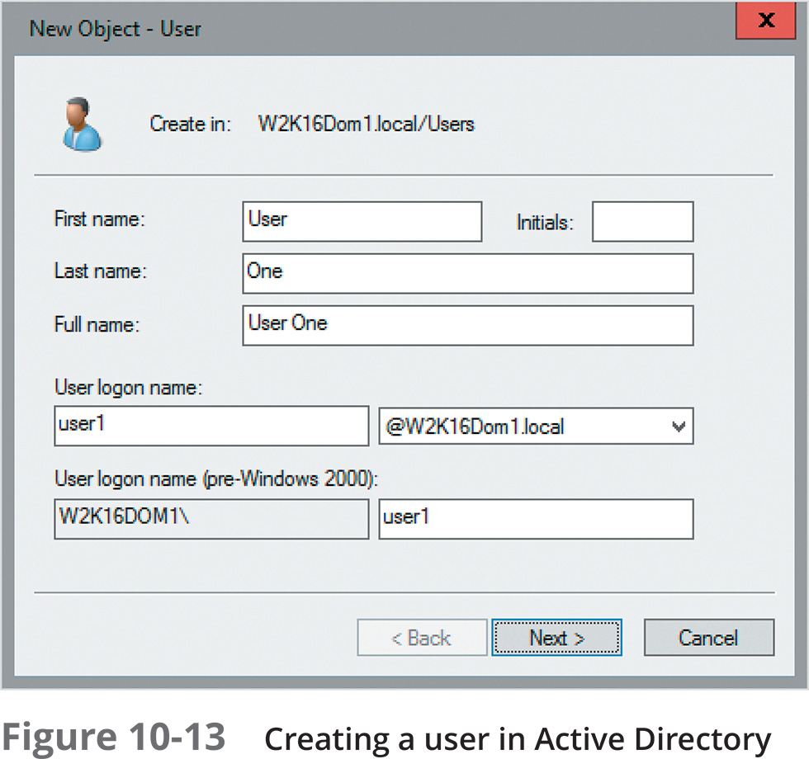
Working with Accounts in Windows (3 of 5)
To create a new user:
Select the folder where you want to create the user
Right-click the folder, point to New, and click User
The New Object – User Dialog box opens
Everything you create in Active Directory is considered an object

Slide 26
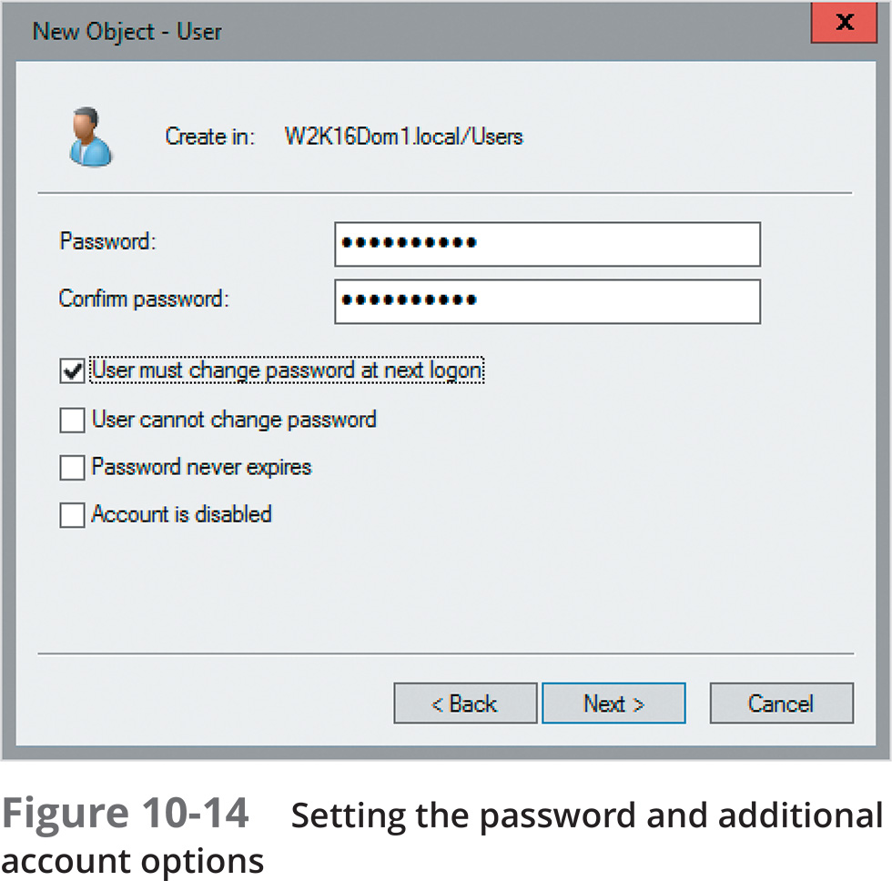
Working with Accounts in Windows (4 of 5)
Next, you will need to set the password with the following options:
User must change password at next logon
User cannot change password
Password never expires
Account is disabled

Slide 27
Working with Accounts in Windows (5 of 5)
Group accounts only require a name in order to be created
Group scope has three options:
Domain local
Global
Universal
Group type has two options:
Security (default)
Distribution

Slide 28
Working with Accounts in Linux (1 of 3)
User and group accounts in Linux are used for the same purpose as in Windows:
User authentication and authorization
Linux also has a default user named root who has full control over the system
Most Linux administration takes place at the command line
Enter useradd newuser, replacing newuser with the logon name for the user account you’re creating
You will then be prompted to create a new password and enter the user’s full name and other information

Slide 29
Working with Accounts in Linux (2 of 3)
All users must belong to at least one group in Linux
When a new user is created, a group with the same name is also created and the user is made a member
Use the groupadd command to create groups
To add users to a group:
useradd username groupname
To view the list of users
Display the /etc/passwd file’s contents with the cat /etc/passwd command

Slide 30
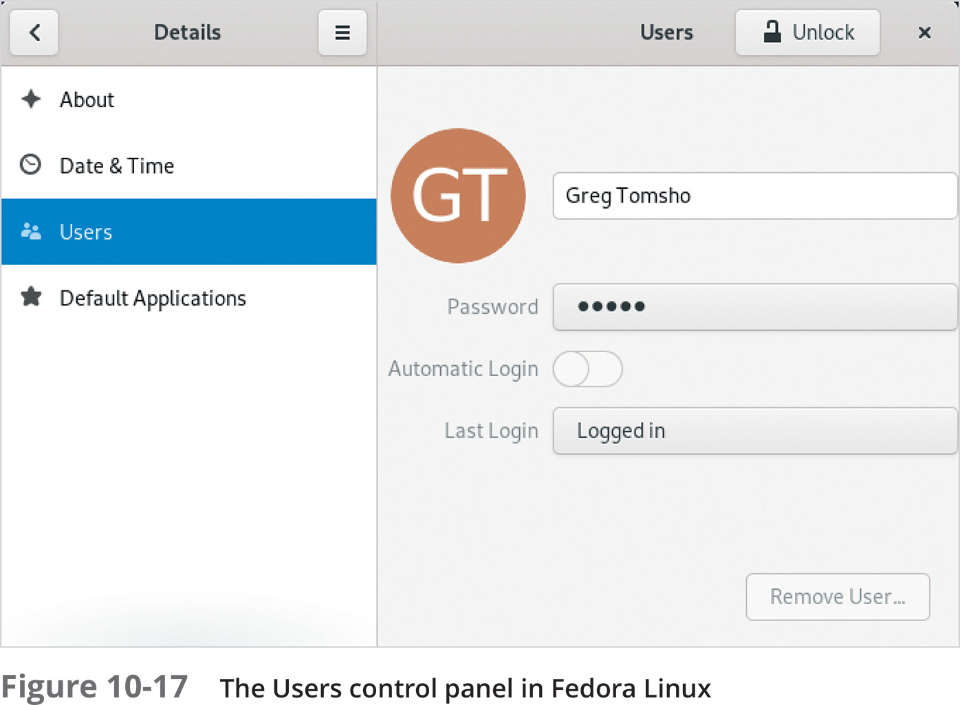
Working with Accounts in Linux (3 of 3)
Most Linux distributions have convenient graphical interfaces for those who prefer a GUI to manage users and groups
In Fedora 30 Linux, the Users tool is available to manage users
Many administrators prefer the command-line method for creating users because they can import user information from a text file

Slide 31
Working with Accounts in macOS (1 of 2)
In macOS, you create users and groups using the Users & Groups tool in System Preferences
To create a user, click the plus sign in the left pane of Users & Groups, then click the selection arrow next to New Account to choose the type of account you want to create
Enter the user’s full name, account name, and password

Slide 32
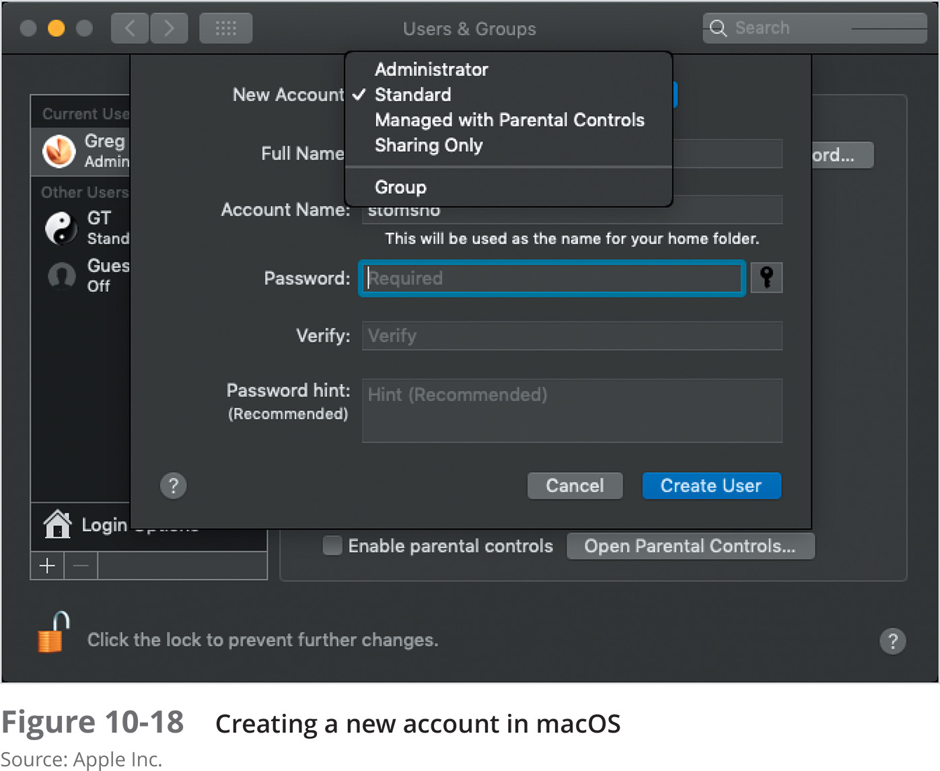
Working with Accounts in macOS (2 of 2)
You can choose the following account types:
Administrator
Standard
Managed with parental controls
Sharing Only
Group

Slide 33
Securing Shared Resources
The general rule when securing computers is to allow the least access that is required to fulfill the purpose of the computer
File sharing can be disabled with the OS’s built-in firewall or by disabling the service altogether
Permissions should be given only to those accounts that need it rather than all accounts

Slide 34
Securing Shared Files on a Windows System (1 of 2)
Permissions specify which accounts can access a file system object and what actions can be taken if permission is granted
Network access uses the SMB protocol to access the files in a shared folder
Interactive access requires the user to be signed in to the computer console

Slide 35
Securing Shared Files on a Windows System (2 of 2)
Two ways to secure files
Share permissions
File and folder permissions
Share permissions apply when using a network to access shared files
File and folder permissions always apply, whether accessing network shares or local files
Each file system object has permissions associated with it
Each permission can be set to Allow or Deny

Slide 36
Share Permissions (1 of 2)
Share permissions apply to folders and files accessed across the network
Can’t be configured on individual files
Three share permissions
Read
Change
Full Control
Generally, the default share permission is Read for everyone

Slide 37
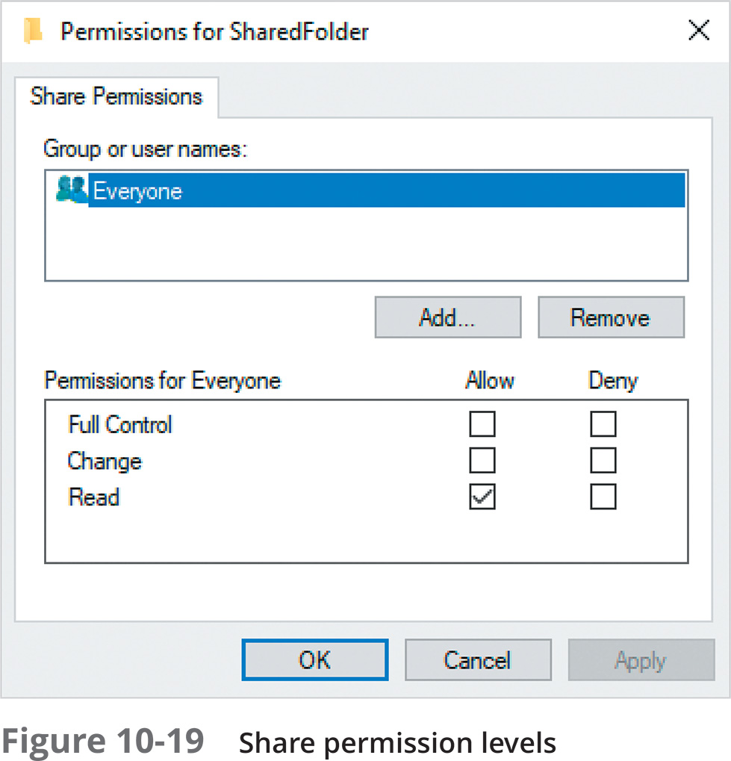
Share Permissions (2 of 2)

Slide 38
File and Folder Permissions (1 of 2)
File and folder permissions can be configured on folders and files
Permission inheritance defines how permissions are transmitted from a parent object to a child object
Parent objects can be a volume or folder, and child objects can be folders and files
To view or edit permissions on a folder or file, use the Security tab of the object’s Properties dialog box
Folders have 6 basic permissions and 14 advanced permissions
Files have 5 basic permissions and 13 advanced permissions

Slide 39
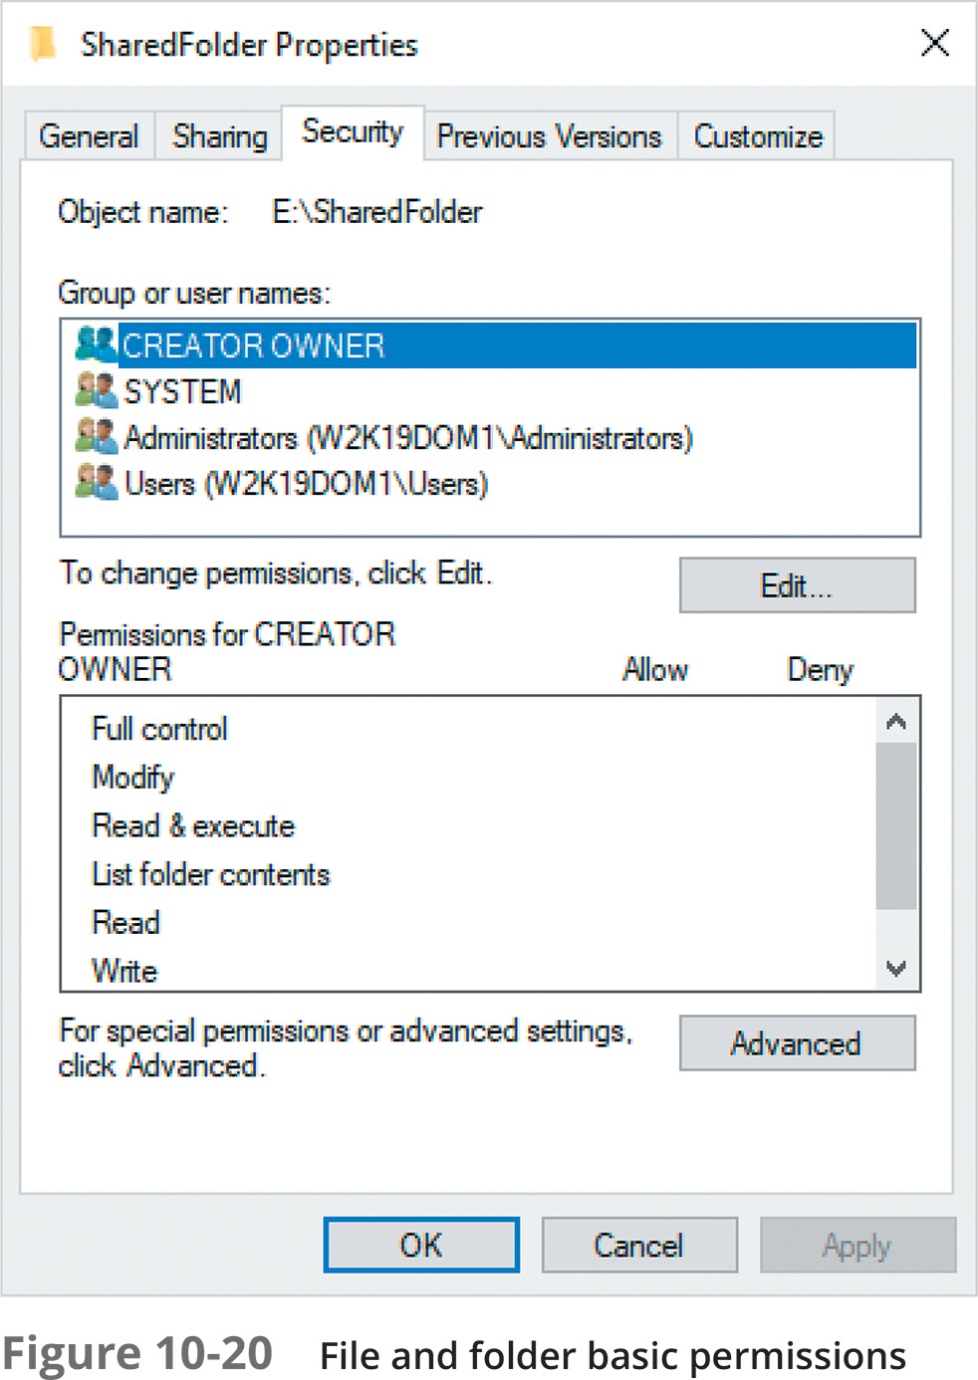
File and Folder Permissions (2 of 2)
Basic permissions:
Read
Read & execute
List folder contents
Write
Modify
Full control

Slide 40
Securing Shared Files in Linux and macOS (1 of 3)
In Linux, there are only three permissions:
Read, write, and execute
There are also three user types that can be assigned one or more of these permissions:
Owner – the owner of the file or folder, which is usually the user who created it
Group – the primary group to which the owner belongs
Other – all other users

Slide 41
Securing Shared Files in Linux and macOS (2 of 3)
Permissions are specified by using a single letter: r for read, w for write, and x for execute
For example, a file named newfile created by a user named mike who belongs to a group named mike is shown by using the ls command:
-rw- r-- r-- mike mike newfile
The permissions on the file above are as follows:
Owner mike has read/write access, group mike has read access, and everybody else has read access

Slide 42
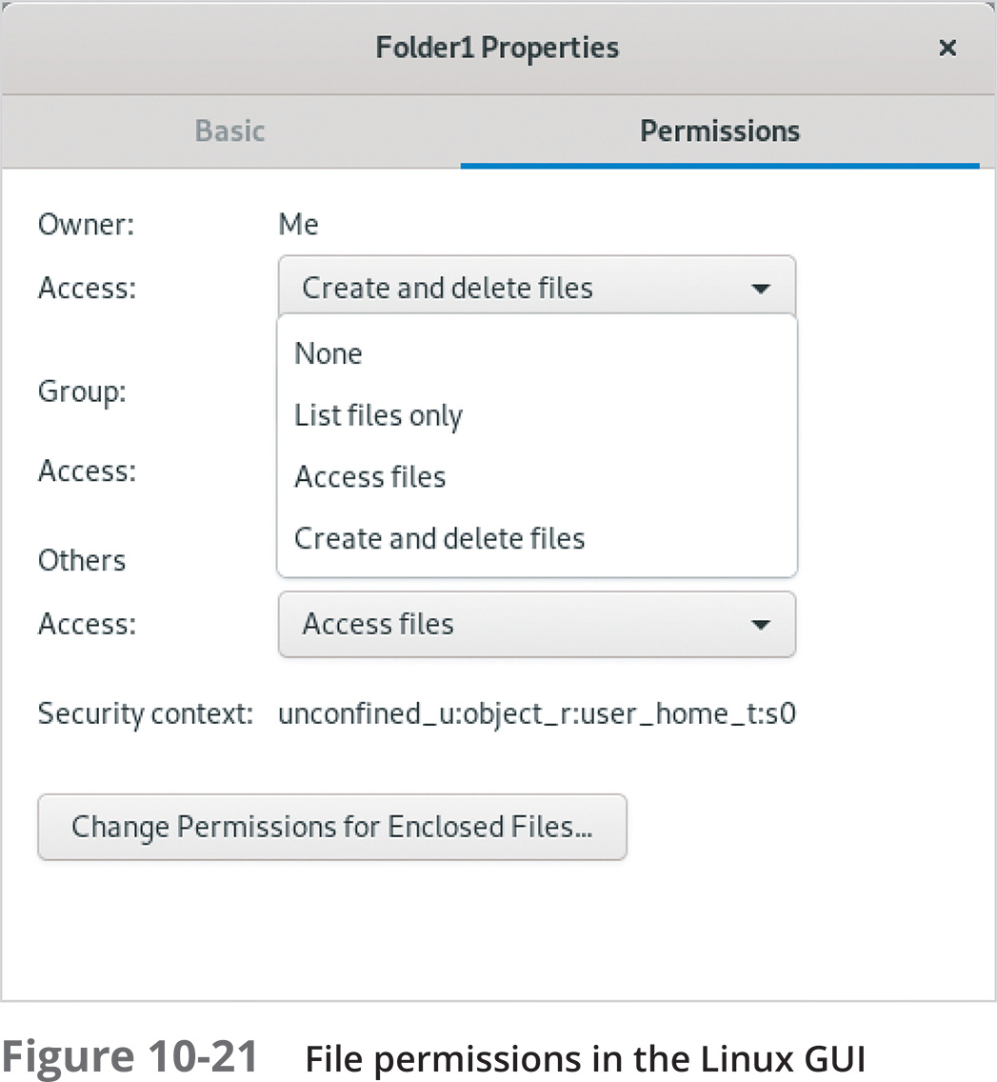
Securing Shared Files in Linux and macOS (3 of 3)
The GUI in many Linux distributions shows permissions in a less cryptic form
With Linux Samba file sharing, there are only two permission options: read only and read/write
Each user who should have access to a folder must be assigned a password specific to Samba

Slide 43
Knowledge Check 2
The process of using user accounts to assign permissions to network resources and defining the types of actions a user can perform on a system is known as which of the following?
A) group scope
B) authentication
C) authorization
D) permission inheritance

Slide 44
Knowledge Check 2: Answer
The process of using user accounts to assign permissions to network resources and defining the types of actions a user can perform on a system is known as which of the following?
C) authorization

Slide 45

Summary (1 of 3)
File and printer sharing is one reason that businesses began to outfit computers with network interfaces and network software
File sharing in Windows is based on Client for Microsoft Networks on the client side and File and Printer Sharing for Microsoft Networks on the server side
When a user or application requests a resource, a redirector intercepts the request and examines it to determine whether the resource is local or remote
To understand how to work with and share printers in Windows, you need to know the terminology for defining the components of a shared printer

Slide 46
Summary (2 of 3)
Linux supports Windows file sharing by using SMB in a software package called Samba
macOS also supports Windows file sharing using the SMB protocol
If you share files and printers, you’ll usually want to control access to those shared resources through user accounts, group accounts, and permissions
User and group accounts in Linux have the same purposes as in Windows: user authentication and authorization
In macOS, you create users and groups using the Users & Groups tool in System Preferences

Slide 47
Summary (3 of 3)
All computers that are connected to a network are vulnerable to attempts to gain unauthorized access
File and folder permissions give network users and interactive users fine-grained access control over folders and files
In Linux and macOS, there are only three permissions – read, write, and execute – and three user types that can be assigned one or more of these permissions

