Slide 1
Prediction Results
Flexivan
October 21, 2025
Mountain Capital Partners + Shakudo
2025

Slide 2
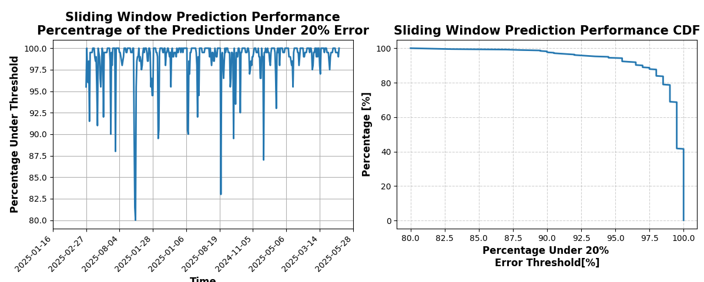
Mountain Capital Partners + Shakudo

