Slide 1
Hands-On: Vision AI on the EK-RA8P1 with /IOTCONNECT
Hot-swap AI models onto an active microcontroller from the cloud and stream live video
60-minutes | Zack Andraka, Technical Solutions Engineer

Slide 2
What We Will Achieve in this Workshop
FIND
PUSH
VALIDATE
WATCH
Locate your device
Deploy AI Models
Seamless Integration
Stream Live Video
Sign in, open the dashboard with your seat number, and watch your board's live telemetry arrive.
Deploy three different AI models from the cloud: a face detector, a 1000-class classifier, an occupancy sensor.
Swap models while the board keeps running, then pull the power and see the model come back from flash.
Open a live WebRTC video stream from your board on the dashboard and the device page, while the model keeps running.
Talk
Lab 1
Lab 2
Lab 3
Lab 4
Talk
EK-RA8P1 · /IOTCONNECT workshop

Slide 3
Workspace Checklist
Board
Two Cables
Pre-flashed and pre-configured EK-RA8P1
Camera module connected
LCD connected
Ethernet
USB-C
Unique Seat Card
Your Laptop
Seat number
/IOTCONNECT Login (user+N) credentials
Name of your /IOTCONNECT dashboard
A browser open to console.iotconnect.io
A serial terminal installed (next slide)
A free USB port for the board's cable
If your workspace is not as described above, please raise your hand to let an instructor know.
EK-RA8P1 · /IOTCONNECT workshop

Slide 4
Before You Start: Open a Serial Terminal
BEFORE LAB 1
Lab 1 uses a serial terminal to show the board’s console. The recommended one runs in your browser, so there is nothing to install.
Recommended: nothing to install
Using Firefox or Safari?
Chrome Labs Serial Terminal runs in your browser on Windows, macOS and Linux
Open googlechromelabs.github.io/serial-terminal in Chrome or Edge
Windows: PuTTY (putty.software) or Tera Term (github.com/TeraTermProject/teraterm/releases)
macOS and Linux: screen /dev/tty.usbmodem* 230400, or /dev/ttyACM0 on Linux
Lab 1 settings: 230400 baud, 8 data bits, no parity, 1 stop bit, no flow control.
EK-RA8P1 · /IOTCONNECT workshop

Slide 5
Why an MCU for Vision AI?
Time Efficiency
Power Efficiency
Cost and Size Efficiency
Boots in milliseconds
Simple firmware reduces design and debug time
Ethos-U55 completes face detection in < 6ms
No worries of spending time on OS updates and re-designs for future incompatibilities
Deterministic firmware on streamlined hardware results in minimal power needs
CPU, RAM, and peripherals all on one chip so power isn’t wasted sending data between components
CPU, NPU, SRAM and flash in a single package
No PMIC or high-speed DDR routing as an MPU design typically needs
Fewer parts means a smaller, lower-cost board
BOTTOM LINE
MCUs are more than capable of supporting top-notch Vision AI applications, without the extra time and energy required with many MPUs.
EK-RA8P1 · /IOTCONNECT workshop

Slide 6
How Does Model Deployment Work?
Here's what happens automatically after you click “Push Model” in /IOTCONNECT:
1
2
3
4
5
Send
Download
Validate
Hot-swap
Save
a command from /IOTCONNECT to the board over MQTT with the model's download link.
the model over HTTPS from S3 into a 4 MB holding buffer in SDRAM.
the file: a CRC checksum confirms it arrived intact, then a test load identifies the model type.
the old model for the new one between two camera frames, reusing the same memory.
the model to the board's flash storage so it survives a reboot or power loss.
FYI
A hiccup at step 3 or 4 keeps the previous model running. The camera, display and telemetry never stop during any step.
A push during a live video stream is deferred until the download can share the heap, then proceeds with the stream still playing.
EK-RA8P1 · /IOTCONNECT workshop

Slide 7
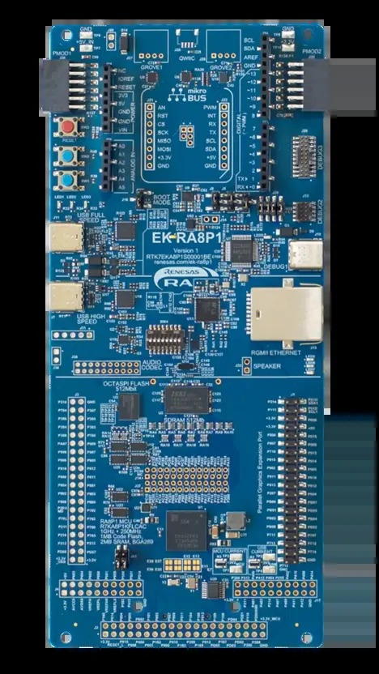
The board: Renesas EK-RA8P1
Part | What it is
MCU | RA8P1, Arm Cortex-M85 at 1 GHz
NPU | Arm Ethos-U55, 256 MACs per cycle
Memory | 1 MB MRAM code, 2 MB SRAM, 64 MB SDRAM
Storage | 64 MB OSPI flash: credentials and the model slot
Network | Gigabit Ethernet
Camera | OV5640 over MIPI CSI-2, 55 fps
Display | 7-inch parallel LCD, optional
Debug | On-board J-Link; USB-C DEBUG1 is also the console
EK-RA8P1 · /IOTCONNECT workshop

Slide 8
Lab 1
Open /IOTCONNECT Dashboard

Slide 9
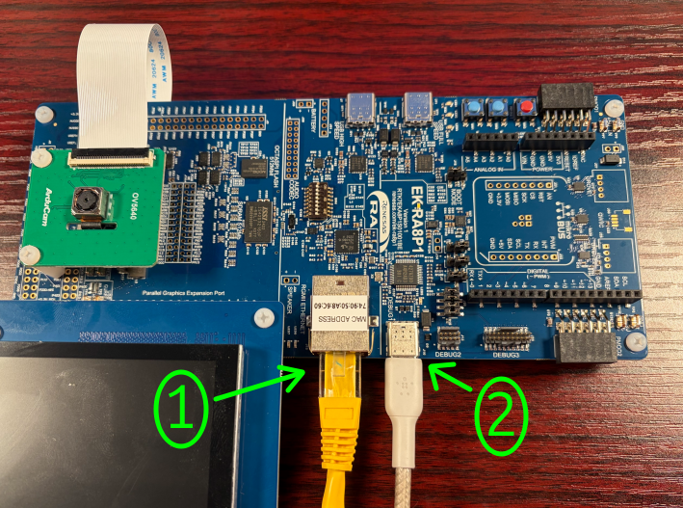
Step 1: Hardware Connections
Plug the Ethernet cable into the board's Ethernet port.
Then plug the USB-C cable into the board's DEBUG1 port and a USB port on your laptop.
EK-RA8P1 · /IOTCONNECT workshop

Slide 10
Step 2: Connect to the Serial Console
SERIAL SETTINGS
Open the Chrome Labs Serial Terminal in Chrome or Edge and enter the settings on the right.
Click Connect and choose the board's port (its name includes J-Link or USB Serial), then click Connect in the pop-up.
Within a few seconds the console shows a processing report every 5 seconds (camera, AI and display timing) and lines starting with IOTC: confirming the board is connected.
Baud rate 230400
Data bits 8
Parity None
Stop bits 1
Flow control Off (unticked)
Convert EOL On (ticked)
WHAT YOU SHOULD SEE
Processing time:
Camera image capture vsync period : 18 ms, 55 fps
AI inference time (Ethos-U55) : 0 us, 0 fps
IOTC: hb up=95 netbuf=16 heap=181360 conn=1 sent=6
If you see no output, or the text is garbled, please raise your hand for assistance.
EK-RA8P1 · /IOTCONNECT workshop

Slide 11

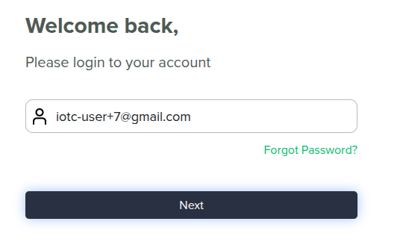
Step 3: /IOTCONNECT Login
In your browser, go to console.iotconnect.io.
Log in to /IOTCONNECT with the username and password on your seat card.
EK-RA8P1 · /IOTCONNECT workshop

Slide 12
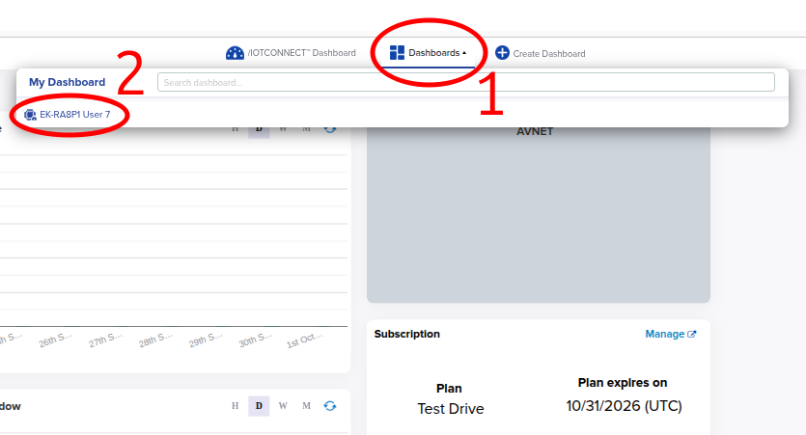
Step 4: Open the /IOTCONNECT Dashboard
Click Dashboards in the toolbar at the top of /IOTCONNECT.
Open the dashboard titled "EK-RA8P1 User N", where N is the user number on your seat card.
EK-RA8P1 · /IOTCONNECT workshop

Slide 13
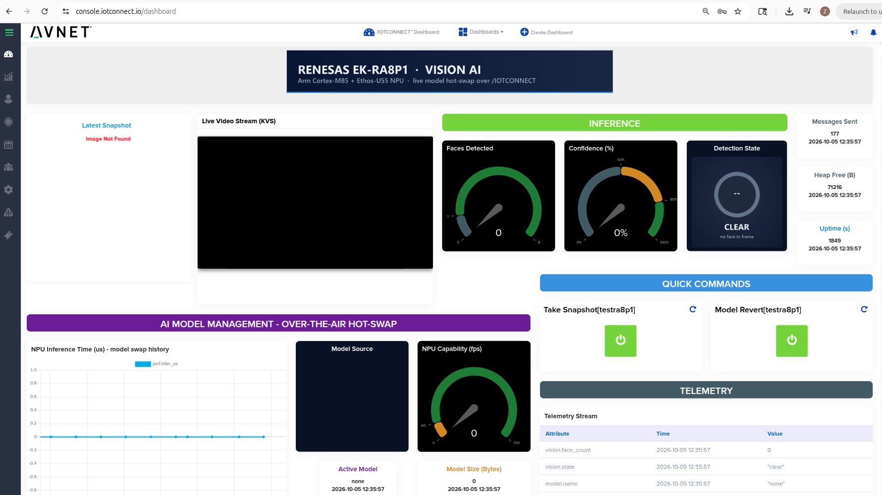
Expected Dashboard State
If your dashboard does not look like this, please raise your hand for assistance.
EK-RA8P1 · /IOTCONNECT workshop

Slide 14
Lab 2
First AI Model Deployment

Slide 15
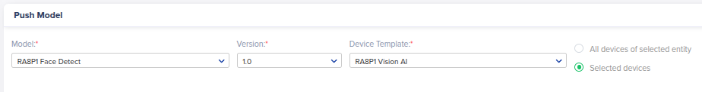
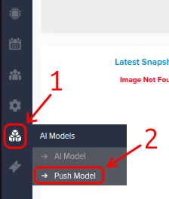
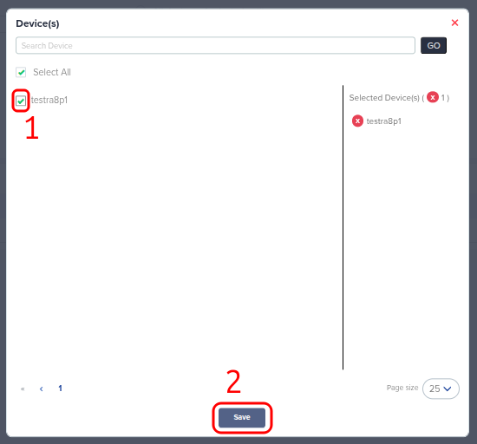

Step 1: Deploy the Face Detect Model
Hover over the blocks icon in the left-hand toolbar, then click Push Model.
Select RA8P1 Face Detect for Model (Version fills in as 1.0), RA8P1 Vision AI for Device Template, then click Selected devices.
Click Select Device, check the box next to your device's unique ID, then click Save.
Click the Push Model button.
EK-RA8P1 · /IOTCONNECT workshop

Slide 16
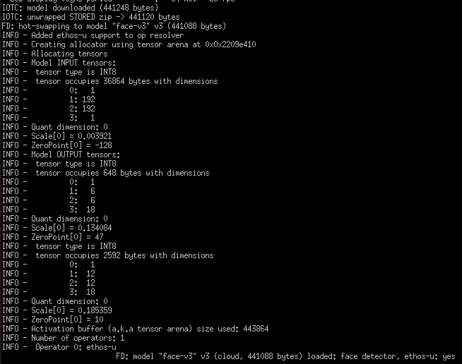
Step 2: Verify the Model Hot-Swap
In your serial terminal, the push arrives within a second or two:
Over the next 10–30 seconds the board downloads the model, checks it and swaps it in. It is ready when the last line reads FD: model "face-v3" v3 … loaded.
On the LCD, the Model line changes from none v0 to face-v3 v3.
Model: none v0
↓
Model: face-v3 v3
Position your face in front of the camera. The board should recognize your face right away and draw a green bounding box around it.
EK-RA8P1 · /IOTCONNECT workshop

Slide 17
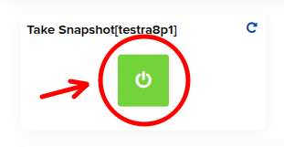
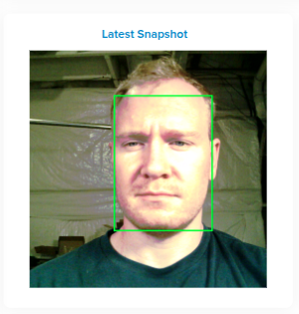
Step 3: Capture a Snapshot from the Dashboard
Go back to your /IOTCONNECT dashboard.
Position your face in front of the camera and press the green Take Snapshot button near the bottom right of the dashboard.
Within about 30 seconds the board uploads the photo to /IOTCONNECT, and the Latest Snapshot widget shows it with the green box drawn around your face.
EK-RA8P1 · /IOTCONNECT workshop

Slide 18
Lab 3
Deploying and Hot-Swapping More Models

Slide 19
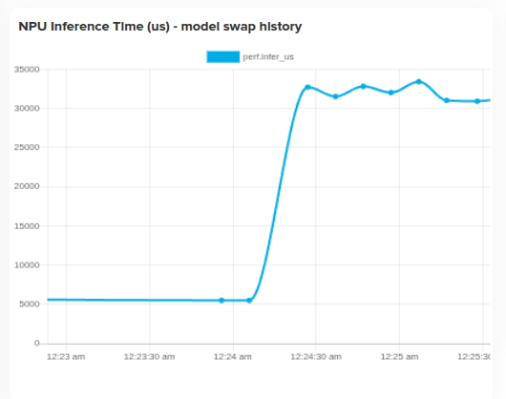
Step 1: Deploy an Image Classification Model
Return to the Push Model page and use the same settings as before, but choose RA8P1 ImageNet Classifier v2 for Model.
This model is about 7× the size of the face detector, so the download and swap take one to two minutes. Watch the serial console for the model info stream.
When the swap completes, the Model line on the LCD changes to mobilenet-v2 v1.
Back on your dashboard, the NPU Inference Time chart (bottom left) jumps from about 6 ms to about 40 ms as the larger model takes over.
Model: face-v3 v3
↓
Model: mobilenet-v2 v1
EK-RA8P1 · /IOTCONNECT workshop

Slide 20
Step 2: Deploy the Person Detect Model
On the Push Model page, use the same settings again and choose RA8P1 Person Detect. It is the smallest model, so it arrives much faster.
After the swap, the Model line on the LCD changes to person-detec v2.
Model: mobilenet-v2 v1
↓
Model: person-detec v2
Hold the board out with the camera facing you: Class changes from no person to person. Score shows the model's confidence, and inference takes about 1.5 ms.
On your dashboard, the same NPU Inference Time chart drops to about 1.5 ms.
Class: no person
↓
Class: person
Score: 95%
EK-RA8P1 · /IOTCONNECT workshop

Slide 21
Step 3: Validate Model Persists Upon Reboot
On the LCD, Source reads cloud: the model came from /IOTCONNECT and was plugged straight into the running application.
Unplug the USB-C cable from the board, wait 3 seconds, then plug it back in.
When the LCD comes back, Source reads flash and Model still reads person-detec v2.
Model: person-detec v2
Source: flash
Source: cloud
The model was hot-swapped into the running application and also saved to non-volatile flash, so it stays active through a power cycle.
EK-RA8P1 · /IOTCONNECT workshop

Slide 22
Lab 4
Live Video with KVS WebRTC

Slide 23
Why Watch Live Video?
SEE IT FOR YOURSELF
Alerts tell you what the model detected. Live video lets you see it yourself, to validate the inference or decide your next step.
Low Latency
Secure Anywhere
Efficient on an MCU
Peer-to-peer WebRTC: video goes straight from the board to your browser
No cloud recording or transcoding in the path
Video appears within seconds of clicking Start
Encrypted end to end with DTLS-SRTP
ICE, STUN and TURN get through NAT and firewalls, with no port forwarding
Signaling channel created automatically by /IOTCONNECT
H.264 encoded in software on the Cortex-M85: 320×240 at 8–10 fps, ~500 kbit/s
Encodes only while someone is watching
Inference and telemetry keep running during the stream
EK-RA8P1 · /IOTCONNECT workshop

Slide 24
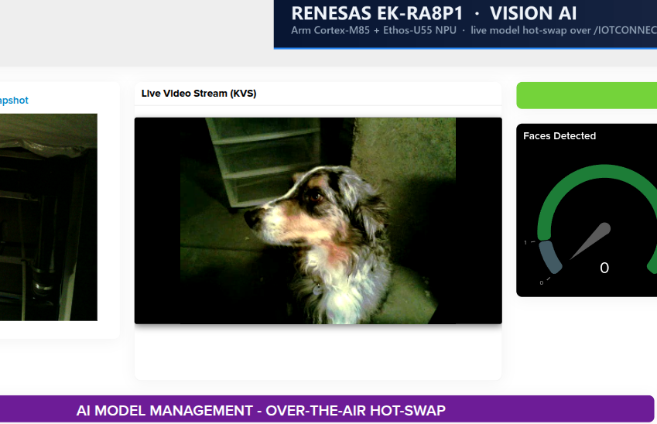
Step 1: Preview the Stream on Your Dashboard
The quickest way to see the video is the Live Video Stream (KVS) widget on the dashboard you opened in Lab 1.
Use it for a quick glance: when telemetry or an alert reports a detection, check the preview to confirm what the model saw, from anywhere.
For a larger view of the same stream, open it from the device page in the next step.
EK-RA8P1 · /IOTCONNECT workshop

Slide 25
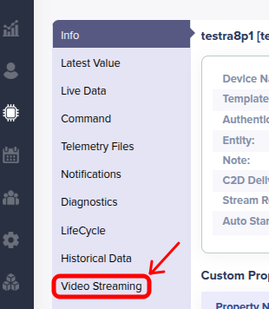
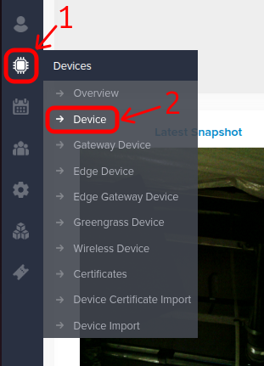
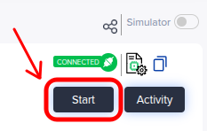
Step 2: Full-Screen View on the Device Page
Hover over the processor icon in the left toolbar, then click Device.
Click the Video Streaming tab.
Click Start in the top-right corner. The same live stream opens in a large, nearly full-screen player.
Click your device's unique ID to open its device page.
“Start” opens a peer-to-peer WebRTC connection and becomes “Stop,” which ends the stream.
The provided firmware only supports 1 viewer connection, so you cannot have the dashboard and Video Streaming both open simultaneously.
EK-RA8P1 · /IOTCONNECT workshop

Slide 26
AI Model Catalog
In AI Models | What the board becomes | Input | Inference | Size
RA8P1 Face Detect | Face detector with boxes (YOLO Fastest) | 192×192 gray | 5.8 ms | 441 KB
RA8P1 Person Detect | Occupancy sensor: person present or absent | 96×96 gray | 1.5 ms | 270 KB
RA8P1 ImageNet Classifier 0.25 | 1000-class classifier, speed tier | 224×224 RGB | 4.5 ms | 432 KB
RA8P1 ImageNet Classifier 0.5 | 1000-class classifier, mid tier | 224×224 RGB | 9 ms | 1.1 MB
RA8P1 ImageNet Classifier v2 | 1000-class classifier, accuracy tier | 224×224 RGB | 40 ms | 3.1 MB
Camera Max FPS: 55 (new frame every 18ms)
Slowest Model FPS: 25
Significance: Provided models never need more than ~2 frames to make their inferences.
Classifier v2 is roughly seven times the face detector's size and workload. That is the one to push while you watch the inference chart.
EK-RA8P1 · /IOTCONNECT workshop

Slide 27
Key Takeaways
AI models are cloud-managed assets
Deploy and update a model from /IOTCONNECT like any other data, to one board or a whole fleet, with no firmware rebuild or reflash.
REAL-WORLD EXAMPLE
Smart Building Occupancy
Detect: A camera node in every meeting room runs person detection on its MCU and reports occupancy to /IOTCONNECT, driving lighting, HVAC and room booking.
Update: When a better model is trained, facilities pushes it to every node in the building overnight, with no site visits.
Verify: A room reports occupied after hours. The manager opens the live video to check before sending security.
Vision AI belongs on the MCU
The Cortex-M85 and Ethos-U55 run detection and classification in milliseconds, on one low-cost, low-power chip.
Verify from anywhere
Each lab today built one piece of it.
Telemetry, snapshots and live WebRTC video let you check what the device saw and decide the next step remotely.
EK-RA8P1 · /IOTCONNECT workshop

Slide 28
Next Steps
Build your own model and keep exploring

Slide 29
Create and Deploy Your Own Model
1
2
3
4
Train and quantize
Compile with Vela
Pack
Upload and push
Export an int8 TensorFlow Lite model whose input matches a supported model family.
Target ethos-u55-256. If Total SRAM used exceeds 640 KiB, recompile with the Size optimisation.
tools/pack_model.py wraps it in the IOTV envelope and writes an uncompressed zip.
In AI Models, create a model with Variant Renesas and upload the zip. Push it to one device, then the fleet.
Supported model families
Limits
Face detector: 192×192 grayscale input (YOLO Fastest)
Classifier: 32–224 px gray or RGB input, with 2 or 1000 classes
Up to 4 MB packed and 640 KiB of Vela SRAM
Must run entirely on the Ethos-U55 NPU
An unsupported model is rejected, and the previous one is restored
Exact commands and details are in the Developer Guide, section 9: AI Models.
EK-RA8P1 · /IOTCONNECT workshop

Slide 30
Explore the Repository
THE REPOSITORY
github.com/avnet-iotconnect/iotc-freertos-ek-ra8p1
Quickstart
Developer Guide
Also in the repo
Repeat today at home
Prebuilt image, no toolchain
From unboxing to live video
Build from source with e² studio
Architecture and memory budget
Adding your own models
Prebuilt firmware image
Device template and dashboard
Five ready-to-push models
These workshop slides
MORE RENESAS /IOTCONNECT DEMOS
CK-RA6M5 Cloud Kit
EK-RA6W1 Wi-Fi MCU
All /IOTCONNECT Projects
Live sensor data over a DA16K Wi-Fi PMOD.
github.com/avnet-iotconnect/iotc-freertos-ck-ra6m5-v2-pmod
Telemetry and commands over the RA6W1’s built-in Wi-Fi.
github.com/avnet-iotconnect/iotc-freertos-ek-ra6w1
SDKs, demos and documentation.
github.com/avnet-iotconnect
EK-RA8P1 · /IOTCONNECT workshop

