Slide 1
The eIQ GenAI Flow, end to end
The exact screens an attendee moves through — sign up with a password, claim a board, then work the cockpit top to bottom in workshop order.
1 sign up → 2 kit → 3 claim → 4 connected → 5 cockpit · cards 1–6
NXP FRDM i.MX 95 · eIQ GenAI Flow · Avnet /IOTCONNECT

Slide 2
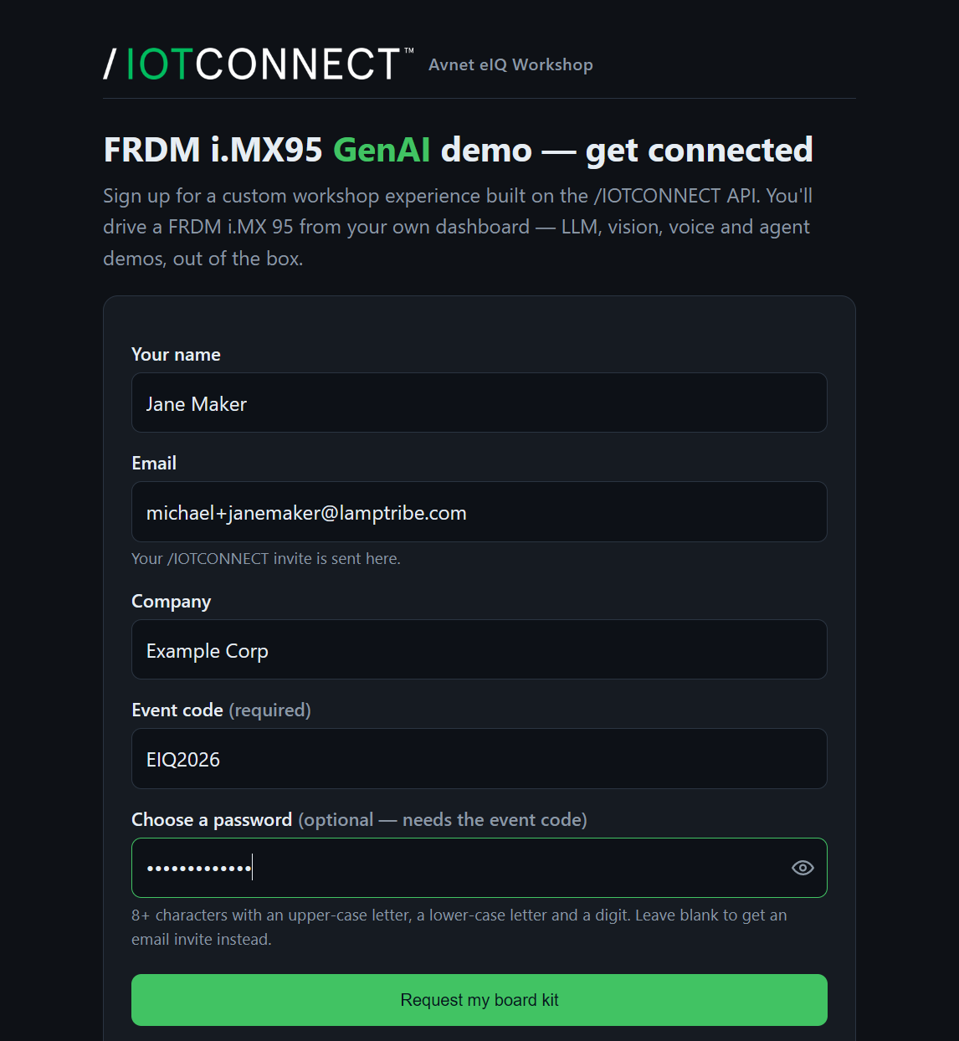
Create your account
One form, one password — your private slice of the platform, instantly
■ Name, email, company, event code — and choose your password right here
■ Setting a password skips the email invite — you're ready the moment you submit
■ One API chain underneath: a private entity, a user, an iMX95genai device with an x.509 cert
■ You only ever see your own board — isolation is the platform's, not the UI's
Notes:
Everything here is the same public REST API a customer uses to onboard a fleet. The password rides the same create-user call, so no invite email is needed.

Slide 3
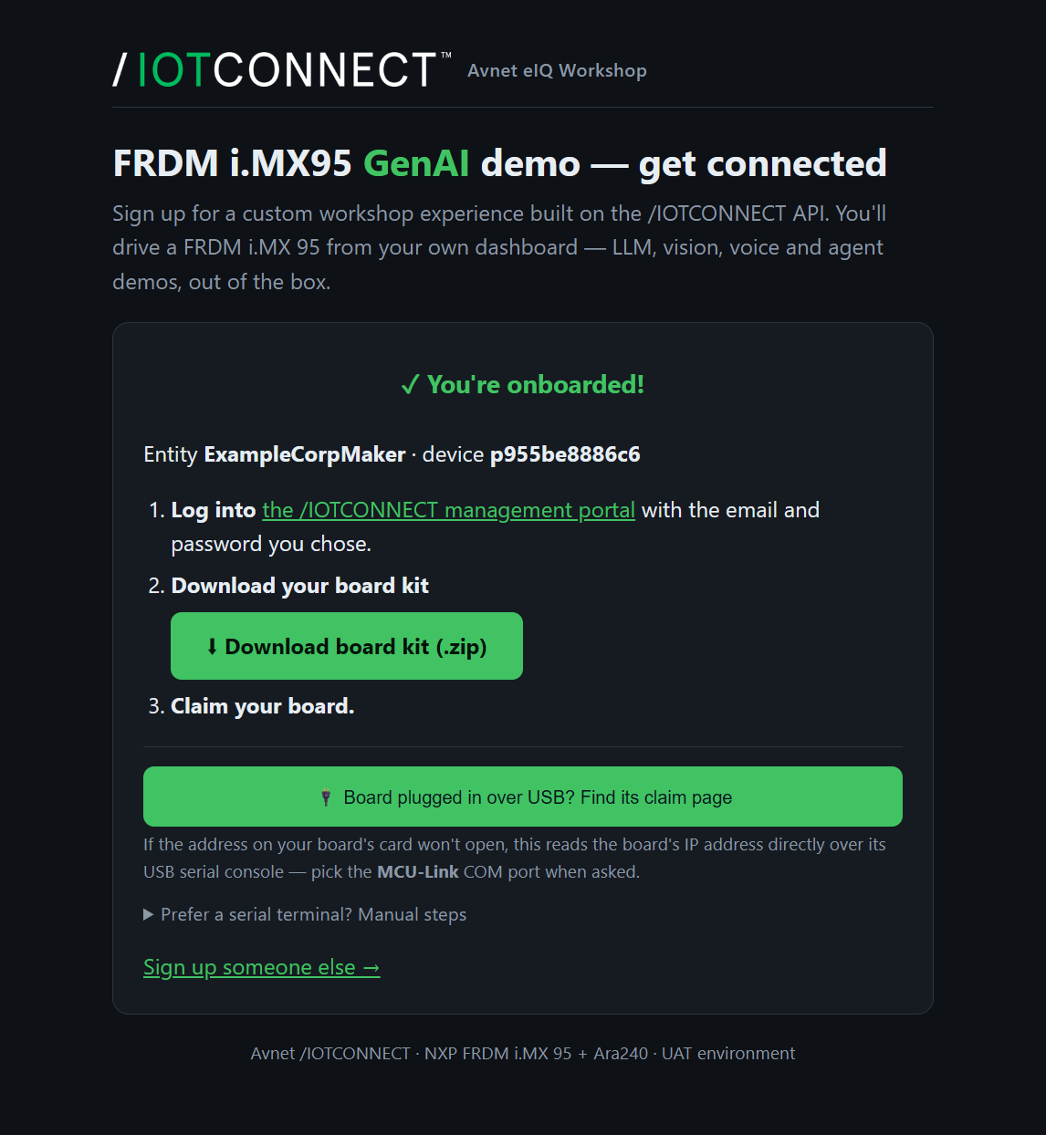
Your board kit
The kit IS your credentials — a real x.509 device identity
■ Log into the /IOTCONNECT management portal with the password you chose
■ Download the board kit (.zip): iotcDeviceConfig.json + x.509 cert + private key
■ Board on USB? The finder reads its IP over the serial console — or use the manual steps
Notes:
The three files in the kit are exactly what authenticates the board over mutual-TLS MQTT — the same identity mechanism a production device ships with.

Slide 4
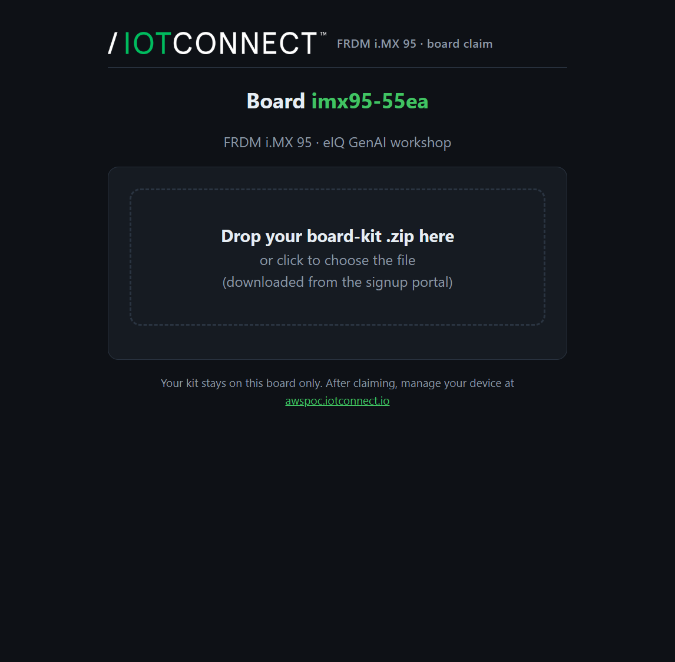
Claim your board
A page the board serves itself — drag, drop, claimed
■ Open the board's own URL from its card — http://imx95-XXXX.local:8088
■ Drag the kit on → identity installs, demo restarts → “✓ Connected”
■ Re-claiming needs explicit confirmation — no accidental board theft
Notes:
The claim page is served locally by the board on port 8088 — no cloud round-trip to install identity.

Slide 5
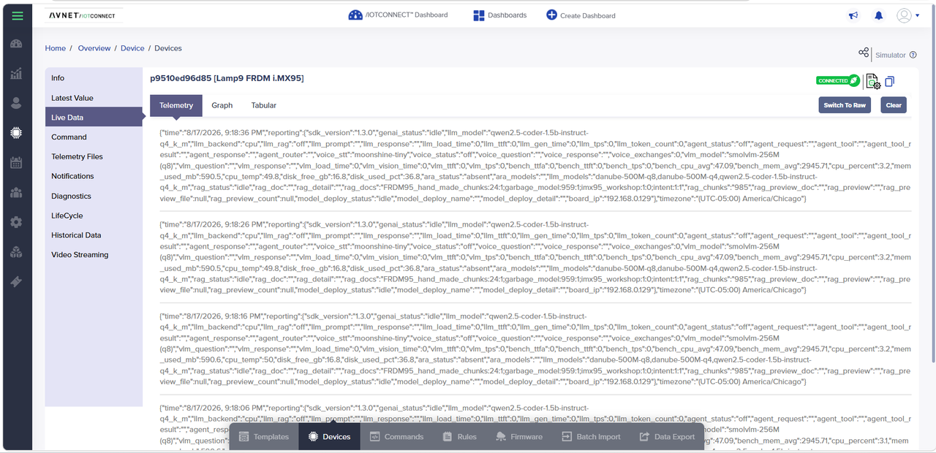
Watch it come online
The board finds its broker itself and streams — the production pipeline, not a mock
■ The board found its broker and credentials itself at boot
■ Template = the contract: 54 telemetry attributes, 18 commands
■ D2C: ~50 attributes every 10 s over MQTT · C2D: every button is a real, acknowledged command
Notes:
The full hop is laptop -> REST API -> C2D command (MQTT) -> board runs the model -> D2C telemetry -> dashboard. Same pipeline a fleet of thousands uses.

Slide 6
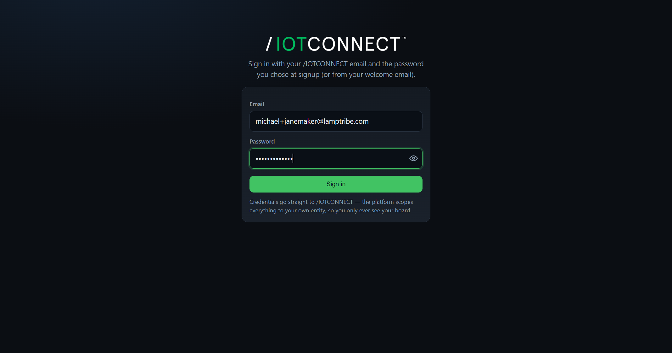
Sign in to your cockpit
The same account you created at signup — scoped to your board
■ Log in with the email and password you chose at signup
■ The platform scopes everything to your entity — you only see your board
■ No new account, no separate password
Notes:
Credentials go straight to /IOTCONNECT; the cockpit never stores them.

Slide 7
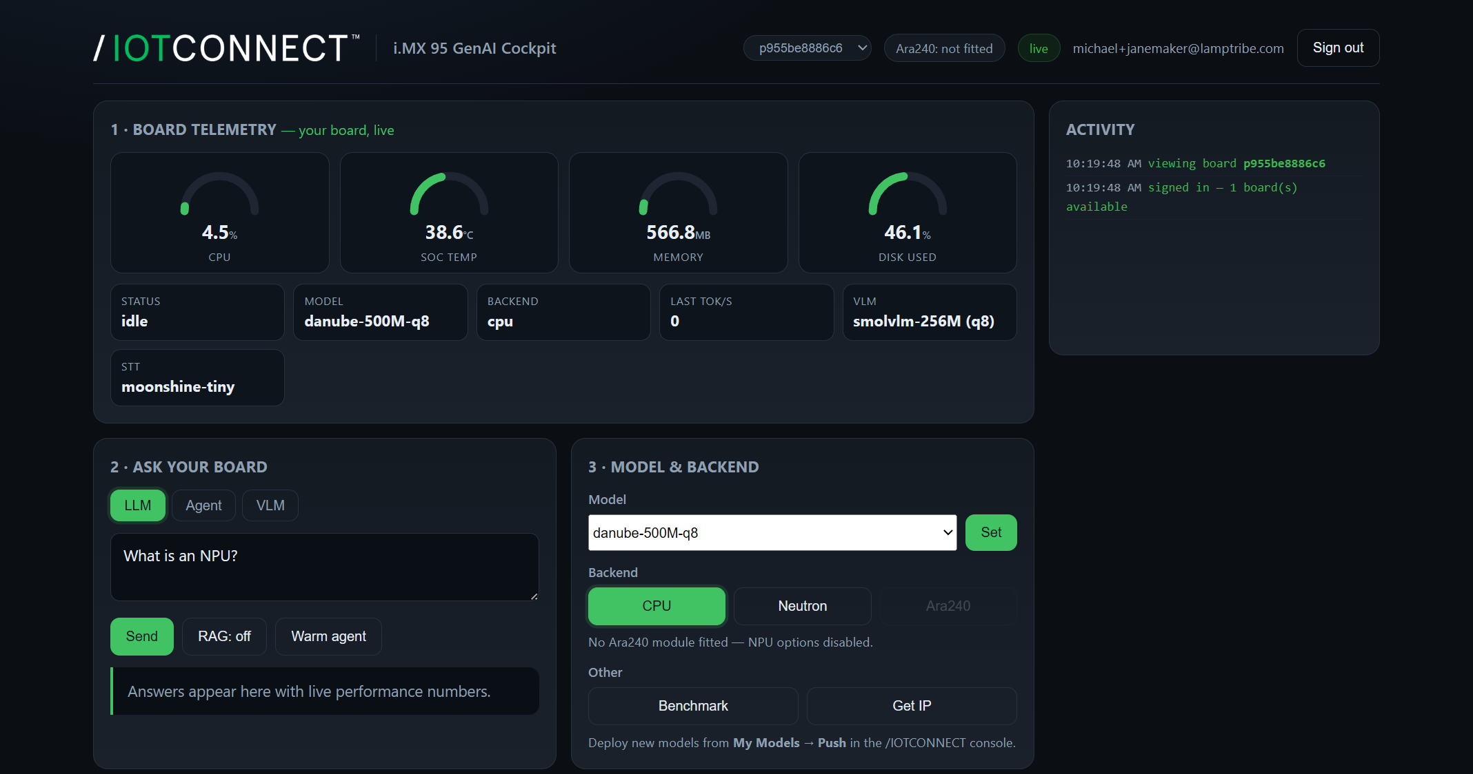
Your board, live
Card 1 — telemetry becomes gauges
■ Board telemetry as live gauges — CPU, temperature, memory, disk
■ The same ~50 attributes, updated every 10 s — now visual
■ The cockpit's cards are numbered in workshop order — scroll top to bottom and you exercise the board step by step
Notes:
This is the D2C stream, rendered. The 1-6 numbering on the cards mirrors the live workshop script.

Slide 8
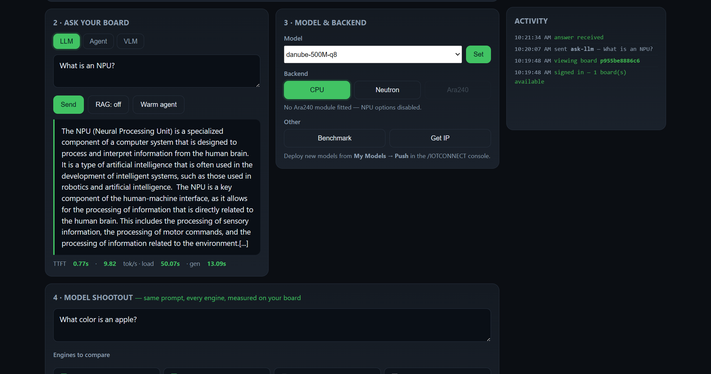
Ask your board
Card 2 — first prompts, every answer measured
■ LLM / Agent / VLM tabs — answers arrive with live load / TTFT / tok/s
■ The agent answers from real board data — time, temperature, memory — not guesses
■ First answer pays the model load (~1 min); it's a metric, not a bug
Notes:
ask-llm 'What is an NPU?' then ask-agent 'how warm is the board?' — the hallucination A/B from the live script.

Slide 9
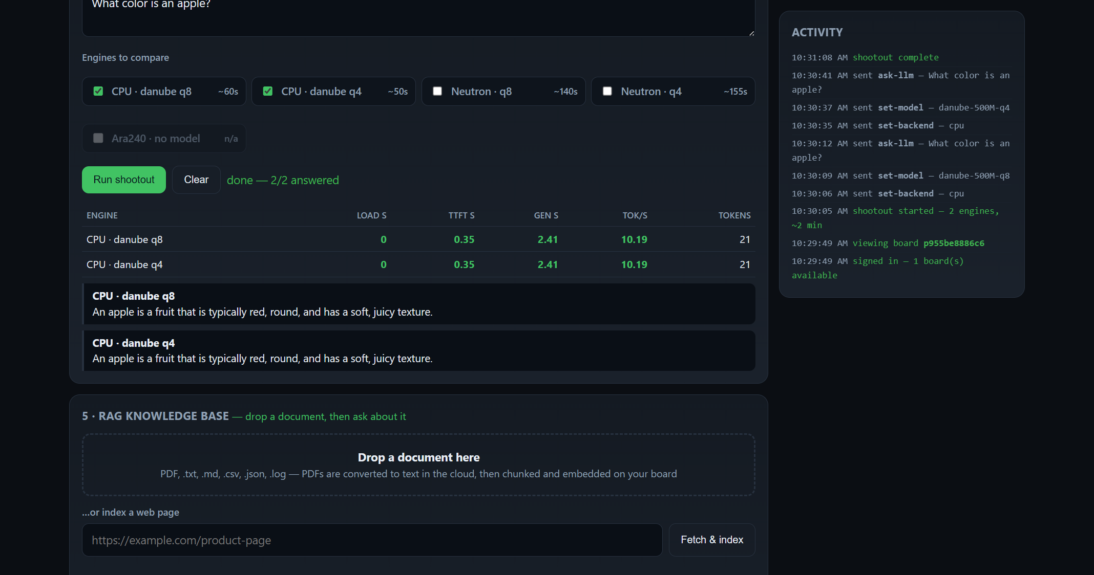
Model shootout
Cards 3 & 4 — pick a model and backend, then race every engine
■ Model & backend: switch models, run on CPU / Neutron / Ara240
■ Shootout: one prompt, every engine — load / TTFT / tok/s + each verbatim answer
■ The honest way to see what quantization, an NPU, or a bigger model buys
Notes:
Ara240 rows light up only on boards with the module fitted. Push a new model from My Models -> Push and it appears in the dropdown.

Slide 10
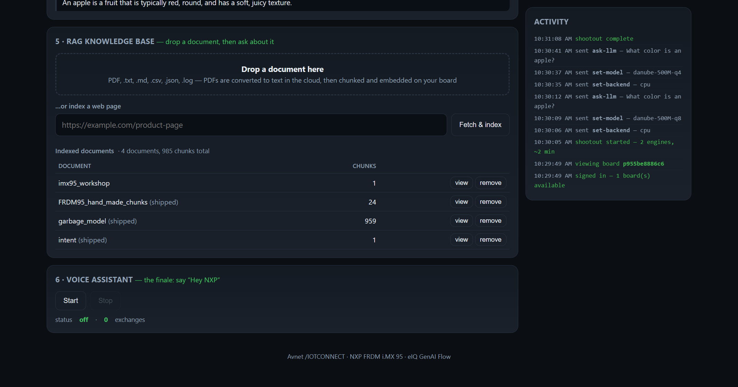
Teach it your docs
Card 5 — a knowledge base you feed yourself
■ Drop a PDF or document, or index a web page URL
■ Converted in the cloud, then chunked & embedded on the board
■ RAG on → grounded answers that quote your docs, verbatim
Notes:
The 'teach the board its own manual' beat — the knowledge base is rebuilt on-device in about two minutes.

Slide 11
Voice, the finale
Card 6 — four models in a row, fully offline
■ “Hey NXP” → wake word → STT → LLM → TTS — no cloud in the loop
■ Every spoken exchange lands in telemetry — question, answer, count
■ The live workshop closes here
Notes:
voice-start takes 2-3 minutes to reach 'listening'; each exchange answers in 10-20 s.

Slide 12
What you leave knowing
Four ideas the whole flow was built to teach
tok/s is a bandwidth story
Every token reads essentially all the weights once — speed is memory-bandwidth-bound.
Quantize, then re-validate
4-bit is survivable with mixed precision, brutal without it.
Ground or agent small models
RAG retrieves real passages; an agent runs a real tool — both beat guessing.
Measure load separately
Load, TTFT and tok/s are three numbers — never bury load in throughput.

