Slide 1

A Short Introduction to
Unix
Andrew Newman
School of Earth and Atmospheric Sciences
Georgia Tech
Fall 2006
Adapted from: www.med.nyu.edu/rcr/rcr/course/PPT/unix_lec1.ppt

Slide 2
Computers are powerful tools for geophysical research
Ever increasing reliance on increased computing power for geophysical studies
As geophysical data sets grow larger and problems become more complex, computing power has also grown (not independently).
Because of its efficiency, the most powerful computers run Unix
  Linux, is a Unix-based operating system that is rapidly replacing traditional UNIX because of lower cost, more rapid evolution, and ease of use

Slide 3
Unix Advantages
It is very popular, so it is easy to find information and get help
    Books available at local bookstore/internet
    Numerous websites
    Online forums and e-mail lists
    Many Comp. Sci. students know Unix
Unix can run on virtually any computer (Sun, SGI, x86, Macintosh, etc)
Unix is free or nearly free
    Linux/open source software movement, numerous versions of the OS and most all tools are free, or have a free version
    Linux has caused traditional Unix companies to reduce costs dramatically (e.g., Sun, SGI)

Slide 4
Stable and Efficient
Unix is very stable:
  Operating System crashes are very rare
  Software failures generally do not require reboot
Unix is very efficient
  gets maximum crunching power from the processor(s)
  Smoothly manages large data sets
  Runs well on old systems that are slow using Windows
Most geophysical tools are developed to run on Unix and Linux machines.
Matlab programs are an exception because it runs on either Unix or Windows.

Slide 5
Unix has some Drawbacks
Command line interface: think DOS
    + Command line operations use less resources and are easier to automate and remotely manage
    - Steeper learning curve than windows or Mac
    + This is changing, on Linux systems, most user tools have GUI interfaces that may make it easier
Many versions of Unix with subtle differences
    - This is particularly the case between Unix and Linux
    - Linux is less standardized but evolving much more rapidly (more user-friendly and more powerful): trade-off between standardization and adaptability

Slide 6
General Unix Tips
UNIX is case sensitive!!
  myfile.txt and MyFile.txt do not mean the same thing
  Default directory listings do no separate files from directories like Windows. All structures are listed alphabetically starting with numbers
Every program is independent
  the core operating system (known as the kernel) manages each program as a distinct process with its own little chunk of dedicated memory.
  If one program runs into trouble, it dies, but does not affect the affect the kernel or the other programs running on the computer.
  Programs and files are less linked than in windows.

Slide 7
The Unix Shell
This is the traditional way to communicate with a Unix computer, through a command program known as a shell. Similar to Windows cmd or dos prompt.
The shell interprets the commands that you type on the keyboard.
Numerous types of shells to work from (e.g. sh, bash, csh, tcsh)—I will try to only use bash
You can use shell scripts to write simple/complex programs to automate many tasks

Slide 8
Unix Commands
Unix commands are short and cryptic like
vi or rm.
    Will take some learning.
Most commands have modifiers which are generally single letters preceded by a hyphen:
ls -l or mv -R
    Capital and small letters may be different functions
    A command often requires an argument, which can be a filename or input variable
      cat -n filename.txt

Slide 9
Wildcards
You can substitute the * as a wildcard symbol for any number of characters in any filename.
If you type just * after a command, it stands for all files in the current directory:
ls * will list all files
You can mix the * with other characters to form a search pattern:
  ls a*.txt will list all files that start with “a” and end in “.txt”
The “?” wildcard stands for any single character:
  ls draft?.doc will list draft1.doc, draft2.doc, draftb.doc, etc., but not draft.doc

Slide 10
Typing Mistakes
Unix is remarkably unforgiving of typing mistakes
    You can do a lot with just a few keystrokes, but it can be hard or impossible to undo
If you have not yet hit ‘return’
    The ‘delete’ key removes the characters that you just typed
    Generally you can use the arrow keys to move back and forth on the command line to correct a mistake without deleting the rest

Slide 11
Getting Help in Unix
Unix is somewhat user-friendly
There is a simple and standardized help system which consists of a set of "manual” pages for most Unix commands.
The man pages tell you which options a particular command can take, and how each option modifies the behavior of the command.
Type man and the name of a command to read the manual page for that command.
man ls

Slide 12
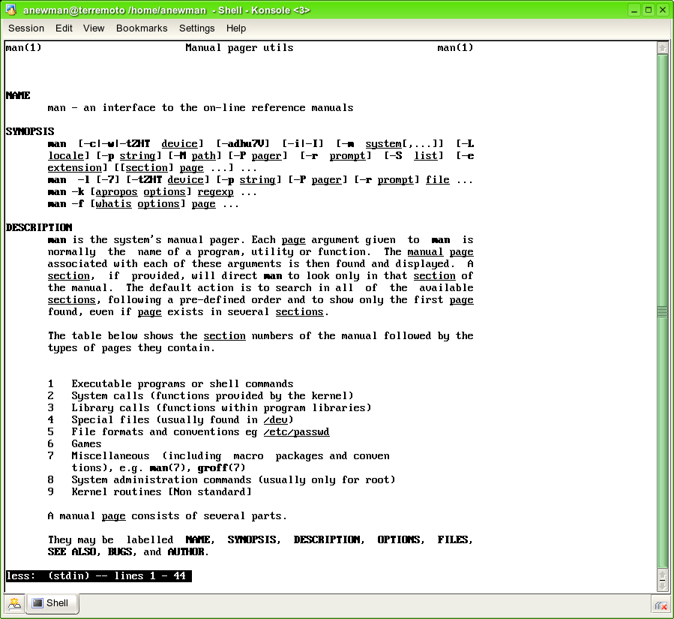

Slide 13
More Help (?)
The man pages give information about specific commands
So what if you don’t know what command you need?
apropos will give you a list of commands that contain a given keyword in their man page header:
  apropos ftp
  The man command with the -k modifier gives a similar result to apropos
Look at getting a Unix book
  O’Reilly books are usually good (e.g. “Unix in a nutshell”)
Google search for solutions

Slide 14
Unix Help on the Web
Here is a list of a few online Unix tutorials:
Unix for Beginners
  http://www.ee.surrey.ac.uk/Teaching/Unix/
Getting Started in Unix
  http://www2.ucsc.edu/cats/sc/help/unix/start.shtml
Unix Guru Universe
  http://www.ugu.com/sui/ugu/show?help.beginners
Getting Started with the Unix OS http://www.leeds.ac.uk/iss/documentation/beg/beg8/beg8.html

Slide 15
Logging in to the Terremoto
(Andy’s Linux Box)
From an Ethernet connection within EAS (not the same as Wireless connection)
start ‘Xwin32’ (should be installed on Windows). As a default, this runs an X-server on your machine, allowing remote Unix windows to be displayed
Bring up Xconfig within Xwin32
  Click ‘Add…’: select StarNetSSH, click next
    Session name: terremoto
    Hostname: terremoto.eas.gatech.edu
    Login: your login name
    Username:I will give this to you (e.g. anewman)
    Command: /usr/bin/xterm
    Leave the rest as default, though you may want to remove the ‘show message option once configured correctly’
  Now start session username@terremoto
    You will be prompted for your password (we will set this up together)
  You should now be connected
3. Test your connection.

Slide 16
Filename Extensions
Most UNIX filenames start with a lower case letter and end with a dot followed by one, two, or three letters: myfile.txt
    This is a common convention and is not required.
    Is possible to have additional dots in the filename.
The part of the name following the last dot is called the “extension.”
The extension is often used to designate the type of file (like windows)

Slide 17
Some Common Extensions
By convention:
  files that end in .txt are text files
  files that end in .c or .f are source code for “C” or Fortran language
  files that end in .html are HTML files for the Web
  Compressed files have the .zip or .gz extension
Unix does not require these extensions (unlike Windows), but it is a sensible idea and one that you should follow

Slide 18
Working with Directories
Directories are a means of organizing your files on a Unix computer.
  They are equivalent to folders in Windows and Macintosh computers
Directories contain files, executable programs, and sub-directories
Understanding how to use directories is crucial to manipulating your files on Unix.

Slide 19
Your Home Directory
When you login to a Unix system, you always start in your Home directory.
Create sub-directories (using mkdir) to store specific projects or groups of information, just as you would place folders in a filing cabinet.
Do not accumulate thousands of files with cryptic names in your Home directory (unlike me!)

Slide 20
File & Directory Commands
This is a minimal list of Unix commands that you must know for file management:
ls (list)
mkdir (make directory)
cd (change directory)
rmdir (remove directory)
cp (copy)
pwd (present working directory)
mv (move, rename)
more, less (view by page)
rm (remove)
cat (view entire file on screen)
All of these commands can be modified with many options. Learn to use Unix ‘man’ pages for more information.

Slide 21
Navigation
pwd (present working directory) shows the name and location of the directory where you are currently working: > pwd
/home/anewman
      This is a “pathname,” the slashes indicate sub-directories
      The initial slash is the “root” of the whole filesytem
ls (list) gives you a list of the files in the current directory: > ls
Desktop NIC00_240.jana Nicoya bin photos
  Use the ls -l (long) option to get more information about each file
> ls -l
total 20
    drwx------ 2 lvisitor users 4096 Jun 27 16:12 Desktop
    drwxrwxr-x 5 lvisitor antelope 4096 Jul 18 13:32 NIC00_240.jana
    drwxr-xr-x 3 lvisitor users 4096 Aug 10 07:55 Nicoya
    drwxr-xr-x 2 lvisitor users 4096 Aug 8 10:24 bin
    drwxr-xr-x 2 lvisitor users 4096 Jul 7 15:14 photos

Slide 22
Sub-directories
cd (change directory) moves you to another directory
>cd bin
> pwd
/home/anewman/bin
mkdir (make directory) creates a new
sub-directory inside of the current directory > ls
assembler phrap space
> mkdir subdir
> ls
assembler phrap space subdir
rmdir (remove directory) deletes a sub-directory, but the sub-directory must be empty
  > rmdir subdir
> ls
assembler phrap space

Slide 23
Shortcuts
There are some important shortcuts in Unix for specifying directories
    . (dot) means "the current directory"
    .. means "the parent directory" - the directory one level above the current directory, so cd .. will move you up one level
    ~ (tilde) means your Home directory, so cd ~ will move you back to your Home.
      Just typing a plain cd will also bring you back to your home directory

Slide 24
Unix File Protections
File protection (also known as permissions) enables the user to set up a file so that only specific people can read (r), write/delete (w), and execute (x) it.
Write and delete privilege are the same on a Unix system since write privilege allows someone to overwrite a file with a different one.

Slide 25
File Owners and Groups
Unix file permissions are defined according to ownership. The person who creates a file is its owner.
    You are the owner of files in your Home directory and all its sub-directories
In addition, there is a concept known as a Group.
    Members of a group have privileges to see each other's files.
    This can be done for people working on a joint project or to otherwise share data/programs

Slide 26
View File Permissions
Use the ls -l command to see the permissions for all files in a directory:
    > ls -l
total 20
    drwx------ 2 lvisitor users 4096 Jun 27 16:12 Desktop
    drwxrwxr-x 5 lvisitor antelope 4096 Jul 18 13:32 NIC00_240.jana
    drwxr-xr-x 3 lvisitor users 4096 Aug 10 07:55 Nicoya
  The username of the owner is shown in the third column. (The owner of the files listed above is lvisitor)
  The owner belongs to the group “users” or “antelope”
The access rights for these files is shown in the first column. This column consists of 10 characters known as the attributes of the file: r, w, x, and -
        d indicates directory
        ---
        r indicates read permission
        w indicates write (and delete) permission
        x indicates execute (run) permission
        - indicates no permission for that operation

Slide 27
> ls -l drwxr-x--- 2 browns02 users 8192 Aug 28 18:26 Opioid
-rw-r----- 1 browns02 users 6205 May 30 2000 af124329.gb_in2
-rw-r----- 1 browns02 users 131944 May 31 2000 af151074.fasta
The first character in the attribute string indicates if a file is a directory (d) or a regular file (-).
The next 3 characters (rwx) give the file permissions for the owner of the file.
The middle 3 characters give the permissions for other members of the owner's group.
The last 3 characters give the permissions for everyone else (others)
The default protections assigned to new files on our system is: -rw-r----- (owner=read and write,
group =read, others=nothing)

Slide 28
Changing File Permissions
Only the owner of a file can change its protections
Use chmod (change mode) to change/directory file permissions. [Beware, this is a confusing command.]
  Can decide for whom you will change the access permissions:
        the file owner (u)
        the members of your group (g)
        others (o) (ie. anyone with an account)
  Next you have to decide if you are adding (+), removing (-), or setting (=) permissions.
Taken all together, it looks like this:
> chmod u=rwx g+r o-x myfile.txt
This will set the owner to have read, write, and execute permission; add the permission for the group to read; and remove the permission for others to
execute the file named myfile.txt.

Slide 29
Commands for Files
Files are used to store information, for example, data or the results of some analysis.
Many files are simple text and are easy to work with
cat dumps the entire contents of a file onto the screen.
  For a long file this can be annoying

Slide 30
More or less
commands more or less view file contents one screen at a time:
> more ~/.bash_history
  vim readfinsmpout
  awk '{printf "%f8.2 %f8.2 \n ", $1,$2}' SIMULPS_clean.xyll | more
  awk '{printf "2%f \n ", $1,$2}' SIMULPS_clean.xyll | more
  awk '{printf "%f2 \n ", $1,$2}' SIMULPS_clean.xyll | more
  awk '{printf "%f2 \n ", $1}' SIMULPS_clean.xyll | more
  awk '{printf "%8.2f \n ", $1}' SIMULPS_clean.xyll | more
  awk '{printf "2%8.2f \n", $1}' SIMULPS_clean.xyll | more
  awk '{printf "%8.2f \n", $1, $2}' SIMULPS_clean.xyll | more
  awk '{printf "%8.2f %8.2f %8.2f %8.2f %8.2f %8.2f %8.2f %8.2f %8.2f %8.2f %8.2f
  %8.2f %8.2f %8.2f \n"}' SIMULPS_clean.xyll
  awk '{printf "%8.2f %8.2f %8.2f %8.2f %8.2f %8.2f %8.2f %8.2f %8.2f %8.2f %8.2f
  %8.2f %8.2f %8.2f \n",$0}' SIMULPS_clean.xyll
  awk '{printf "%8.2f %8.2f %8.2f %8.2f %8.2f %8.2f %8.2f %8.2f %8.2f %8.2f %8.2f
  %8.2f %8.2f %8.2f \n",$1,$2,$3,$4,$5,$6,$7,$8,$9,$10,$11,$12,$13,$14}' SIMULPS_c
  lean.xyll
  awk '{printf "%8.2f %8.2f %8.2f %8.2f %8.2f %8.2f %8.2f %8.2f %8.2f %8.2f %8.2f
  %8.2f %8.2f %8.2f \n",$1,$2,$3,$4,$5,$6,$7,$8,$9,$10,$11,$12,$13,$14}' SIMULPS_c
  lean.xyll > j1
  --More--(15%)
  Hit the spacebar to page down through the file
  On bottom of screen more shows how much has been displayed
More sophisticated options for viewing and editing text files are available in a text editor…. a whole other subject/class?

Slide 31
Copy & Move
cp lets you copy a file from any directory to any other directory, or create a copy of a file with a new name
    > cp filename.ext newfilename.ext
    > cp filename.ext subdir/
    > cp /u/jdoe01/filename.ext ./subdir/newfilename.ext
mv allows you to move or rename files
  Filename and directory syntax for mv is similar to cp.
    > mv filename.ext subdir/newfilename.ext
  NOTE: mv moves a file or directory, thus old file no longer exists

Slide 32
Delete
Use the command rm (remove) to delete files
There is no way to undo this command!!!
  Most have an alias set up that will ask before it deletes
  Answer ‘Y’, ‘y’, anything that starts with ‘y’ to delete
> ls
Documents bin public_html
> touch j1 # creates an empty file named j1
> ls
Documents bin j1 public_html
> rm j1
rm: remove test.seq? y
> rm public_html
rm: cannot remove directory `public_html': Is a directory
> rmdir public_html # will only remove an empty directory
> rm -r public_html # will recursively remove directory
# and everything in it…
# be careful with this command!

