Slide 1
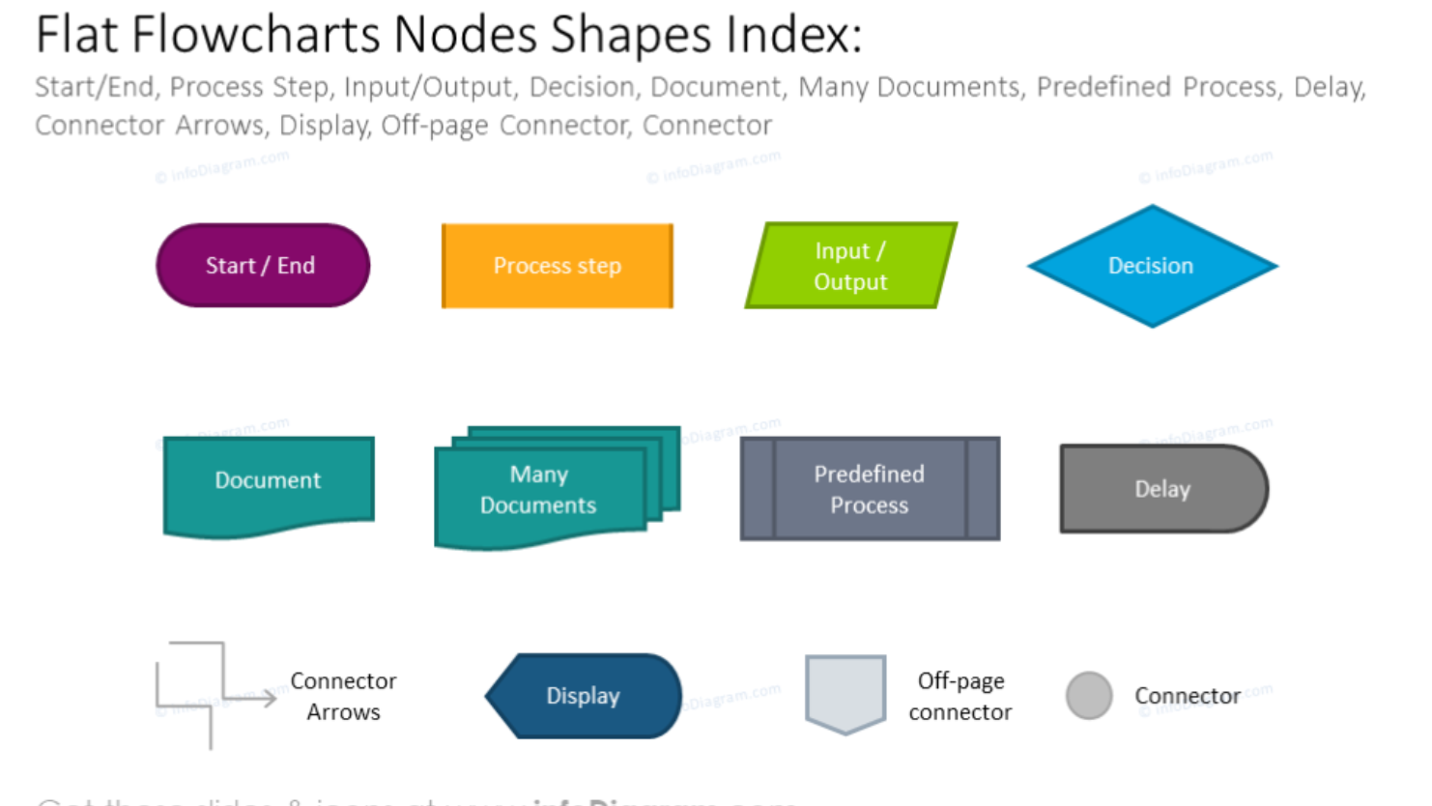

Slide 2

User-defines parameters
Interactive search/parser
cat
Event.html created by Eqerg_webupdate
Parent pkl of events
(rterg_summary.pkl)
QuakeML cat
Create downloadable data (QML, csv)
Create search-formatted url
Update parent pkl
(program name here)
Create/update interactive map
Recreate or update quakeML
(program name here)
User-selects event(s)

Slide 3
Form-based User-defines parameters
cat
Event.html created by Eqerg_webupdate
Parent pkl of events
(rterg_summary.pkl)
Interactive search/parser
Map-based User-selects event(s)
QuakeML cat
Update parent pkl
(program name here)
Create/update interactive map
(using Plotly?)
Recreate or update quakeML
(program name here)
Create downloadable data (QML, csv)
Create search-formatted url
New/updated page with pertinent plot/data
(php or java) with plotly

Slide 4












Look at SPUD for model of operation:
http://ds.iris.edu/ds/products/eqenergy/

